Slide 2
60 Tips in 60 Minutes
Kylie Kiser Heidi Neuhauser

Slide 3
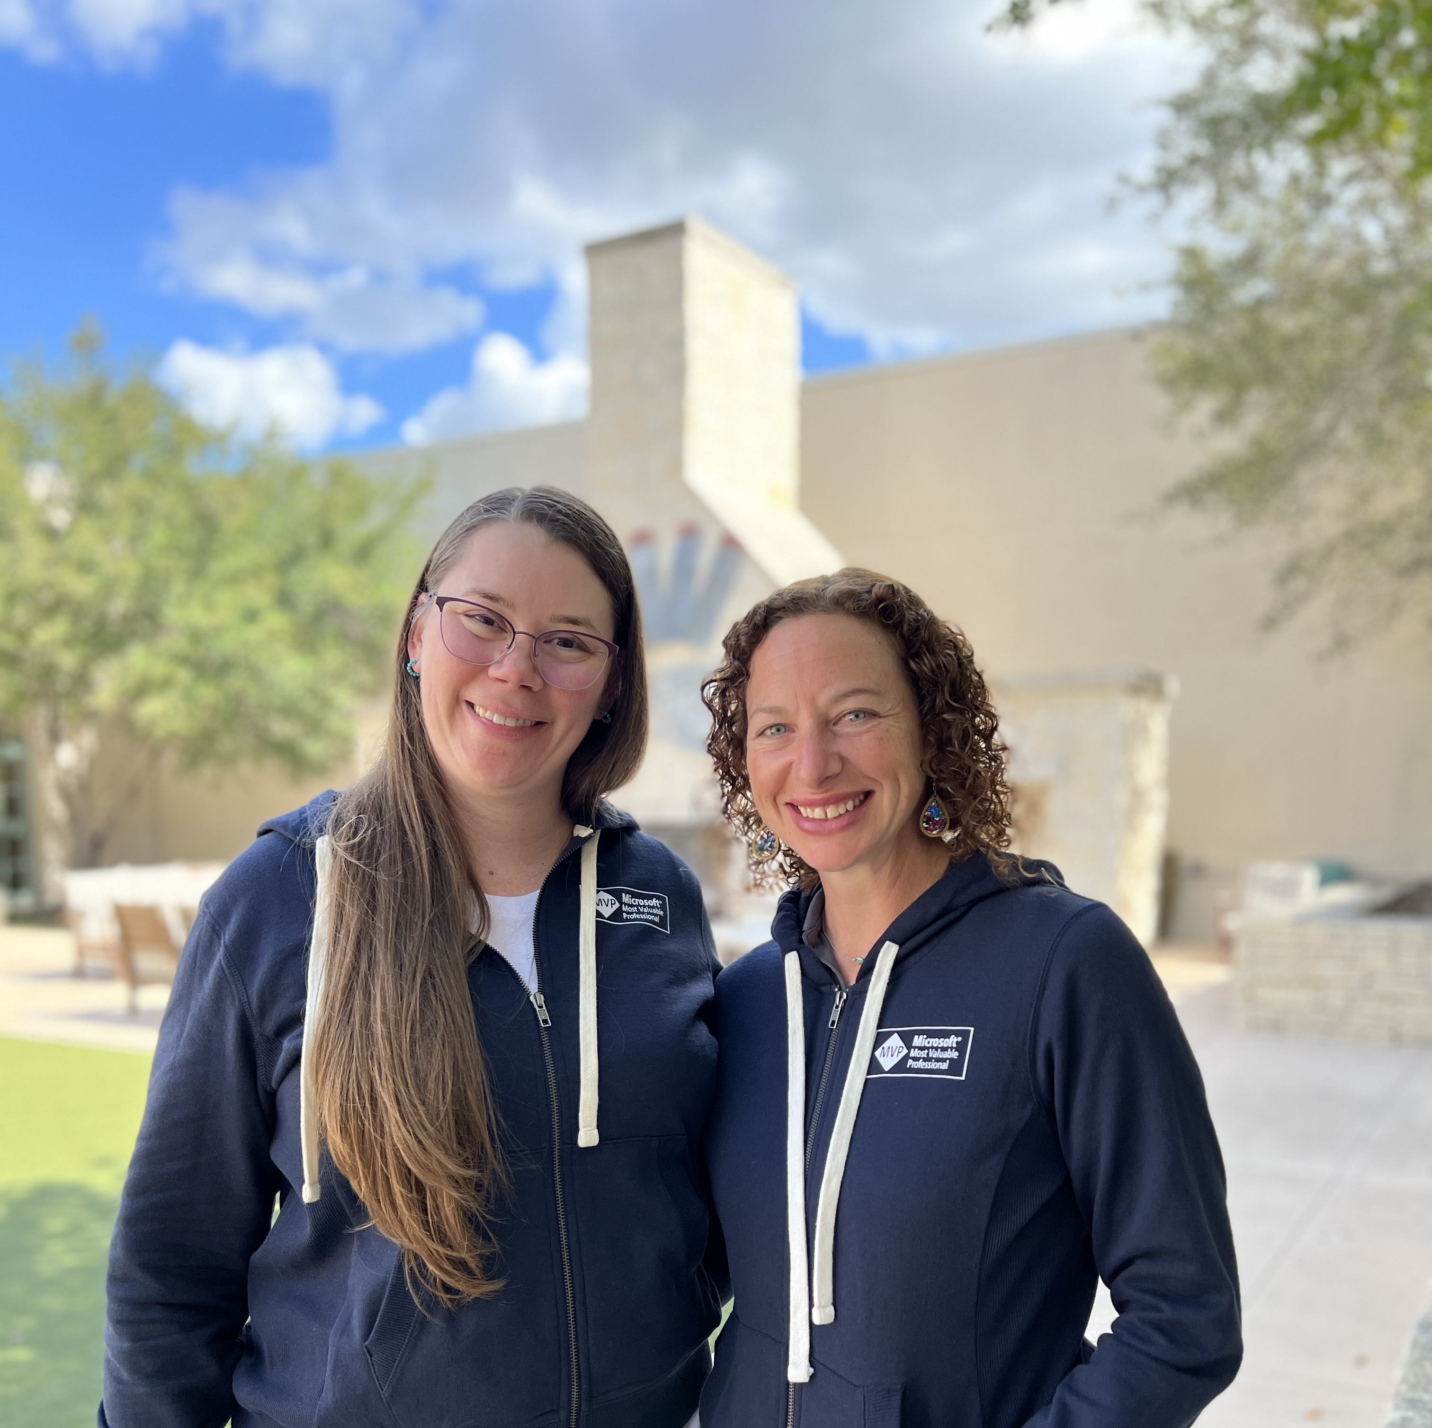
Presented By
Kylie Kiser
Solution Architect
RSM Canada
FTRSA, MVP
Heidi Neuhauser
Partner
Reenhanced
UG Chapter Leader, MVP

Slide 4
Agenda
Random tips from a bank of over 175 Tips!
At least 60 tips will be discussed

Slide 5
Agenda
Random tips from a bank of over 175 Tips!
At least 60 tips will be discussed

Slide 6
Thank you for attending!
Kylie Kiser
RSM Canada
Kylie.Kiser@RSMCanada.com
KylieKiser.com
Heidi Neuhauser
Reenhanced
heidi@reenhanced.com
CRMHeidi.com

