Slide 2
Administering Data and Documents in Business Central

Slide 3
Your speaker
Dave Wiser
Solution Architect & Functional Consultant
Tigunia LLC
Raised as an Accountant & Controller
BCUG Legend and All Star
Active in the user group communities
Using NAV/BC for almost 20 years

Slide 4
Session Objectives
What will you learn today?
Learn how to safely condense ledger entry transactions to free up needed database space.
Learn how to clean up old purchase and sales documents, and master records.
Learn how to use retention policies to maintain your data.

Slide 5
Table Information
Ability to see tables size and number of records:
Admin Center
Table Information (link to Data Administration)
Dat Administration

Slide 6
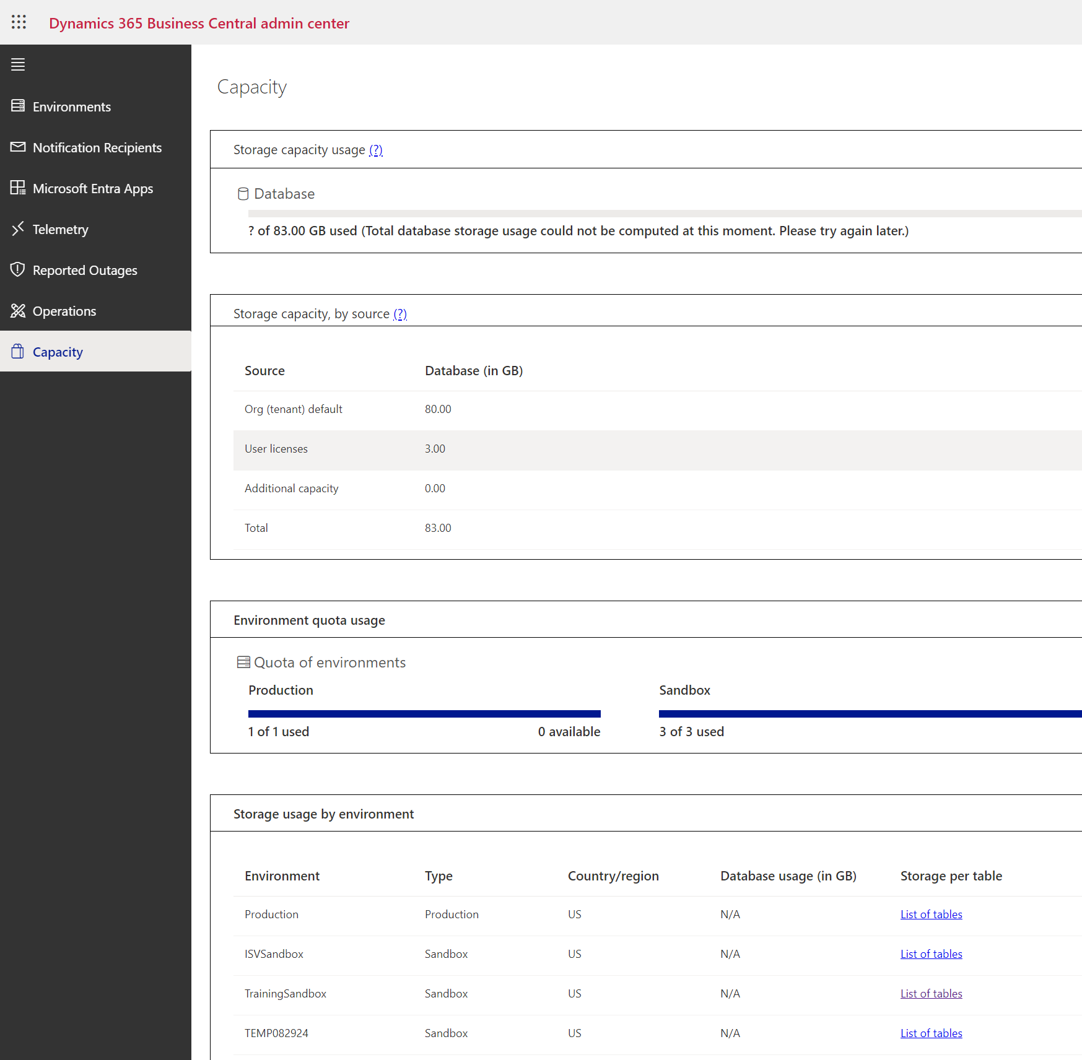
Admin Center

Slide 7
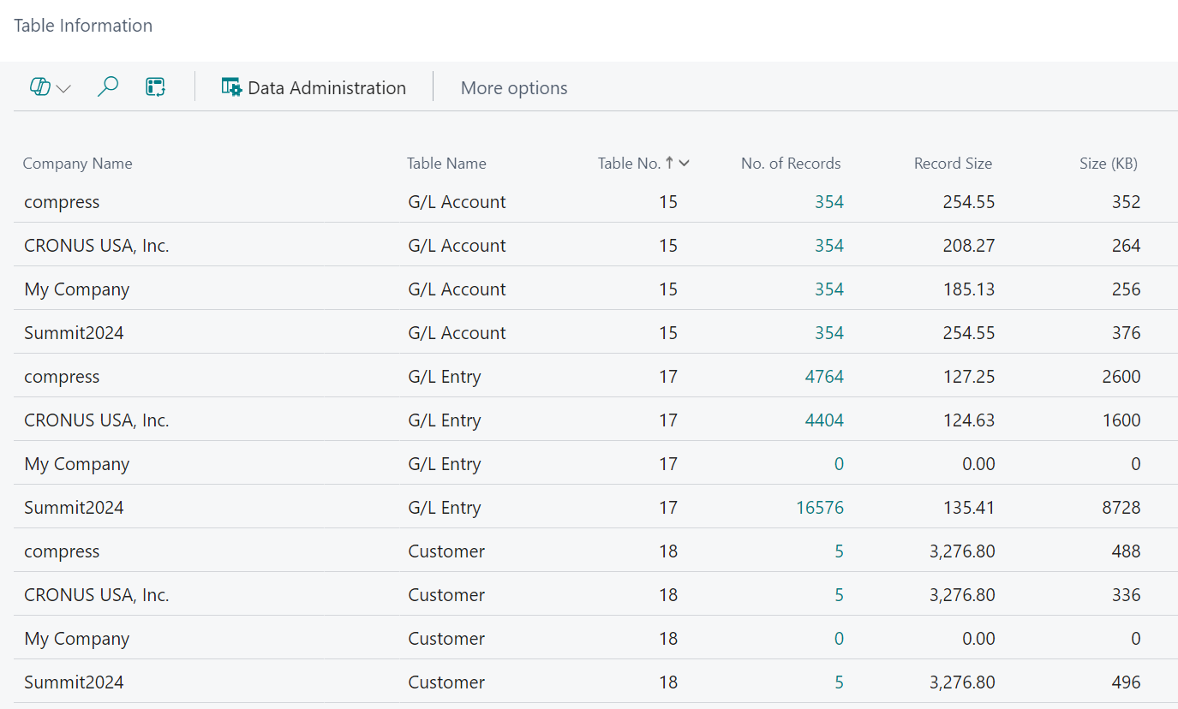
Table Information

Slide 8
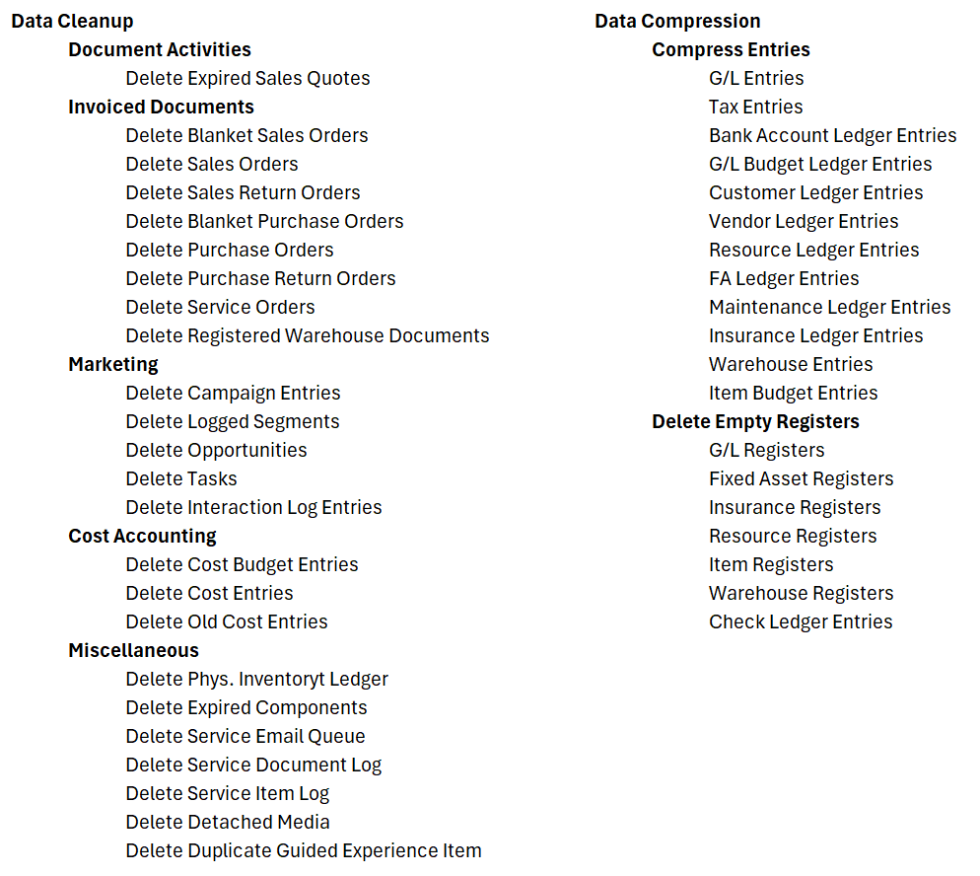
Data Administration Actions

Slide 9
Data Cleanup
Tools to clean up stranded documents.
Processed Blanket Orders
Invoices Orders
Expired Quotes
Cost Entries
Expired Components
Others
We’ll focus on just a few during this session.

Slide 10
Delete Expired Sales Quotes
Allows removal of quotes to remove the clutter.
Based on “Quote Valid To Date” field.
Filter by quote number or customer.

Slide 11
Delete Sales Orders
Blanket Sales Orders
Not normally removed when fully used.
Sales Orders
Not removed when invoiced using Sales Invoice page.
Must have Outstanding Quantity = 0
Must be fully shipped and invoiced.
Works for purchase documents also.

Slide 12
Delete Expired Components
Used on Production BOMs when replacing component items.
Triggered by Ending Date on BOM lines.

Slide 13
Date Compression
Tools used to compress the number of entries in various ledger entry tables:
G/L Entries
Bank Account Ledger Entries
Customer Ledger Entries
Vendor Ledger Entries
Resource Ledger Entries
FA Ledger Entries
Others

Slide 14
Date Compression
Accessed through Data Administration page
Test first in sandbox
Can be done in various levels with decreasing level of details
The more data points you compress by, the less compression is available.

Slide 15
Compress Requirements
Must leave latest 5 years uncompressed
Fiscal year must be closed
Close Income Statement to Retained Earnings must be run
Entries must have Open = No
Analysis Views must be updated

Slide 16
Data Administration Guide
Tool to help users step through the cleanup and compression process.
Limited in the number of data points you can compress by.
Preference is to run the processes individually.

Slide 17
Compress G/L Entries
Used to compress many entries into fewer entries based on the following:
Period Length
Document Type and/or No.
Project No.
Business Unit Code
Journal Template
Dimensions

Slide 18
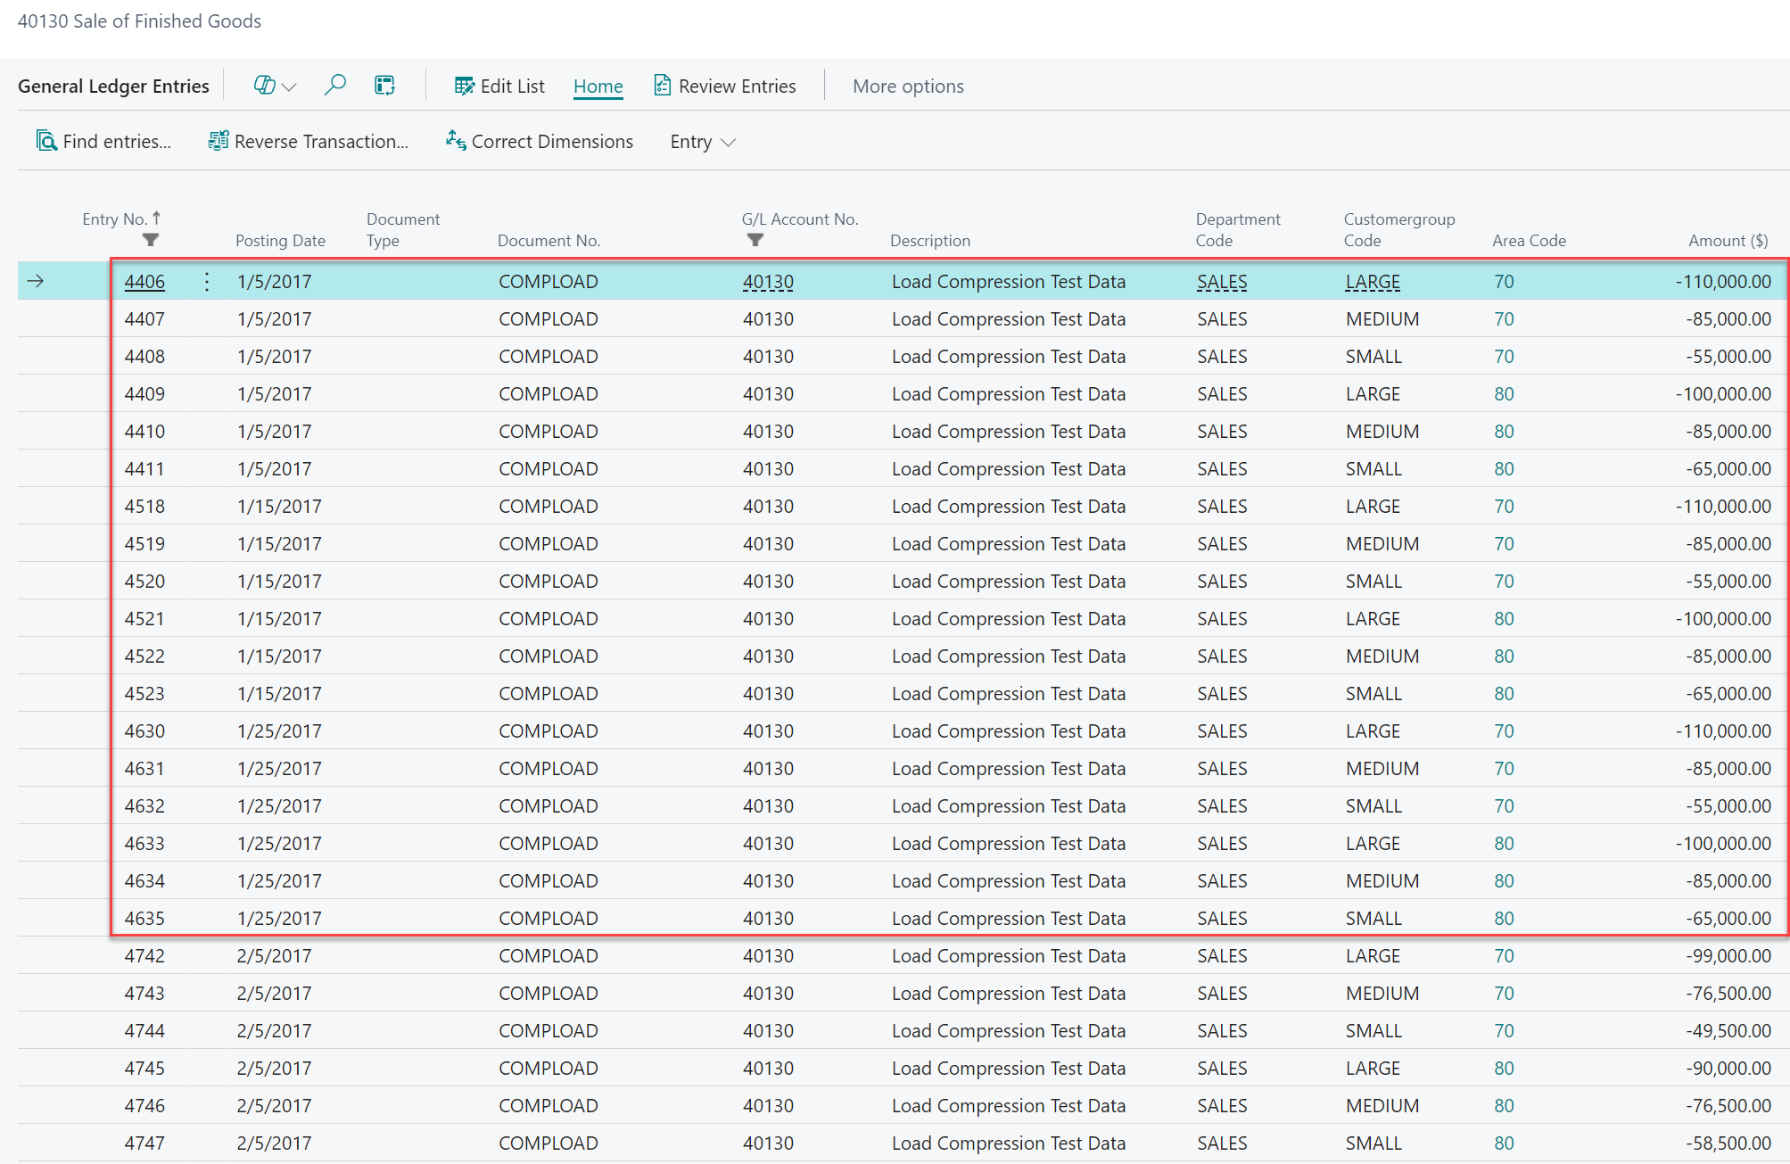
Original Data Table

Slide 19
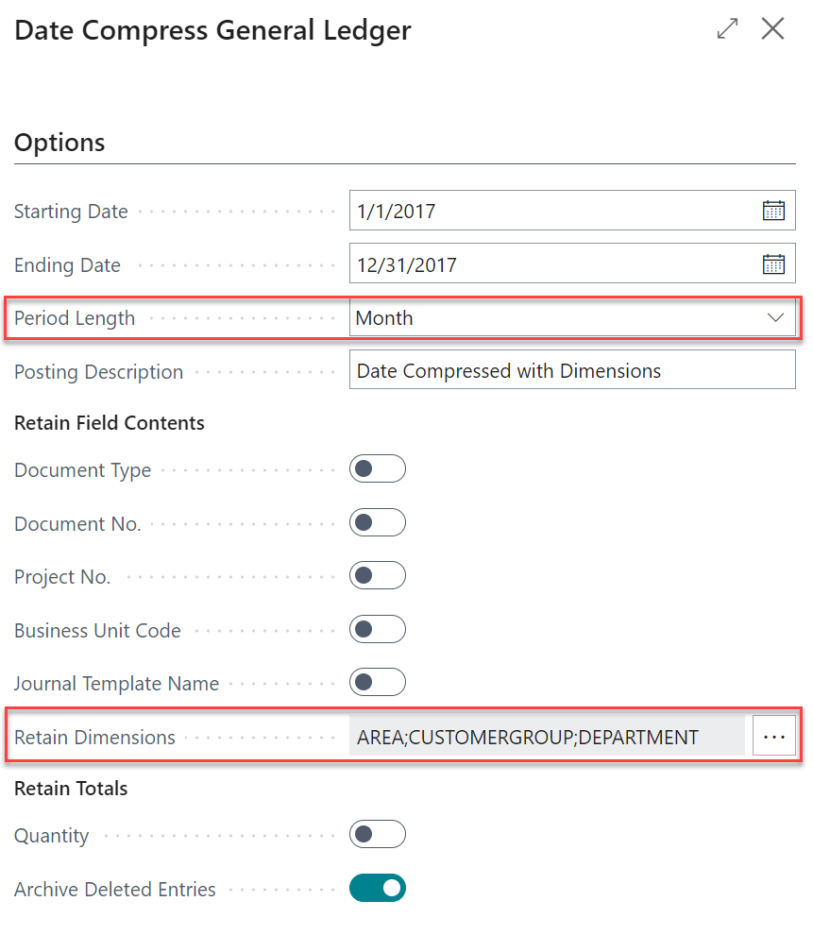
Compression Options
Set options for how much you want to compress.
The more options selected, the less the compression.
Can run various different compression based on the dates being compressed.

Slide 20
After Compression (retaining dimensions)
Note: No document type or no.

Slide 21
Compression #2 – Remove Dimensions
Compression bypasses dimension requirements for accounts.
Dimensions used in Analysis Views must be retained.
Can have levels of compression based on how far past the periods are. For example:
Compress with dimensions if 6 years out.
Compress without dimensions if 10 years out.

Slide 22
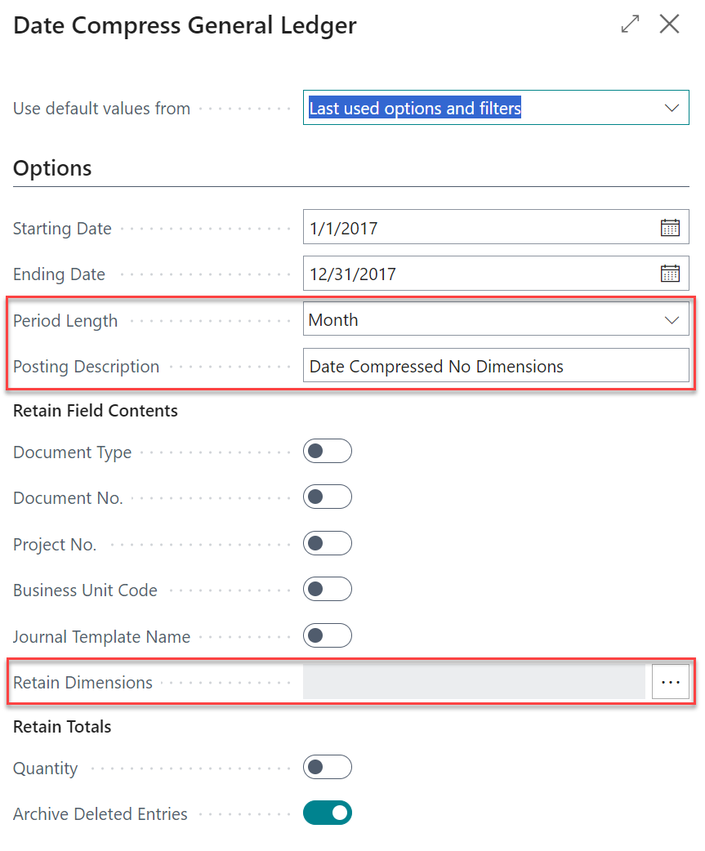
Compression Option #2
Remove dimensions on this run.

Slide 23
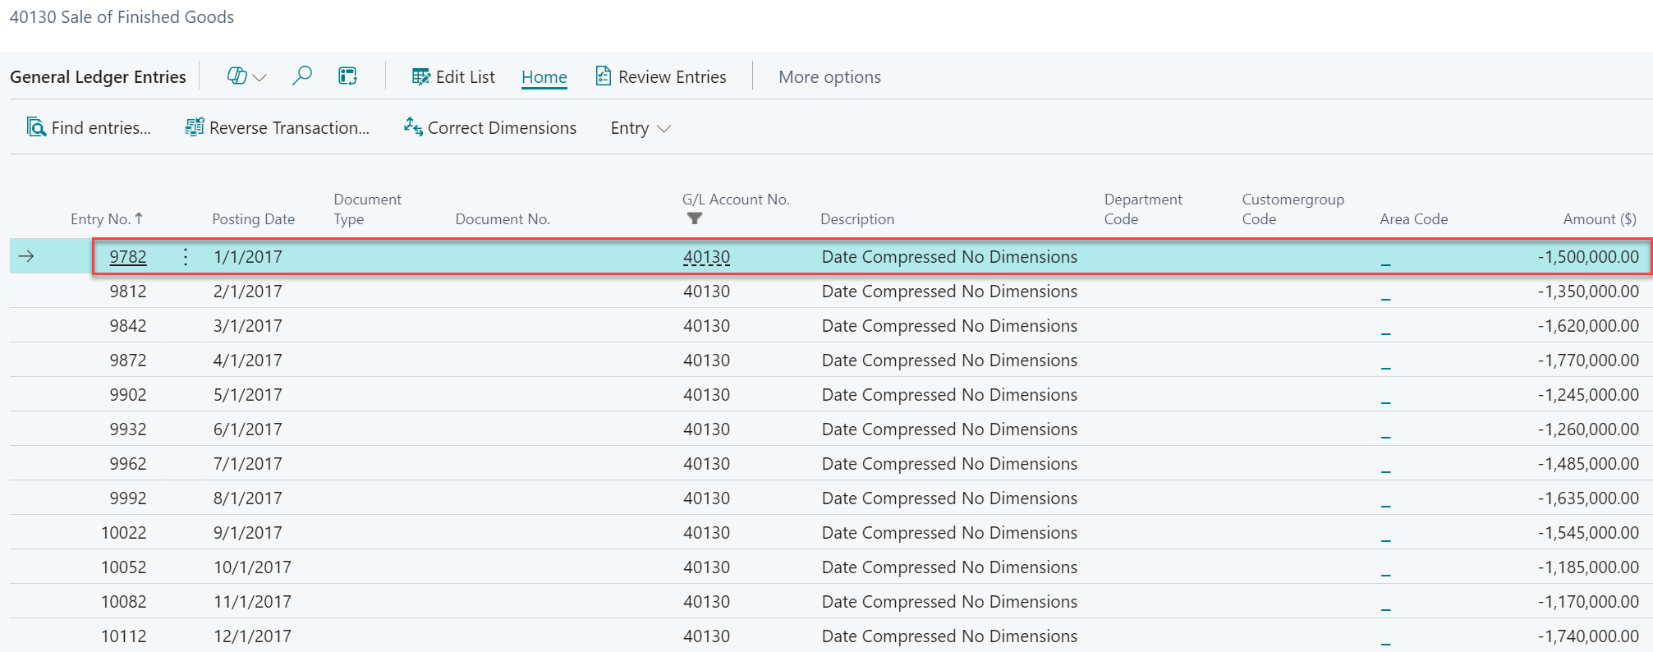
After Compression (removing dimensions)
Note: No dimensions

Slide 24
Retention Policies
Policies can specify how often to delete outdated data in tables that contain log entries and archived records. For example, cleaning up log entries can make it easier to work with the more relevant data. Policies can delete data based on an expiration date, or you can add filters to include only certain expired data.

Slide 25
Retention Info
Only available for certain tables (log entries and archives)
Control how long to keep records
Job Queue running frequently can keep tables clear

Slide 26
Related Links
https://learn.microsoft.com/en-us/dynamics365/business-central/admin-manage-documents
https://learn.microsoft.com/en-us/dynamics365/business-central/admin-data-retention-policies

Slide 27
Summary
Business Central provides tools to cleaning up stray documents and compressing data to save on disk space.
Retention Policies can be used to removed outdated log entries and archived records.

Slide 28
Thank You! Please remember to complete your surveys
Dave Wiser
dwiser@tigunia.com
253-235-4760

