Slide 2
Financial Reporting
Tanya Henderson

Slide 3
Presenter
Consultant Since 2000 GP, BC, PP
Inaugural Dynamics Prof Board Member
GPUG Presenter Since 2011
GP Tech Presenter
Conference Planning Committees
Summit Australia Presenter
Directions EMEA Hamburg and Lyon Presenter
Dynamic Minds Presenter
Dynamics Con and Con Live Presenter
Microsoft MVP

Slide 4
Agenda
Chart of Accounts
Account Category
Account Subcategory
Generate Financial Reports
Row Definitions
Column Definitions
Reports
Analysis Views

Slide 5
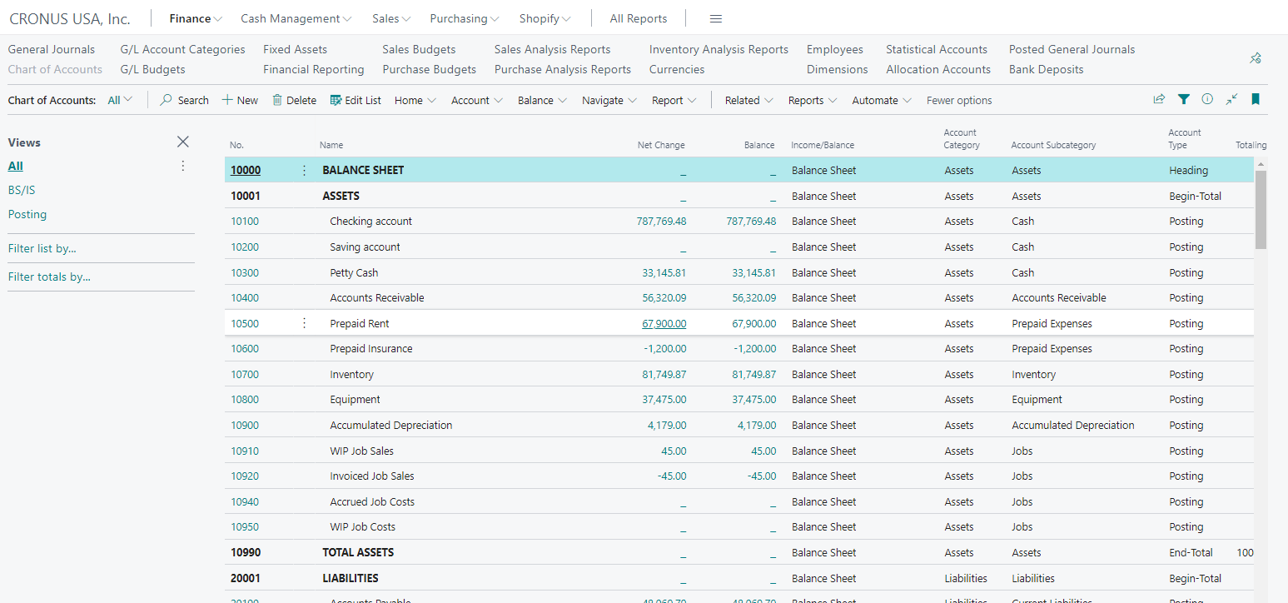
Chart of Accounts
Accounts
Category
Subcategory
Types
Views

Slide 6
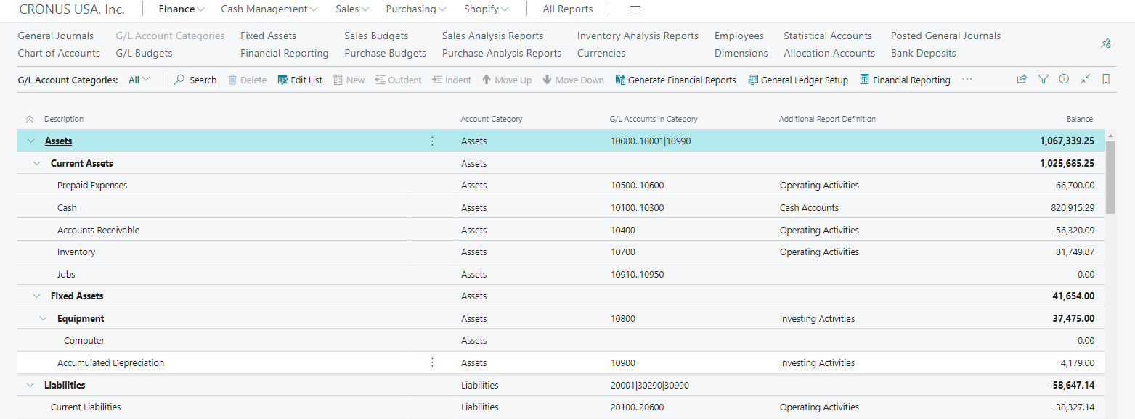
G/L Account Categories
5 Major Categories
Subcategories
Edit List
New
Outdent
Indent
Move Up/Down

Slide 7
G/L Account Categories
Generate Financials
Financial Reporting

Slide 8
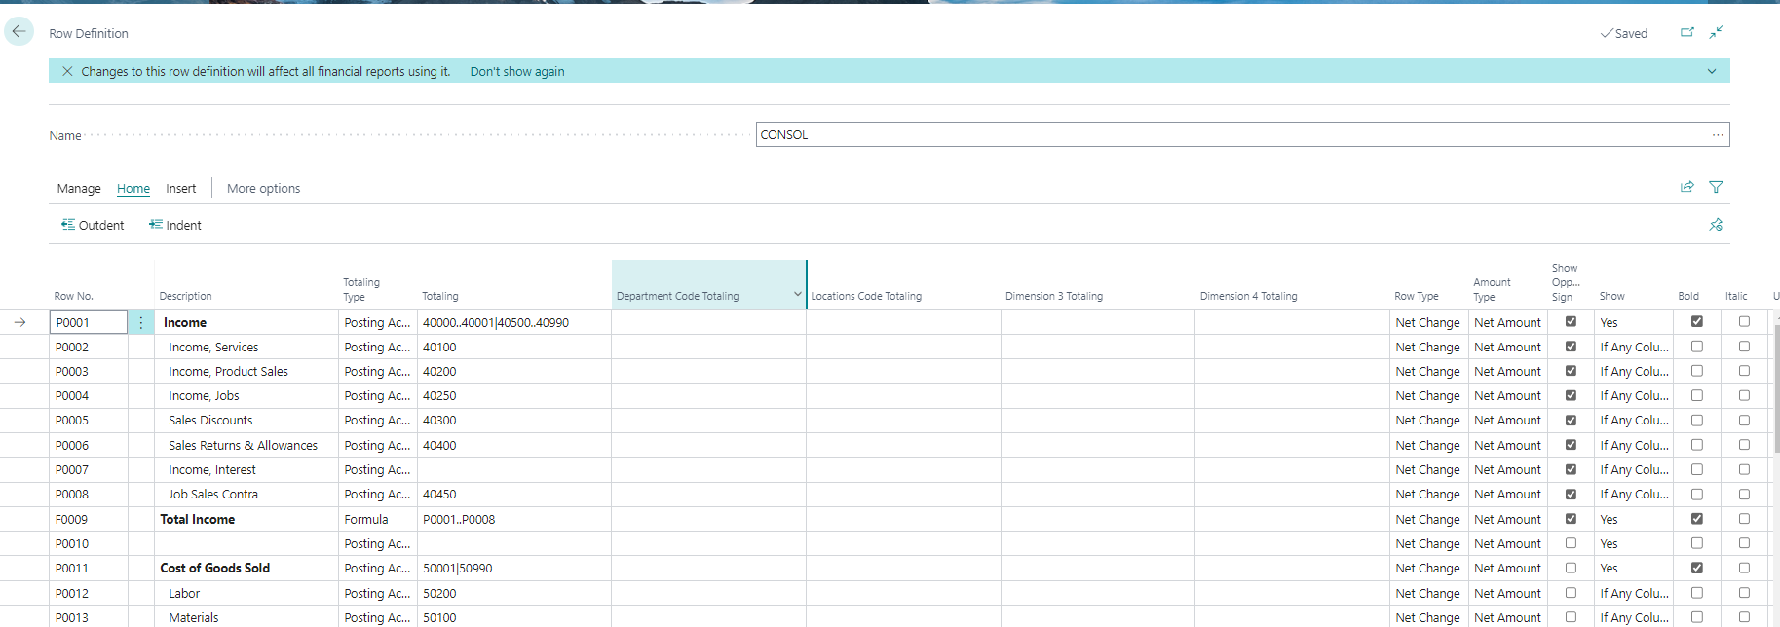
Row Definitions
Row No
Totaling Type
Totaling
Dimensions
Options
Row Type
Amount Type…

Slide 9
Column Definitions
Column No
Column Type
Ledger Entry Type
Amount Type
Dimensions
Budgets
Formula
Comparison Period Formula

Slide 10
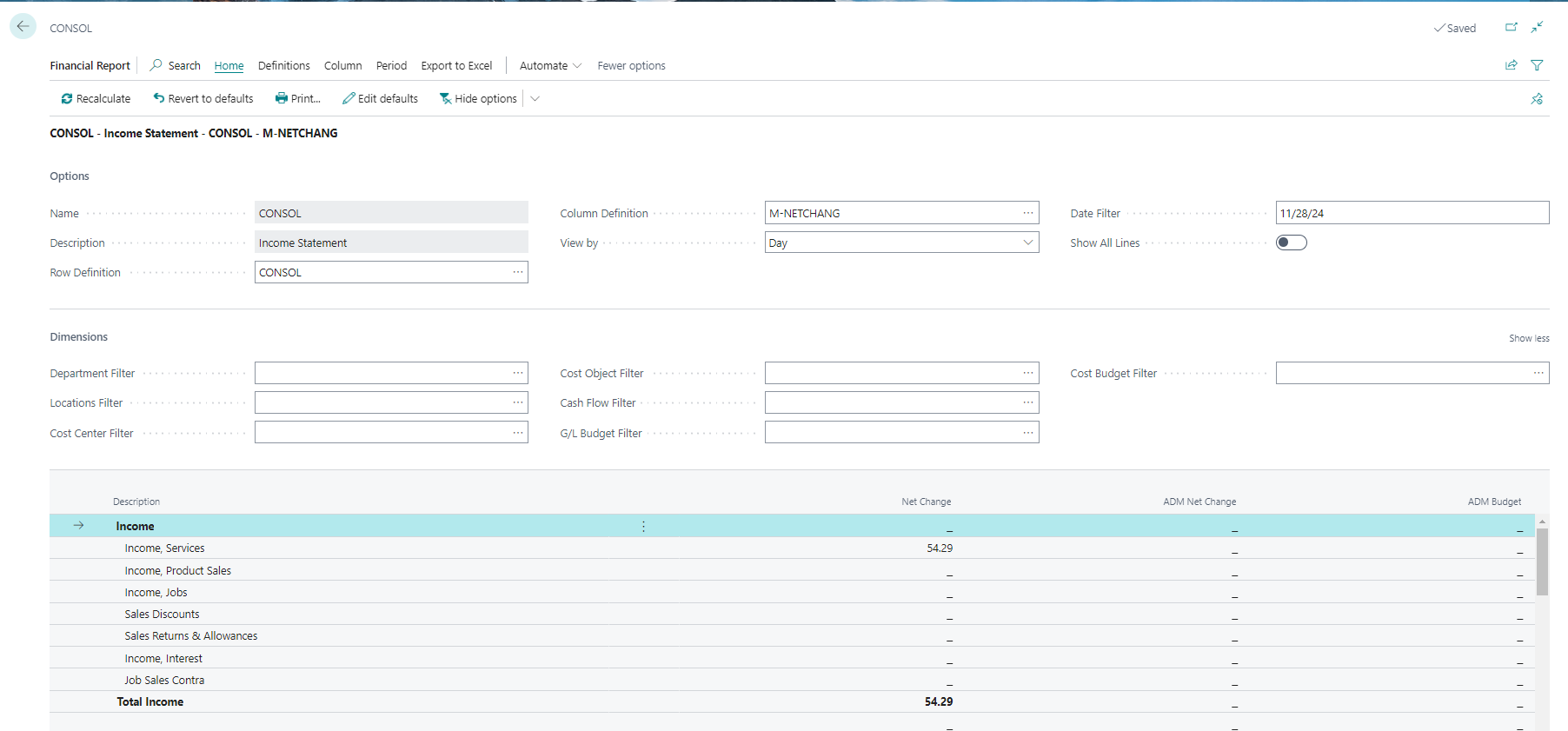
View Financial Report
Options
Dimensions
Edit Defaults
Print
Export to Excel
Drill Down

Slide 11
Analysis Views
Setup
Update
Dimensions
Row and Column Definitions

Slide 12
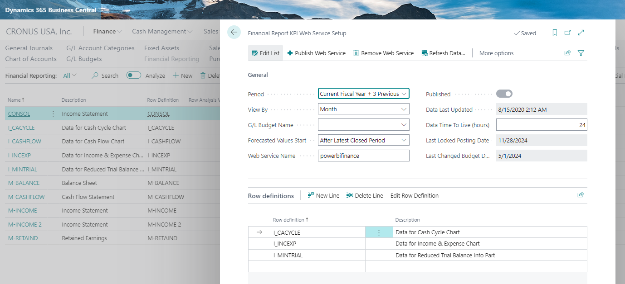
Analysis Views
Web Service Setup

Slide 13
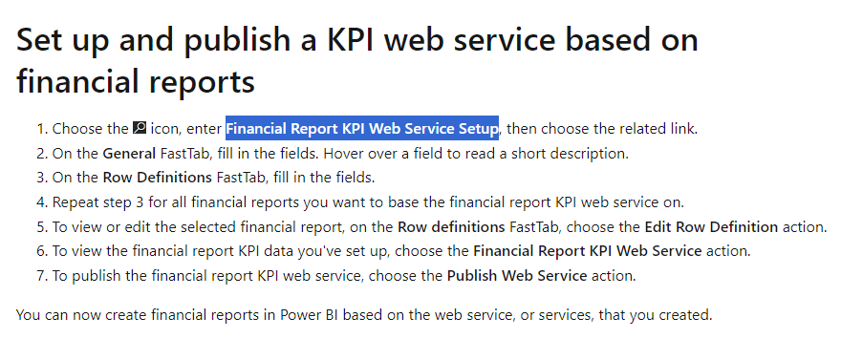
KPI Web Service
Web Service Setup

Slide 14
Microsoft Learn
https://learn.microsoft.com/en-us/training/paths/create-financial-reports-dynamics-365-business-central/
https://learn.microsoft.com/en-us/dynamics365/business-central/finance-reports
https://learn.microsoft.com/en-us/dynamics365/business-central/bi-column-definitions

Slide 15
Demo

Slide 16
Questions?

Slide 17
Contact Information
tanya@tessteam.com
@TanyaTessTeam - Twitter/X
linkedin.com/in/tanya-henderson/
https://www.youtube.com/@tanyatessteam

