Slide 2
Change Readiness & Management

Slide 3
Our Session Takeaways
Understand change management as a proactive approach
How we can balance people, process, and technology to be effective and efficient
Prepare ourselves to make decisions from a place of courage instead of fear

Slide 4
Hello!

Slide 5
What is Change Management?
“Fear is a reaction. Courage is a decision.” -Winston Churchill
Proactive approach
Outcome can minimize confusion, boost morale, maintain business continuity of operations
Takes into account impacts, dependencies and all stakeholders

Slide 6
People
Process
Technology

Slide 7
The Delicate Balance
Managing change is about managing expectations
Transparent, proactive communication builds your brand
Acknowledging the fear
Consider the end user
People
Process
Technology

Slide 8
The Delicate Balance
Fix processes, not people
Document, share, learn
Take in feedback and act on it; give feedback with tact
People
Process
Technology

Slide 9
The Delicate Balance
Good tools make processes work
Make it easy for internal and external stakeholders to understand and buy-in
People
Process
Technology

Slide 10
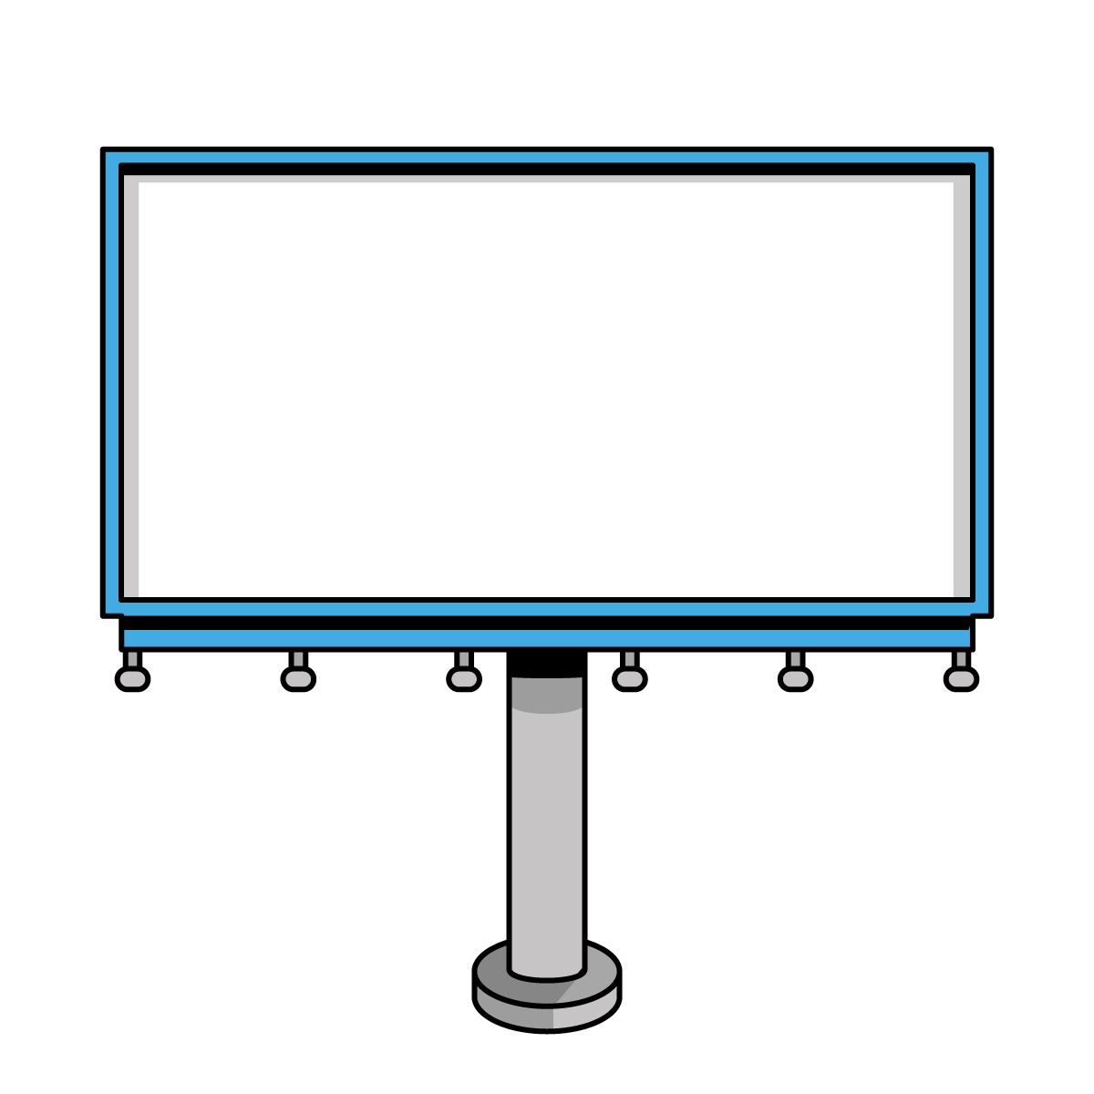
Q&A

Slide 11
Use Cases: Summary
Product delivery
Build versus buy
Customer service
Outside of work

Slide 12
Use Case: Product Delivery
People: communication the change(s); upskilling on new or improved platform/data
Process: new or improved workflows and automations; deprecation of manual efforts
Technology: bringing in new vendors or new capabilities from existing vendors

Slide 13
Use Case: Build versus Buy
People: insourcing or outsourcing resources and associated costs; upskilling/training
Process: vendor management and/or onboarding; internal ability to support growing business need and scale
Technology: costs associated with implementation, development/ customizations, licenses, training for support/maintenance staff

Slide 14
Use Case: Corporate Structure
People: Job loss or change; decreased productivity; low morale
Process: Disruptions or lags; manual processes exacerbated
Technology: High focus on automations and efficiencies

Slide 15
Use Case: Outside of Work
New role and/or organization
Family and caregiving obligations
Personal growth goals

Slide 16
What We Covered
Understand change management as a proactive approach
How we can balance people, process, and technology to be effective and efficient
Prepare ourselves to make decisions from a place of courage instead of fear

Slide 17
People
Process
Technology

Slide 18
Q&A

Slide 19
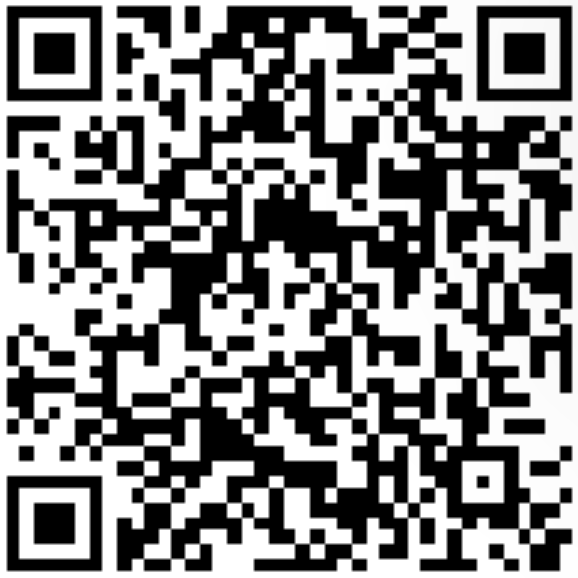
Let’s Connect!

