Slide 2
Don’t Fear! The New Sales Price is Experience is here!

Slide 3
Kim Dallefeld, MVP, MCT, MCP
Dallefeld Consulting, LLC
kim@dallefeld.com
Kimdandnavbc.com
BC3 Amigos youtube
Kim Dallefeld | LinkedIn

Slide 4
Agenda
Enabling the new pricing experience
What’s the Change
Sales Price List
Header and Lines
Suggest and Copy Lines
All Items Discount
Jobs Only Unit Cost + Cost Factor
Demo
Notes:
Recommendation on enable and converting
Customer Price Group **
Suggest Lines
Copy Lines
All Items Discount
Jobs Only Unit Cost + Cost Factor
Header fields and Line Defaults
Sales & Receivable – Default Price List….check other fields

Slide 5
Objectives
Learn how to enable the new pricing experience
Understand how to setup a new price list
See how to use the Price Worksheet

Slide 6
What’s the Point?
Manage complex pricing structures
Leave the item card untouched
Better version control

Slide 7
Enabling the new Sales Price Experience
Feature Management → Turn on for all users

Slide 8
Prices and Discounts are Combined
Purchase Prices
Purchase Price Lists
Purchase Discounts
Sales Prices
Sales Price Lists
Sales Discounts
Notes:
There are two types of discounts – Line and Invoice
Line Discount
A discount amount that is given for lines on sales and purchase documents. Typically, line discounts are based on a combination of customer, item, minimum quantity, unit of measure, or period of time that you define for sales and purchases on the Sales & Receivables Setup and Purchase & Payables Setup pages.
Invoice Discount
A discount percentage that is subtracted from sales and purchase document total if the sum of all lines on the document exceeds a certain minimum.
Because sales prices and sales line discounts are based on a combination of item and customer, you can also set them up on the items to which the rules and values apply.
Tip
If an item should never be sold with a discount, leave the discount fields on the item empty, and don't include the item in any line discount setups.

Slide 9
Unchanged
Customers can still have Price Groups
Customers can still have Discount Groups
Items can still have Price Groups
Items can still have Discount Groups

Slide 10
Sales & Receivable Setup

Slide 11
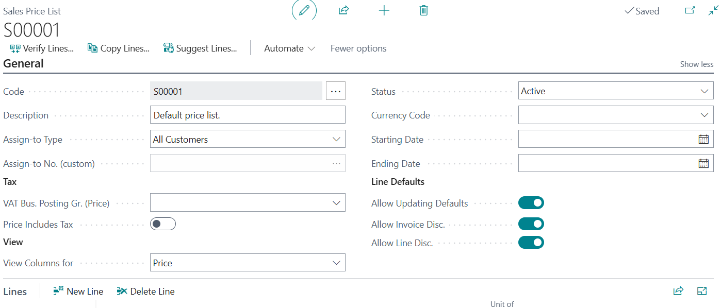
Sales Price List - Header
Notes:
By default, the status of new price lists is Draft. When you're ready to start using the list, you can change the status to Active.

Slide 12
Tip
One Price List per Currency
Notes:
The Edit in Excel action offers a fast way to add or update multiple lines.
The action exports the price list information to Excel, where it's easy to edit.
When you're done, publish your changes to update Business Central.
The action is available on the Sales Price Lists page, and the Lines FastTab on the Sales Price List page. Choose , and then choose Edit in Excel. To learn more about the action, go to Edit in Excel.

Slide 13
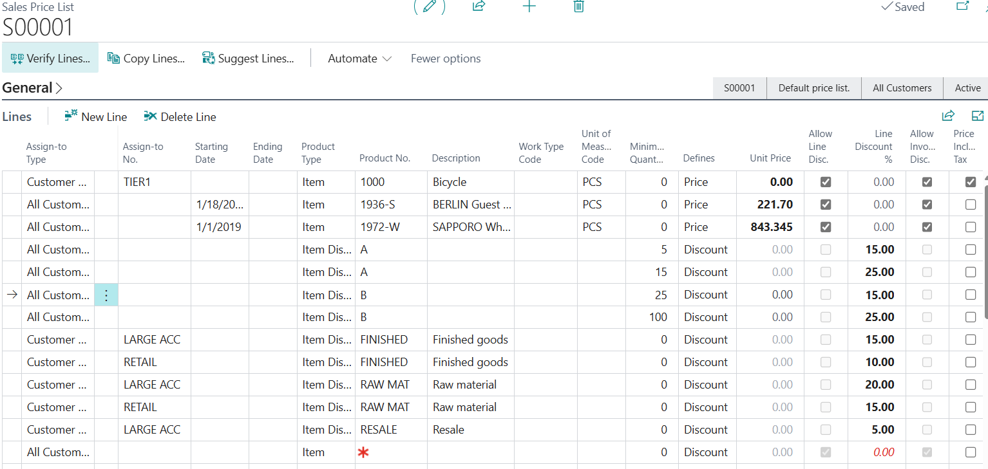
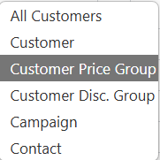
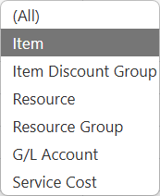
Sales Price List - Lines
Notes:
You can add items and services manually for each line, or you can use the Suggest Lines action to create new prices for selected items, item discount groups, resources, and other product types.
If you choose Suggest Lines, on the Price Lines - Create New page you can use filters to select the items or services to include on the price list. You can also specify whether to consider other factors, such as:
A minimum quantity when calculating prices.
The adjustment factor to apply for new price list lines.
The rounding method to apply for prices.

Slide 14
Tip
If an item should never be sold with a discount,
leave the discount fields on the item empty,
and don't include the item in any line discount setups.

Slide 15
Updating Sales Prices
Sales Price Worksheet – best used when using one default price list
New Price List w/ Copy feature
Edit in Excel

Slide 16
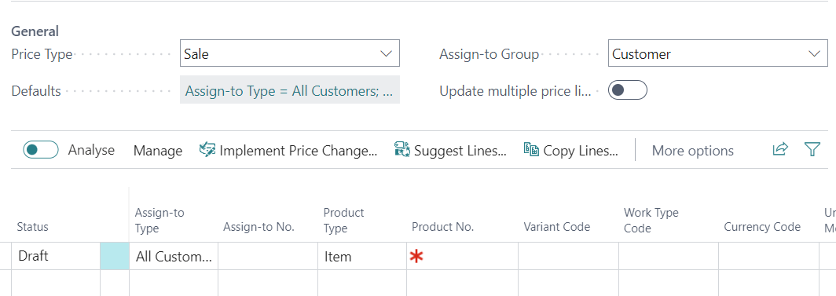
Old Sales Price Worksheet
Suggest or Copy Lines – apply filters, apply adjustment factor, make changes, implement

Slide 17
New Sales Prices
Create new price list using ‘copy lines’
Apply desired filters
Apply adjustment factor
Edit as desired / make changes
Change status from Draft to Active
Inactivate old price list
Very similar to Old Sales Price Worksheet
Suggest or Copy Lines –
Apply filters
Apply adjustment factor
Make changes
Implement

Slide 18
Tip
The Edit in Excel action offers a fast way
to add or update multiple lines.
Notes:
The Edit in Excel action offers a fast way to add or update multiple lines.
The action exports the price list information to Excel, where it's easy to edit.
When you're done, publish your changes to update Business Central.
The action is available on the Sales Price Lists page, and the Lines FastTab on the Sales Price List page. Choose , and then choose Edit in Excel. To learn more about the action, go to Edit in Excel.

Slide 19
Takeaways
Once the new sales price experience is enabled, it cannot be disabled
Price lists let you maintain price (or cost) and discount combinations for customers/vendors
A default price list can be defined in:
Sales and Receivables setup (for sales pricing)
Purchase and Payables setup (for purchase pricing)
The Pricing Worksheet can:
Update existing price lists
Add new lines to the default price list

Slide 21
Best price calculation
After you record special prices and line discounts for sales and purchases, Business Central calculates the best price on sales and purchase documents, and on project and item journal lines.
The best price is the lowest price with the highest line discount allowed on a given date. Business Central calculates best prices when it adds unit prices and the line discount percentages on document and journal lines.
Note
The following describes how the best price is calculated for sales. For purchases, the calculation is similar but is based on the available parameters. For example, item discount groups are not supported for purchasing.

Slide 22
Business Central checks the combination of the bill-to customer and the item and then calculates the applicable unit price and line discount percentage, using the following criteria:
Does the customer have a price/discount agreement, or does the customer belong to a group that does?
Is the item or the item discount group on the line included in any of these price/discount agreements?
Is the date within the starting and ending date of the price/discount agreement? For invoices and credit memos, this is the date in the Posting Date field on the document header. For all other documents, it's the date in the Order Date field on their headers.
Is a unit of measure code specified? If so, Business Central checks for prices/discounts with the same unit of measure code, and prices/discounts with no unit of measure code.
Business Central checks whether any price/discount agreements apply to information on the document or journal line. It then inserts the applicable unit price and line discount percentage using the following criteria:
Is there a minimum quantity requirement in the price/discount agreement that is fulfilled?
Is there a currency requirement in the price/discount agreement that is fulfilled? If so, the lowest price and the highest line discount for that currency are inserted, even if local currency would provide a better price. If there's no price/discount agreement for the specified currency code, Business Central inserts the lowest price and the highest line discount in your local currency.
If no special price can be calculated for the item on the line, then either the last direct cost or the unit price from the item card is inserted.

Slide 23
THE ELEMENTS AND BACKGROUNDS ON THE FOLLOWING PAGES CAN BE COPIED AND PASTED INTO YOUR SLIDES.​ VISIT DYNAMICSCON.COM TO DOWNLOAD MORE.

