Slide 2
Strategy Isn't Just for Marketing Campaigns
Scott Rich and Alana Ashurst

Slide 3
Agenda
Introduction: Setting the Stage
Knowing the neighborhood: Understanding the Microsoft Dynamics channel
Building the Foundation: Becoming a Trusted Partner
Being a Good Neighbor: Day-to-Day Engagement
Staying Top of Mind: Long-Term Relationship Building
Conclusion: Becoming the Preferred Choice
Notes:
We have created an analogy that I like to referencewhen it comes to approaching partnerships for partner marketing manager which we call being a "good neighbor."
So thoughout todays session we will go through what we have found to be a good approach outside of typical partner marketing camapgins and how we can leverage everything within the partner marketing role to our companies advantage.
We will set the stage for our conversaion, then explain the landscape of the Microsoft Dynamics channel
We will talking about being a trusted partner, what does it take to gain crediblity in this space
Then we will go into day to day practical engagement steps
We will talk about long term relationship building we know that deals don’t just happen over night so that will lead us into being the prefferred choice when deals come up​ that our partners choose our solution.

Slide 4
Introduction: Setting the Stage
The importance of building strong partner relationships outside of typical partner marketing campaigns
Collaborating starts long before creating co-branded marketing campaigns, we have to build trust, which starts with understanding the channel and gaining credibility within
Once we are "in the neighborhood," what does it look like to be a "good neighbor"
Nurturing relationships by being creative and strategic
Thinking long-term
Being the go-to option when your partner needs your solution
Notes:
Alana

Slide 5
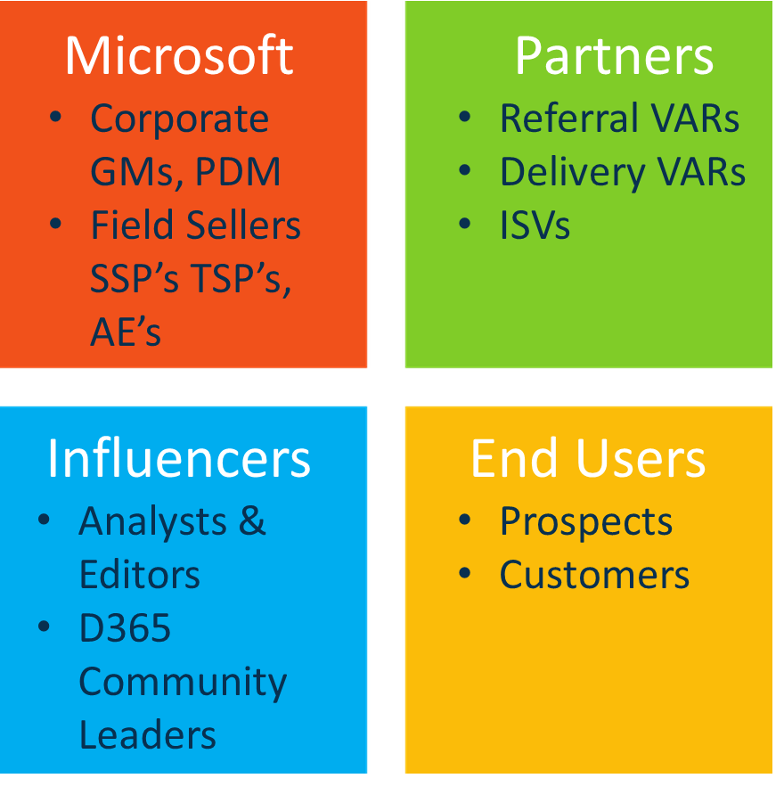
Knowing the neighborhood
On-Going Partner Management
Partner Campaign Execution
Roles/Personas
Building Partner Relationships
Influencers; Brand Awareness
Microsoft Relationship
Notes:
Scott

Slide 6
Day-to-Day Marketing Activities
Visibility/Awareness | Content & Sales Tools | Lead Generation
Logo, Branding, Naming, Tagline and Identity Public Relations – Press Releases Analyst Relations Social Media Channel Content Articles, Stories Trade Shows, Conferences & Events Sponsorships Advertising Web Site Content & Personas Directory Listings Comparison and Review Guides OEM Platform Partner Relationships Microsoft ISV Solution Partner Relationships VAR Reseller Partner Relationships | Positioning Statements, Company Descriptions Battlecards Collaterals, Datasheets Sales Presentations Corp. Graphic Standards Product Demos Newsletters and Win Wires Email Templates Customer Testimonials Customer & Corp. Videos Product Promotions Partner Portals and Programs Sales & Marketing Guides Competitive Analysis Target Market Reports, White Papers | Trade Shows Platform Partner Marketplace Listings Website updates, SEO, AL Webinars and Seminars Sponsored receptions Partner Events and Campaign Initiatives AdWords and Web Banner Ads Referral Programs Email Campaigns Social Campaigns List Acquisition, Named Accounts Lead Database Management; Data Cleansing; Lead Processes Lead Metrics & Reporting Lead Follow-up BDR Activity

Slide 7
Understanding the Microsoft Dynamics Channel
Approximately 400 meaningful VAR partners
Selling vs. Non-selling ISVs approach
70% of opportunities typically come from partners (Best Qualified leads)
Alignment with Microsoft
AppSource, Azure Marketplace
Transactable, MACC enabled
Co-Sell Ready; Incentivized
Registering deals; Moving up the ISV Success Levels; Gaining GTM $
Formal Microsoft relationship (assigned PDM, iPDM)
Following John O'Donnell, Brian Galicia, etc. for general MSFT updates
Partner of the Year award nominations (Opens June 18)
Notes:
Scott

Slide 8
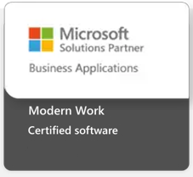
Microsoft ISV Partnership Growth Progression (FY25)
Inner Circle
Microsoft Dynamics
Global ISV
Managed ISV
Certification with a Solution Designation
Co-Sell Ready/Incentivized & MACC Enrolled
Transactable Offer in Azure MP
Azure Marketplace & AppSource Approved
ISV Success Membership
Notes:
Scott

Slide 9
Microsoft Marketing and Sales Benefits
Benefits for partners with transactable, qualifying Business Applications, or Teams App offers
Company level commercial marketplace billed sales, solution value, or Teams App MAU
All benefits subject to change and must be completed on the anniversary date of when you first received benefits.
Marketing and Sales benefits
Publisher
$500
$25K or 250 MAU
$100K or 1K MAU
$500K or 5K MAU
$1M or 50K MAU
$4M or 400K MAU
Commercial marketplace listing optimization | ✓ | ✓ | ✓ | ✓ | ✓ | ✓ | ✓
Press release support + # | ✓ | ✓ | ✓ | ✓ | ✓ | ✓ | ✓
Marketplace what's new blog | ✓ | ✓ | ✓ | ✓ | ✓ | ✓ | ✓
Marketplace Rewards testimonial |  | ✓ | ✓ | ✓ | ✓ | ✓ | ✓
Commercial marketplace featured category placement + # ▲ |  | ✓ | ✓ | ✓ | ✓ | ✓ | ✓
Commercial marketplace blog feature + # |  |  | ✓ | ✓ | ✓ | ✓ | ✓
In-depth customer review + # |  |  | ✓ | ✓ | ✓ | ✓ | ✓
Azure sponsorship for deployment/proof of concept + # ^ |  | $2K | $2K | $30K | $60K | $100K | $300K
Azure sponsorship for Test Drive/trial sandbox + # ^ |  |  |  | $5K | $40K | $50K | $100K
Partner or customer success story + # |  |  |  | ✓ | ✓ | ✓ | ✓
Microsoft seller webinar + # |  |  |  | ✓ | ✓ | ✓ | ✓
Solution spotlight to Microsoft sales team + # * |  |  |  | ✓ | ✓ | ✓ | ✓
Commercial marketplace featured home page placement + # ▲ |  |  |  |  |  | ✓ | ✓
Social promotion spotlight + # ▲ |  |  |  |  |  | ✓ | ✓
Individual guest blog post + # |  |  |  |  |  | ✓ | ✓
Microsoft executive endorsement + # |  |  |  |  |  | ✓ | ✓
+
Not available for
BYOL offers.
#
Requires a completed Commercial marketplace listing optimization.
^
Sponsorship is available as per offer availability in the respective country/region.
Private offers require a public listing with the same solution.
▲
Not available for Private offers.
*
TTM (trailing 12 months)
cumulative on MBS.
Read the benefit guide for full details
Notes:
Scott

Slide 10
Leveraging the Microsoft Dynamics Partnership
Product briefings with key Microsoft resources
Corporate GMs, Industry Leaders, GTM leads
Field sellers (SSP,s TSPs, AEs) Regional team briefings
Attend and exhibit at key events
Ignite is the new WPC/Inspire (F&O/AX Summit, BizApp Summit/Convergence, Inspire/WPC, Ready, and DTA)
Directions NA, EMEA, APAC
DynamicsCon and UG Summit
BizApp Partner Summit
DUG regionals and DCI roadshows
Power Platform, M365 Events, Co-Pilot
Visiting the Microsoft campus
Notes:
Scott

Slide 11
How are you strengthening your Microsoft partnership?
Notes:
Scott

Slide 12
Building the Foundation: Becoming a Trusted Partner
It’s all about trust!
Build Personal relationships
Meeting in-person with VAR partners (Sales Kick-offs, Sales Meetings, One-on-one meet-ups, being intentional at events)
Establishing ISV to ISV relationships – knowledge sharing, Co-Sponsoring parties at major events.
Sponsoring VAR, SI, ISV Partner Customer Conference events
Briefing their sales team before or after
Networking with reps.
Lead sharing at events (e.g. Booth passport, booth referrals)
Establish reciprocal partner pages, press and social partnership awareness
Incentive programs (Incentivize partners, trading leads, spiffs, etc.)
Notes:
Scott

Slide 13
Building the Foundation: Becoming a Trusted Partner
Choosing an approach that works for your company and resource capacity
Self-Service (Pre-packaged campaigns and materials)
Tailored campaigns to each partner
Mix of packaged and tailored
Determining partner communication cadences and partner marketing vs. partner sales/account management responsibilities
Structured engagement – Strategic vs. Tactical
Orientation resources
Quarterly business reviews
Defining success together
Partner team determines tier of partner
Set realistic expectations; Don't over promise
Notes:
Alana: These are all things to consider when building trust with your partner; every interaction and touchpoint can be impactful.

Slide 14
How are you building trust with your partners?
Notes:
Alana

Slide 15
Being a Good Neighbor: Day-to-Day Engagement
Beyond the campaign
Support before, during, and after campaigns
Stay engaged, even when not selling
Content & creative collaboration
Provide co-branded assets, videos, joint webinars
Cameos in videos or podcasts—make your partner the star
Share social content, not just product sheets
Accessibility & responsiveness
Clear communication channels
Celebrate their wins
Respond to emails!
Notes:
Alana

Slide 16
Creating a Strong Internal Partner Marketing Team
Establishing a bridge between the Marketing Team and the Partner Team; Ideally a dedicated Partner Marketing resource
Collaborate with the corporate marketing and partner team to select campaign partners and topics for campaigns
Work with different partner types: VARs (ERP), ISVs, and Implementation SI Partners
Focus on nurturing relationships and generating opportunities through partners
Create and coordinate partner/sponsored events

Slide 17
Partner Marketing Campaign Approach
Partner team determines tier of partner
Determine partners with marketing team (work with partner team to approve)
Determine campaign type: blog, social post, podcast, webinar, email campaign, etc.
Determine campaign topic with partner or and internal team
Plan partner campaigns at least 3 months in advance.
Coordinate the marketing promotion strategy with partner

Slide 18
Examples of Partner Marketing Campaigns
Podcasts
Webinars
Co-created/co-marketed blogs
Social media spotlights
Quarterly Partner Newsletter (showcasing DynamicWeb updates)
Co-branded fact sheets
Customized Partner Orientation Guide
Events
Create and maintain a Partner Portal
Notes:
Establishing a bridge between the Marketing Team and the Partner Team; Ideally a dedicated Partner Marketing resource
Collaborate with the corporate marketing and partner team to select campaign partners and topics for campaigns
Work with different partner types: VARs (ERP), ISVs, and Implementation SI Partners
Focus on nurturing relationships and generating opportunities through partners
Create and coordinate partner/sponsored events
Partner team determines tier of partner
Determine partners with marketing team (work with partner team to approve)
Determine campaign type: blog, social post, podcast, webinar, email campaign, etc.
Determine campaign topic with partner or and internal team
Plan partner campaigns at least 3 months in advance.
Coordinate the marketing promotion strategy with partner

Slide 19
How do you stay engaged with your partners?
Notes:
Alana

Slide 20
Staying Top of Mind: Long-Term Relationship Building
In-person interactions matter
Partner meetups, executive dinners, site visits
Build real trust with real time together
Visibility Is Key
Attend industry and partner events
Sponsor relevant gatherings
Send gifts
Be creative with swag/merch- make a lasting impression
Attend their webinars
Repost their posts
Notes:
Alana

Slide 21
Staying Top of Mind: Long-Term Relationship Building
Collaboration activities
Host roundtables or partner-only huddles (collaborate on next steps with partners, stay engaged with new leads together)
Pre-event planning and post-event follow-up
Consistent brand presence
Share your wins and photos post-event
You represent your brand- connect with team on LinkedIn, keep them updated with your life too!
Let your partners be ambassadors
Notes:
Alana

Slide 22
Staying Top of Mind: Consider Incentives for Partners
Types of incentives
Deal registration rewards
Sales SPIFFs (cash, gifts, recognition)
MQL-to-SQL bonuses
Who gets the reward?
Individual rep vs. company-level incentives
Make the value personal and professional
Gamification & leaderboards
Monthly contests or “partner of the quarter”
Use dashboards and regular updates
Notes:
Scott

Slide 23
Knowledge Sharing and Collaboration
Benefits
Shared customer base, shared goals
Trusted relationships = higher conversions
What you can share
Market insights, best practices
Industry trends
Product roadmaps (selectively)
Tactical collaboration
Bundled solutions
Joint GTM campaigns
Account mapping + co-selling

Slide 24
Conclusion: Becoming the Preferred Choice
Maintaining trust:
High quality pre-sales and sales team engagements
Successful implementations; referenceable customers (finding subtle ways to remind your partner of the strength of your relationship and the value of your solution)
Microsoft recommended (Co-Sell, Certified, etc.)
Consistency in community presence at events
Staying in touch with key contacts at multiple org levels
Ensuring Lead generation goes in both directions
Notes:
Scott

Slide 25
Conclusion: Becoming the Preferred Choice
Final thoughts
People buy from people – Build personal relationships
Ensure business integrity as a good neighbor
Follow through on commitments
Maintain continuous communications
Quality in every interaction – sales, pre-sales, marketing, finance, support, delivery...
The small moments matter
It's all about trust
Notes:
Alana

Slide 26
What long-term strategies are you using to maintain strong partner relationships?

Slide 27
Questions? Contact us!
Alana Ashurst
Partner Marketing Manager DynamicWeb
ash@dynamicwebusa.com
Scott Rich
Director of Marketing DynamicWeb sri@dynamicwebusa.com

