Slide 2
Dynamics GP
DYNAMICS GP TRIVIA

Slide 3
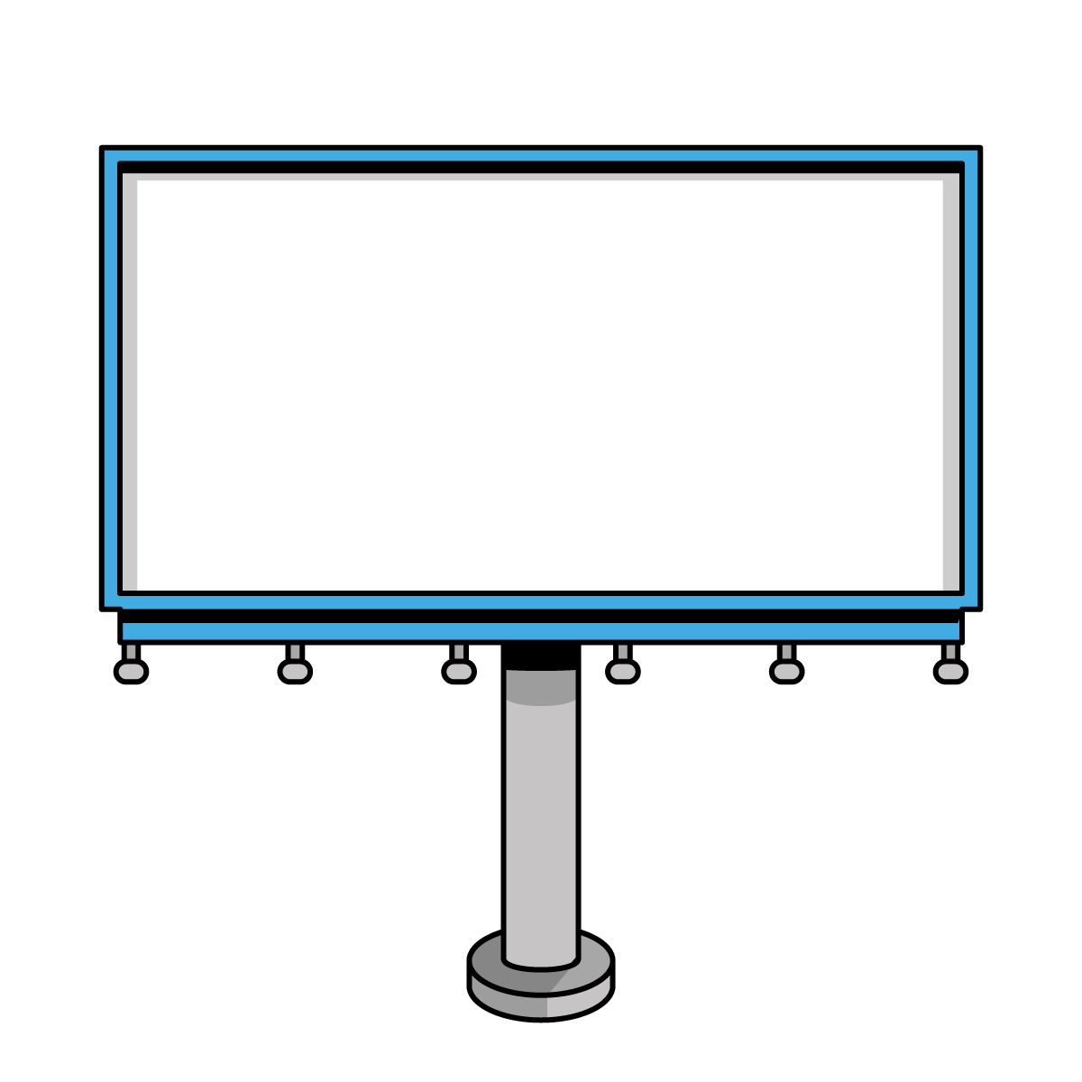
Windi Epperson
Customer Account Manager – Njevity, Inc.
CPA with 25+ Years GP Consulting​
GP All-Star​ and Granite Awards
Helping build products to extend GP
Twitter: @WindiEpperson
wepperson@njevity.com

Slide 4
Agenda
Learn and have fun!

Slide 5
Size Matters
Is this a test?
Could it be any smaller?
It’s a Wrap
To roll or not to roll
Is that original?
I O U
Is it just temporary?
You’re cut off!
Marie Kondo it
A little to the right
Potpourri
Are you taking your name back?
Is it dead?
What’s the origin?
Wah’s UP?

Slide 6
Is This a Test?
Adding <TEST> to the Company Name will cause GP to prompt you with each login letting you know that you’re working in a test company.
This is case sensitive
When adding a test company, consider whether you need all the setup and/or history of your primary company.
It might save a lot of space and effort to create a shell company instead.
You can use PSTL to copy accounts, vendors, etc. from an existing company to a test co.
Don’t forget the script – you must run a script after creating a test company to ensure the test company does not contain references that have the same COMPANYID and INTERID information as the live company.
https://learn.microsoft.com/en-us/troubleshoot/dynamics/gp/set-up-a-test-company

Slide 7
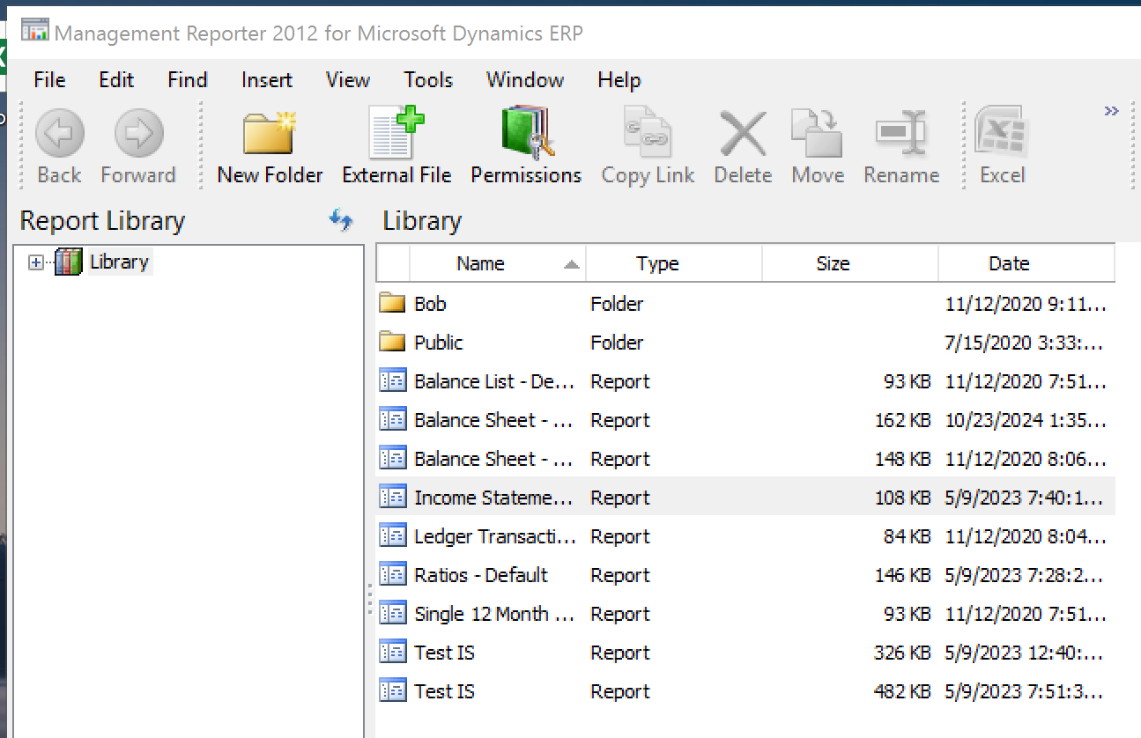
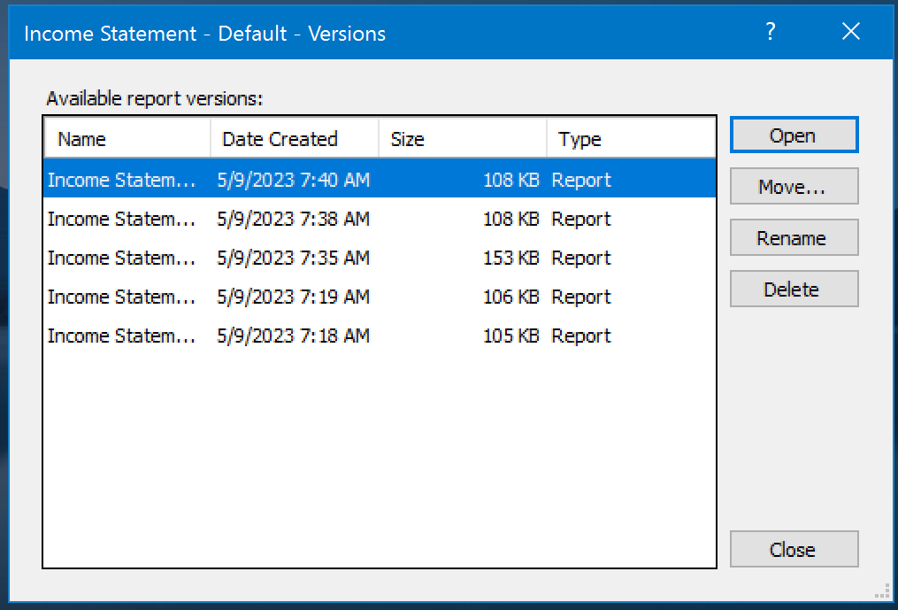
Could it be Any Smaller?
Did you know that Management Reporter saves a copy of every report run every time it’s run?
Your MR database could be very large.
You can remove old versions of reports from within the Report Viewer Library.
Right click on a report & choose Show Versions
There’s a script to remove prior year reports.
(99+) MR clean up old reports - Microsoft Dynamics GP Forum Community Forum
Sometimes it makes sense to delete and rebuild the database.

Slide 8
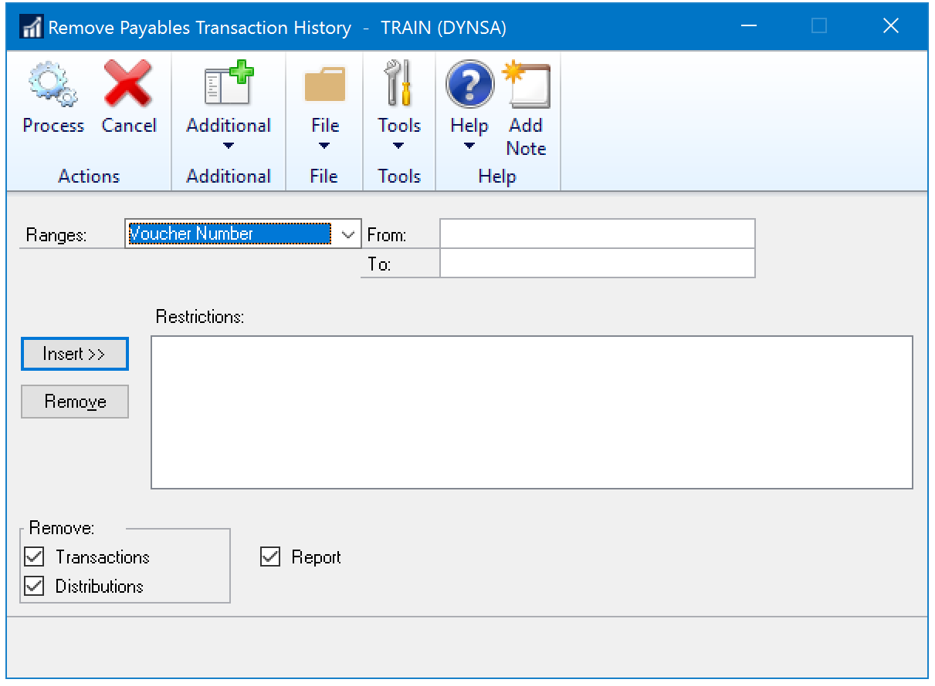
Marie Kondo It
Since GP is such a mature product, many users have 10+ years of data.
All this extra data can cause processes to run slowly.
You can remove history from GP for each module using native utilities.
Check audit requirements.
Make a backup first.
If you need to keep history consider CDA
Company Data Archiver
By Professional Advantage

Slide 9
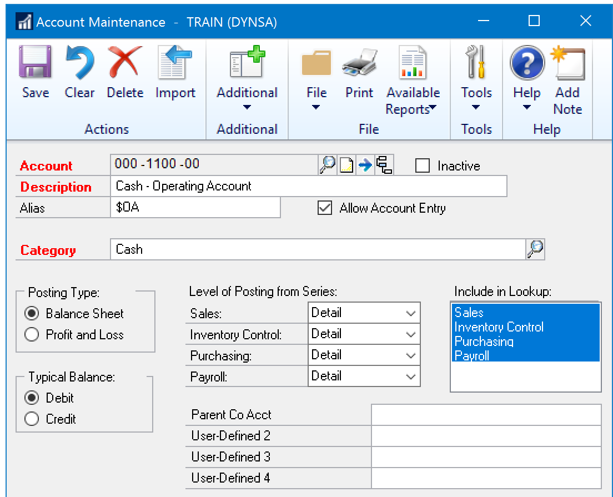
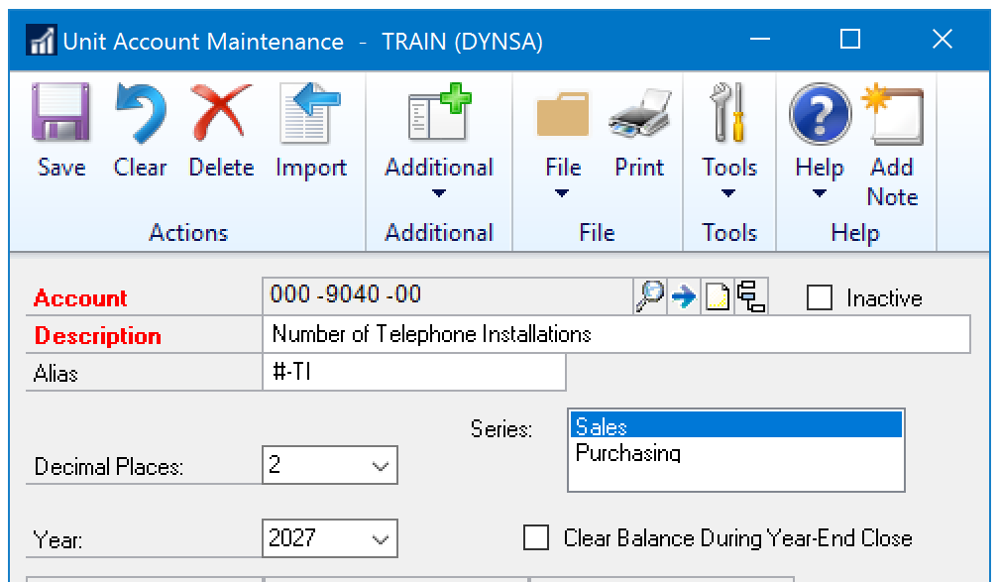
To Roll or Not to Roll
Make sure the account type is set correctly to ensure balances roll forward properly
Set your Unit Accounts to clear or roll
You can post to the last closed year!

Slide 10
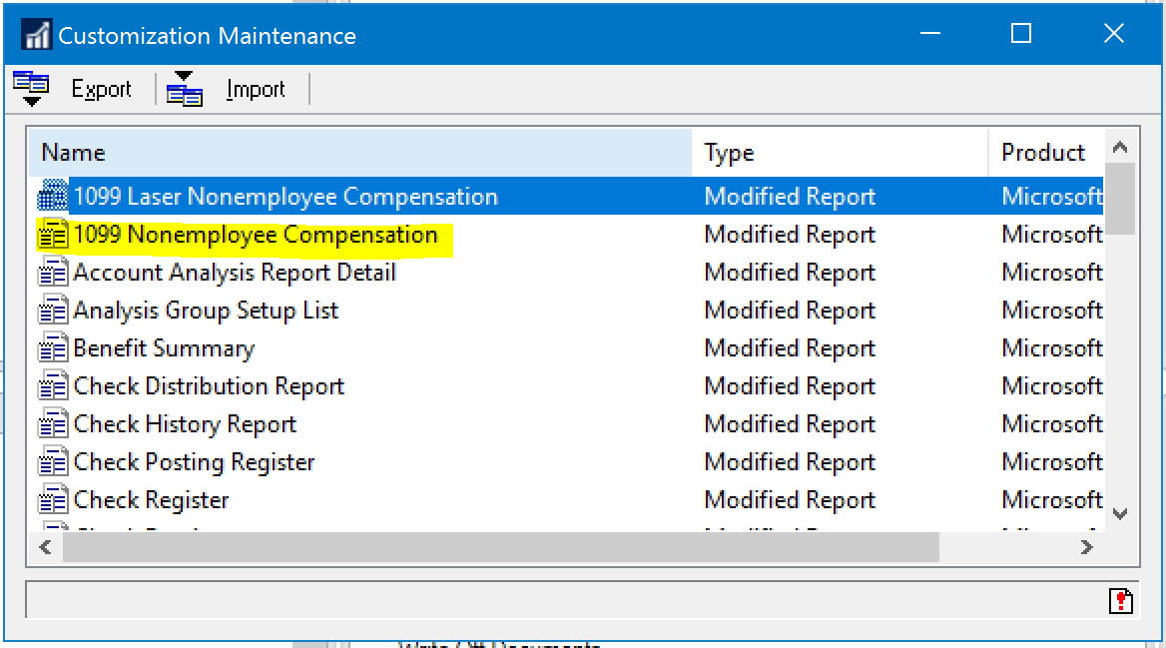
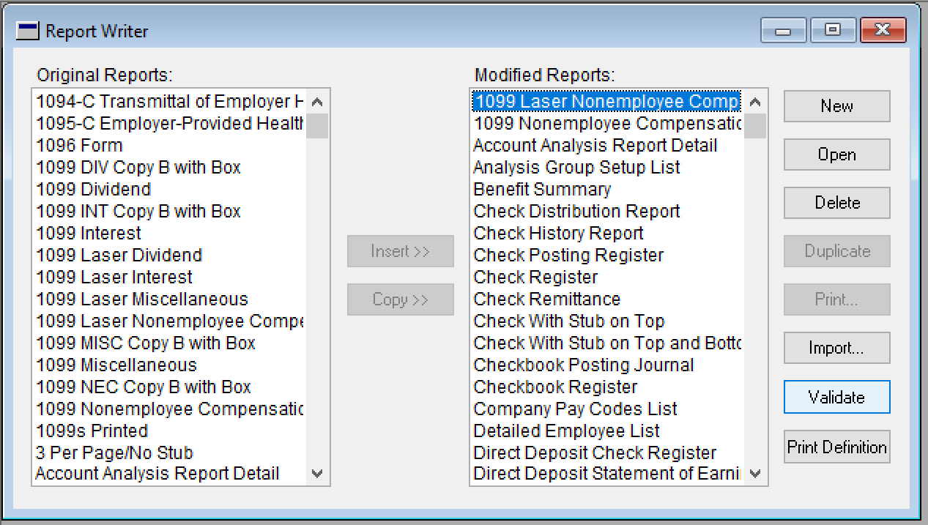
Is that original?
Old versions of modified forms can cause issues.
Check Tools\Customize\Customization
Turn off security to old forms
Alternate/Modified Forms and Reports
Delete them from the modified reports
Tools\Customize\Report Writer\Reports

Slide 11
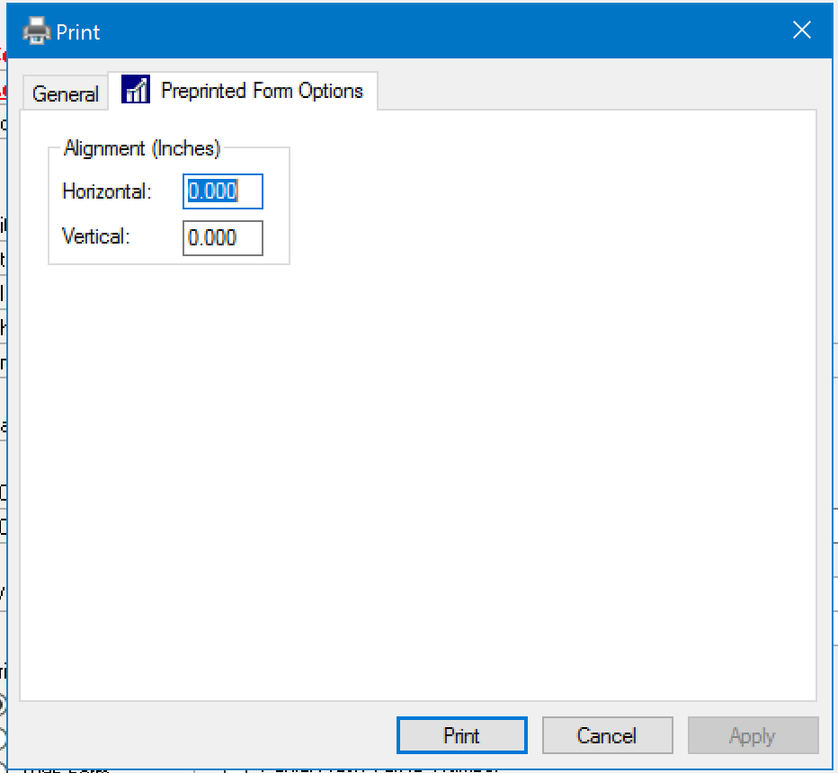
A Little to the Right
1099 Print Alignment
Changes affect all printed forms including checks
The change is saved in the dex.ini file and can be cleared by editing that file.
Example: PRNTALGN HP LaserJet Professional P 1102w=60;90
Remove the printer name and all that follows

Slide 12
Is it Just Temporary?
Vendor Type = Temporary
Can delete the vendor at any time as long as they don’t have a current balance, open invoices, or incomplete purchase orders
The historical transactions are NOT deleted
Historical transactions can be viewed in the Inquiry by Document window but NOT in the Inquiry by Vendor window
If you recreate the vendor, their documents will be re-linked to them and you’ll be able to see them in Inquiry by Vendor
Vendor List Report Type = Temporary
Navigation List to mass delete

Slide 13
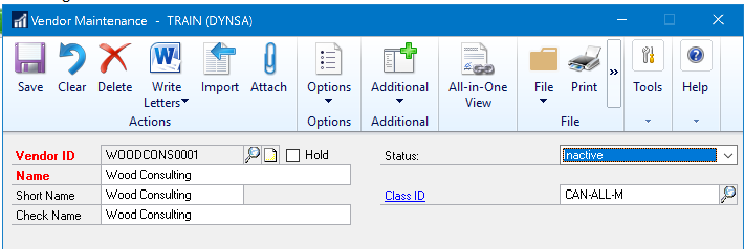
You’re Cut Off
Putting Vendors On Hold
Can’t issue or apply payments
Can still enter new invoices and credit memos
Can still apply credit memos
Inactivate
More permanent
Can’t enter any transactions
Delete
Can delete vendor records with zero balances, no unposted/posted transactions, and no 1099 amounts for the current year

Slide 14
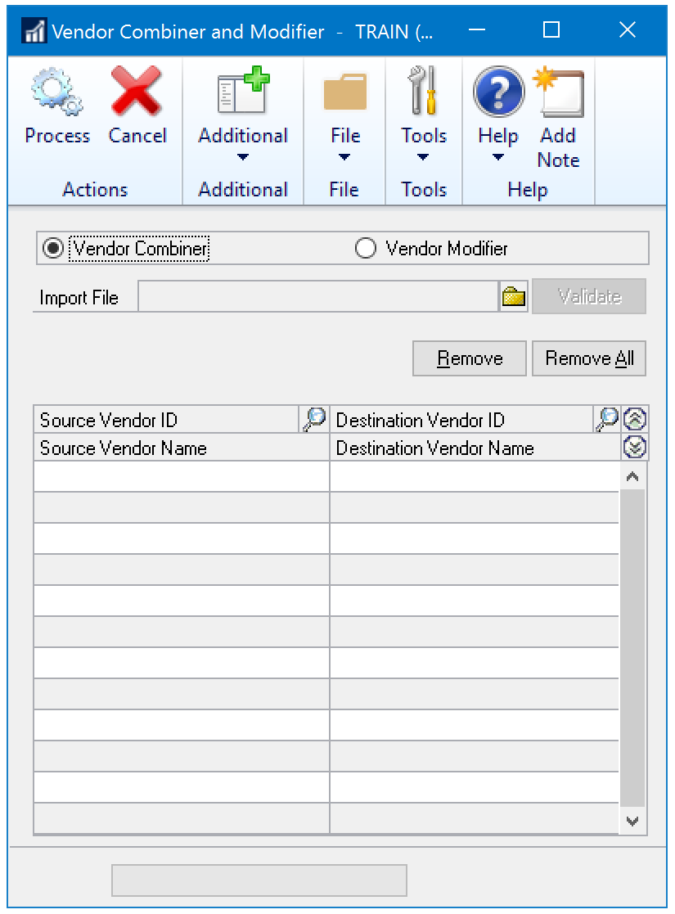
Are You Taking Your Name Back?
Vendor Combiner\Modifier
User must have SQL Server Admin privileges – usually sa or DYNSA
Combine two Vendor IDs
Source Vendor ID is removed
Modify a Vendor ID
Name must be changed in Vendor Maintenance
Can mass change by using the import option

Slide 15
Is It Dead?
You have time to decide!
Modern Lifecycle

Slide 16
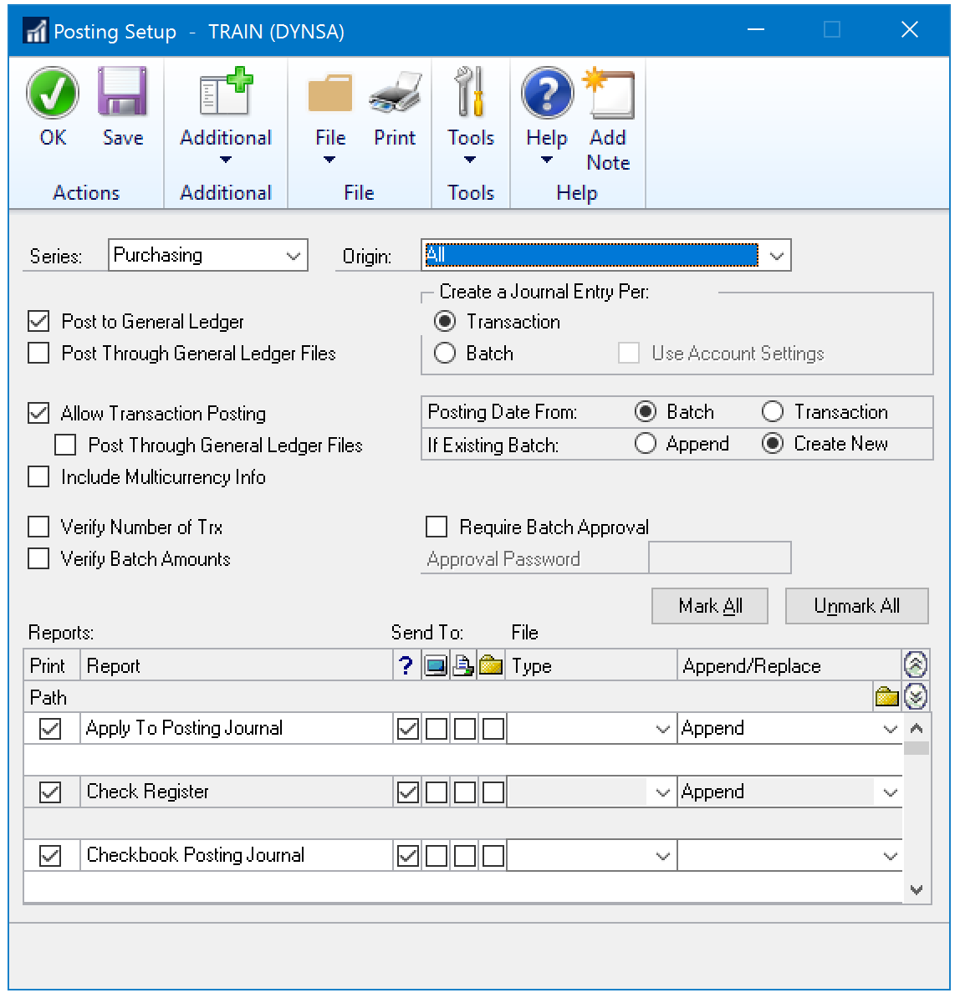
What’s the Origin?
Posting Setup
Tools\Setup\Posting\Posting
NEVER MAKE CHANGES WITH ORIGIN SET TO ALL!
Post To/Through
Transaction Posting
Journal Entry Per
Posting Date From

Slide 17
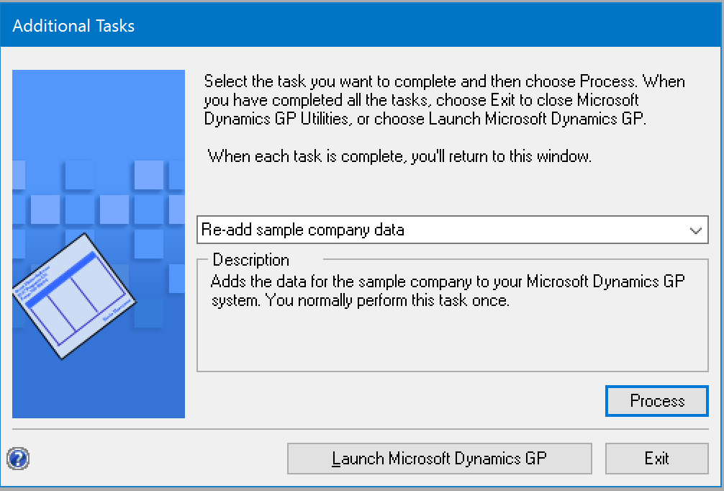
Wah’s UP
Upgrade Considerations
Frequency
Time to clean house
Uninstall unused modules
Remove/Re-add sample company
Remove unused test companies
Check Links
Training

Slide 18
Windi Epperson
Twitter: @WindiEpperson
wepperson@njevity.com
Q&A

