Slide 2
Dynamics GP
DYNAMICS GP IN THE CLOUD

Slide 3
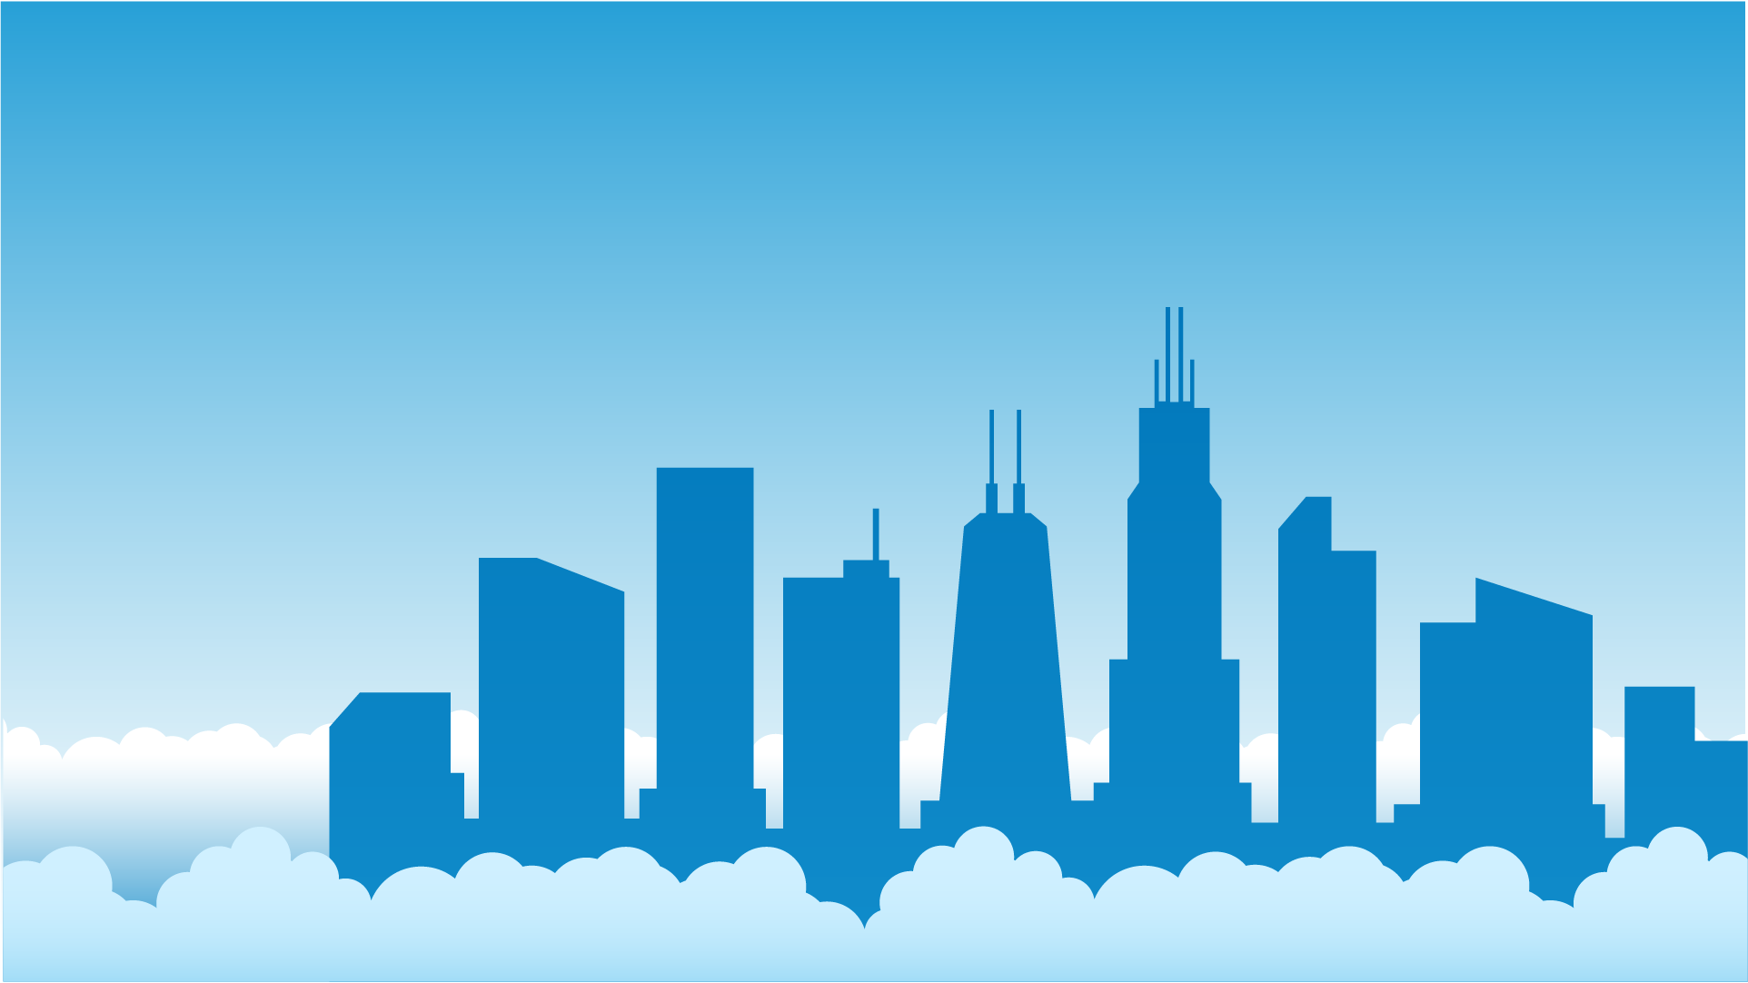
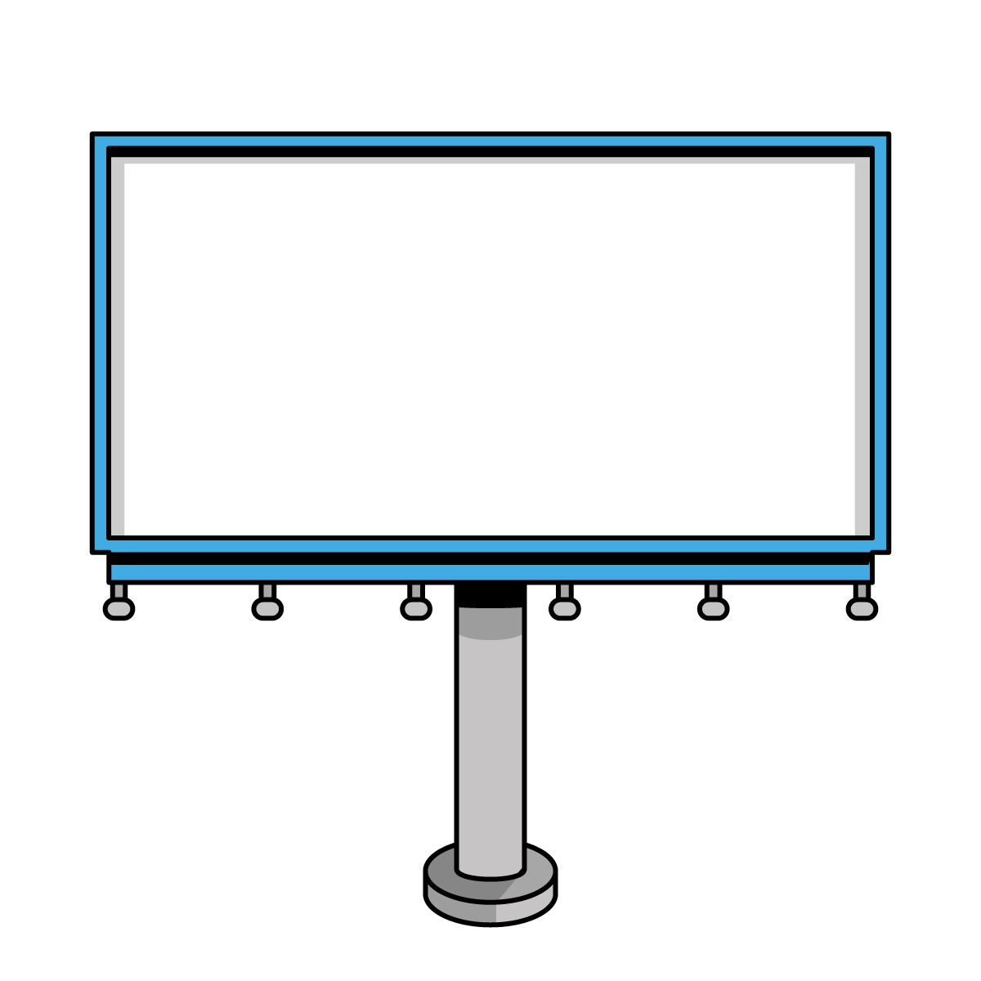
Windi Epperson
Customer Account Manager – Njevity Inc.
CPA with 25+ Years GP Consulting​
GP All-Star​ and Granite Awards
Helping build products to extend GP
Twitter: @WindiEpperson
wepperson@njevity.com

Slide 4
Agenda
Why should I consider moving my GP to the Cloud?
Finding the right cloud for your business
Dynamics GP and Azure
How to move GP to the Cloud
Taking GP to the Cloud vs “Migrating” to another ERP
The Bottom Line

Slide 5
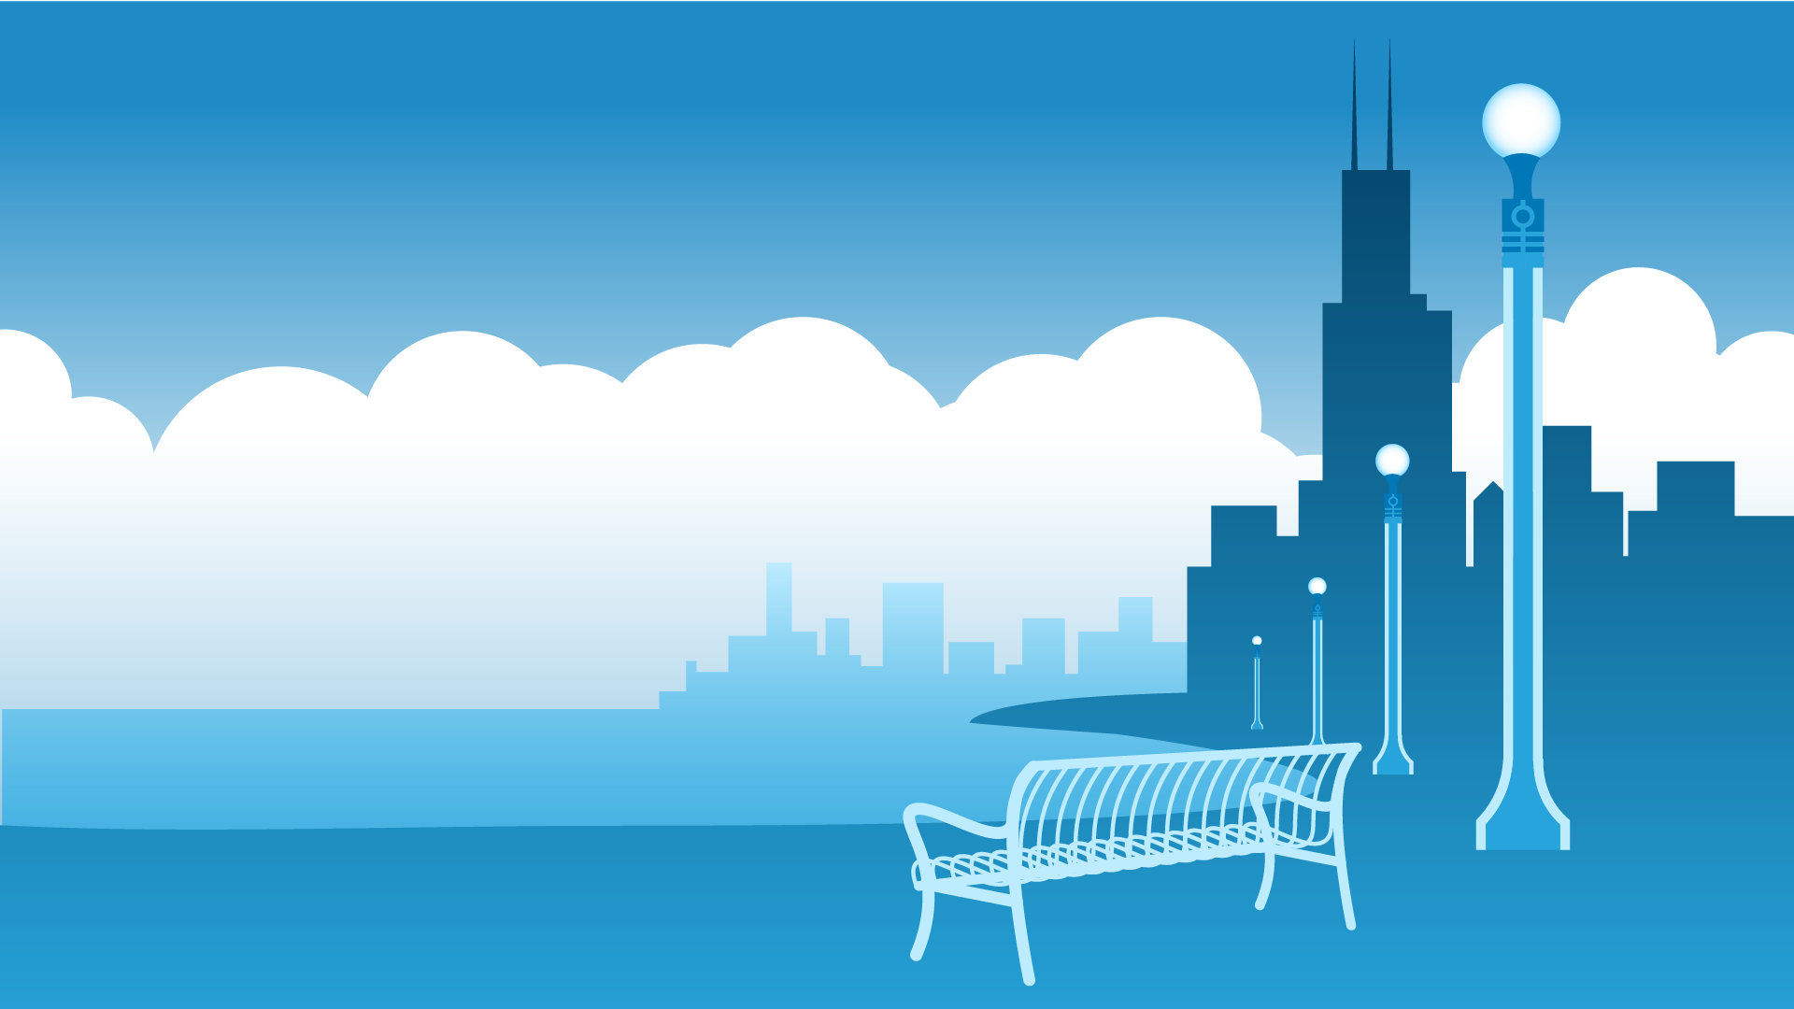
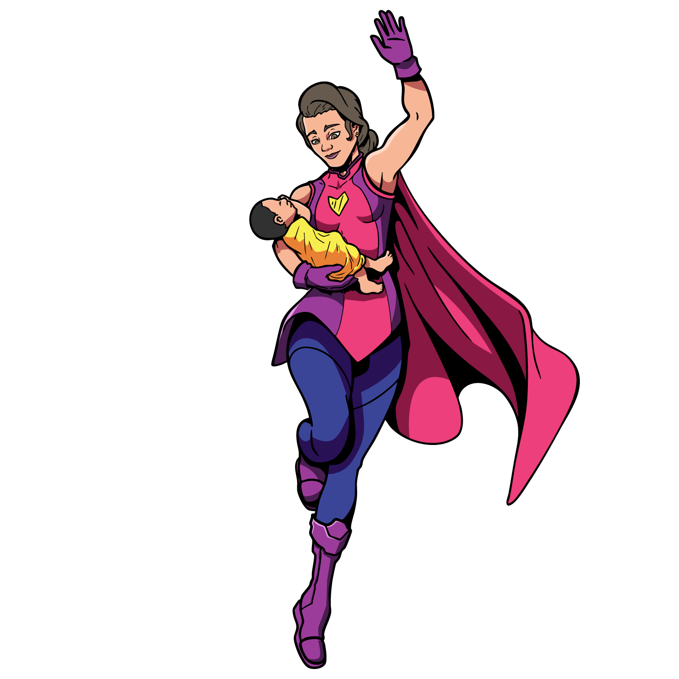
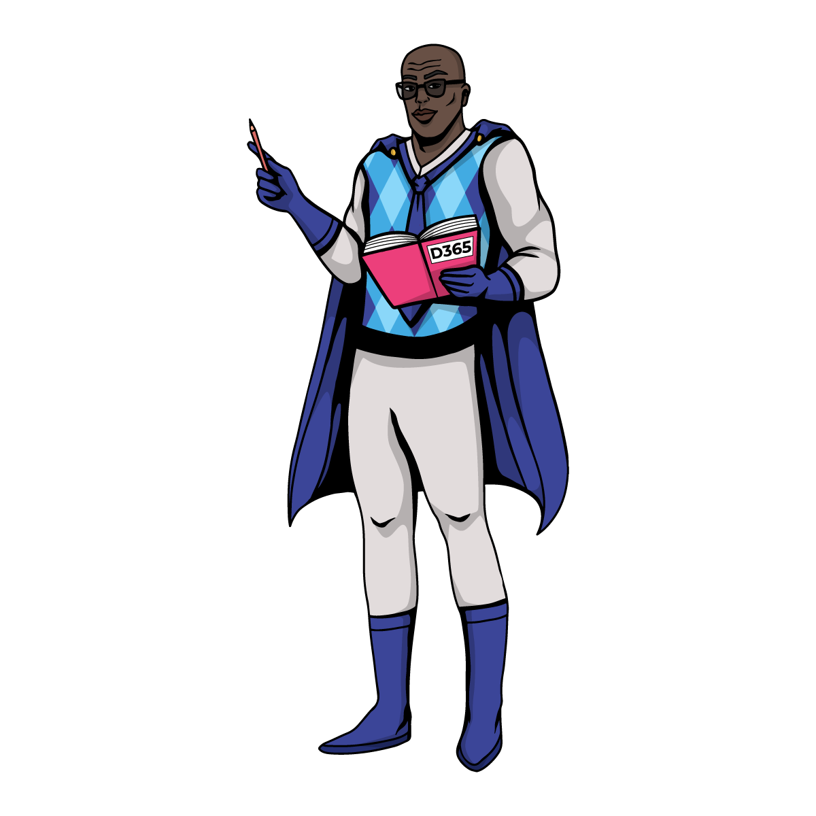
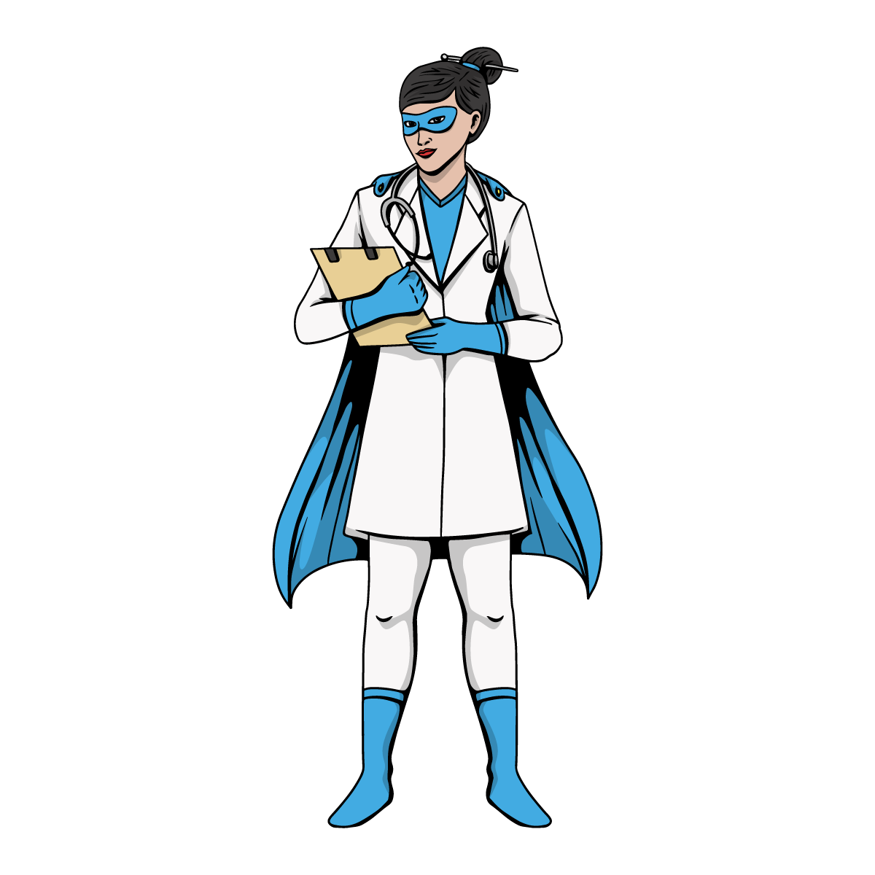
Why should I consider moving to the cloud?

Slide 6
The Dynamics GP Advantage
The BEST Mid-Market ERP in North America
Broad and Deep Functionality
Industry Verticals through our ISV Community
Powerful Reporting and Integration Capabilities
Ability to tune your system to your needs
Public, Private and Hybrid Cloud Options.
On Premises Options
Your Business is already wired up with Dynamics GP!

Slide 7
Why Companies Move GP to the Cloud
The top reasons people want to look at cloud options:
Aging hardware that will need to be replaced
Lack of internal IT
Access from anywhere
Cybersecurity

Slide 8
The World has become a Scary Place
In 2020, 6.95 Million new Phishing pages created
In 2021, $1.2B in Bank Secrecy Act filings for Ransomware attacks
In 2022:
Average ransomware payment was $812,360
Spear Phishing increased by 127%
Executive Impersonation increased by 344%
Chat Bots are going to make it harder to identify fraudulent emails
State Sponsored Hacking
Ransomware-as-a-Service

Slide 9
Types of Clouds – Public Cloud
Definition: A public cloud is a cloud computing environment where services like servers, storage, and applications are delivered over the internet by third-party providers (e.g., Microsoft Azure, Amazon Web Services, Google Cloud). These resources are shared among multiple customers—called multi-tenancy.
Key Features:
Scalability: Easily scales up or down based on demand.
May require extensive configurations for uptime guarantees
Cost: Pay-as-you-go pricing model—no need to invest in hardware.
May have to pay for data processed and data movement
Managed Infrastructure: The cloud provider handles hardware maintenance, updates, and uptime.
Some updates may be done at the will of the provider and can’t be scheduled
Accessibility: Access services from anywhere with an internet connection.
Use Case Example: Hosting Dynamics GP on Microsoft Azure—you don’t own the servers but rent computing power and storage in a secure Microsoft-managed data center.

Slide 10
Types of Clouds – Private
Definition: A private cloud offers the same advantages as a public cloud—virtualized resources and scalability—but is dedicated to a single organization. It can be hosted on-premise or by a third-party provider.
Key Features:
Single-Tenant Environment: Greater control over resources, configurations, and security.
Customization: More flexibility for compliance and complex workloads.
Higher Cost: Requires more investment in infrastructure or a third-party host.
Enhanced Security: Ideal for industries with strict data regulations (e.g., healthcare, finance).
Use Case Example: A company hosts Dynamics GP in a third-party datacenter, fully managed but reserved solely for that company's use.

Slide 11
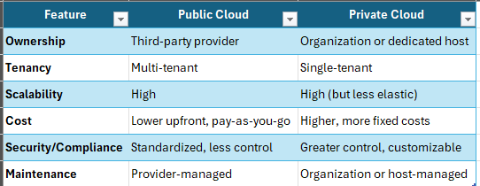
Summary

Slide 12
Can I run Dynamics GP in Azure or AWS?
The short answer is YES
400 Dynamics GP User Deployment
Agriculture / Food Processing Industry
Customer had Zero Downtime Requirement
Worked closely with Dynamics and Azure Teams
100% Commitment to the Microsoft Cloud
Office365
Power BI
We have built both Public and Hybrid Cloud models on/with Azure.
Small Deployment
Oil & Gas Related
Multiple Servers
Environment setup/maintained by customer
Remote access via published apps
Power BI

Slide 13
Questions to Ask
What are the uptime guarantees and how do they work?
How many servers are needed?
How is the configuration done?
Do Logins/Passwords sync between the SQL Servers
What are the licensing considerations?
You must be current on your Dynamics GP Enhancement Plan
Not all of the Licenses you own can be used in the Cloud
Remote Desktop CALs are not included with Azure
Office 365 on Remote Desktop Servers requires an Enterprise Plan

Slide 14
Managed Services are NOT Included
You are responsible for:
Backups
Patch Management
Monitoring
Redundancy and Uptime
Securing your Remote Desktop Servers
Cyber Security
Incident Response

Slide 15
How to Move GP to the Cloud?
Upgrading to the Cloud
Similar to a SQL Server Move
The Cloud is your Test Environment
Roll Back to On Premise
Light Up New Tech Heavy Features
What you need
SQL Database Backups
MR Export
IM.MDB
VPN or SFTP for Integrations with On Premises Data
Go Live
Light Up New Features
Build Cloud Environment
Copy SQL Backups
Upgrade
Validate

Slide 16
Migrating to Another ERP
Whole new product
Whole new implementation
Not all of your data migrates
You have retrain your employees
You have to redesign your Processes
Minimum of 80-100 hours for the basics
ISVs? Integrations? Reports?

Slide 17
The Bottom Line
Taking GP to the Cloud
You DO Keep ALL of:
Your Data
Your ISV Solutions
Your Integrations
Your Reports
Your business processes
You DO NOT have a painful, expensive implementation project

Slide 18
The Bottom Line
No More worries
Servers
Hard Drives
Backups
Cyber Security
Anti-Virus and Anti-Malware
No more costly Workstation Installs
Use GP from Anywhere with Internet Access

