Slide 2
Get started with Power Virtual Agents Copilot Studio
Sharon Weaver, RD, MVP, MCT
https://copilotstudio.microsoft.com/
https://learn.microsoft.com/en-us/training/modules/power-virtual-agents-bots

Slide 3
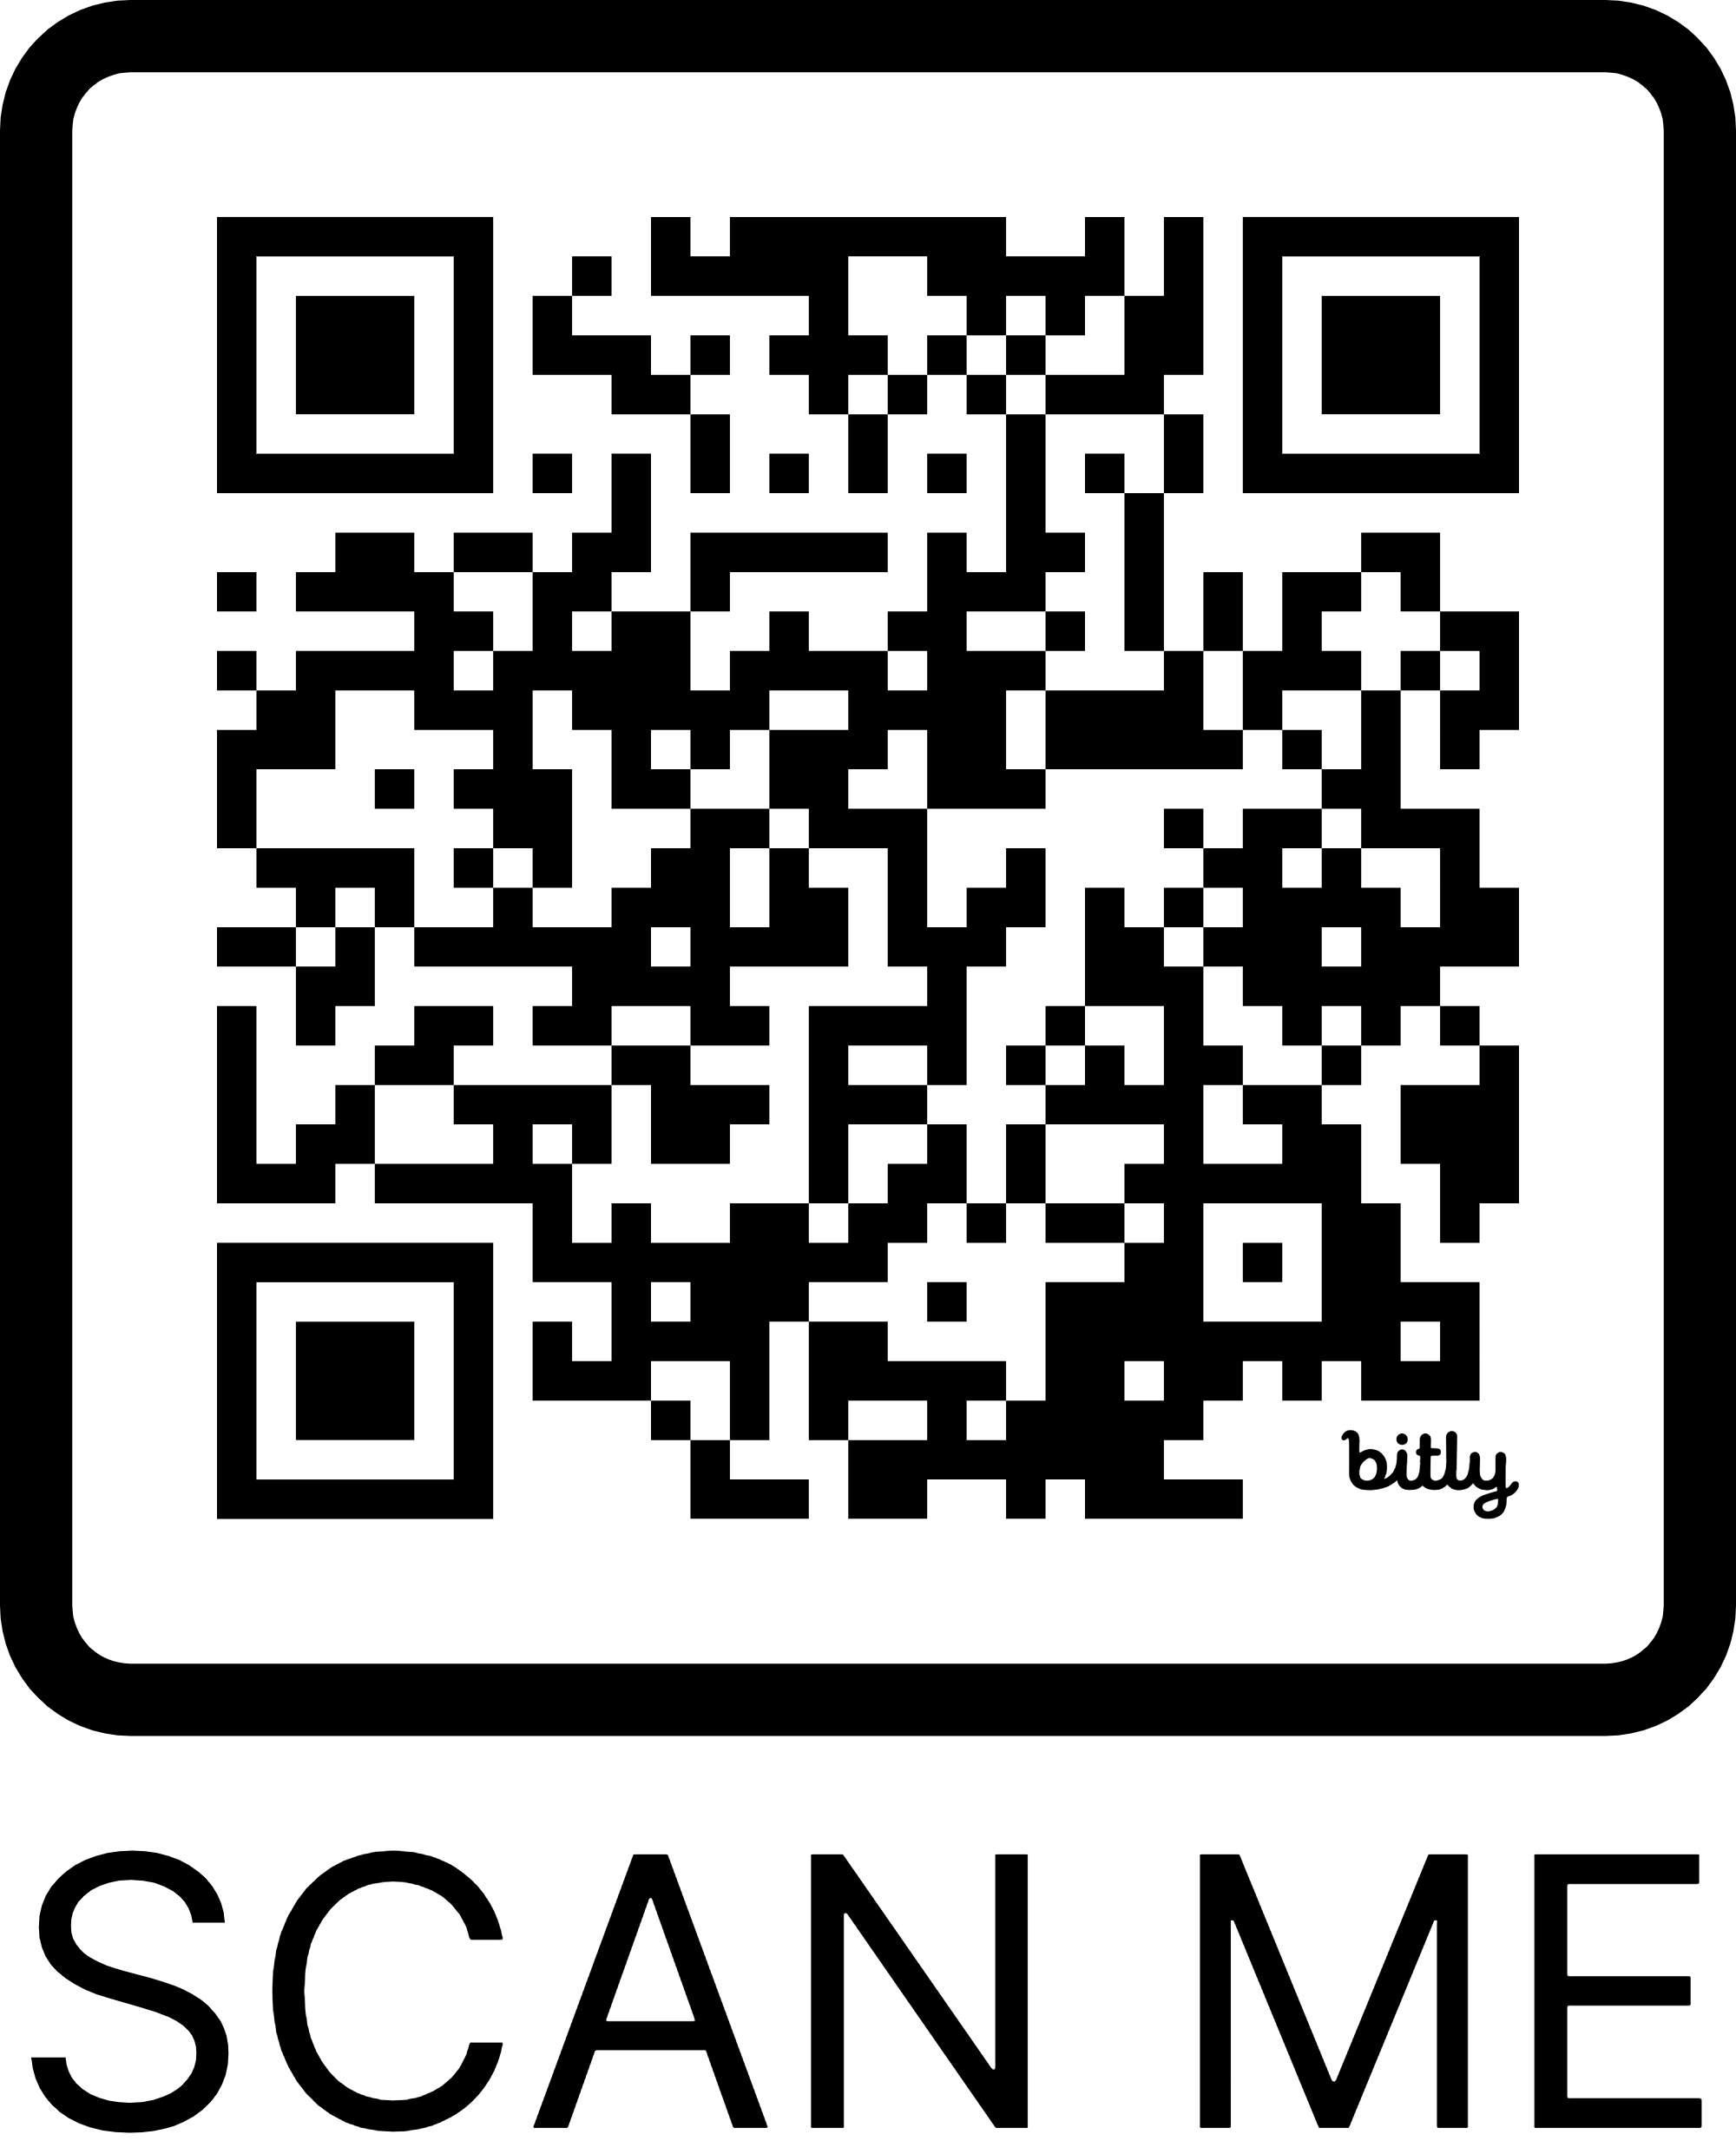
Sharon Weaver
Founder and CEO of Smarter Consulting
30+ years designing, developing, and managing technical solutions
Microsoft RD, MVP, MCT
Microsoft Learn Expert
Microsoft MGCI Board Member
Business & Systems Analysis Certified
Six Sigma Black Belt
sweaver@smarter-consulting.com
@sharoneweaver
Bit.ly/SCContactUs

Slide 4
What is
Copilot Studio?

Slide 5
What is Copilot Studio?
Copilot Studio lets you create powerful AI-powered chatbots…copilots…agents for a range of requests—from providing simple answers to common questions to resolving issues requiring complex conversations, interactions, or integrations.

Slide 6
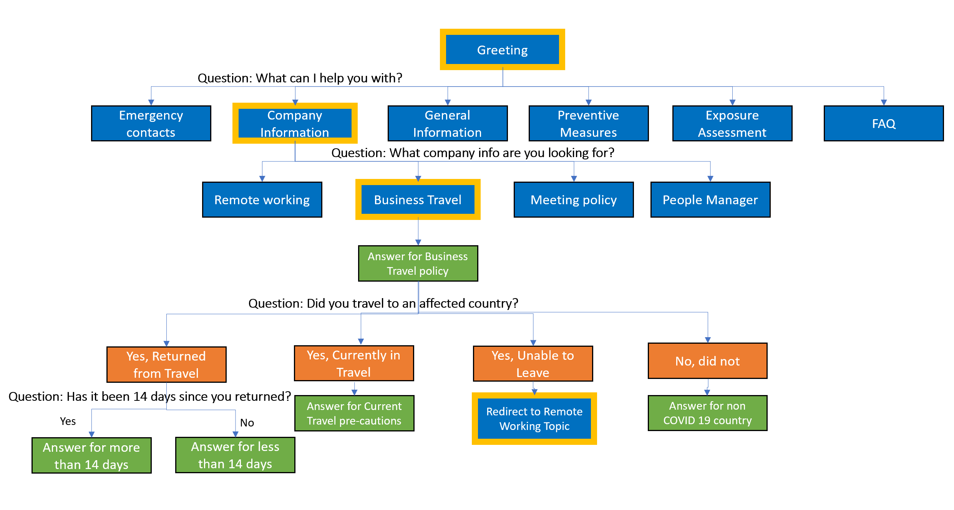
2020 Power Virtual Agent Chatbots
A conversational interface to answer questions or guide users through predefined flows
Simple keyword driven questions with prompt responses.
Example:
User: Hello
Response: Good morning, how can I help?
User: Reset my password
Response: ok OR ERROR
All prompts and responses entered manually.
Limited integration via Power Automate or APIs

Slide 7
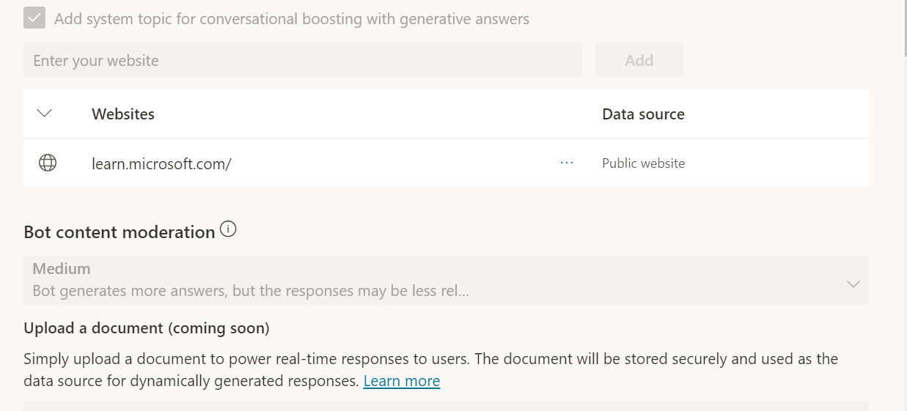
2024 Copilots
The beginning of generative AI assistance using NLP and existing content sources
Example:
User enters - How do I build a Copilot?
Response - Step based answer sourced from a defined and specific content source

Slide 8
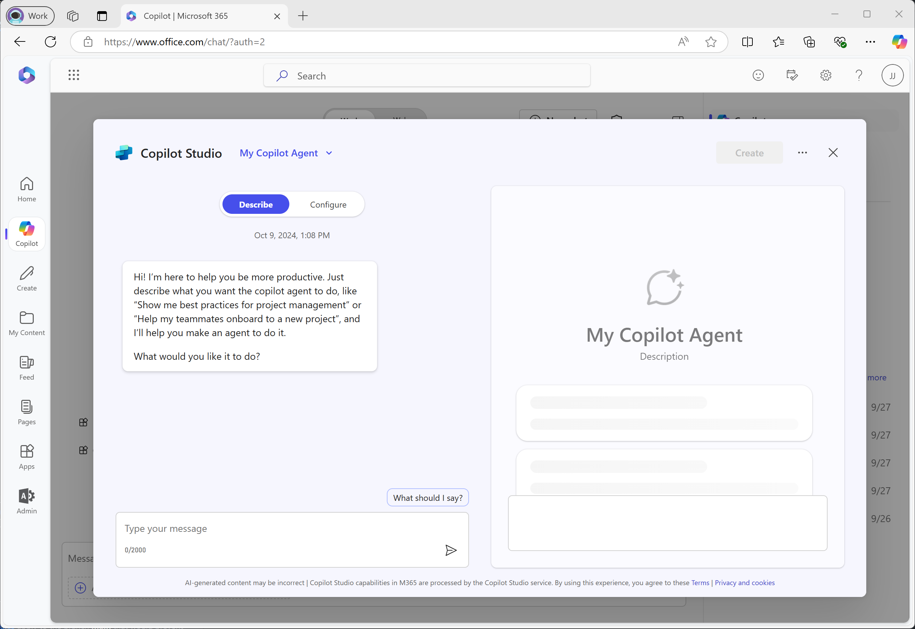
2025 Agents
A task-oriented AI entity that can reason, take autonomous action, and coordinate steps and tools to reach a goal.
Example:
User: Please onboard John Smith
Response: I’d be happy to help with that. The onboarding process for John Smith is complete. You can find the report with more information…

Slide 9
Create a new agent
Create a new agent by selecting Create agents
Agents can be created in separate environments.
By default, all copilots will be created in the default Power Apps environment for your organization or tenant, unless otherwise specified.
You can choose which environment that you want to use by selecting more options to see a list of available environments.

