Slide 2
Introduction to BC Manufacturing
Andrew Good CEO Liberty Grove Software

Slide 3
About Andrew
CEO at Liberty Grove Software
24 years working with Business Central
Professional Engineer
Microsoft Certified Trainer
Love to Sail

Slide 4
Overview
Learn the building blocks of BC Manufacturing. We will review BC terminology, and the concepts of how to describe a manufacturing operation. This will include Bills of Materials, Routings, and how to tie them together. This is great way to get a base understanding of your options in BC.

Slide 5
Learning Objectives
Learn BC terminology
Learn what Flushing is and how to use it
What are some common challenges and how to avoid them

Slide 6
Agenda
BC Terminology
BC Building Blocks
Anatomy of a Production Order
Gotchas

Slide 7
BC Terminology
Base BC
Posting
Previewing
Ledger Entries
List
Card
Report

Slide 8
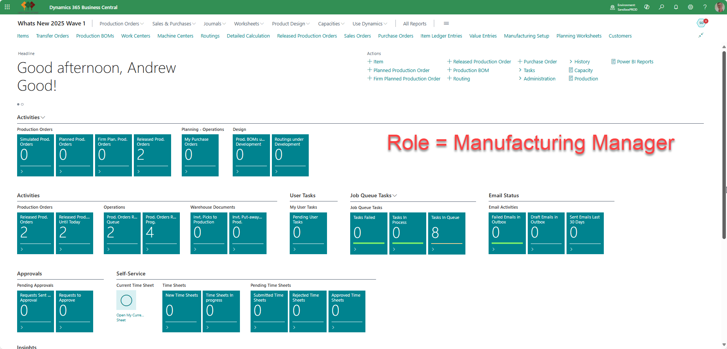
BC Terminology
Manufacturing and Master Data
Item
Stockkeeping Unit
Bill of Materials
Work Center
Machine Center
Routing
Item Tracking
Reservations
Location
Calendar

Slide 9
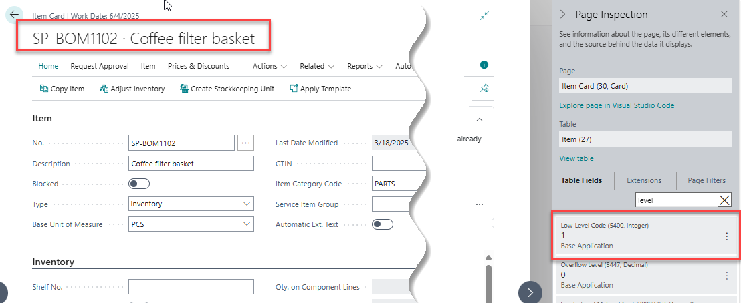
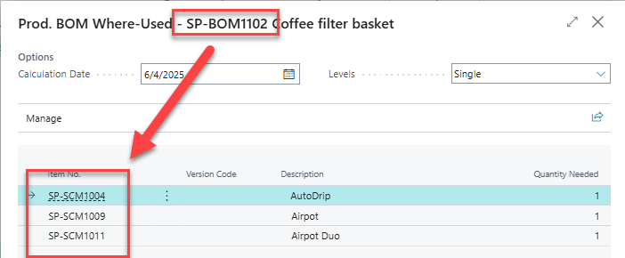
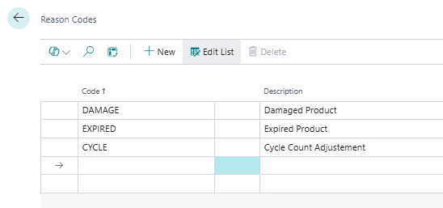
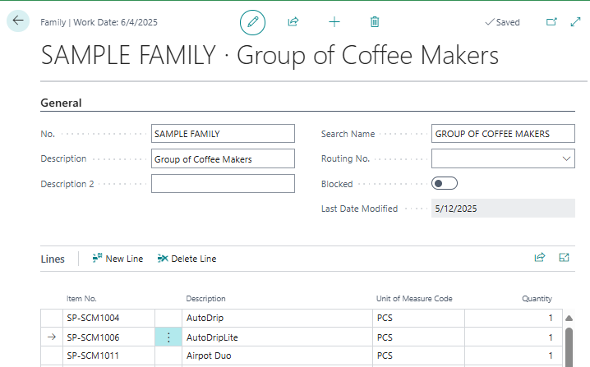
BC Terminology
Manufacturing (cont.)
Low Level Code
Where Used
Reason Codes
Families

Slide 10
BC Terminology
Transactions
Production Order Types
Item Ledger Entries
Value Entries
Capacity Ledger Entries
Consumption
Output
Production Journal
Item Journal
Capacity Journal

Slide 11
BC Terminology
Planning
Planning Worksheet
Requisition Worksheet
Demand Forecast
Subcontractor Worksheet

Slide 12
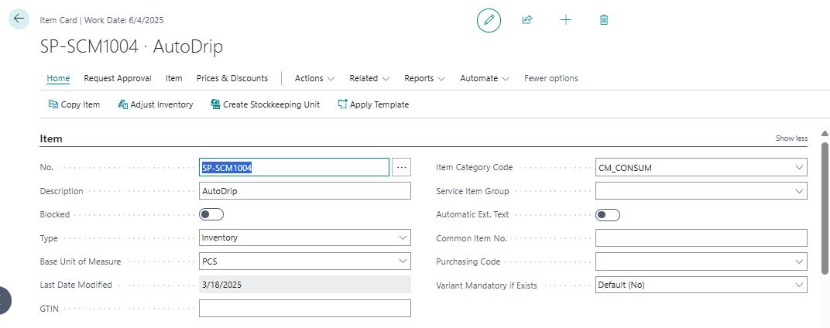
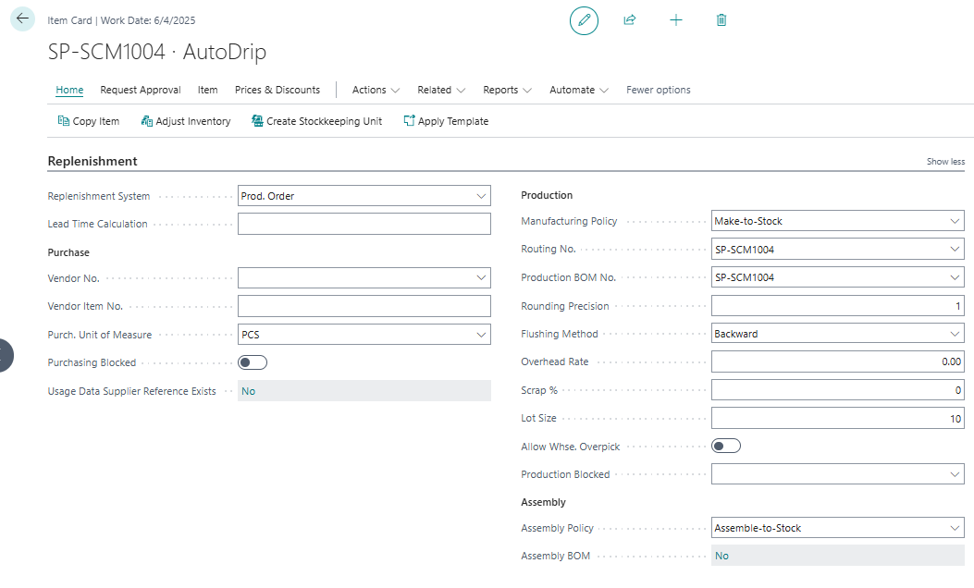
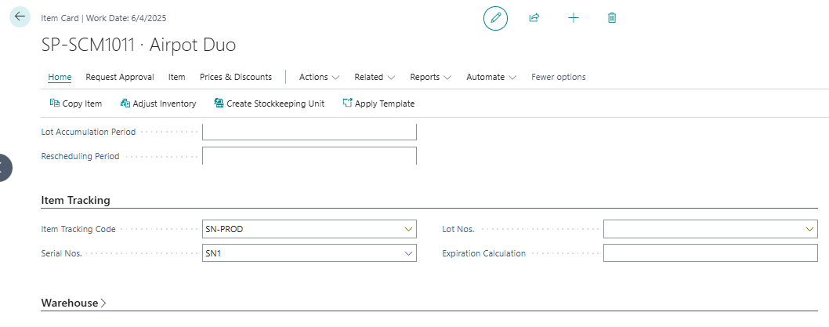
Building Blocks - Items
General
Replenishment
Planning
Item Tracking

Slide 13
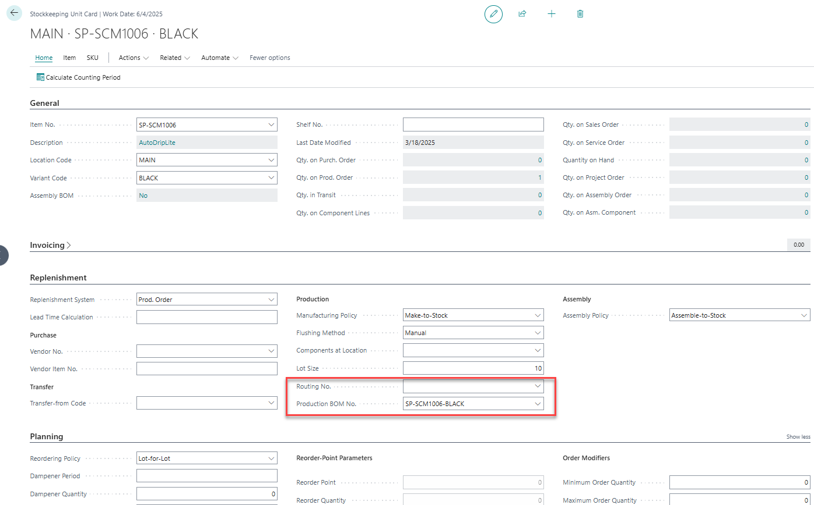
Building Blocks – Stockkeeping Units
Location/Variant Specific details
Costing
Replenishment
BOM
Routing
Blocking

Slide 14
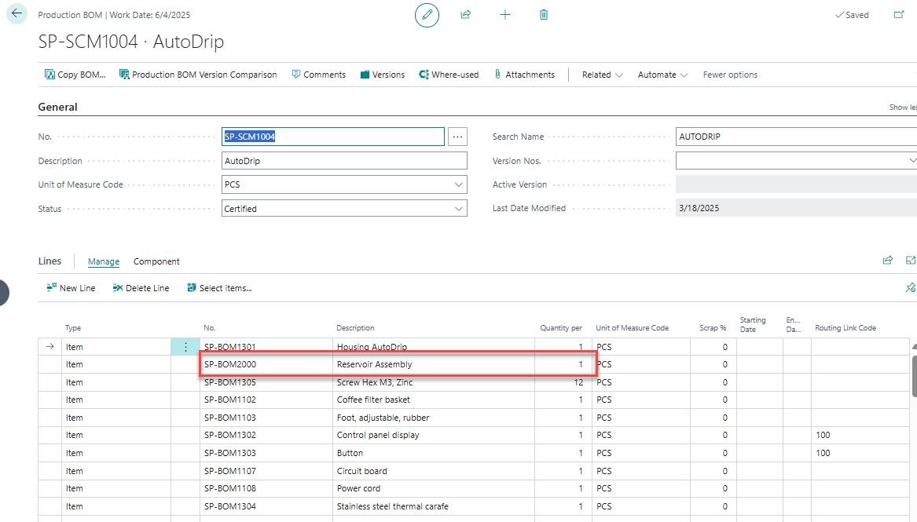
Building Blocks – Bills of Material
List of components needed
Flat (one level)
Indented (using sub-assembly items)
Indented (using Production BOMs)
Low Level Codes

Slide 15
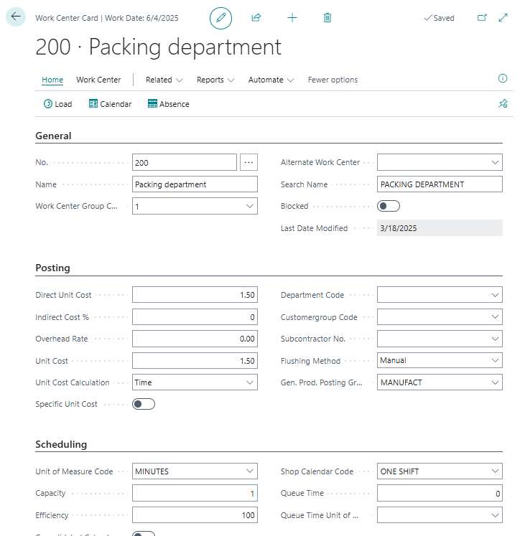
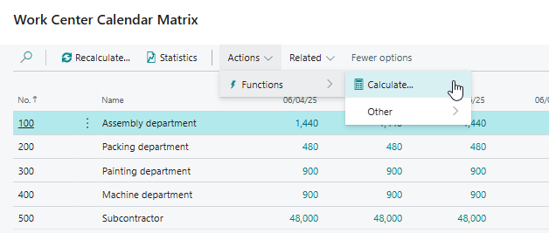
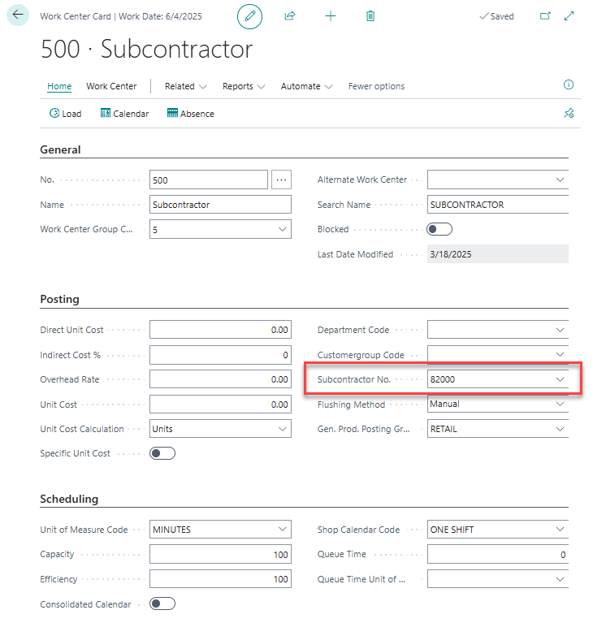
Building Blocks – Work & Machine Centers
Where work is performed
Costing
Time
Per Unit
From Routing Line
Available time
Subcontacting

Slide 16
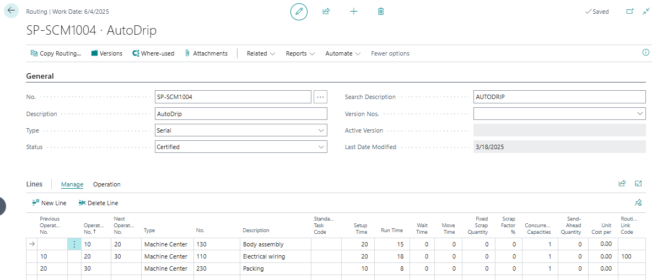
Building Blocks – Routings
Defines the path that an item takes through a factory
Costs
Time Needed
Costed
Setup
Runtime
Non-Costed
Wait
Move
Queue

Slide 17
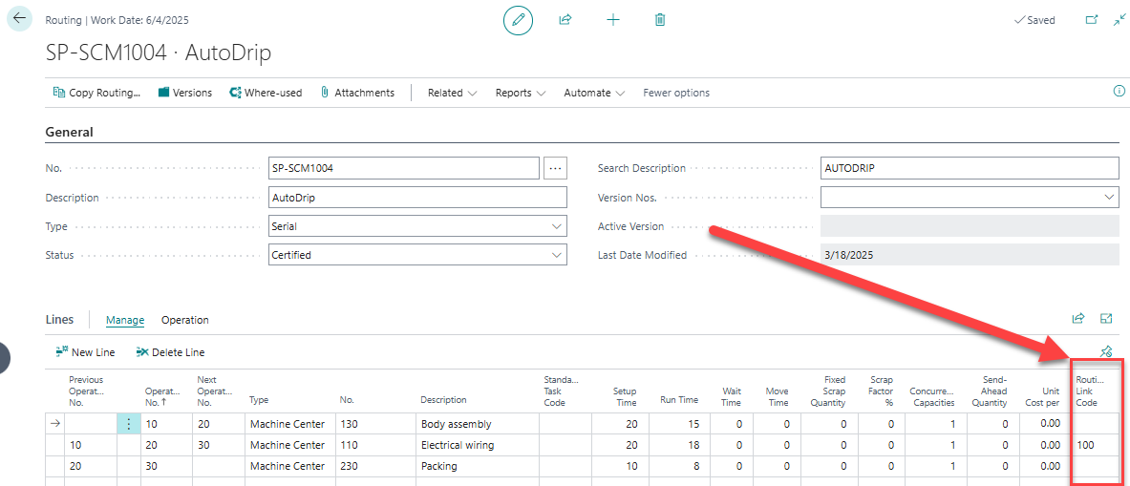
Building Blocks – Routing Link Codes
Used to link a Routing operation to related component
Planning
Flushing

Slide 18
Consuming Items and Capacity
Flushing
Manual
Backward
Forward
Pick + Forward
Pick + Backward

Slide 19
Costing Implications
Standard
All costs are either assigned or rolled up from assigned costs. The are fixed and do not vary from transaction to transaction
FIFO
The costs are system assigned to layers of inventory. BC will consume the oldest inventory first with its cost, then it will consume the next newest layer of inventory with its related cost…
Average
The costs are system calculated. Each time inventory is increased the system will re-calculate the average cost and revalue all remaining inventory.

Slide 20
Production Order Types
Simulated
Planned
Firm Planned
Released
Finished

Slide 21
Production Order Flow
Planning/creation
Weeks in advance
Sequencing
Releasing
Running
Review
Finish

Slide 22
Gotchas
Editing BOMS when Component Item has multiple UOM
Production Orders take snapshots
What gets validated when editing

Slide 23
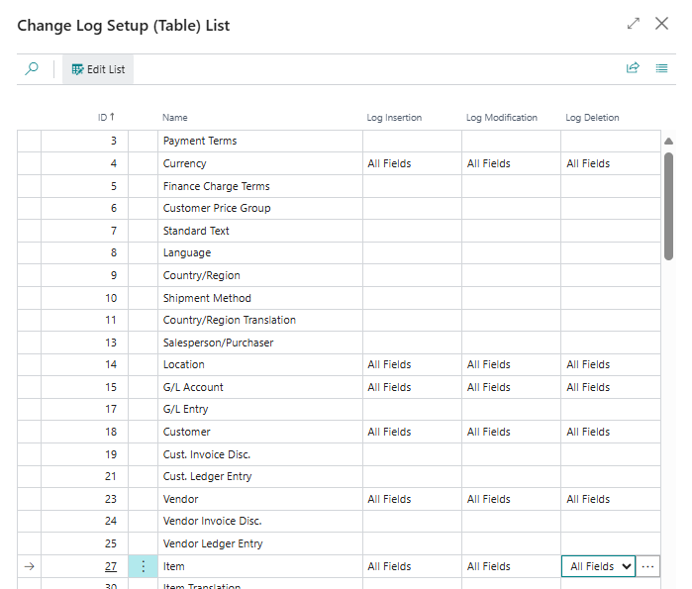
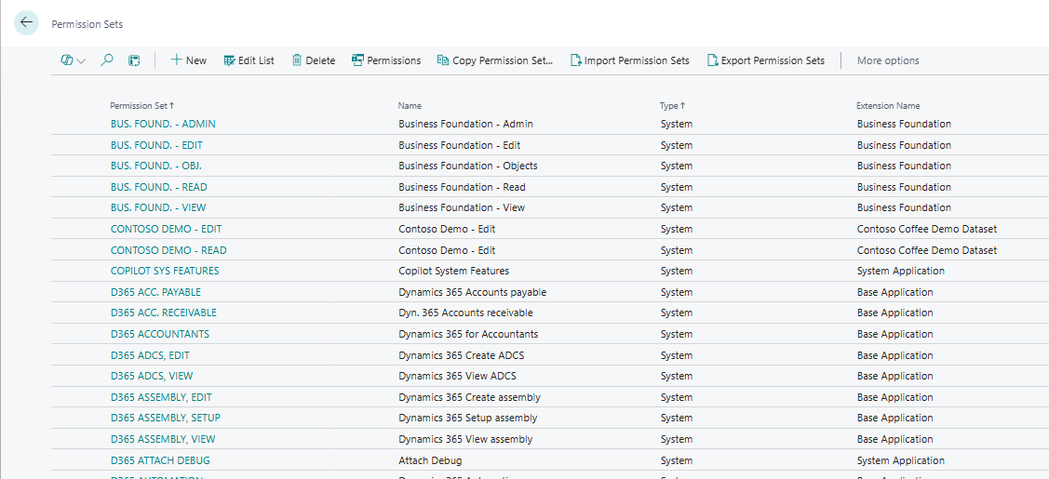
Take Aways
Change Log
Permissions
Design Changes
Task Lists
Subcontracting
Components at Location

Slide 24
Coming Up in BC 2025 Wave 1
Report Improvements
Omit warehouse pick for Manual Flushing methods
Block items or variants from production output
Production Order output with warehouse put-aways
Reopen Finished Production Order
Print bar codes from Production
Manage Document Attachments
Edit in Excel for Item, Output and Consumption Journals

Slide 25
References
https://Centralq.ai - ask BC related questions
https://aka.ms/BCManufacturingAnalytics - PowerBI for Mfg
https://www.linkedin.com/feed/update/urn:li:activity:7310034914467336193 – Manufacturing Costs
https://learn.microsoft.com/en-us/dynamics365/release-plan/2025wave1/smb/dynamics365-business-central/planned-features - Release Notes

Slide 26
Thank You!
Andrew Good
agood@libertygrove.com

Slide 31
Thank You!
Andrew Good
agood@libertygrove.com

Slide 32
THE ELEMENTS AND BACKGROUNDS ON THE FOLLOWING PAGES CAN BE COPIED AND PASTED INTO YOUR SLIDES.​ VISIT DYNAMICSCON.COM TO DOWNLOAD MORE.

Slide 34
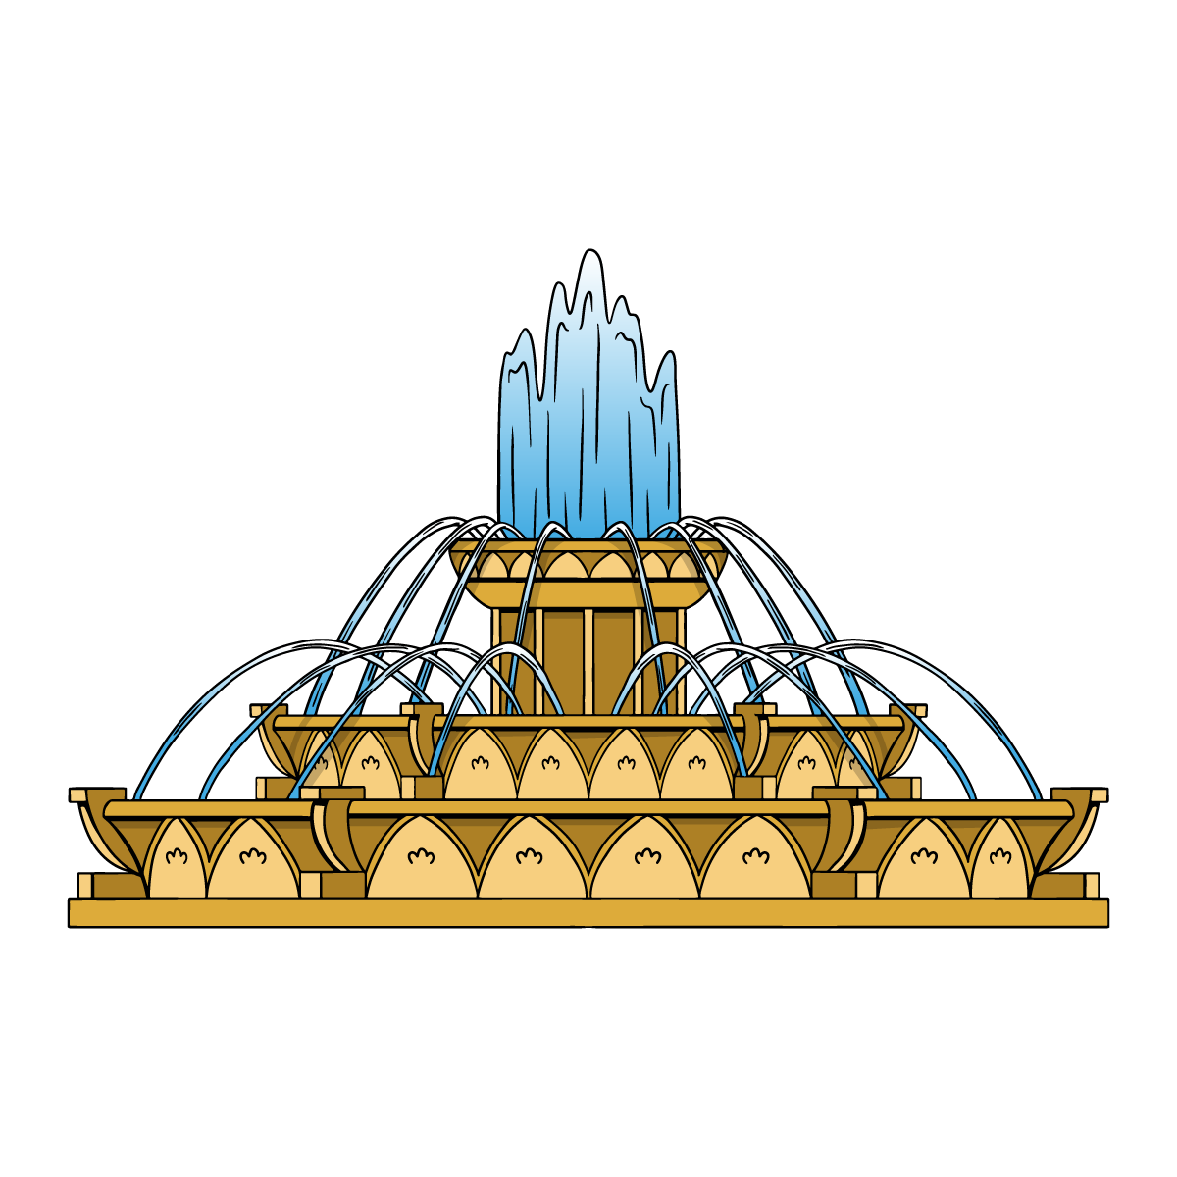
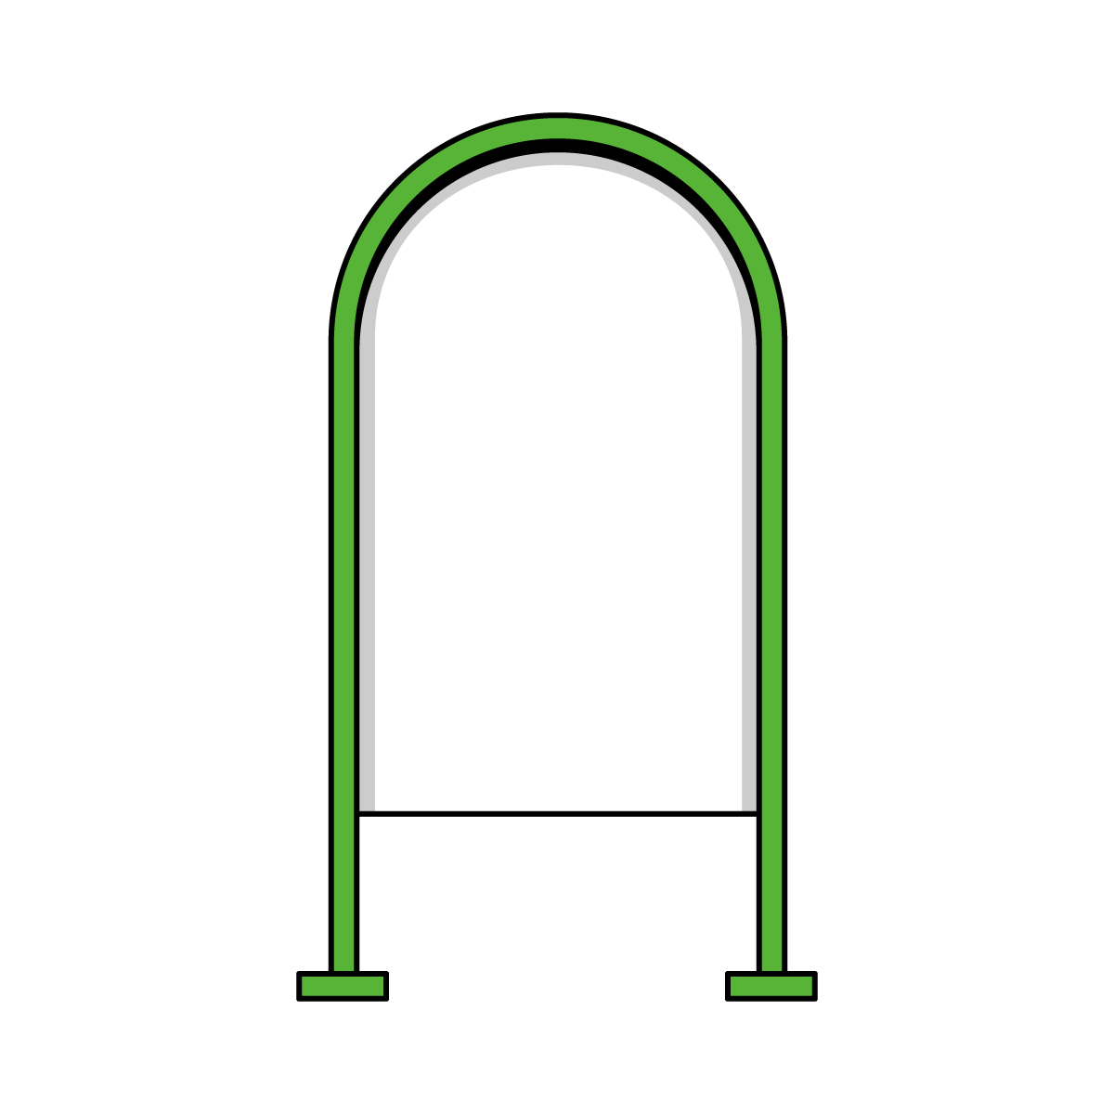
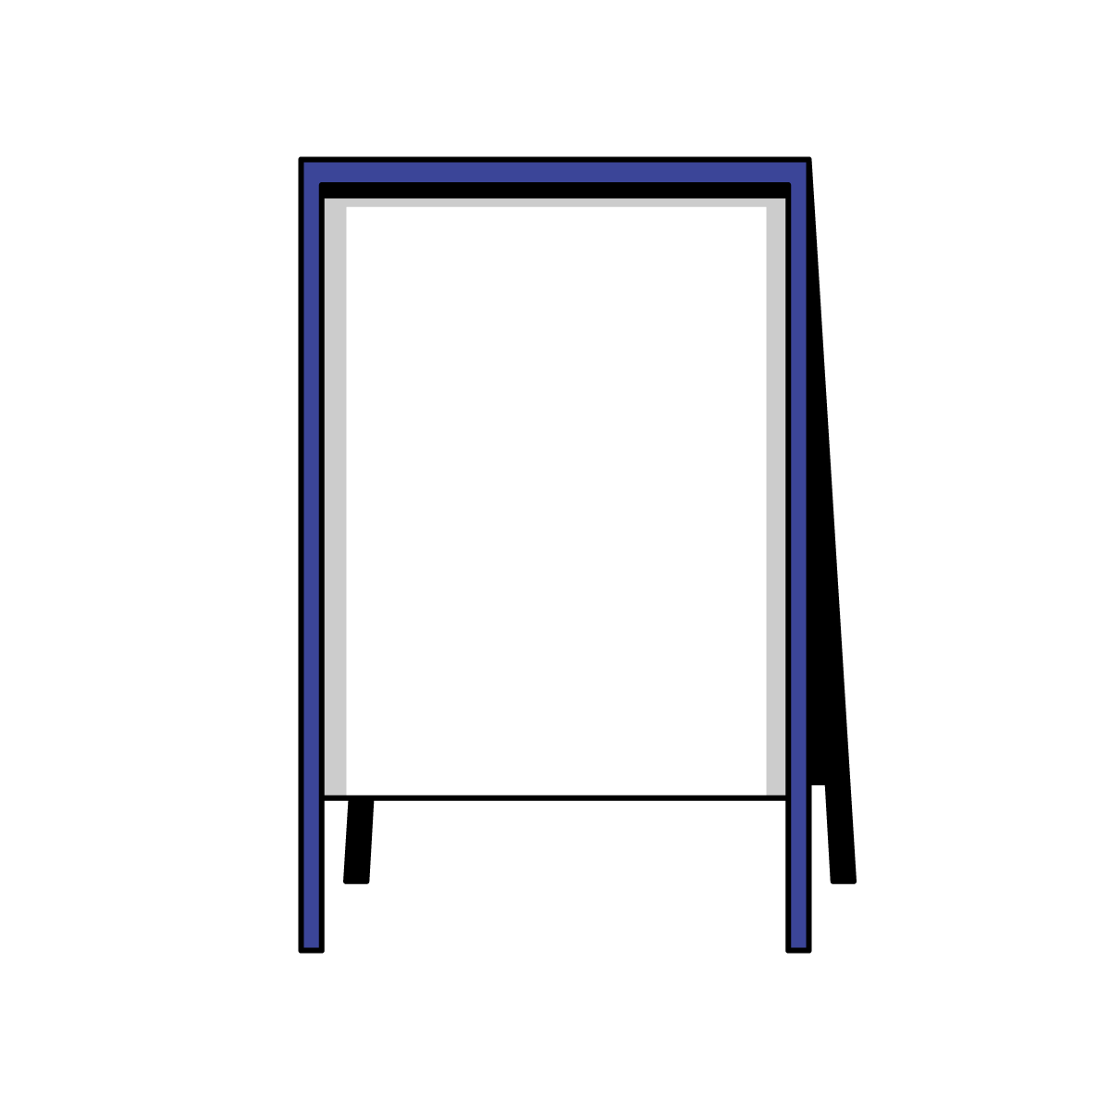

Slide 35
