Slide 2
Case Studies:
THE CONTENT STRATEGY
YOU CAN’T IGNORE

Slide 3
Today’s speakers
Kelly Mazur
Marie Wiese
Mary Miller
Suzy Tarrant
Marketing Director at Evenica
President & Founder at Marketing Copilot
Marketing Director at PayTrace
Director of Operations & Client Success
at Marketing Copilot

Slide 4
QUESTION FOR THE AUDIENCE:
Do you know what your top performing website pages are?

Slide 5
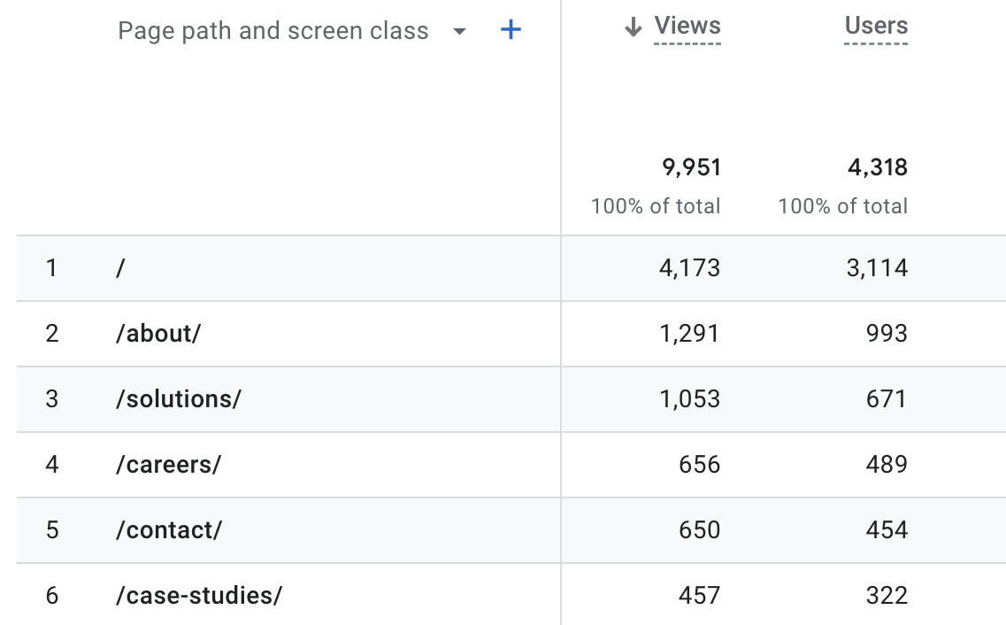

Slide 6
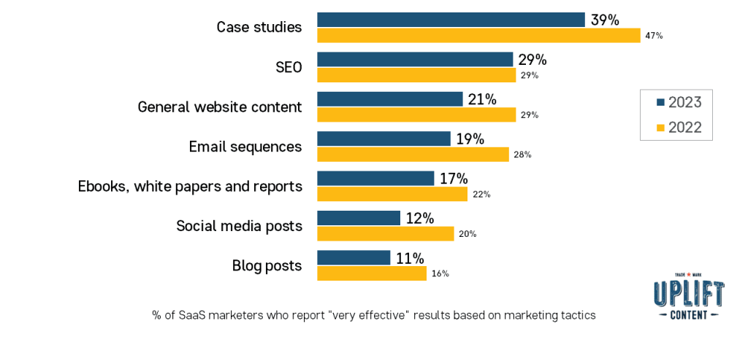
How effective are these marketing tactics in increasing sales for SaaS companies?

Slide 7
73% of B2B buyers find case studies to be the most influential type of content when making a purchasing decision. (Content Marketing Institute)

Slide 8
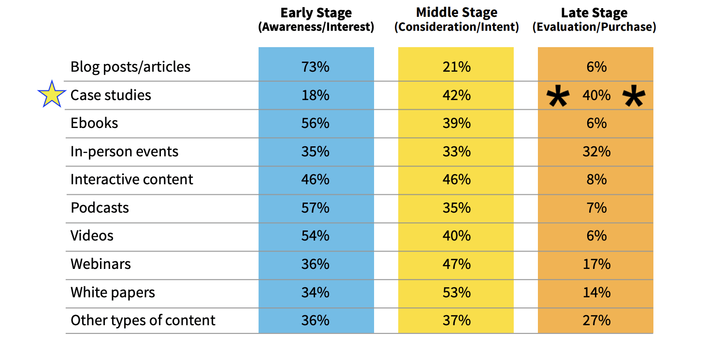
In which stage of the buyer’s journey is each content type most effective?
Content Marketing Institute

Slide 9
QUESTION FOR PANELISTS:
How do you spot a great customer story within your organization?

Slide 10
QUESTION FOR PANELISTS:
How do you ask customers for a case study?

Slide 11
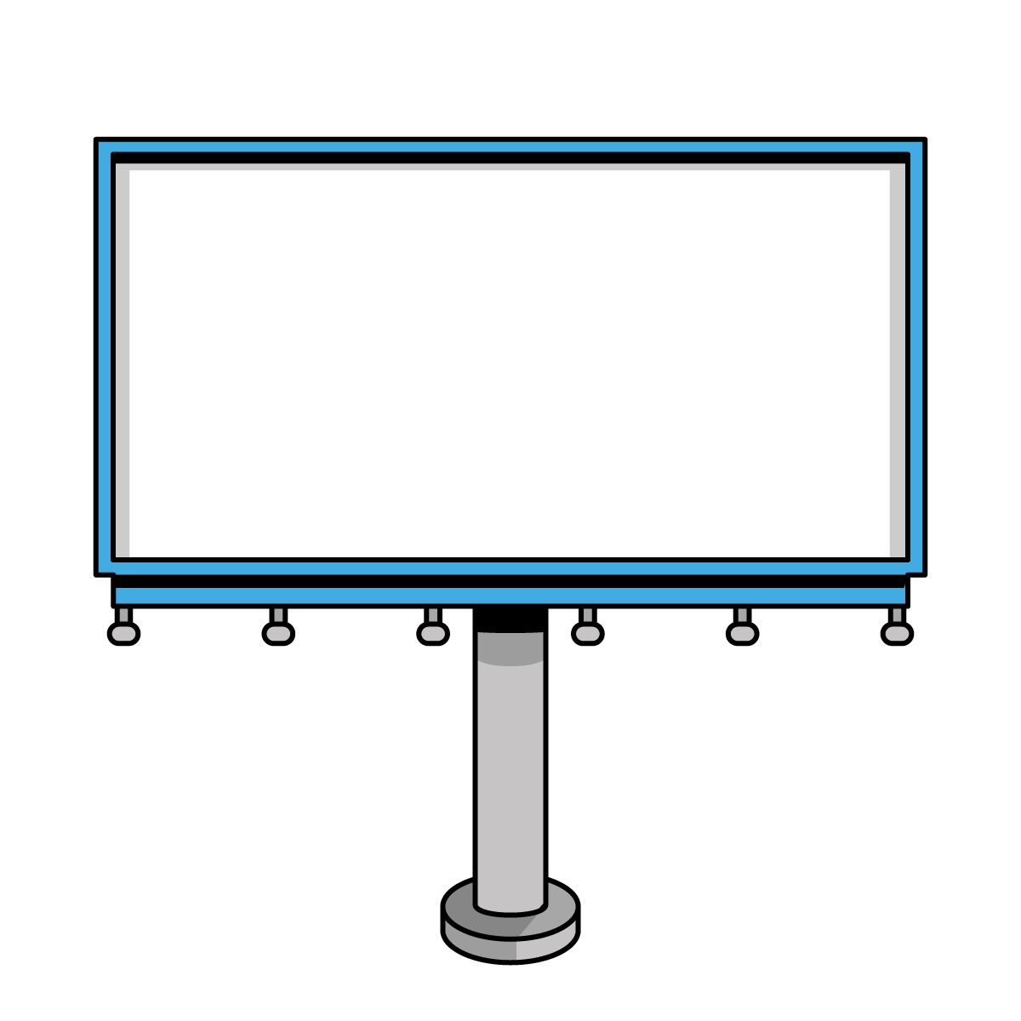
The alternative to case studies
Case Study
Use Case
vs.
Customer name & logo
Story about customer
No customer name
Story about solution

Slide 12
QUESTION FOR PANELISTS:
How do you prepare your customer for a case study interview?

Slide 13
Successful case study prep for your customer:
Interview questions
Hardware (lights, camera, mic)
Recording software

Slide 14
QUESTION FOR PANELISTS:
What are your tips for streamlining the case study creation process?

Slide 15
Interview Prep
Templated interview questions
Templated prep list for customer
Record Interview
Teams meeting with customer
Save video, audio & transcript
Case Study Creation
Copywriter creates written case study
Templated format for PDF, video, webpage, etc.
Meet with Project Manager
Revisions & Approvals
Templated form for client sign-off
Marketing & Recycle
Initial marketing campaign (Canva templates)
Begin recycling story (templated checklist)

Slide 16
Interview Prep
Templated interview questions
Templated prep list for customer
Record Interview
Teams meeting with customer
Save video, audio & transcript
Case Study Creation
Copywriter creates written case study
Templated format for PDF, video, webpage, etc.
Meet with Project Manager
Revisions & Approvals
Templated form for client sign-off
Marketing & Recycle
Initial marketing campaign (Canva templates)
Begin recycling story (templated checklist)

Slide 17
QUESTION FOR PANELISTS:
How is your organization using case studies within the sales process?

Slide 18
QUESTION FOR PANELISTS:
How do you leverage a completed case study by creating additional content pieces?

Slide 19
Recycling a case study
Video interview
PDF Case Study
Whitepaper
Email Newsletter
Video
Podcast
Short Clips (social media)
Website Page
Blog Post
Testimonial

Slide 20
QUESTION FOR PANELISTS:
What are your tips for asking your customer to join you at public speaking engagements?

Slide 21
Q&A

Slide 22
Connect with us
Kelly Mazur
Marie Wiese
Mary Miller
Suzy Tarrant
kmazur@evenica.com
marie@marketingcopilot.com
marmiller@paytrace.com
suzy@marketingcopilot.com

