Slide 2
Dynamics GP
Pick A Card

Slide 3
Windi Epperson
CPA with 25+ Years GP Consulting​
GP All-Star​ and Granite Awards
Helping build products to extend GP
Twitter: @WindiEpperson
wepperson@njevity.com

Slide 4
Agenda
Accounts
Posting, Unit, Allocations, Mass Modify
Vendors
1099 Details
Customers
Items
Sites
Posting Setup
Company Setup

Slide 5
Why should I consider moving to the cloud?

Slide 6
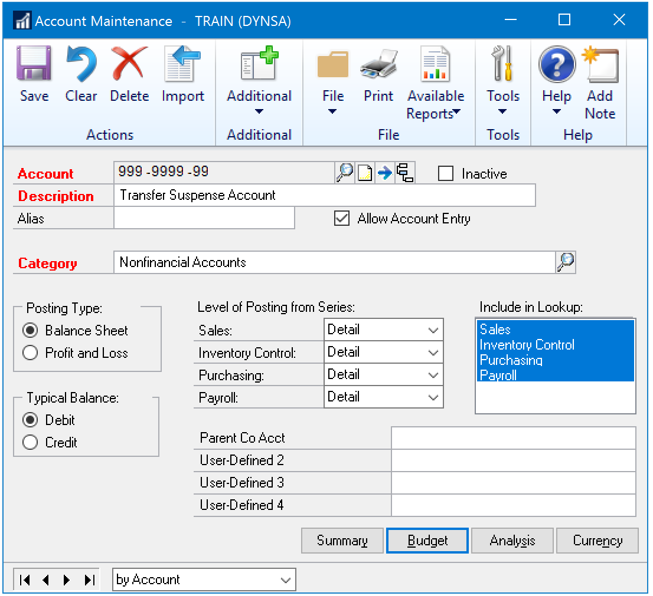
Accounts: Posting Accounts
Financial\Cards\Account
Items of Note:
Allow Account Entry
Posting Type
Include in Lookup

Slide 7
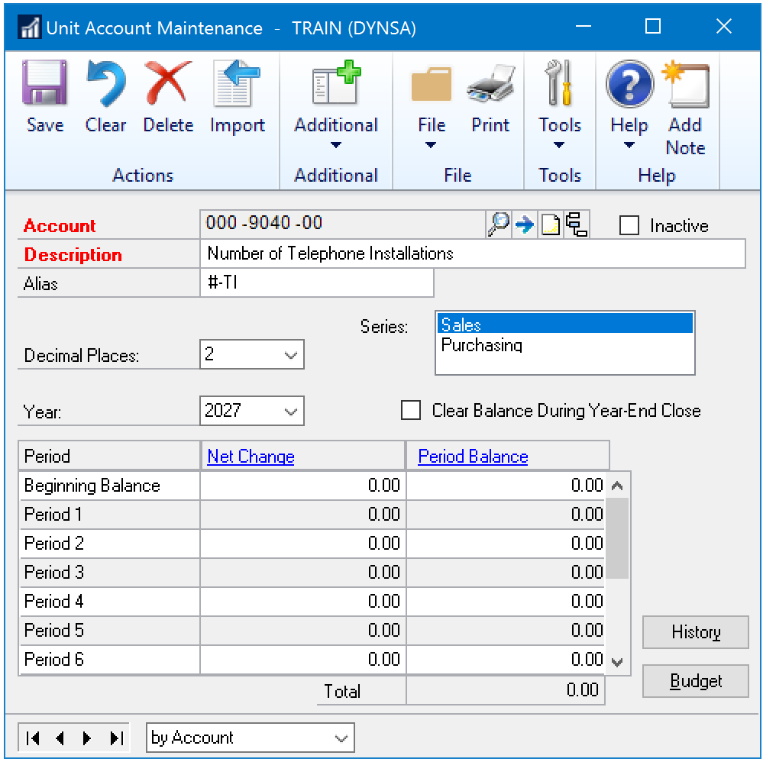
Accounts: Unit Accounts
Financial\Cards\Unit Account
Items of Note:
Series
Clear Balance During Year-End Close

Slide 8
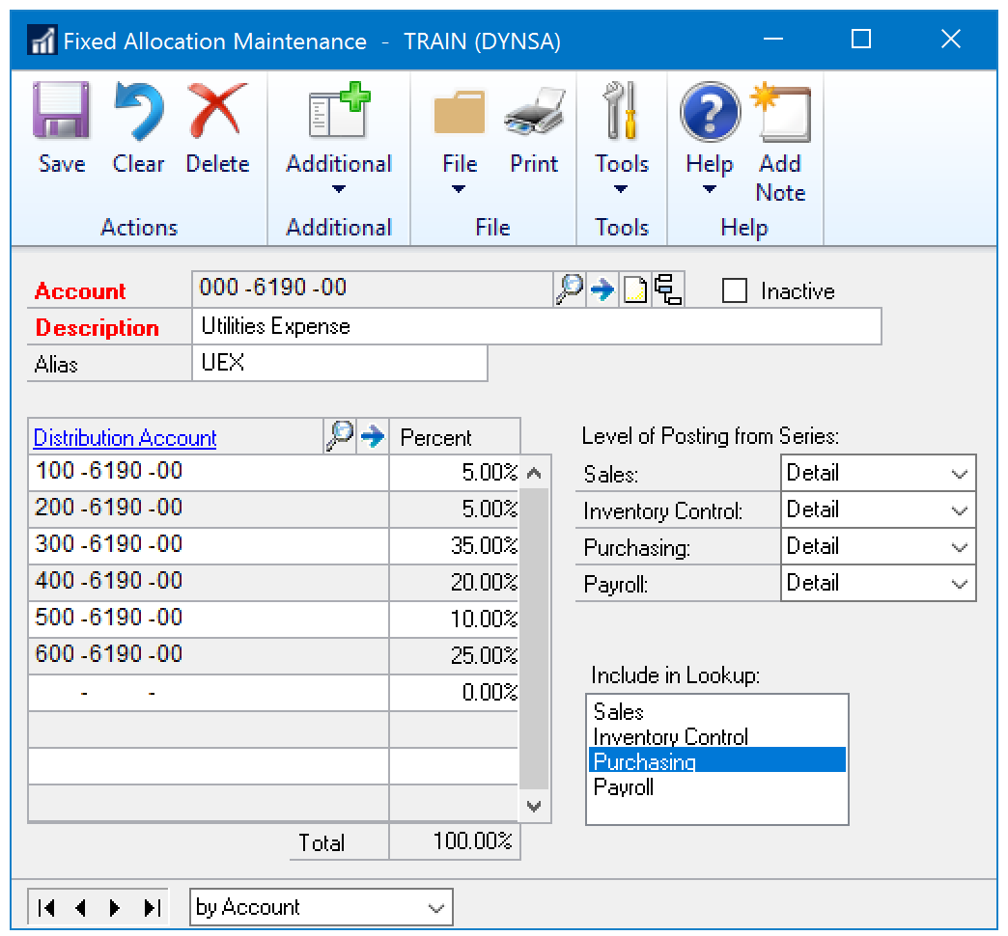
Accounts: Fixed Allocation Accounts
Financial\Cards\Fixed Allocation
Items of Note:
Include in Lookup
When to change percentages

Slide 9
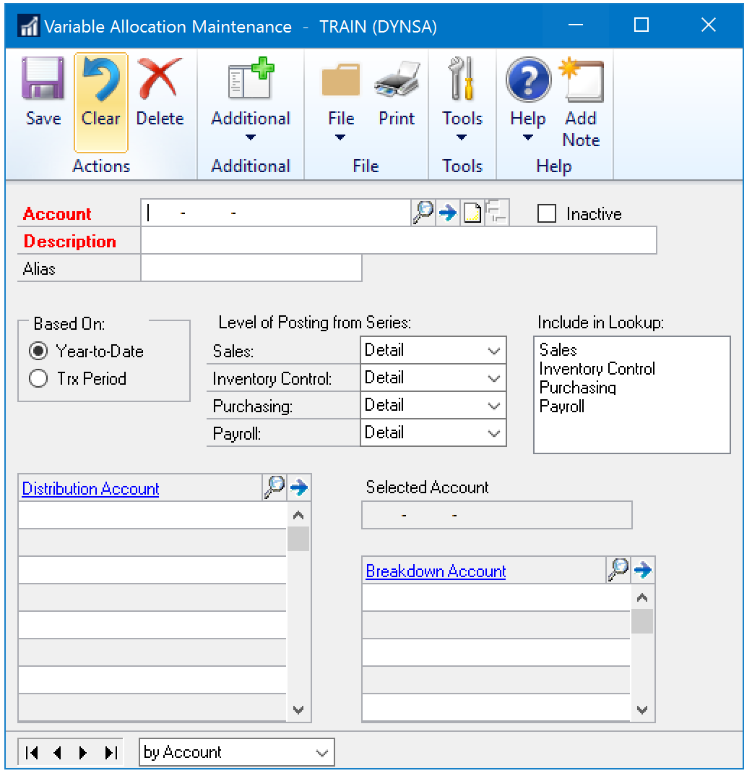
Accounts: Variable Allocation Accounts
Financial\Cards\Variable Allocation
Items of Note:
Based On
Include in Lookup
Breakdown Account

Slide 10
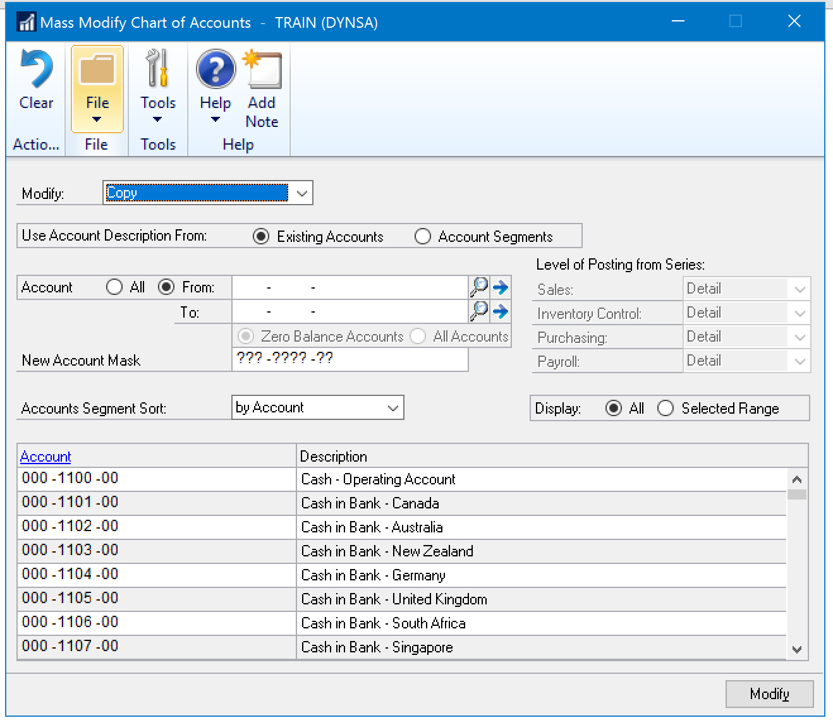
Accounts: Mass Modify
Financial\Cards\Mass Modify
Items of Note:
Modify Drop Down
Account Description From
Account Mask
Display Selected Range

Slide 11
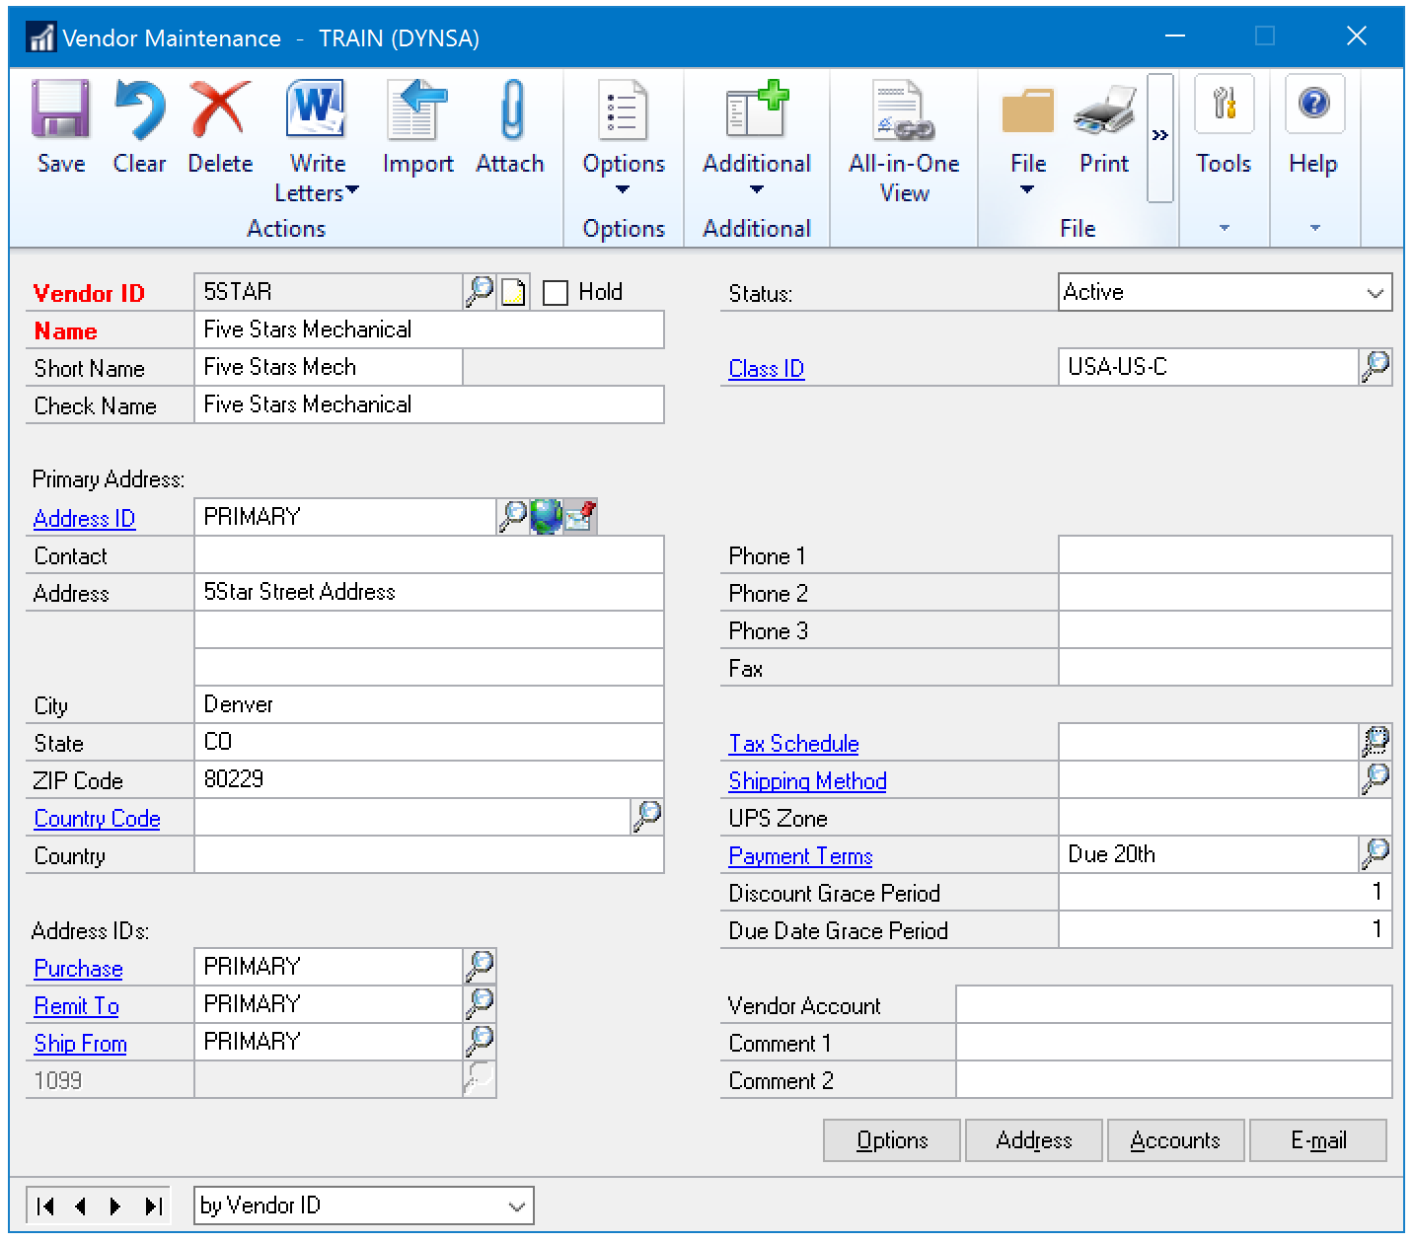
Vendors
Purchasing\Cards\Vendor
Items of Note:
Status
1099 Address
User Defined
Attach
Notes

Slide 12
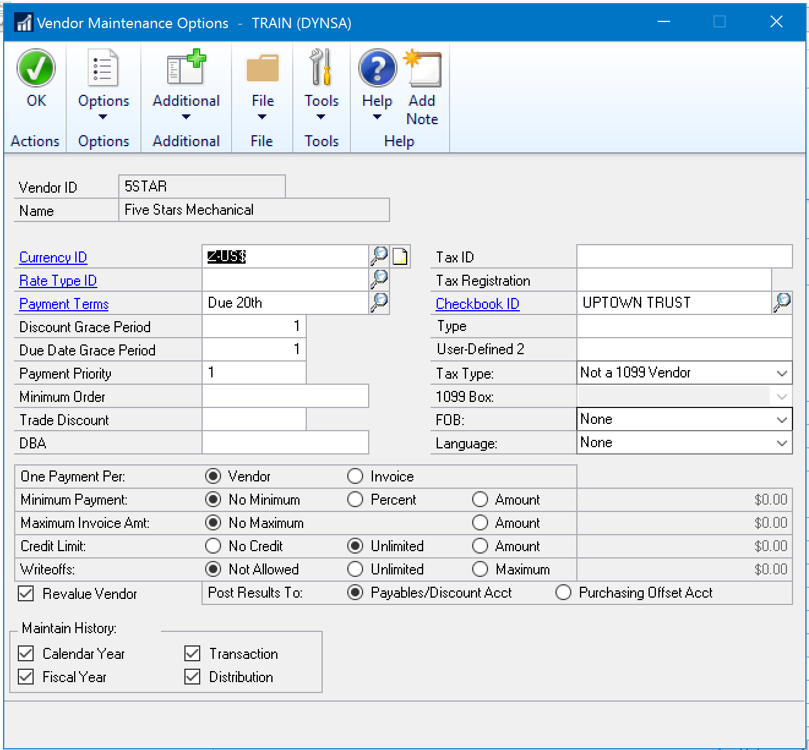
Vendors: Options
Purchasing\Cards\Vendor
Options Button
Items of Note:
Grace Periods
Tax Type
One Payment Per
Maintain History

Slide 13
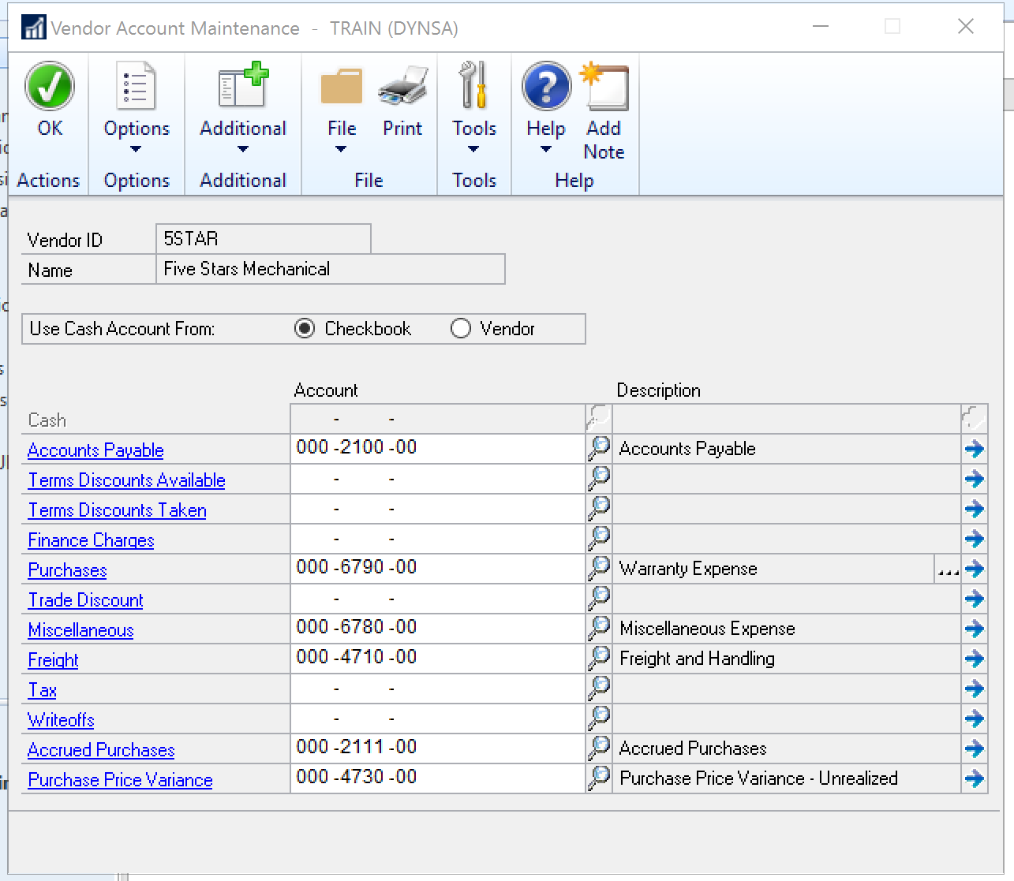
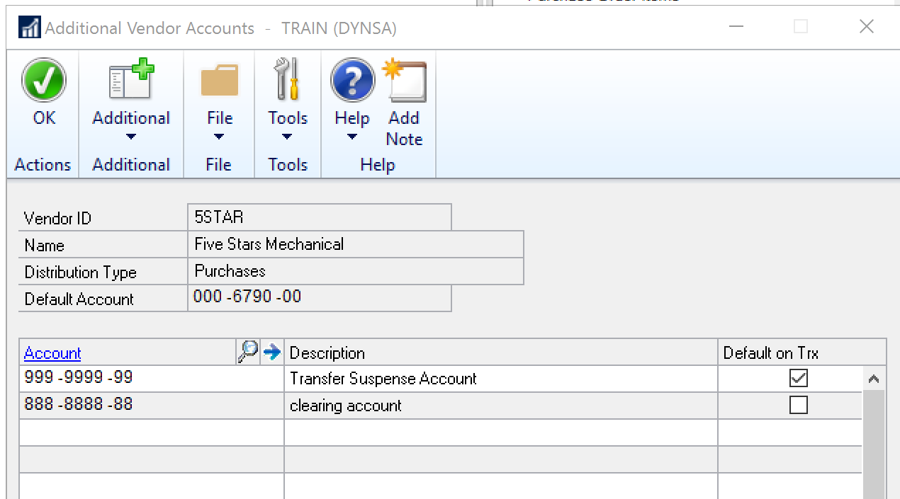
Vendors: Accounts
Purchasing\Cards\Vendor
Account Button
Items of Note:
The Ellipse Button

Slide 14
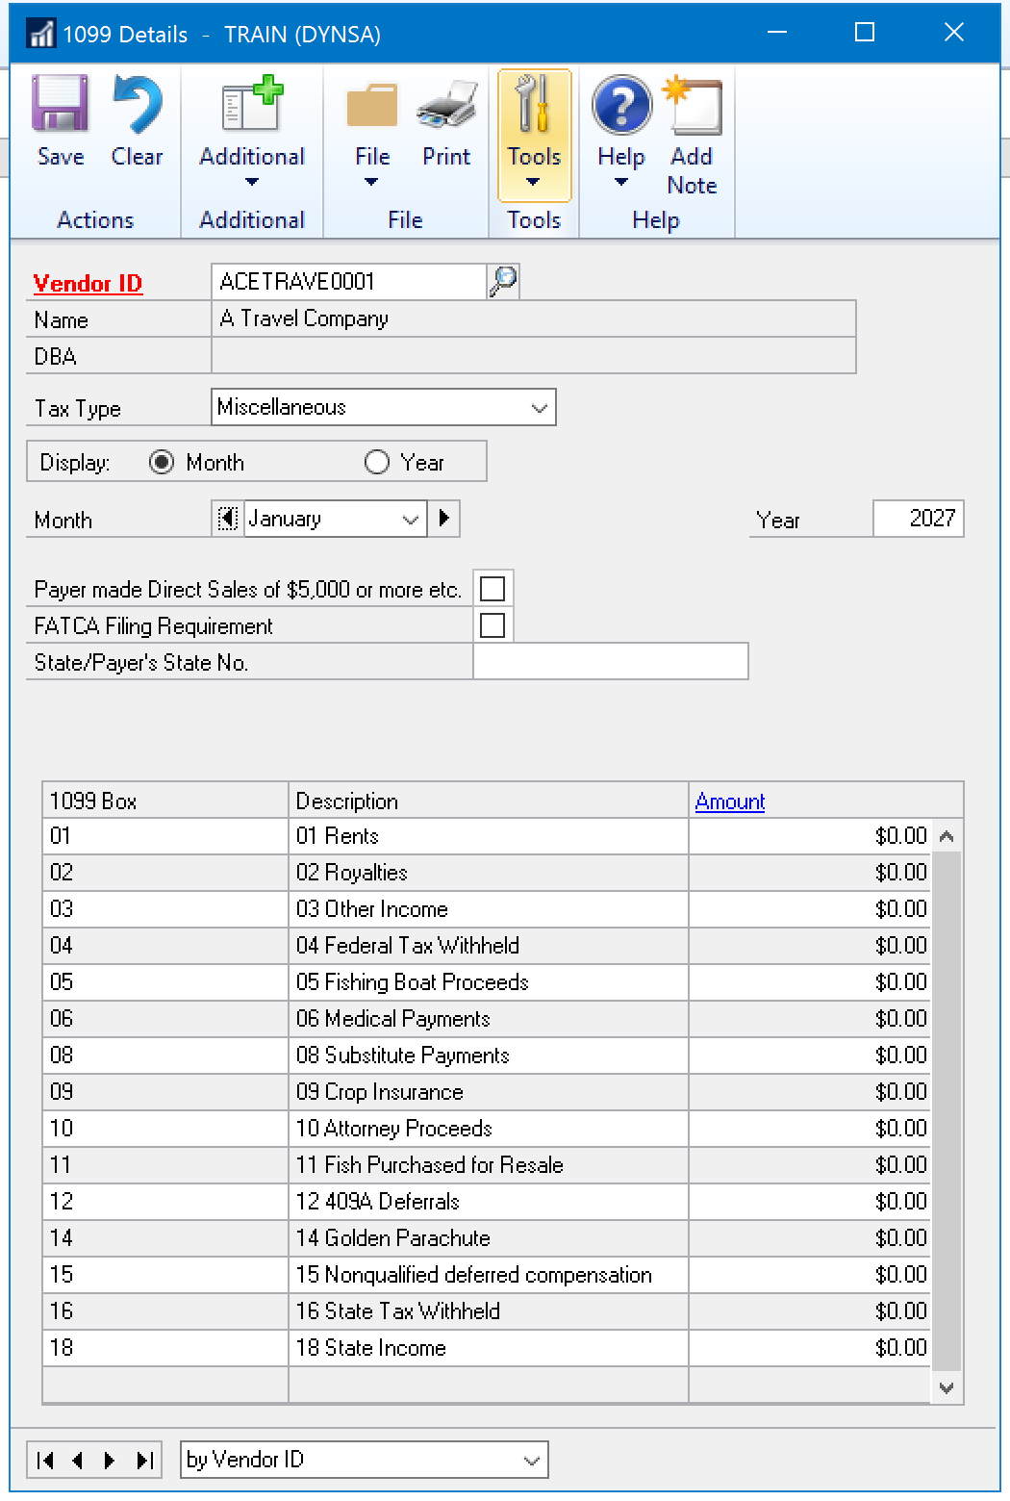
1099 Details
Purchasing\Cards\1099 Details
Items of Note:
Tax Type
Display
Amount
Consider Reconciles

Slide 15
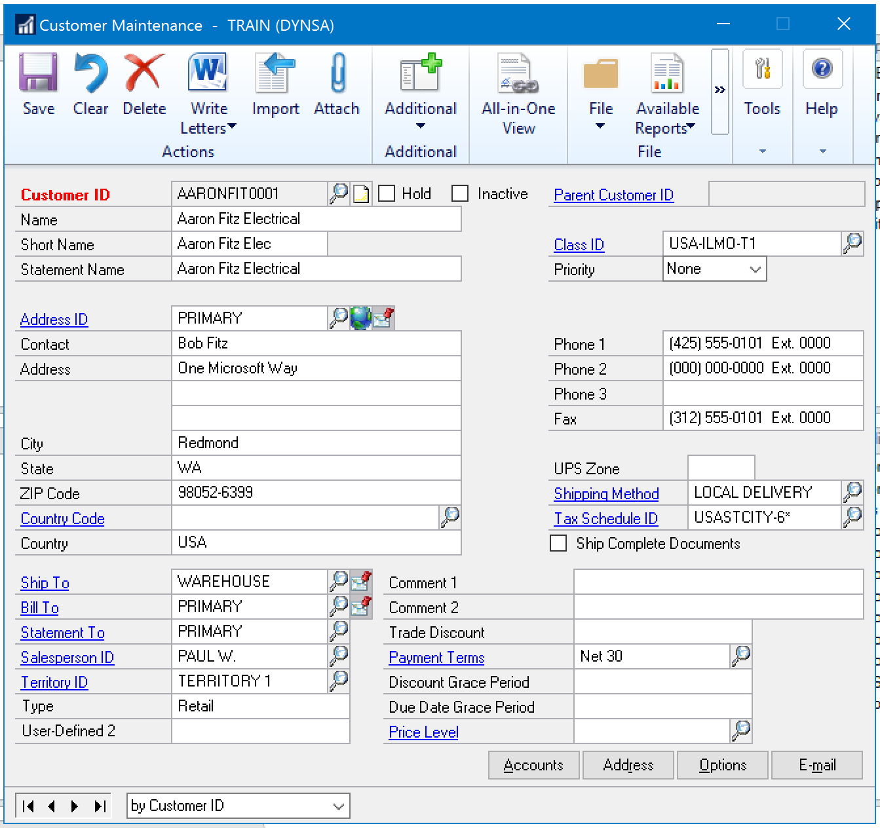
Customers
Sales\Cards\Customer
Items of Note:
Statement Address
User Defined 1

Slide 16
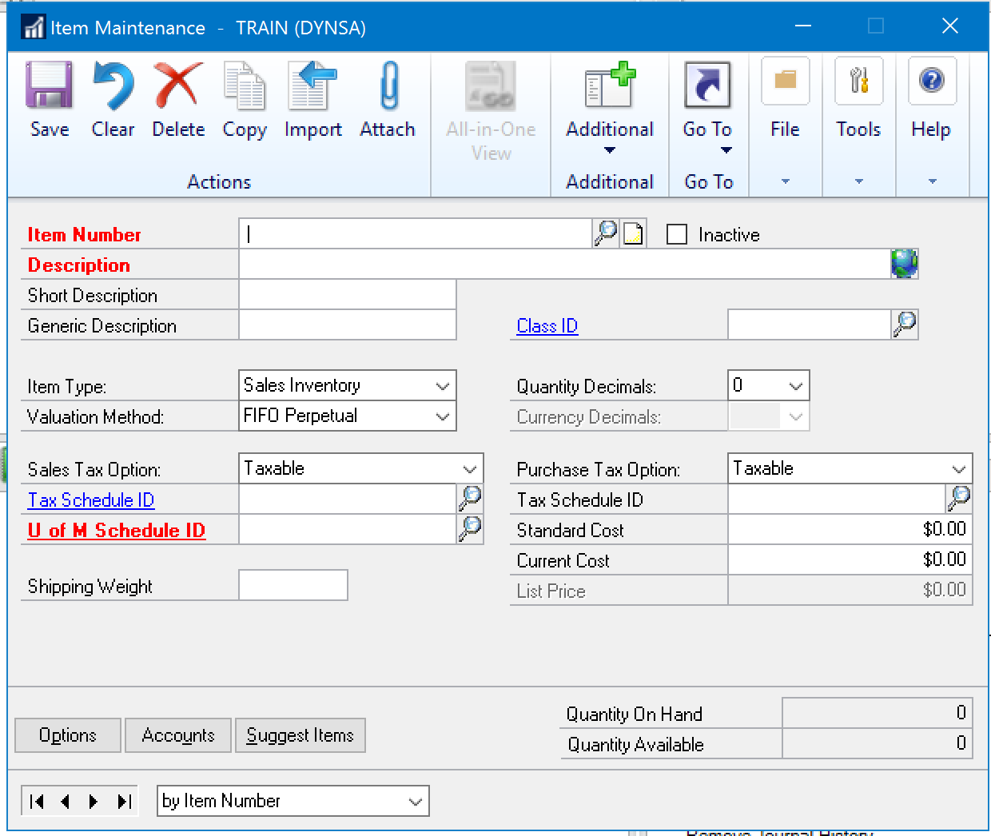
Items
Inventory\Cards\Item
Items of Note:
Short Description
Generic Description
Item Type
Valuation Method

Slide 17
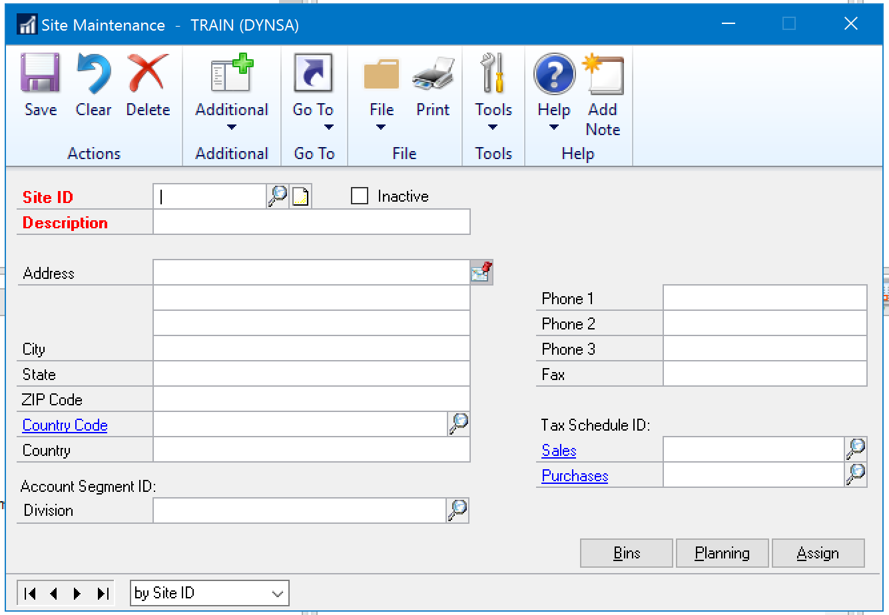
Site
Inventory\Cards\Site
Items of Note:
Account Segment ID

Slide 18
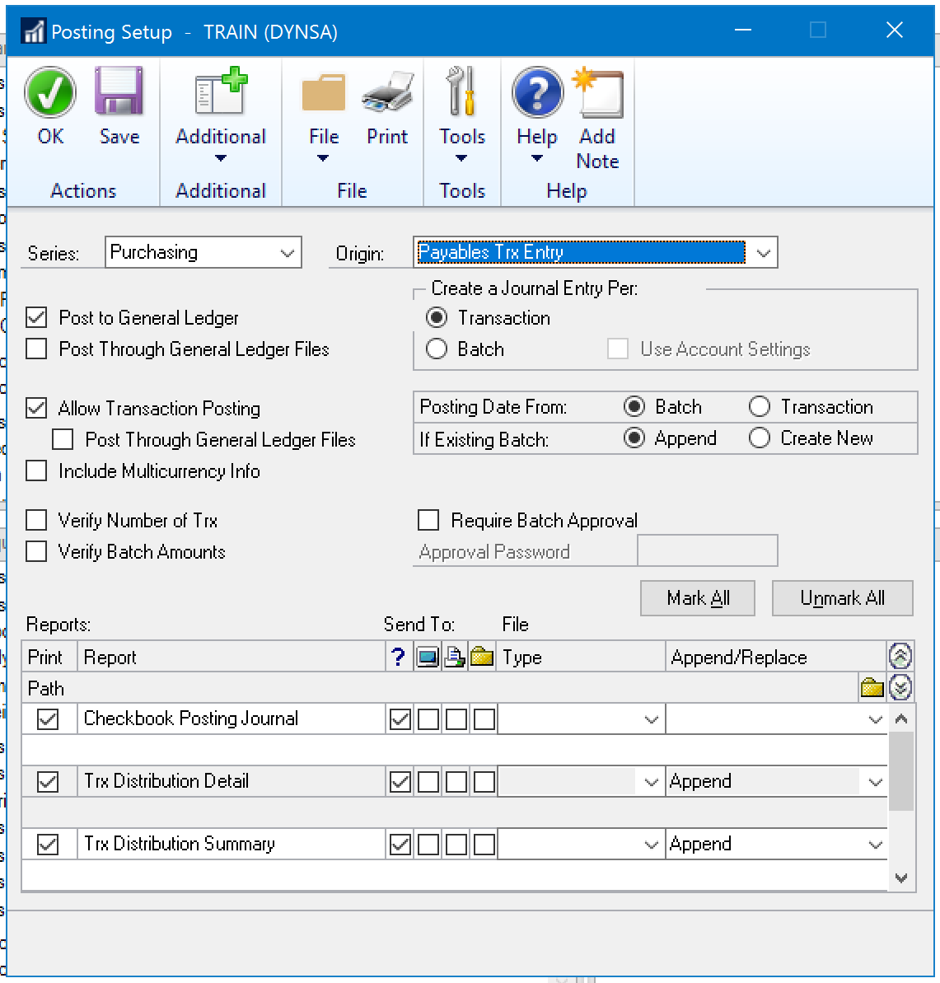
Posting Setup
Tools\Setup\Posting\Posting
Items of Note:
Origin
Post To\Post Through
Journal Entry Per
Posting Date From
Transaction Posting
Batch Approval
Reports

Slide 19
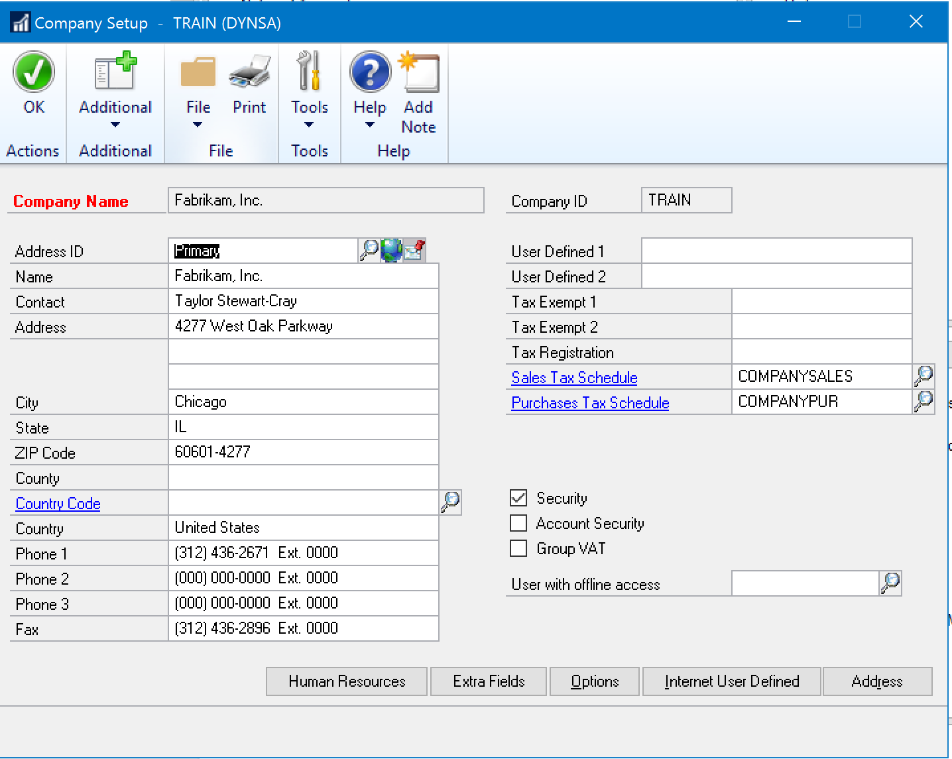
Company Setup
Tools\Setup\Company\Company
Items of Note:
Security
User With Offline Access

Slide 20
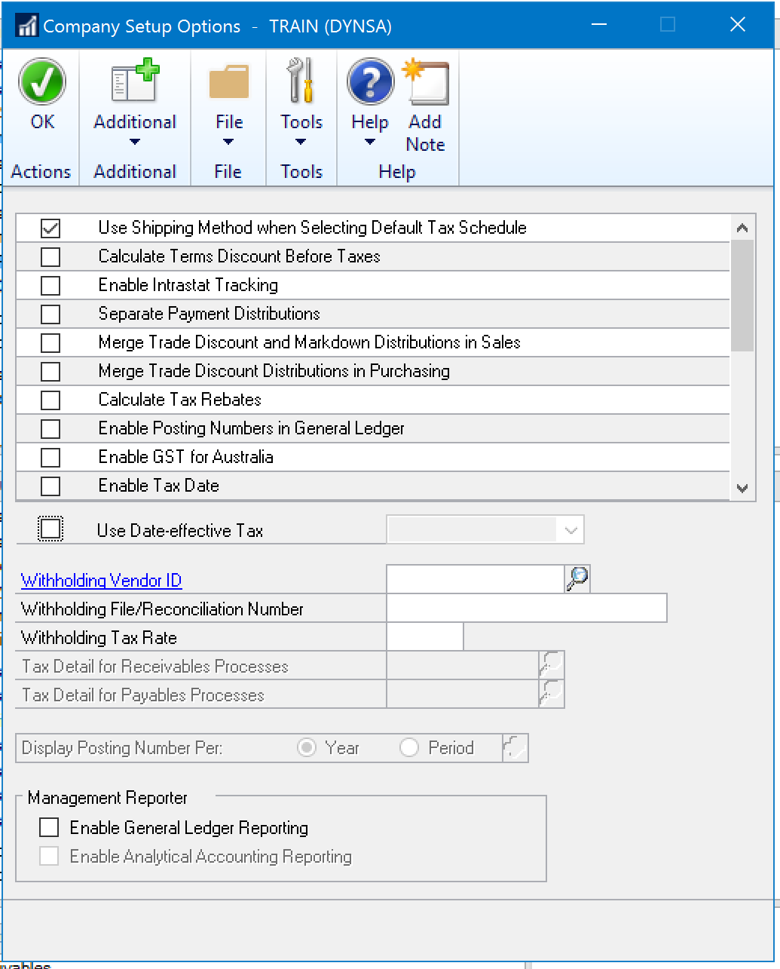
Company Setup
Tools\Setup\Company\Company
Options Button
Items of Note:
Checkboxes
Automatically Post Cash Receipts
Management Reporter
Enable General Ledger Reporting

Slide 23
Windi Epperson
Twitter: @WindiEpperson
wepperson@njevity.com
Q&A

