Slide 1
Power Pages 101: Unlocking the Potential of Simple Site Creation
Easily create stunning websites with Power Pages
Notes:
AI-generated content may be incorrect. --- Welcome to our presentation on Power Pages! In this session, we'll explore how this platform can help you create stunning websites with ease. We'll discuss its features, practical applications, and much more. Get ready to unlock the potential of simple site creation!

Slide 2



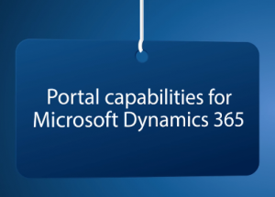
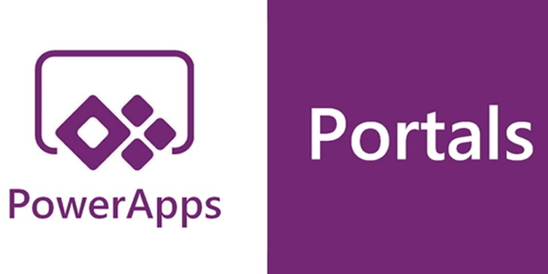

Cory Christoffel
Just a little background…

Slide 3
Agenda Items
What Is Power Pages
Simple Site Build Example
Data Integration: The Power Pages Superpower
Security In Power Pages
Data in Power Pages
Resources and Q&A
Notes:
Today, we will cover what Power Pages is and its key features and benefits. We'll take a look at a simple site build example, explore data integration capabilities, learn about Dataverse, discuss data management in Power Pages, and review security practices. Finally, we’ll wrap up with resources and a Q&A session.

Slide 4
What Is Power Pages
…and what is it good for?
Notes:
Power Pages is a platform designed to simplify the process of building websites. It enables users to create responsive sites with minimal coding, making it accessible for both beginners and experienced developers.

Slide 5
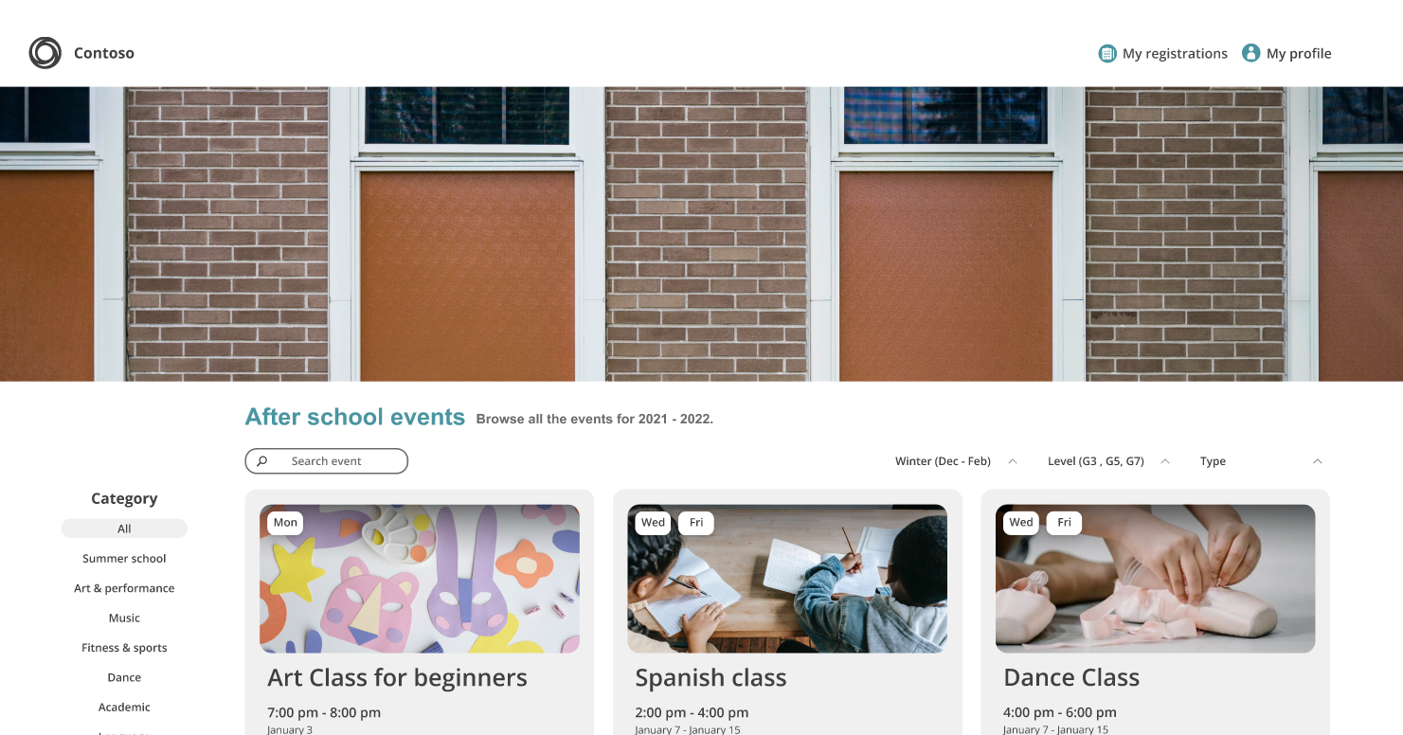
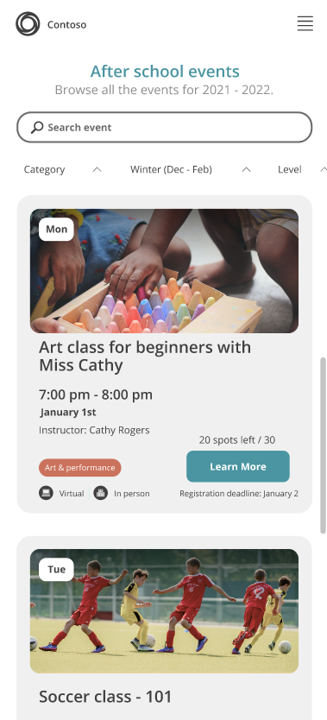
Power Pages is the Power Platform’s answer for the end user in your business process.
Extend your Business Processes
Use your skills in Model Driven Apps and the data that flows through Dataverse to enable your end users to engage from the web.
Make authoring easy for everyone
Enable everyone in your organization to design and launch engaging websites in minutes – no coding required.
Build without boundaries
Empower your developers with advanced, web design tools that can take your pages to a whole new level.

Slide 6




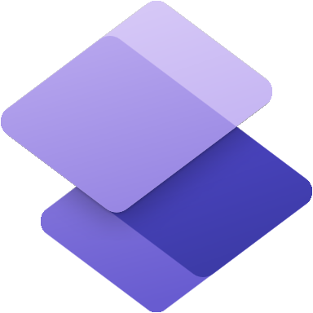






Power Pages in the Power Platform
Power Apps
Application development
Power Automate
Process automation
Power BI
Business analytics
CoPilot Studio
Intelligent bots
Power Pages
External websites
Now generally available!
Data connectors
AI Builder
Microsoft Dataverse
Power Fx
Managed Environments
Notes:
Power Platform is a unified platform of low-code tools that spans Office 365, Azure, Dynamics 365, and standalone applications that helps you analyze data, build solutions, automate processes, and create virtual agents to transform your business.
Power Platform is a rapid application development platform that helps citizen developers with limited coding abilities to innovate and build new solutions faster in an environment and user experience that feels like PowerPoint and Excel.
Beyond use by citizen developers, Power Platform is a rapid application development and extensibility framework for professional developers that seamlessly integrates the high-speed capabilities of low-code tools and prebuilt components with no-cliffs extensibility across Azure and other professional development environments.
Power Platform truly is a transformative solution that brings together all kinds of developers and employees to collaborate and build solutions – whether no code, low code, or code first.
Let’s dive deeper into each of the four Power Platform products: Power Apps, Power Automate, Power BI, and Power Virtual Agents one by one.

Slide 7


Power Pages Users are???
Historically requires traditional application development, few ready-made solutions
Workplace productivity Low Code Citizen Dev Ready-made solutions
Public/Anonymous External Users
External
Customers, Partners, ​
Suppliers, Vendors, etc.​
Public/Anonymous External Users
Internal
Users inside my organization
Internal Users
Power BI
Power Automate
Power Apps
Able to address all user audiences
Dynamics 365
Office 365
Power Pages
Copilot Studio
Power BI Embedded
Notes:
Only Power Pages can address diverse user audience.

Slide 8
Power Pages supports data-driven business websites
Resident & Community Services
Reach and serve citizens at scale
Partner Operations
Streamline partner business processes
Brochures
Self-service permitting
Licensing
Supplier onboarding
Tracking
Photography portfolios
Grant applications
Incident/outage reporting
Inquiry management
Vendor support
Blogs
Customer Self-Services
Provide 24/7 support
FAQ Sites
Provide answers to common questions
Registration
Returns
Products
Services
Support inquires
Appointments
Special events
Policies
Bookings
Forums
Procedures
Notes:
Has many industry use cases (300+) for registrations or application processes; adoption across Government, Utilities, Finance, Healthcare & EDU.
Power Pages has a large majority of B2C portals; organizations are reaching out to customers at scale over the web, presenting a major opportunity.

Slide 9
Build your first website
Let’s see how easy it really is
Notes:
Next, we will walk through a simple site build example. This section will provide a practical demonstration of how easy it is to create a site using Power Pages.

Slide 10

Power Pages website
Web Page
Liquid code
Web Template
Localized Content
Header/Footer
Custom JavaScript
Page Copy
Page Template
Table
Form
Basic Form
Custom JavaScript
Content Snippet
Form
Multistep Form
Table
Liquid code
Custom JavaScript
Form Tabs
Form steps
Custom JavaScript
List
Table
Table view

Slide 11
Home Page and Style
Show and Tell

Slide 12
Data Integration
The Power Pages Superpower
Notes:
One of the standout features of Power Pages is its data integration capabilities. This section will dive into how you can connect to external data sources to enhance your site’s functionality.

Slide 13
Power Pages runs on Microsoft Dataverse
Dataverse is Microsoft's low-code data platform
Dataverse seamlessly pulls data from a variety of sources and stores that data in a single source of truth that runs on Azure security, enables streamlined analytics, and comes equipped with built-in automation.
Dataverse data is used to rapidly spin up Power Pages, leveraging the same underlying components of model-driven Power Apps.
Power Pages does not have its own datastore, so there is no sync delay and the real-time data interaction in Dataverse enables you to act, automate, measure via the rest of Power Platform.

Slide 14
Data Space Demo
Show and Tell

Slide 15
Security In Power Pages
Safety First!
Notes:
As we move forward, security is paramount. This section will cover various security measures that can be implemented in Power Pages to protect data and users.

Slide 16
Security Structure
Dataverse Contact
Web Role
Page Permissions
Table Permissions
Notes:
Security within Power Pages is made up of several different components. Some of these components work together in order to provide the functionality. It is necessary to configure security in order to control what types of users (e.g. - unauthenticated users, authenticated users of a specific type, etc.) have access to various areas of your website as well as to control record level access (e.g. - if I have submitted an application, you should not be able to view or edit that record in most circumstances). It is important to remember that all users that register an account (no matter the identity provider) and log into that site are Contact records within CRM, so the Security Roles are not applicable.
The components that make up security on the Power Pages site are -
Web Roles
Page Permissions
Table Permissions
These components work together in order to secure the website.

Slide 17
Announcing: Windows 365 Government
Security Structure
Web Role
Table Permissions
Web Page
Basic Form
Dataverse Form
Dataverse Table
Page Permission
List
Dataverse View
Contacts
Access
Website Setup (Custom Domain, SSL Certificate, Power BI, SP, .. )
Configuration stored in Dataverse Data
Dataverse Metadata
Content & Code
Manual Configuration

Slide 18
Securing the Site
Show and Tell

Slide 19
Data in Power Pages
Now that we know where it is, and who should see it…
what do we do with it?!
Notes:
Understanding how to manage data within Power Pages is essential. This section will cover how to display and collect data effectively using the platform’s features.

Slide 20
Power Pages website
Web Page
Liquid code
Web Template
Localized Content
Header/Footer
Custom JavaScript
Page Copy
Page Template
Table
Form
Basic Form
Custom JavaScript
Content Snippet
Form
Multistep Form
Table
Liquid code
Custom JavaScript
Form Tabs
Form steps
Custom JavaScript
List
Table
Table view

Slide 21
Basic Forms/Lists
Show and Tell

Slide 22

Resources and Q&A
Official Documentation
Microsoft Learn
Tutorials and Guides
Power Pages in a Day
Community Resources
Power Pages Pro Newsletter Tino R.
Power Pages Tips – Engineered Code
Notes:
To conclude, we will provide helpful resources for further learning and answer any questions you may have. This is a great opportunity to clarify any doubts and gain additional insights.

Slide 23
Conclusion
Thank You for Your Attention
We appreciate your engagement and attention throughout this presentation. Your participation is invaluable.
Opportunity with Power Pages
Power Pages provides an incredible opportunity for users to create websites easily, with robust features and integrations.
Inspiration to Build
We hope this presentation has inspired you to start your own site-building journey. The possibilities are endless!
Notes:
Thank you for your attention! Power Pages offers an incredible opportunity for simple site creation with powerful features and integrations. We hope you feel inspired to start building your own sites. Let's open the floor for any questions.

