Slide 2


How to review Power Pages projects
like a Power CAT
Nikita
Polyakov

Slide 3
Goals for today
Our Review Process
Demo
Q&A
Notes:
When to Configure, Customization or Code
What are latest tools available and how to use them as a team
How to plan and analyze your project web, user and data security

Slide 4




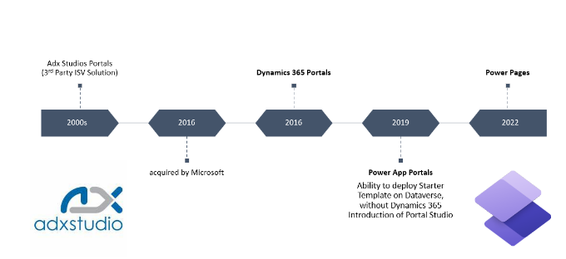
Power CAT (Customer Advisory Team)
Power CAT Intelligent Applications
Prepared By : Nikita Polyakov
9yrs at Microsoft :
5yrs at FastTrack for Dynamics 365
4yrs at Power Pages Power CAT
Implementation Consulting at
Microsoft Partners:
PowerObjects
Tribridge
AgileThought
Started career as .NET and SQL developer
Worked with this technology since AdxStudio Portals v5
Notes:
Phil
Prepping the PM’s
Each been working with the product for over decade
On September 28, 2015, Microsoft announced the acquisition of Adxstudio Inc.

Slide 5

Pages
Solution Review Report Contoso

Slide 6
Timeline CAT Solution Review : Who, What, When
Week 1 : Alignment Kick-off Call
Present to business to align realistic expectations and required effort/inputs of Solution Review
WHO: MSFT Power CAT Leads the call + Customer Business and Technical leadership
Week 2 : Reverse Demo
Present a functional demo portal to MSFT team to catchup everyone.
WHO: Portal Dev (Leads the call) + MSFT Account & Tech + Business team should join to address business questions
Required for MSFT to understand the project and to understand the areas of focus
Week 3&4 : Tech Deep-Dives
Follow-up behind-the-scenes code/configuration deep-dive review meetings
Portal Dev (screenshares and opens Pages Studio, Management App, shows Code, etc) + MSFT Tech
This is the core essential review motion – is this where the most impact happens
Week 4&5 : Draft Review Summary
MSFT takes time to process the findings and consider recommendations
Week 6 : Final Solution Findings Presentation
Everyone joins the solutions findings and recommendations presentation
Optional Draft Preview Call - Portal Dev + MSFT Account + Tech
Follow-up Homework : Customer is identifying team members and priority areas to focus the review
Completed

Slide 7
Power Pages Solution Review
High-level scoring : Contoso Portal
 | Review Area
✅ | Solution Fit
➖ | Architecture Documentation
➖ | Geographic Residency
➖ | Users & Licensing
➖ | Licensing Cloud Capacity
⚠️ | Load Testing
➖ | Security Testing
➖ | Go Live Readiness
✅ | Customization
➖ | Caching
 | Review Area
✅ | User Identity
➖ | ALM
⚠️ | Data Security
➖ | Custom Integrations
➖ | AI Capabilities
⚠️ | Modernization/Migrations
➖ | Roadmap Asks
Legend:
  ✅Good
  ➖ Did not review
  ⚠️Concern/Risk

Slide 8






Solution Review Area (Template Slide)
 | Concern
Discussion Point A
  No
Discussion Point B
  Maybe
Reason the discussion point is important
Recommendation:
Do this for A Do this for B

Slide 9
Solution Fit
 | Green
Solution Fit
  No concerns
  Review Comments:
  Power Pages is a good fit for self-service access to data for this scenario.
  Dataverse (Dynamics 365) is used as a data source is a good fit with Power Pages
  Configure, Customize and Custom Code choices were reasonable
  API and Data integration is planned and there are no issues
Why this is important
  Solution fit is important
  Power Pages is a SaaS platform
  Power Pages integration with Dataverse/Dynamics 365
  Custom Dev vs Out of the Box

Slide 10
Solution Architecture Documentation
 | Did not review
Architecture Diagram
  Not presented for review
Design Documentation
  Not presented for review
Why this is important?
  This is important so knowledge transfer can happen, new team members and project team shift, and future phase development
Recommendation:
If absent, please plan to document more complex end to end scenarios Process Architecture with data synchronization to other data sources Data Model is key to Data Security design and handy during updates or improvements

Slide 11
Platform Modernization Migrations (Deprecations)
 | Concern | Did not discuss plan
Bootstrap v5
  Unknown/Not Planned
Enhanced Data Model
  Unknown/Not Planned
Why this matters?
Power Pages has 2 major platform shifts (a first in 7 years of the product lifecycle) A migration of CSS framework v3 to v5 and migration of where website config is stored in Dataverse.
To gain long term support plan and consider migration to the latest platform versions.
Especially with custom UI – do not develop new code on Bootstrap v3, take the time to migrate.
Deprecation of SDM and v3 not yet published.
Recommendation:
Please evaluate and come up with migration plan and timeline. Review for blocking issues – Extend, Code or Table Permissions to any adx_ tables review why and mitigate Data Model should be quick and typically require little changes CSS Framework would require a code changes and re-testing

Slide 12
Configure, Customize, Code

Slide 13
Portals Project – Capability Categories
Matrix to help understand complexity in Portal Projects
Complexity | Characteristics | Requirements
Low | Basic nearly out of the box Portal Use Case Basic CSS Styling and some Content Simple Custom Entity Lists & Detail Pages No external Data or Web Services used | Lower Required Investment & Team Skillsets Still expected Basic Fit Gap & Solution Design
Medium | Customized Portal Use Cases & Larger Scope Advanced Styling and Complex Web Content Custom Entity Lists, Search & Advanced Pages Light use of External Data & Web Services | Higher Required Investment & Skillsets Invested in Performance Benchmark Aware of Monitoring and Update Testing
High | Enterprise Customer Portal Use Cases Bespoke Style and UX modifications needs Custom experiences w/ external data & services | Highest Required Investment & Skillset needed Enterprise Testing Cycles and IT Maturity Deep Operational Telemetry & Monitoring Investment in ongoing Maintenance & Updates
Notes:
This is important key information for both partners and customers.

Slide 14





Microsoft Power Pages: Low Code to Pro Code Capabilities
NO to LOW CODE
PRO CODE
Inside Power Pages
Power Pages’ Standard Features
Custom Front End UI & Code
JavaScript, HTML, CSS etc.
Configuration Features
Configuration
Native Data Controls
List, Form & Multi-Step Form
Custom Page Layouts and Stylesheets
Web Pages and Page Content
Core Styling themes
Authentication & Authorization
Multi-Language Support
Content Snippets
Site Settings
+ more
Custom Grid or Input Form
Custom Data Presentation
Unbound
Code Component (PCF)
Field-type Code
Component (PCF)
Dataset Code Component (PCF)
Liquid Code
(Personalization, Data Query, Server-Side Logic Pre-Render)
Power Pages Web API
(Full CRUD to Dataverse
+ Power Automate trigger)
Power Pages Data Layer
Authorization User Security Layer (Web Roles + Table Permissions)
Copilot
Studio
Power BI &
Power BI
Embedded
w/ RLS
Dataverse (Dynamics 365)
Tables, Columns, Relationships , Data Schema and Data Storage
Power Pages
Trigger Action
Azure
API-M
Dataverse Plugins
Virtual Tables *
Power Automate
Your APIs
1000+ connectors
Custom Connectors
On Prem Connectors
SAP
Connectors
AI Builder
Azure AI
GPT
Other Data Sources

Slide 15
 | No Code / Configuration |  | Low Code / Some Code | Low Code / Some Code | Pro Dev Code | Pro Dev Code
UI | Native Features Web Pages Rich Text & Images Styles/Themes Native Data Controls |  | Custom CSS styles Custom Web Page Layouts | Custom CSS styles Custom Web Page Layouts Custom Grids and Forms |  |  | Custom UI and UX | Full Custom UI and UX
Data Interactions | Forms, Lists, Multi-Form |  | Liquid Code Custom List JS Form Logic | Liquid Code Custom List JS Form Logic | Custom Code Components (PCF) | Custom Code Components (PCF) | Power Pages Web API | Power Pages Web API
Power Pages Backend | Power Pages connection to Dataverse via our lens Authorization (Web Roles, Page and Table Permissions) |  | Dataverse via Power Pages Authorization |  |  |  | Dataverse via Power Pages Authorization
Power Platform Backend |  | Dataverse
Power Platform Advanced Logic and Data Connections | Power Automate Cloudflows Connectors |  | Dataverse Virtual Tables (1st party or Custom) |  | Dataverse Plugins (CRUD-triggered) C# code or Low Code Plugins |  | Power Pages Action (Custom Event Trigger) Power Automate
Other backends and Platfomrs | Other APIs and Data sources |  | Other APIs and Datasrouces

Slide 16
Technical Capabilities : Example Custom UI Frameworks
Microsoft Power Pages
Authentication, Content Management System, Language, etc
Standard features
Web Pages,
Web Templates,
Content Snippets,
Site Settings,
And more
React.JS
Custom Front-End JavaScript, HTML, CSS, etc
Custom
Header/Footer
Custom
Pages
Custom
Code
Components (PCF)
React.JS
Liquid Code
(Data Query, Personalization,
Pre-Render Logic Server-side)
Power Pages Web API
(Full CRUD)
Power Pages Data Layer
Authentication, User Context, Security (Web Roles, Table Permissions), Read Cache
Dataverse (Dynamics 365)
Tables, Columns, Relationships , Data Schema and Data Storage
Dataverse Plugins
Dataverse Virtual Tables
For Visual Example Only

Slide 17




Customization
 | No Concern | Comment
Configure, Customize
  No concerns with extended native grids and forms
  OK to use Basic Forms chained when Multi-Step is not a fit
Customization
  Customized UX of the native List on Orders page via CSS & jQuery
Custom Code
  OK to have custom code to meet requirements where native controls do not exist
    Examples: Dashboad, My Order Packing Checklist
    Dashboard consider perf impact of using liquid since this page will be high traffic and first early experience for users
Beautiful!
Recommendation:
Do Document where both Customization and Custom code customizations are Keep in mind that you want regression testing for customized experiences, test monthly using Early Upgade Evaluate when to use server-side Liquid agaist client-side Web API – for high traffic web pages – there is a perceived performance difference to the end-user

Slide 18
3 Simple Steps to a Happy Customer with Portals:
Step 1 : Strong Value Position + Solution Fit
Step 2 : Solid Design + Delivery Excellence
Step 3 : Informed Ownership + Maintenance

Slide 19
Vision for
Healthy Portal
Project Lifecycle
Build
Documentation
Launch
Performance Benchmark
Operate
Monitor
User Adoption
Update
Performance Review
User Test Scripts
Testing Automation
Setup Telemetry & User Monitoring
Review Telemetry
Review Error Logs
Test Monthly Updates
Testing Automation
Notes:
While our technology makes it easy to get started and gain value rapidly; it’s important to apply common best practices to any technology solution.
Here are a few things that are important to ensure are part of your Portal implementation and operation lifecycle.
Note that all of these activities produce services revenue and increase customer success rate! So win-win!!!

Slide 20
Lifecycle Best Practices
Encourage Documentation & Automated Testing
Ensure success with continuous Performance activities
Setup Telemetry Monitoring & Instrument Portal customizations
Configure Custom Error Message & Encourage Error Log Review
Validate your Portal stability monthly by Testing via Early Upgrade
Action TODO: Setup Pages and experience features yourself!
Action TODO: Ensure you Project Plans have these activities scoped
Action TODO: Ensure you have Extended Support contract
Notes:
This slide is required. Do NOT delete. This slide is required just prior to the “session resources” slide
SESSION TAKEAWAYS & ACTIONS:
Bullet points highlighting the primary actions learners should take away or knowledge learners should recall to help them successfully perform in role (e.g. practical guidance, tips, suggested behavior changes.)
Please Note: Session Takeaways are not required for Group Discussions; however, takeaways should be captured real time by the facilitator during the session and those key points should be emphasized during the discussion or workshop. If you have questions, please contact your Track Content Lead.

Slide 21
CCC : Example

Slide 22
Requirement
Partner manages orders on behalf of many Customers
List of Orders for a Customer
Ability to filter orders grid by Customer
Customer has a mock-up or something they seen some where else how we want it to look
The project team is experienced developers
But new to Power Pages
They are awesome at just getting started

Slide 23
Very Custom Partner Customer Orders Portal
Customer Orders
Customer :
Fabrikam
V
Order :
Order $
Order Date :

Slide 24
Very reasonable Partner Customer Orders Portal
Customers
Please pick a Customer
Fabrikam
Tailspin
Contoso
View Orders
View Orders
View Orders

Slide 25
Very reasonable Partner Customer Orders Portal
Customer Orders
Customer Name :
Fabrikam
Orders Sub-Grid:
Order :
Order $
Order Date :

Slide 26
Process Integration

Slide 27
Solution Architecture : Power Pages + Power Automate
Legend
Your own custom code
requires Pro Dev skills
Microsoft Power Pages
Authentication, Content Management System, Language, etc
Standard features
Web Pages,
Web Files,
Forms, List,
etc
Custom Front-End UI JavaScript, HTML, CSS, etc
Custom
Button
Custom
Input Form
Custom
Data Grid
Power Pages Web API
NEW! Power Automate Method
Permission Model based on Web Roles
(Anonymous, Authenticated, Custom Web Roles)
Inputs
Outputs
Power Automate “Power Pages” Trigger
Action type Trigger with Inputs and Synchronous return of Outputs (1min timeout)
Note: Power Automate licensing applies depending on throughput
Use cloud flows with Power Pages sites | Microsoft Learn
Dataverse
1000+ Prebuilt Connectors
Custom Connectors
SAP Connectors
On Prem Connectors
Your APIs
Notes:
Use cloud flows with Power Pages sites | Microsoft Learn

Slide 28
Exploration for other Dataverse APIs on Power Pages
Legend
Your own custom code
requires Pro Dev skills
Microsoft Power Pages
Authentication, Content Management System, Language, etc
Standard features
Web Pages,
Web Files,
Forms, List,
etc
Custom Front-End UI JavaScript, HTML, CSS, etc
Custom
Button
Custom
Input Form
Custom
Data Grid
Power Pages Web API
NEW! Power Automate Method
Permission Model based on Web Roles
(Anonymous, Authenticated, Custom Web Roles)
Inputs
Outputs
Power Automate “Power Pages” Trigger
Action type Trigger with Inputs and Synchronous return of Outputs (1min timeout)
Use cloud flows with Power Pages sites | Microsoft Learn
Dataverse unbound Custom API or Custom Action
Notes:
Use cloud flows with Power Pages sites | Microsoft Learn

Slide 29
Custom Solution Approach : Hosting Custom HTML+JS
For Visual Example Only
Microsoft Power Pages
Content Management System, Language, etc
Standard features
Custom Front-End JavaScript, HTML, CSS, etc
1
Custom
JS Code
calling
Outputs
Inputs
2
JSON
of Address Lists
Power Automate
Power Pages Trigger
4
3
AKV Get Azure Key
Call Azure Map Service Token

Slide 30
Tooling

Slide 31
Power Pages studios, editors and tools
Editors & Templates
NEW !
Power Pages Studio
Website Runtime
The “web app” that runs the website. All Features are available no matter source.
This runtime is same no matter site template or when site was created.
Portal Management App
Pages Management App
VSCode Desktop
PAC CLI
NEW!
Solution Templates
Website Configuration
(Configuration data is stored in Dataverse tables)
NEW! VSCode.Dev
Online IDE
Educational Visualization from Power Pages CAT
SDM
12+adx_
EDM NEW!
3 tables OTB

Slide 32
Power Pages : Tools
PPMA / PMA
Studio
The original portal tool
Model-Driven App
The real config data is actually here
This is where the Runtime reads from for the actual Site
Less and less investments here
This is where most new feature configuration would be introduced
This is where all new things happen

Slide 33
Power Pages : Tools
VSCode Desktop
VSCode Online
Works on local copy of the code
Copilot helps you write code
Must download/upload to preview
Careful with multi-devs on the same environment – can override code made by others or even yourself
Works on the live version of the code in the Dataverse configuration
Copilot helps you write code
Conflict resolution chance when saving over changed code
Studio/PMA “Edit in VS Code”

Slide 34
Power Pages : Tools
DevTools extension
Error log
See Output trace from liquid code running on server side
It’s the alternative to outputting raw values
Enable full error is on by default in Developer website mode
Make sure your site is not having error
Notes:
Debug your Power Pages site with the DevTools extension | Microsoft Learn

Slide 35
Power Pages : Packaging Tools
PAC CLI
Solution
Enterprise Grade
Packing & Unpacking
Real Files
Very good fit for
Can be use inside of automation DevOps or GitHub
Enhanced Data Model
Works with Pipelines
Simple to use
Whole site for now
Expand to see code hard, hard to compare change set

Slide 36
ALM
 | Concern
Current ALM Usage
  Did not review
ALM via PAC CLI
  Did not review
ALM via Solutions
  Did not review
Why is this important?
It’s vital for developer productivity
Also source control is critical to be able to revert back or look at code changes over time
Recommendation:
Source Control between environments, so that code changes can be tracked over time Deployment automation option to help automate moving of the website, faster and more dependable

Slide 37
Security

Slide 38





Solution Architectures Example
Microsoft Power Platform & Dynamics 365
External Users
Other Customer
APIs & Data
Contoso API,
Azure SQL,
SAP, etc
User Identity
A) Entra External ID
B) Entra ID
c) 3rd Party
(Auth0, etc)
Data Security
A) Web Roles
B) Table Permissions
C) Web API Configuration
3rd Party
API & Data
Example:
DocuSign
Web App Infra
A) Pages WAF
B) Azure Front-Door
C) Custom WAF
Ex: Akamai, etc

Slide 39
Power Pages : Security frontiers
Web App Security
User & Data Security
Some out of the box, but a typical for makers to set.
Your own WAF can help here
How Browsers & Web Servers talks and behave
Which and where can any code allowed to run
Ex terms related to this topic:
  Content Security Policy (CSP)
  HTTP Rules (iFrame blocking)
Makers define this from scratch
Identity
  How I login
Web Roles
  What role groups
Table Permissions
  Table Data
Page Access
  Web Page

Slide 40
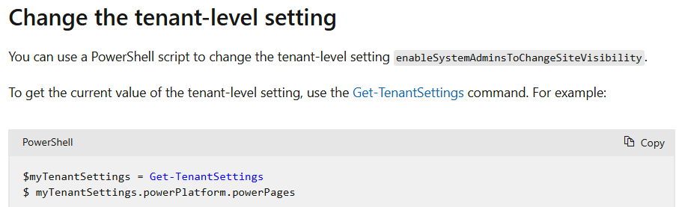
Site Visibility and why it rocks!
Private
Public
Default state for each site
Every site starts this way
Makers/Admin of Env
can see site by default
  Must manually share with each user in my tenant to see the site
  Outside tenant users or anonymous browsing impossible
You should lock-out this
toggle out to only Admins
All Prod sites even Intranet
https://learn.microsoft.com/en-us/power-pages/security/site-visibility
Notes:
https://learn.microsoft.com/en-us/power-pages/security/site-visibility

Slide 41
Security Layer Cake in Power Pages
It’s a lot of new information to learn for Power Pages, this will help!
Network Web Traffic Control (Web Application Firewall and IP Range)
User Access Modes & Identity Providers (Site setup and what do users login with)
Web Roles, Web Pages Access Permissions (Which users can access what pages)
Web Roles, Table Permissions (Which tables user can do what with)
Power Pages Web API & Power Automate & File Storage & Power BI Configurations
Web Application Policies (Content Protection Policy)

Slide 42
Security Testing (Web App Security)
 | Did not review
Pages Deep Scan
(Preview 2024)
  Not Reviewed
3rd Party / Own ITSec Scanning
  Did not discuss in the review
Why is this important?
Settings like X-HTTP-FRAME and other XSS settings need to be setup to meet modern security postures.
Have ample time. Addressing some of these items might take time (research/understand, remediate,
re-scan/review results, meetings)
Recommendation:
Run Power Pages Deep Scan (Available commercial cloud only at first) Please review obligations and leave room to remediate via Pages security settings or WAF changes If any Pages platform Security bugs suspected submit via MS Support Ticket directly.

Slide 43
Microsoft Power Pages: Low Code to Pro Code Capabilities
NO to LOW CODE
PRO CODE
Inside Power Pages
Power Pages’ Standard Features
Custom Front End UI & Code
JavaScript, HTML, CSS etc.
Configuration Features
Configuration
Native Data Controls
List, Form & Multi-Step Form
Custom Page Layouts and Stylesheets
Web Pages and Page Content
Core Styling themes
Authentication & Authorization
Multi-Language Support
Content Snippets
Site Settings
+ more
Custom Grid or Input Form
Custom Data Presentation
Unbound
Code Component (PCF)
Field-type Code
Component (PCF)
Dataset Code Component (PCF)
Liquid Code
(Personalization, Data Query, Server-Side Logic Pre-Render)
Power Pages Web API
(Full CRUD to Dataverse
+ Power Automate trigger)
Power Pages Data Layer
Authorization User Security Layer (Web Roles + Table Permissions)
Copilot
Studio
Power BI &
Power BI
Embedded
w/ RLS
Dataverse (Dynamics 365)
Tables, Columns, Relationships , Data Schema and Data Storage
Power Pages
Trigger Action
Azure
API-M
Dataverse Plugins
Virtual Tables *
Power Automate
Your APIs
1000+ connectors
Custom Connectors
On Prem Connectors
SAP
Connectors
AI Builder
Azure AI
GPT
Other Data Sources

Slide 44
The 4 things are to review in each website are:
How can users sign-up or login
What access do users get immediately
Do any tables have all rows accessible
If Web API is enabled for which columns

Slide 45
User Identity
 | No Concerns
Why is this important?
A real IdP is best for all users
Local Authentication will be deprecated in future by Microsoft and is not a real IdP which another website can re-use
User Identity Providers
  AAD B2C
Local Auth
  Not using
Recommendation:
Review roadmap for Entra External ID migration deadlines, as it becomes clear Power Pages support for EEID is very close to ready

Slide 46
Data Security
 | Concern
Why is this important?
Table Permissions and Web Roles drive the most important aspect of Pages website – users access to data, misconfiguration here can lead to data exposure.
Web Roles Reviewed
  Only 1 default web role
Table Permissions Reviewed
  Review Global scope in Table1/Table2
Web API columns set
  Specific columns listed
Recommendation:
Global might not be a concern if business requirement is to have this ability for brokers Web API does not need a separate Web Role –API uses run-time user data permissions Why have Table Permission for adx_* tables? This would be concern for Migration to EDM Ensure Default web role and default Authenticated web role permissions are appropriate

Slide 47
Identity Checklist
Ask who the audience is for the website
Review what IdPs enabled in Studio
  Do they make sense?
Local Authentication is to be highly discriminated against
Does the site need to SSO?
  If so then page permissions and IdP defaults need to be aligned
If only 1 Login method
  is Login Page needed?
  Consider Set as Default
  If need more than 1 IdP check out the Login page for UX review and discuss Login Pages copy and Content Snippets
Does IdP verify Email Addresses? It should be!
    Local Login Email validation req additionals
Do you need MFA?
Notes:
MFA – Multi-factor Authentication
IdP – Identity Provider

Slide 48
Identity Checklist (Continued)
Do IdP system collect or hold special IDs on user records
  These sometimes need to be user for mapped as identifiers to be existing data Customer ID or Vendor ID (see Data Security next section)
Do you need Invitation?
Discuss registration process what users get to do right away on the site once they Auth
  OpenRegistration state
Do you need Invitation process?
  Disable if not needed
If using Local Authentication
  Enable Captcha on Registration page
  Setup Email Validation and Password Reset workflows

Slide 49
Web Pages Permission Checklist
What is site purpose?
  Anonymous-only
  Authenticated-only
  Mix
If Authenticated-only : Does the site need a Home page?
  There is a potential licensing cost there, discuss 24 hours to login or else anon
Does the site need to SSO?
  If so then page permissions and IdP defaults need to be aligned carefully to help realize this scenario
Navigation hidden but still active live pages make sense?
  Example in most sites: Contact Us
Check Pages list and review Pages permissions make sense
  Look for anything that stands out like a details page that is not protected
  There should not be any test or POC playground pages left over

Slide 50
User & Data Security Checklist for Power Pages sites
Open Web Roles list and review
Check Web Role common misconfiguration with 1+ defaults Anon/Auth
Web Role changes after user logged in? Discuss cache impact re-login / alternatives
Open Table Permissions and review
Table Permissions with Global scope are elevated as risks to review meeting biz req’s
Same table for same web role – review for unnecessary/ duplicates – consolidate where needed, notice any layer with default web roles that is already in effect. Impact is added query logic can slow down perf.
No Web API specific Web Roles – explain how API uses Users actual user runtime
Web API column scope set to * is a risk, use specific columns – demonstrate if needed
Web API - use column permission as needed (Ex: Read-only for ‘Application Status’ column)
General: No code should be do data security trimming – start with Table Permissions 1st

Slide 51
Demo
“Just a simple site“

Slide 52
Resources

Slide 53
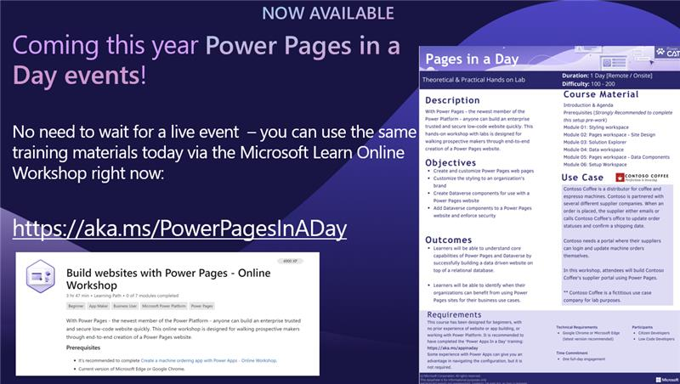
Notes:
https://aka.ms/PowerPagesInADay

Slide 54
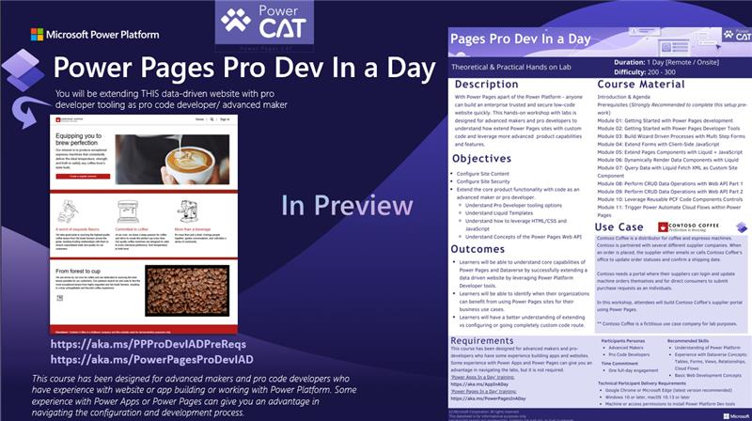
Notes:
Power Pages Pro Dev
https://aka.ms/PPProDevIADPreReqs
https://aka.ms/PowerPagesProDevIAD

Slide 55
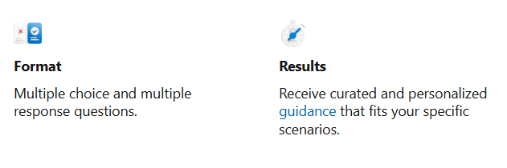
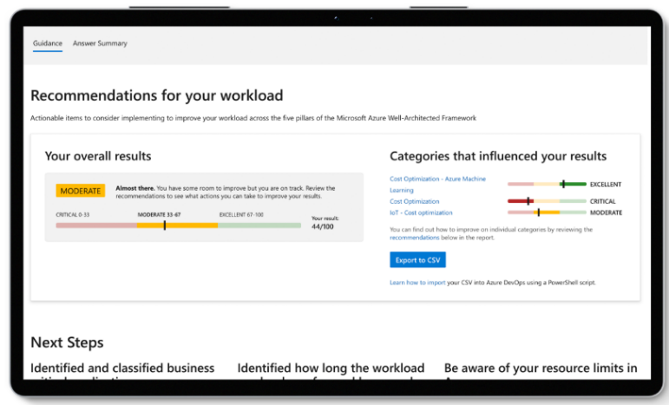
NEW! Power CAT Solution Assessment Tool https://aka.ms/pasolutionreview
Notes:
https://aka.ms/pasolutionreview

Slide 56
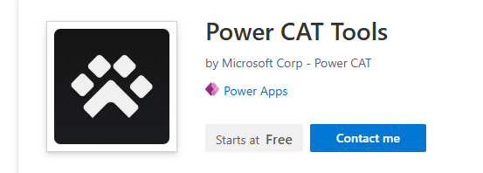
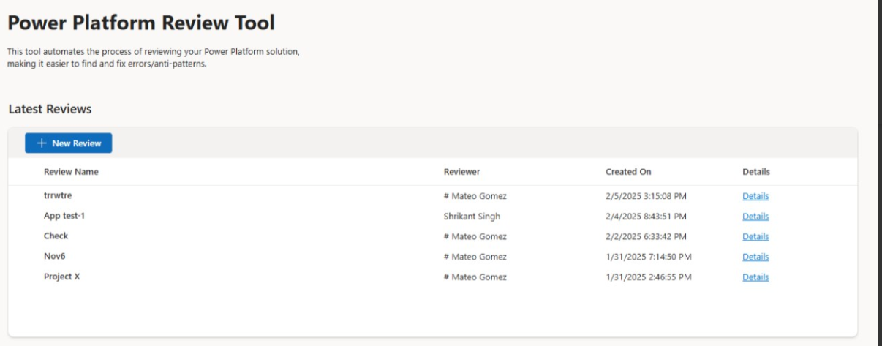
NEW! Power CAT Solution Review Tool https://appsource.microsoft.com/en-us/product/dynamics-365/microsoftpowercatarch.powercattools
Notes:
https://appsource.microsoft.com/en-us/product/dynamics-365/microsoftpowercatarch.powercattools

Slide 57
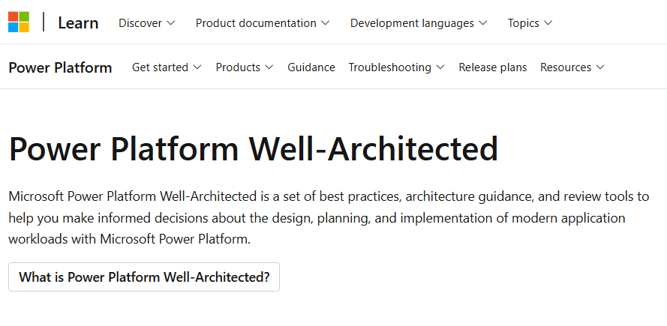
Coming soon : Power Pages User & Data Security https://aka.ms/PoWA
Notes:
https://aka.ms/PoWA
https://aka.ms/pasolutionreview
https://appsource.microsoft.com/en-us/product/dynamics-365/microsoftpowercatarch.powercattools

Slide 58
Question 1: Power CAT Solution Review process shown here today would be useful in the following format:
Power Point is fine actually
Solution Assessment Toolkit
(Web Quiz Online)
Power Platform Review Tool (Power CAT Solution Analyzer)
Other – let us know!

Slide 59
Q2: Do you have projects you would want to use Power CAT Solution Review process in ?
Yes
Not now, but Interested
No

Slide 60
Thank You! Now Q&A
Do you want to be the first to pilot
Power Pages Solution Review process?
Please reach out:
Nikita.Polyakov@Microsoft.com

Slide 61

Thank You! Nikita.Polyakov@Microsoft.com

