Slide 1
Production
Scheduling

Slide 2


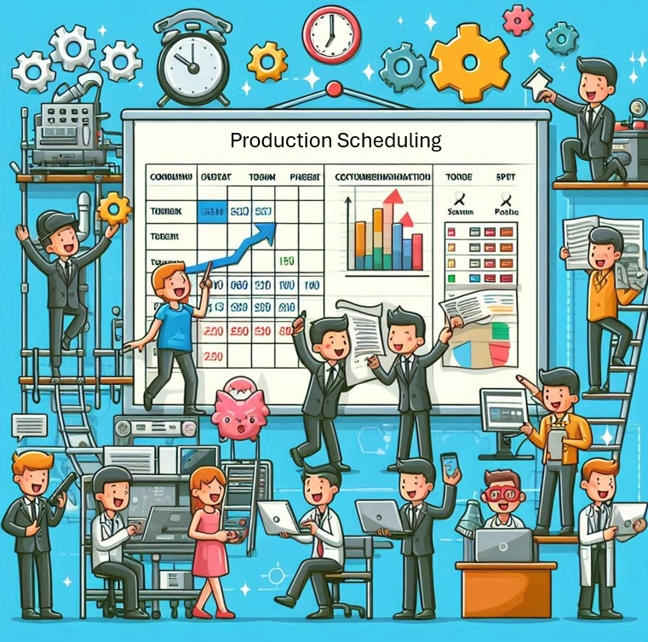




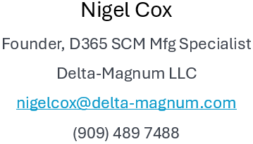
Delta-Magnum.com

Slide 3
Production Scheduling
Agenda
  The higher goal
  How does Scheduling fit in SCM?
    Demand Planning
    Master Production Scheduling
    Master Planning
    Capacity Planning
  The role of Action Messages – Pro-active vs. Reactive SCM
  Scheduling vs. Planning
  Production Release
  Gantt Charting
  Dispatching
  Production Lead Time

Slide 4
The Higher Goal
Good Planning and Scheduling

Slide 5
Demand Planning
Sales and Operations Planning
  C-Suite and Stakeholder Collaboration
    Demand Planner
    Master Planner
    Sales
    Operations
    Marketing
    Finance
  Typically a Monthly meeting
  With huge prep by Demand Planner - Better forecasts
  With huge prep by Master Planner- Supply constraint visibility
  Balance Chase vs. Level Load
  - developing an inventory plan
  Consider Minimum Keys

Slide 6
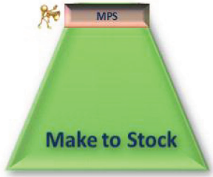
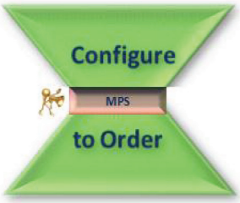
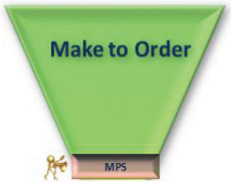
Master Production Scheduling
Make to Stock
Configure to order
Make to Order

Slide 7
MRP – Material Requirements Planning
Assumptions
Starting On-Hand
Open Sales Lines
Forecasts
Production/Batch Order BOM demand
Transfer Order demand
Journal Demand (Transfer, Movement, Count)
Safety Stock Level
Lead time
Bills of Material (BOMs)
Routes - only for lead time, capacity plan
and finite capacity constraint (optional)
Lot Sizing

Slide 8
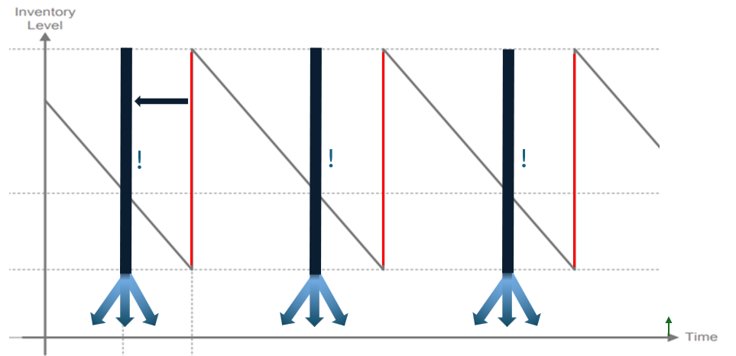
MRP – Material Requirements Planning
Net-Offset-Explode
Lumpy demand
Simultaneous availability of materials

Slide 9
Capacity Planning
Load vs. Capacity
Real vs. Planned orders
Project Accounting load/capacity
Finite vs. Infinite Capacity

Slide 10
The role of Action Messages
They are the difference between MRP and mere Order launch
Strategize and manage message level minimization
  Adequate planner capacity
  Smart coverage settings
    ABC analysis
  Safety Stock analysis
    Journals
    ABC Class
    Advance postpone margins
  S&OP
  Master Production Scheduling
  Minimum keys
Aim for every planner looking at every message every day:
  For their items (can stagger by day)
  For a given set of Advance and Postpone margins (and tighten)
  For a give time horizon (and expand)

Slide 11
And that is all to set the best possible scene
Improving the odds of viability!
For Production Scheduling
and then releasing to the Floor
with ongoing dispatching

Slide 12
Production Lead Time
Routing (Activated, Dimension, Site)
Item Coverage (Dimension, Warehouse)
Default Order Settings (Site based)
Item master (Company wide)

Slide 13
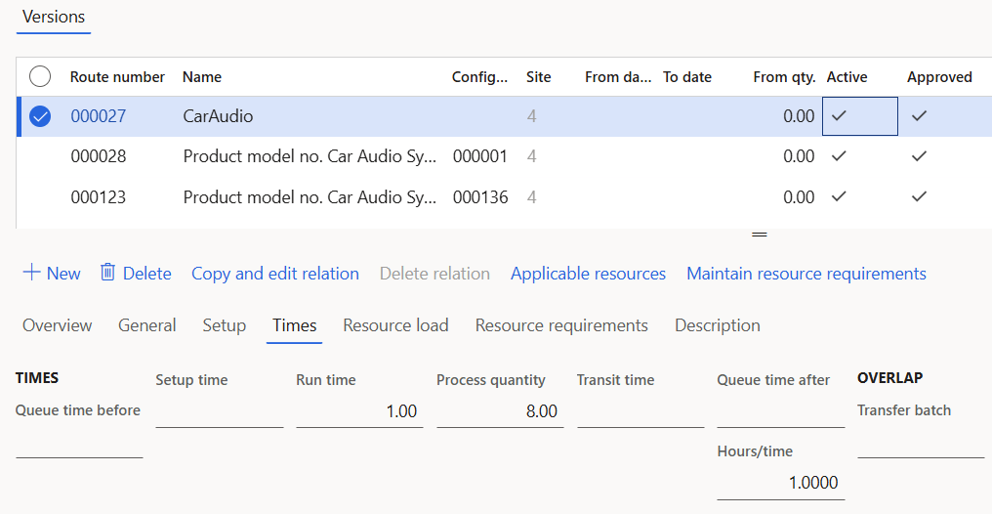
Production Lead Time Elements
Queue
before
Setup
Run
Quantity
Transit
Queue
after

Slide 14
Lead Time Margins
All lead times are subject to Margins
  Issue
  Receipt
  Order
Beware: each is cumulative!
  Coverage
  Plan
  Parameters

Slide 15
Lead Time Margins Best Practice
Set to Zero
Only set at Coverage Group

Slide 16
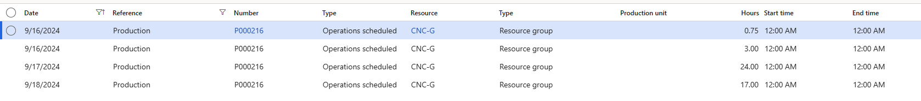
Operation Scheduling
Group level
Ignores Route Capability
No start/end time
Can’t use Gantt Chart or Dispatching
CAN use Material Availabilty! (now)

Slide 17
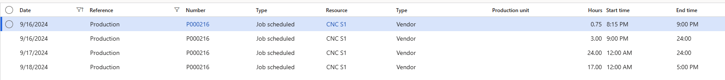
Job Scheduling
Resource scheduling
Resource Capability
Start and end times calculated
Can use Gantt Chart and Dispatching

Slide 18
Scheduling
Demo

Slide 19
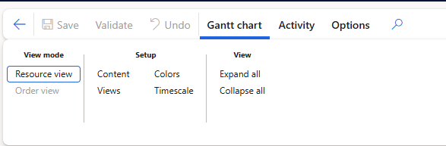
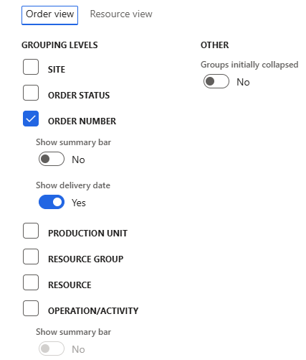
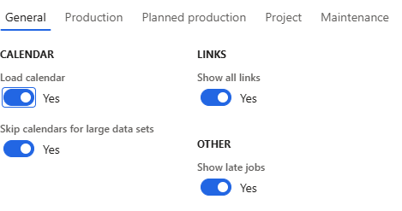
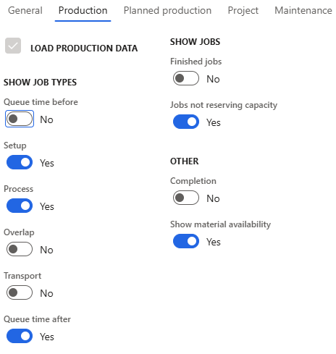
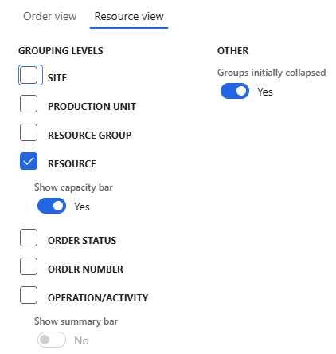
Gantt Charts
View
  Resource or Order level
Setup
  Content
  Views
  Color
  Timescale
Activity

Slide 20
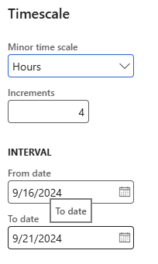
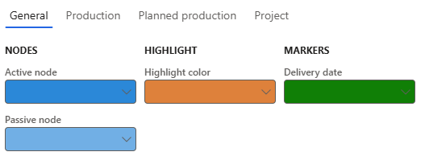
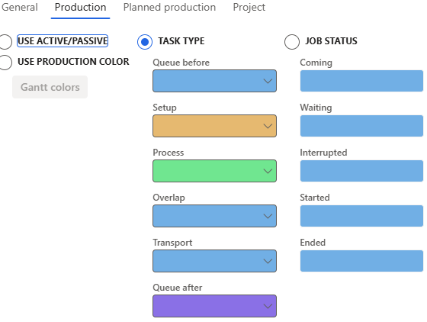
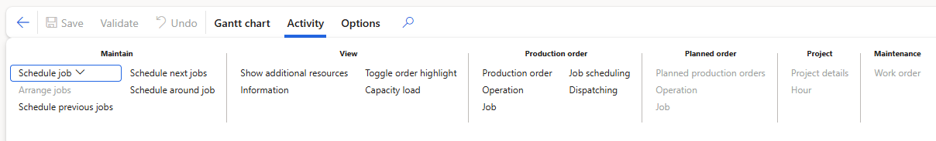
Gantt Charts
View
  Resource or Order level
Setup
  Content
  Views
  Color
  Timescale
Activity

Slide 21
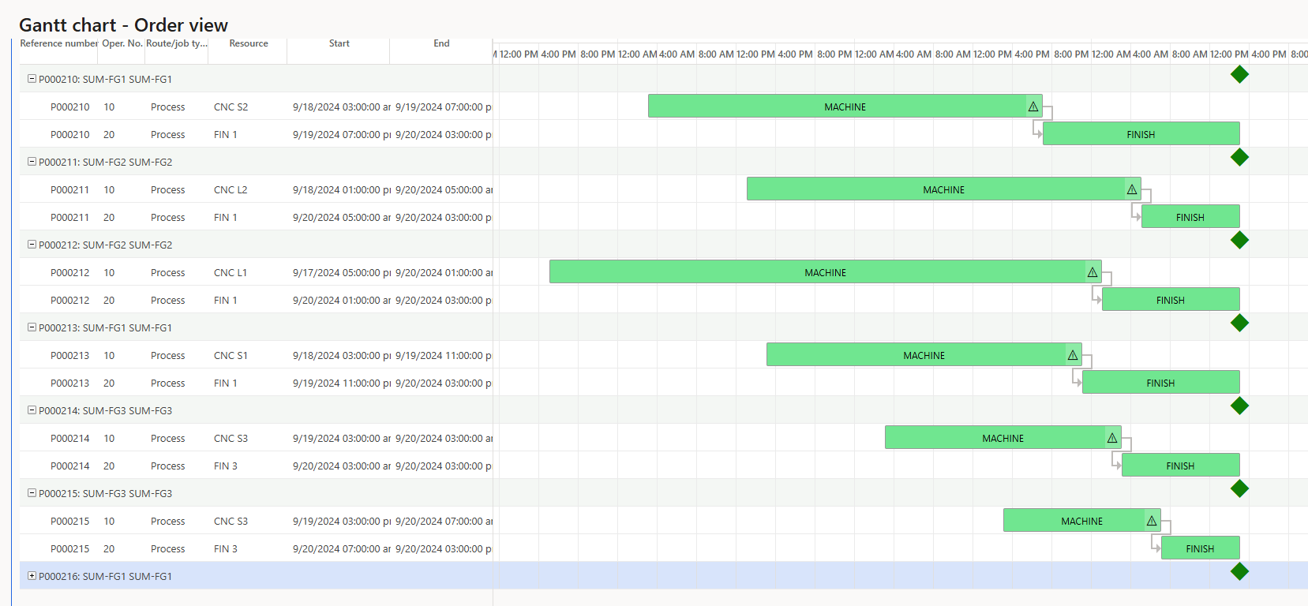
Gantt Charts
Order View

Slide 22
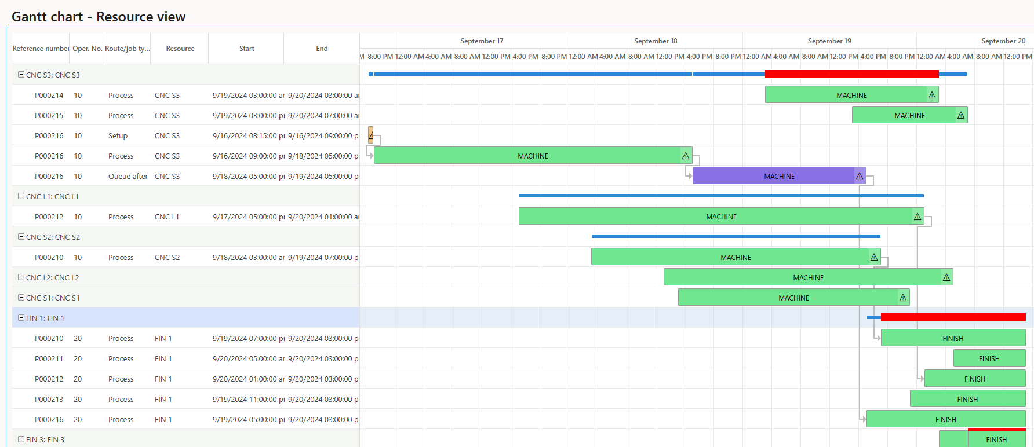
Gantt Charts
Resource View

Slide 23
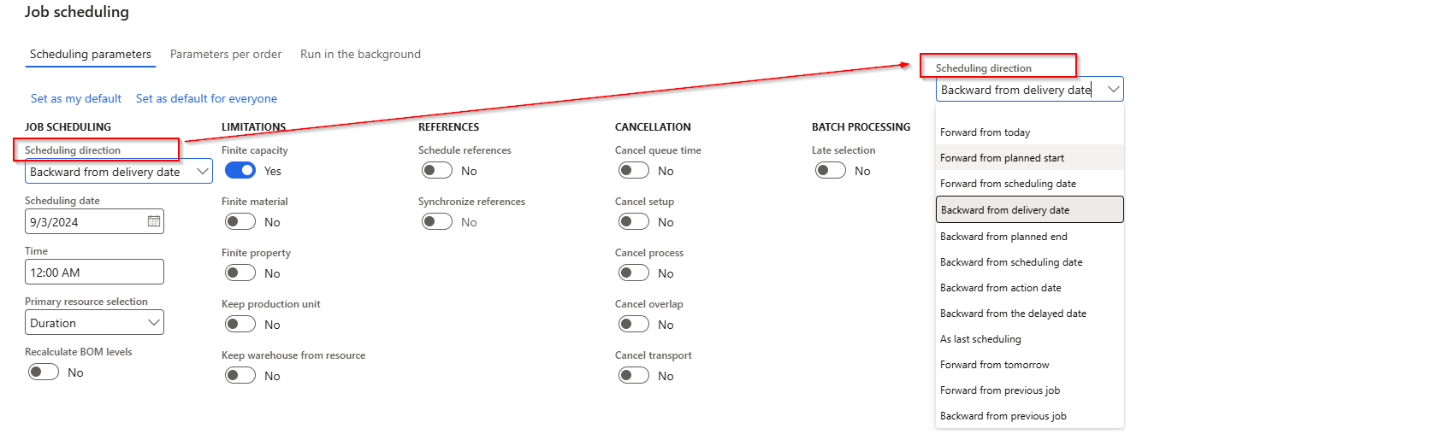
Scheduling Parameters

Slide 24
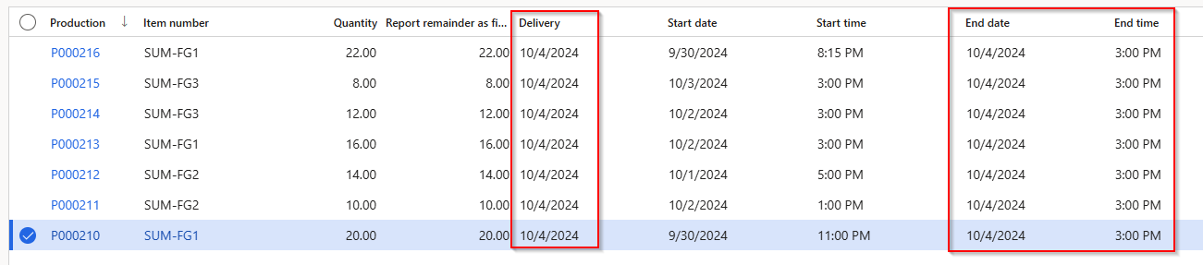
Scheduling Direction
Backward from delivery date
  This is the Master Planning default
  Plans for the latest possible start
  Does not allow for anything to go wrong
  Leaves potential gaps in the capacity load

Slide 25
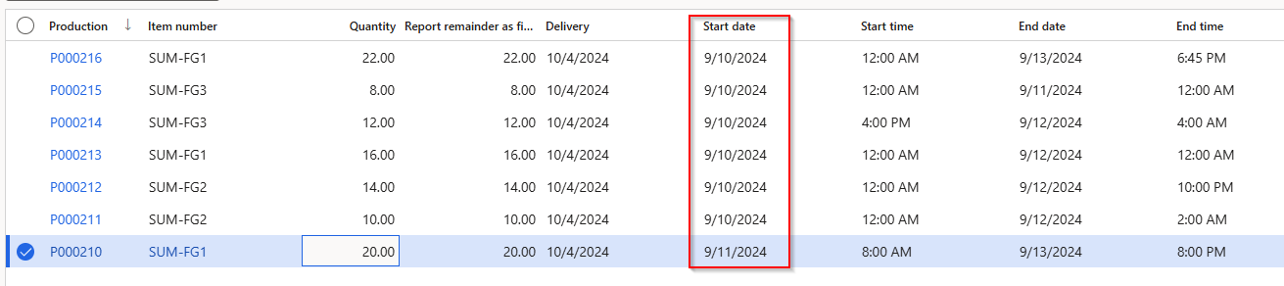
Scheduling Direction (cont…)
Forward from tomorrow
  Plans for the earliest start
  Assumes material is available (if Finite material flag = No)
  Compensates/fills more of the capacity load gaps

Slide 26
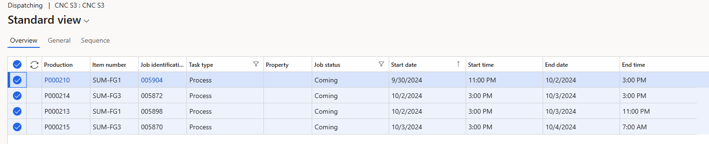
Dispatching
Available at the Resource level
Only available if Job Scheduling is used
Can be used to sequence orders

Slide 27
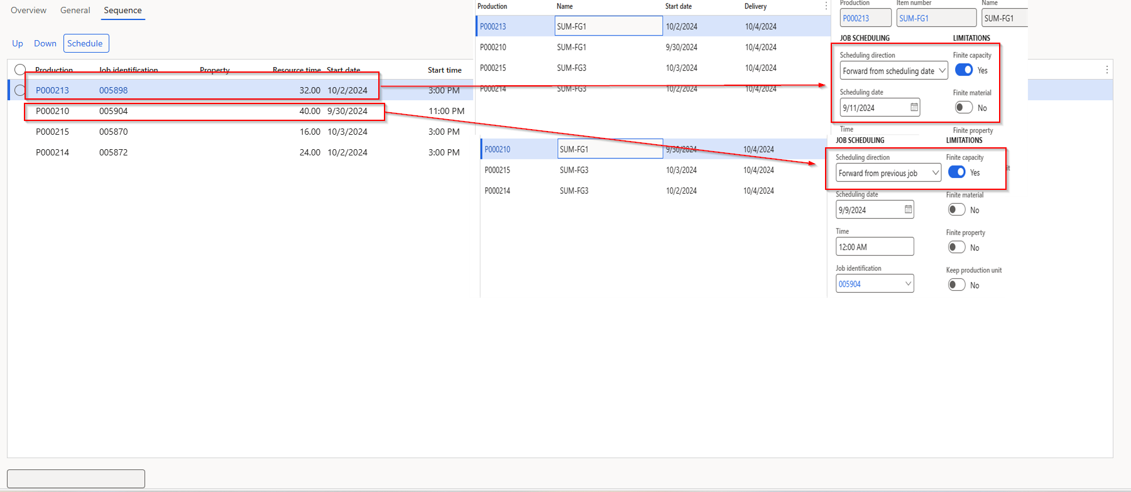
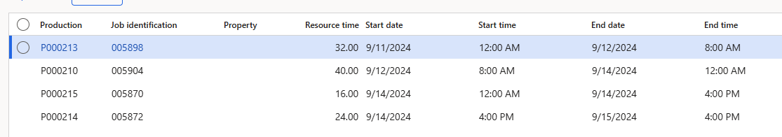
Dispatching (cont..)
Use up and down to arrange the orders
Pick the Scheduling Direction on the first order
Subsequent orders will be scheduled from the previous job

Slide 28
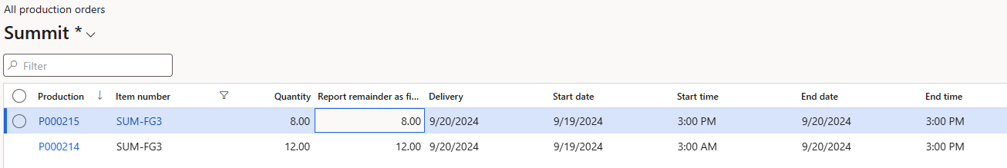
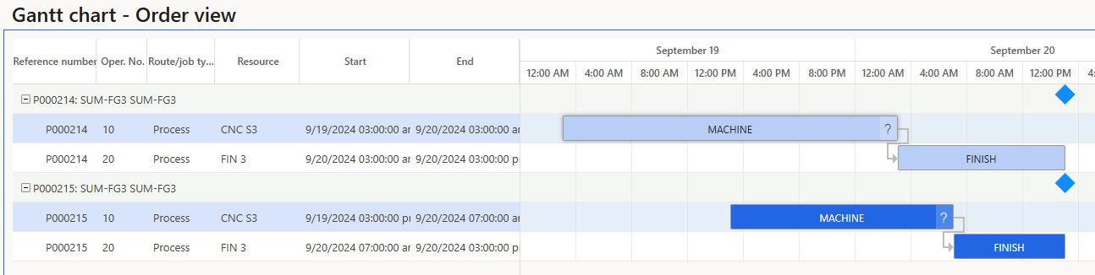
Infinite Capacity Scheduling
Assumes that sufficient capacity exists and may schedule many orders in the same time frame
Ignores resource constraints and plans production activities from the production order’s need date
Can help identify uneven workloads and overbooked capacity

Slide 29
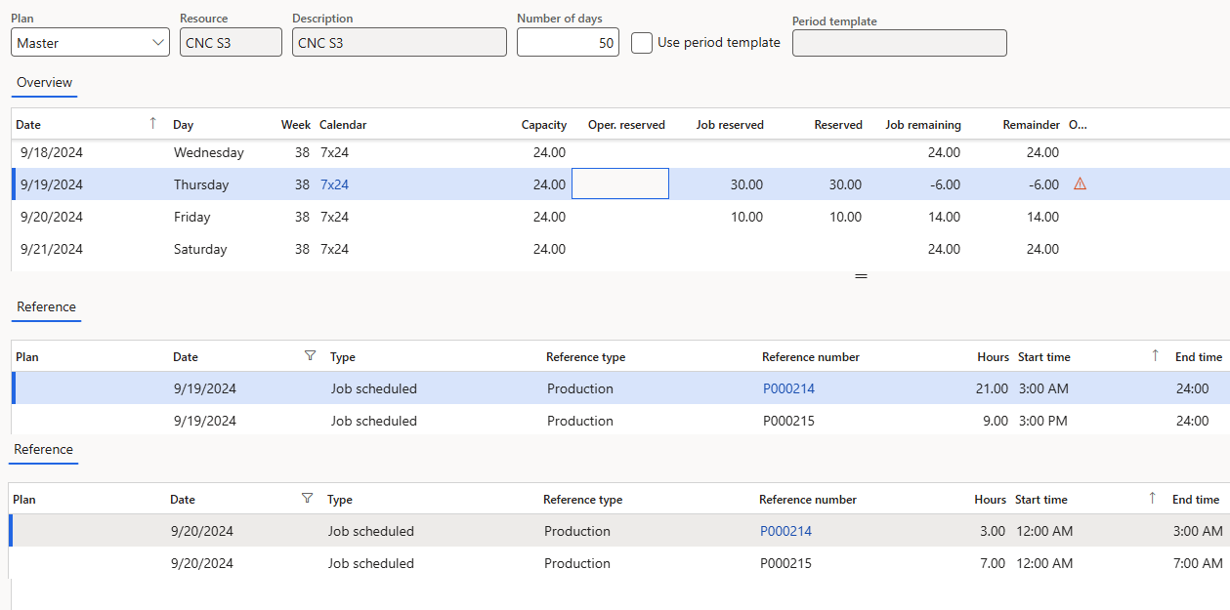
Infinite Capacity Scheduling (cont…)

Slide 30
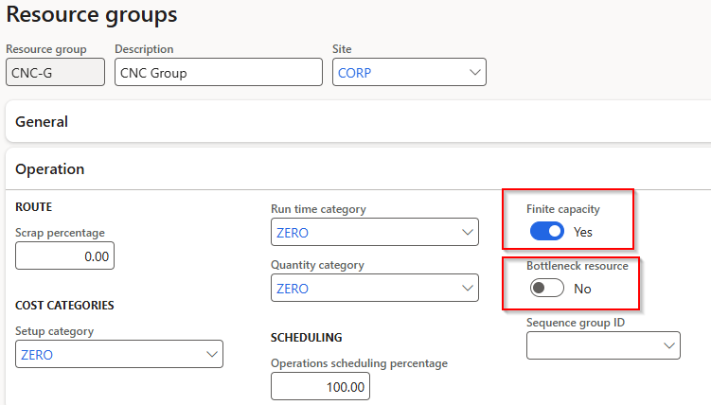
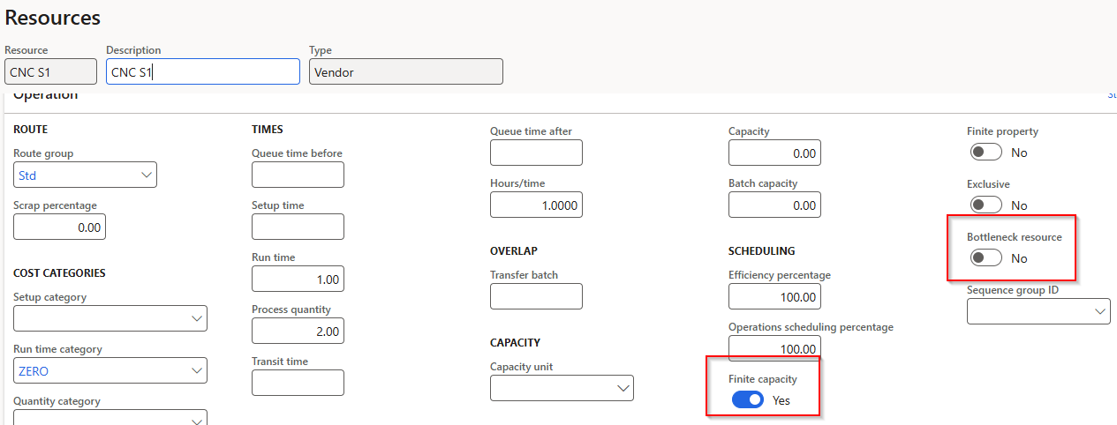
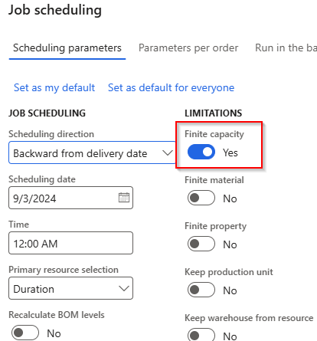
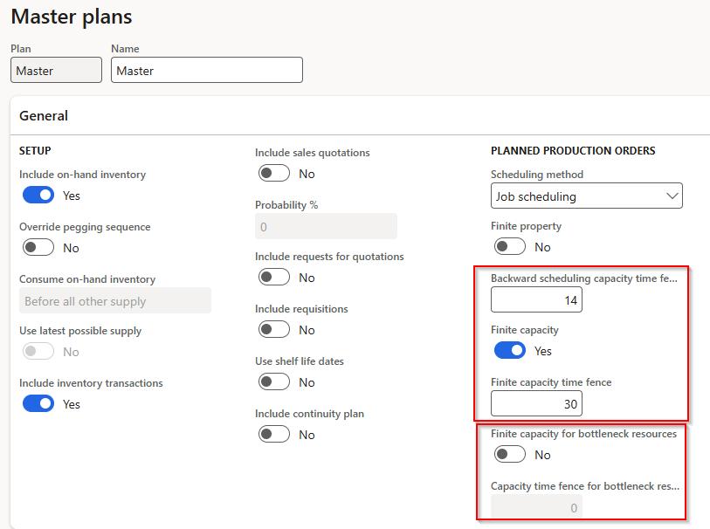
Finite Capacity Scheduling
Prerequisite setup required
  Resource Group and Resource
    Finite Capacity
    Bottleneck Resource (Optional)
  Job Scheduling
    Finite Capacity
  Master Plan
    Finite Capacity
    Finite Capacity Time Fence
    Backward Scheduling Capacity Time Fence
    Finite Capacity For Bottleneck Resources (Optional
    Capacity Time Fence for Bottleneck Resources (Optional)

Slide 31
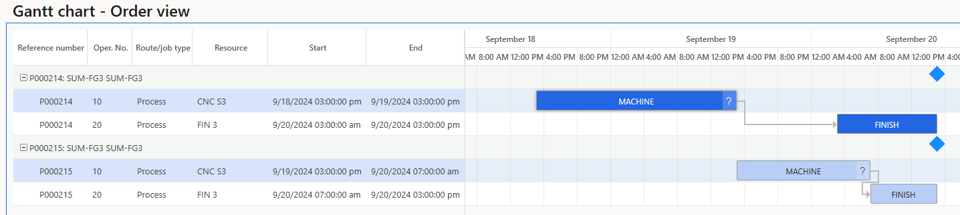
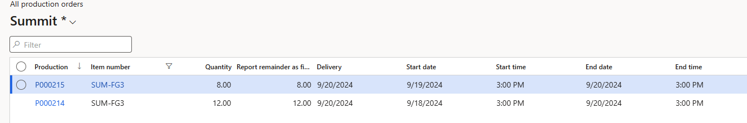
Finite Capacity Scheduling
Takes info account resource availability
Ensures schedule is realistic and feasible
Requires active management of messaging
Requires at least Resource and Job Scheduling to have Finite Capacity flags = Yes

Slide 32
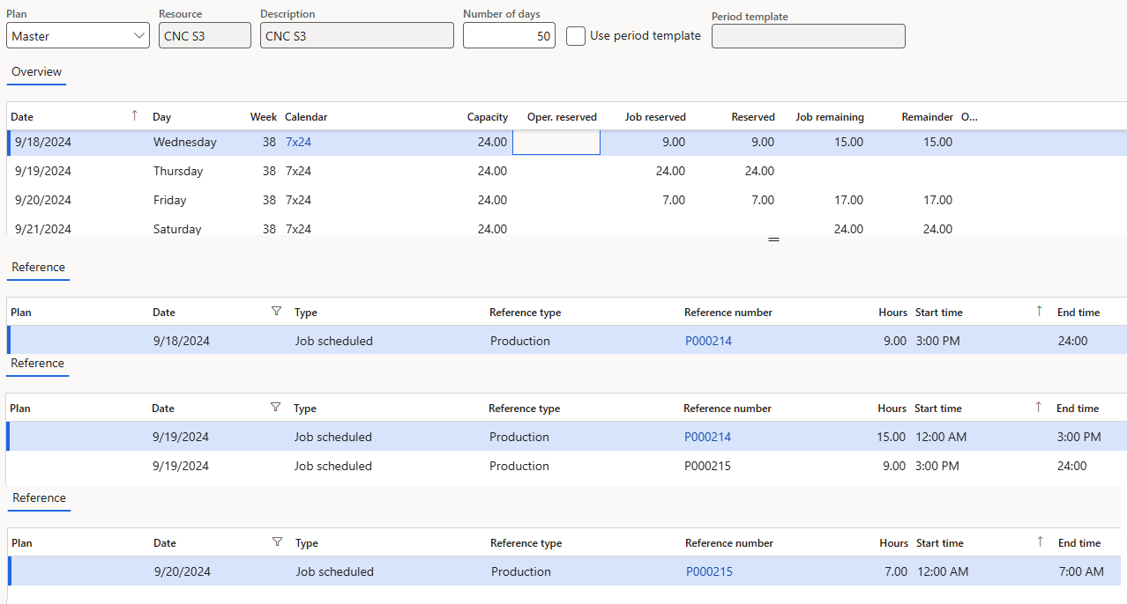
Finite Capacity Scheduling (cont…)

Slide 33
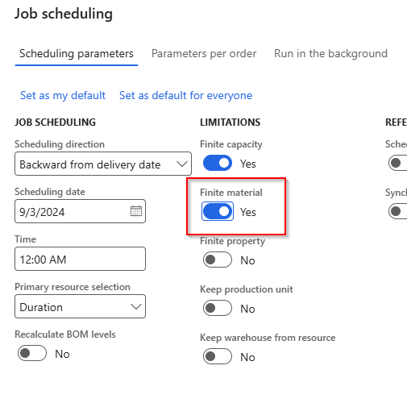
Finite Material
Ensures scheduled start date is not prior to material being available
Prerequisite setup:
  Job scheduling – Finite Material

Slide 34
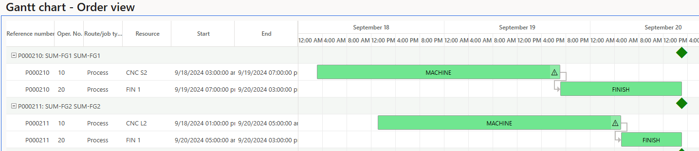
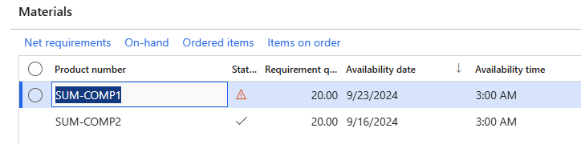
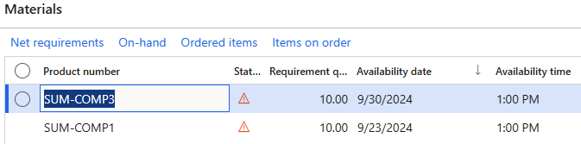
Finite Material = No
Component lead times
  SUM-COMP1 = 14 days
  SUM-COMP2 = 7 days
  SUM-COMP3 = 21 days
Current date = 9/9

Slide 35
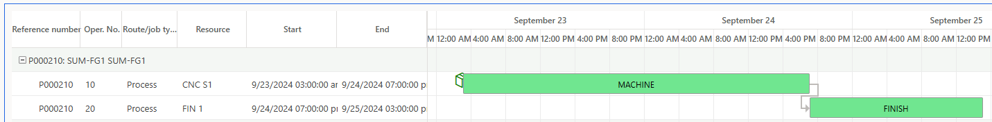
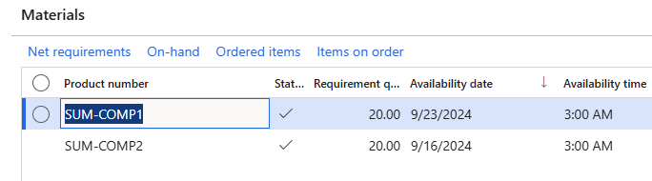
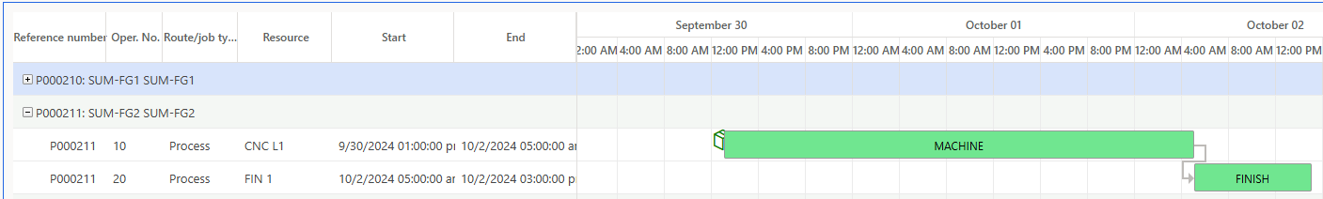
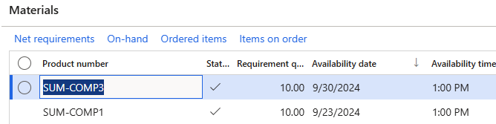
Finite Material = Yes
Component lead times
  SUM-COMP1 = 14 days
  SUM-COMP2 = 7 days
  SUM-COMP3 = 21 days
Current date = 9/9

Slide 36
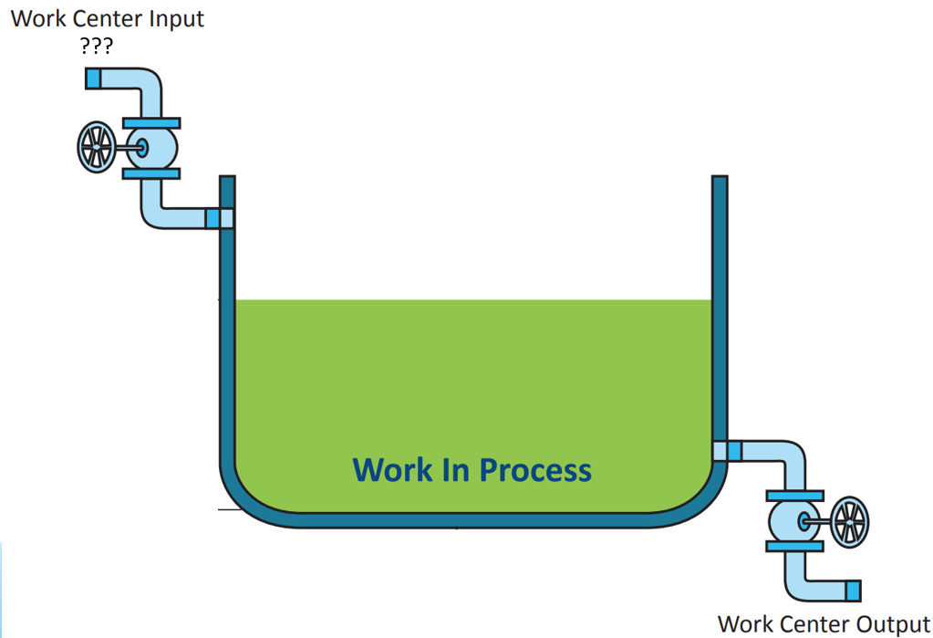

Where do hours released to Resources come from?

Slide 37
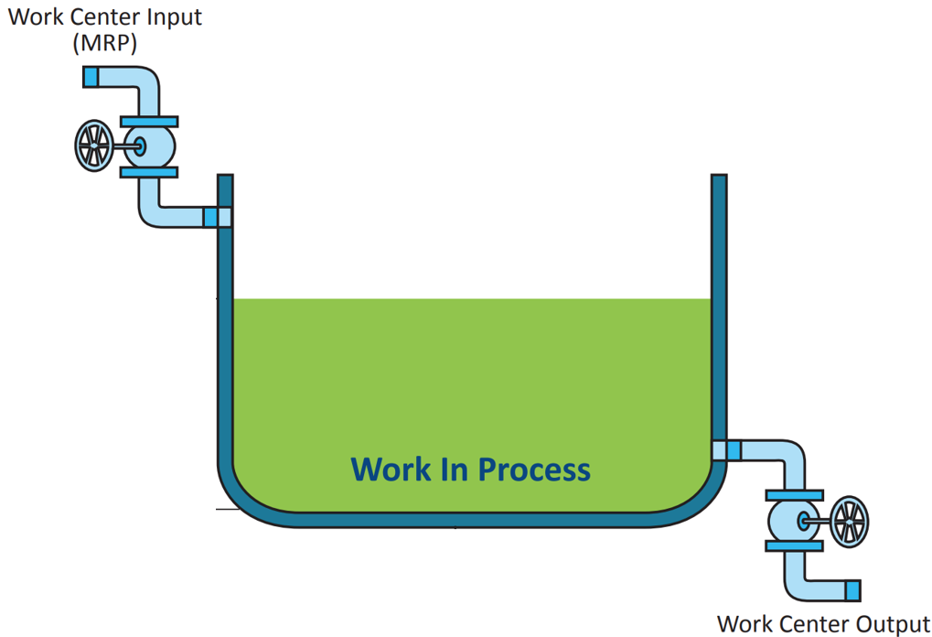
They come from firming planned orders
(or manually from hitting reorder points or triggering kanbans)

Slide 38
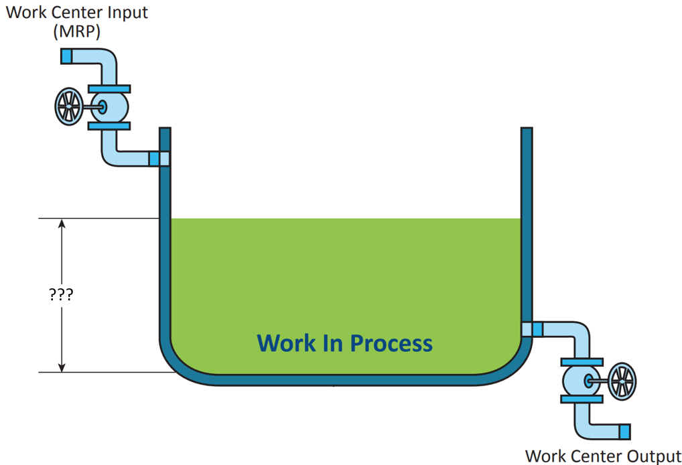
What is the D365 equivalent of the depth in the tank?

Slide 39
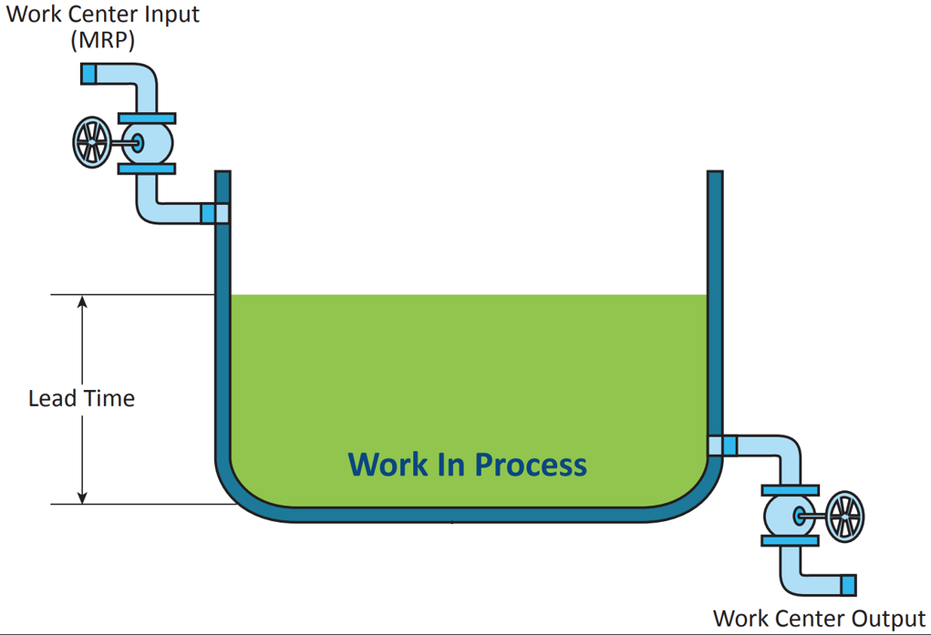

It’s the expected lead time
And the closer the MRP assumption, the better . . .

Slide 40
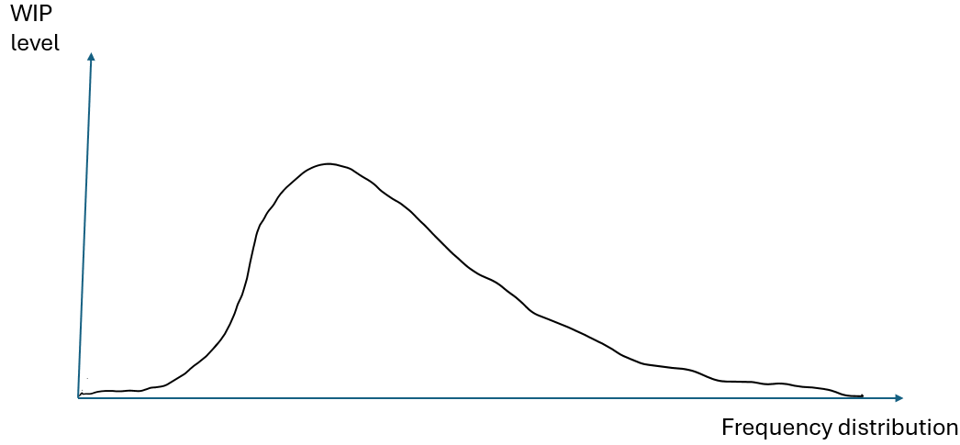
Best practice
At least model a Queue before time
Set this to the lowest value Operations agrees to and MONITOR
This can be defaulted from the Resource or Resource Group
but this is NOT dynamic!

Slide 41
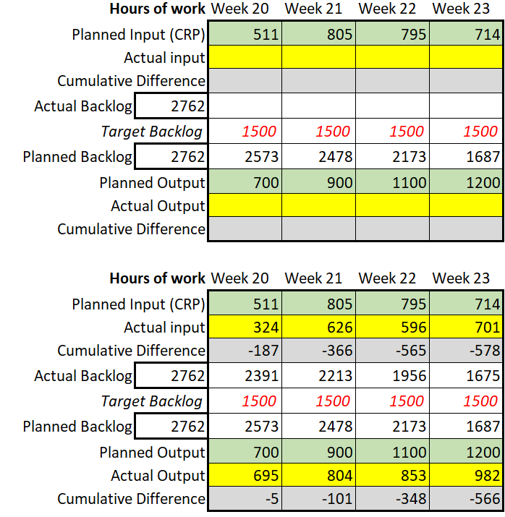
Input-Output Control

Slide 42

THE ELEMENTS AND BACKGROUNDS ON THE FOLLOWING PAGES CAN BE COPIED AND PASTED INTO YOUR SLIDES.​ VISIT DYNAMICSCON.COM TO DOWNLOAD MORE.
Questions?

Slide 43











Slide 44







Slide 45



Slide 46





Slide 47

Delta-Magnum.com

