Slide 2
Sales Tax in Business Central

Slide 3
Andrea Riviezzo, CPA, MBA
Riviezzo Consulting, LLC
NAVUG All Star, Former Member of Board of Advisors, and Denver CO Chapter Leader
2X Colorado State Champion
1x North American Champion
Dave Wiser
Solutions Architect & Functional Consultant
Tigunia
NAVUG All Star, Programming Committee, Former Member of Board of Advisors, and Former Seattle WA Chapter Leader

Slide 4
Session Objectives & Agenda
What will you learn today?
Understand the current sales tax environment and recent sales tax developments.
Understand how to set up Business Central to account for and report sales tax.
Understand how to deal with sales tax audit and document management.

Slide 5
Current Sales Tax Environment

Slide 6
What is Nexus? And when do you have it?
Nexus is a legal term that refers to the requirement for companies doing business in a state to collect and pay tax on sales in that state.
How to know if you have Nexus:​
Physical Presence​
Having a Physical Location​
Salesperson or Consultant living in/working/entering a state ​
Having Inventory or the company's tangible personal property (TPP) in a state (even if Amazon owns the warehouse), ​
Performing services in a state,
Having a booth or even attending a trade show in some states​
Delivering inventory or TPP in a company vehicle​
Wayfair vs South Carolina ​
Economic Nexus – all states are going this way​
This is in additional to Physical Presence! ​
100 to 200 transactions, and can be as low as $100K in any 12-month period (seeing transactions limits reversing)

Slide 7
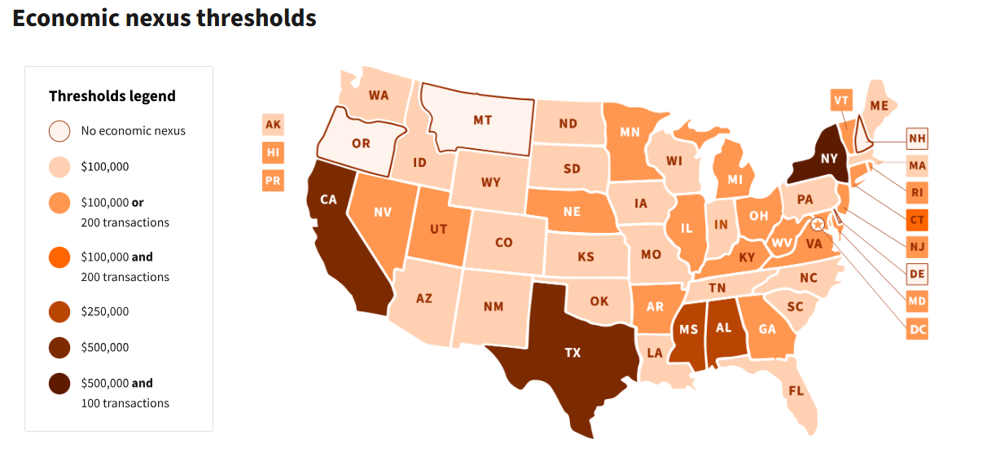
Current Economic Nexus

Slide 8
US Tax Laws Continued
Sales tax is imposed on retail transactions. It applies to all retail sales of tangible personal property (and services in some states) in the state.​
Use tax is imposed on consumers of tangible personal property that is used, consumed, or stored in the state. Consumer’s use tax applies to purchases from out-of-state vendors that are not required to collect tax on their sales. Cities, states, parish, countries can all make different decisions if use tax is required. ​
Tax is imposed on a customer if it is a state YOU are nexus in that they are shipping into and do not have a valid exemption. Just as tax may be opposed on you if you have a vendor drop ship into a state they are nexus and you are not (as you cannot provide a resell certificate).​
Overcharging sales tax can lead to civil penalties. The punishment for overcharging varies from state to state, and it is severe for companies that intentionally overcharge sales tax with the intention of keeping it.​
Never collect sales tax and not remit it to the State!

Slide 9
But what I offer isn’t taxable…
Be Careful!
Just because you think your product/service is non-taxable or it’s not taxable in your home state does not mean that all states feel that way or you don’t need to file/prove it’s not taxable
The Twix Bar Dilemma

Slide 10
How will I know if I have Nexus?
You can evaluate on your own by looking up each state you feel you may meet Nexus requirements
TaxJar.com, the states website, salestaxsupport.com
Outside CPA Firm – make sure to use one qualified to handle Sales Tax
TaxOps LLC
Nexus Study by a company
Avalara

Slide 11
Using Business Central to calculate Sales and Use Tax

Slide 12
Questions to Answer:
Who collecting tax for? (Tax Jurisdiction/Area)
What are the tax rates? (Tax Details)
What customers/vendors are liable for tax? (Customer/Vendor Card)
What items are taxable? (Item Card)

Slide 13
General Setups
Under General Ledger Setups, Vat Posting Setup (or Tax Posting Setup) >> Ensure it’s set to Sales Tax not Normal Tax
Do not mix VAT and US Tax unless you are using VAT in the US version of BC

Slide 14
General Setups
Specifies if the payment discount is calculated based on amounts including or excluding Tax.
Specifies whether to recalculate tax amounts when you post payments that trigger payment discounts.
Specifies whether to handle unrealized Tax, which is Tax that is calculated but not due until the invoice is paid.
Specifies whether to handle unrealized Tax, which is Tax that is calculated but not due until the invoice is paid.
Specifies the maximum Tax correction amount allowed for the local currency. For example, if you enter 5 in this field for British Pounds, then you can correct Tax amounts by up to five pounds.

Slide 15
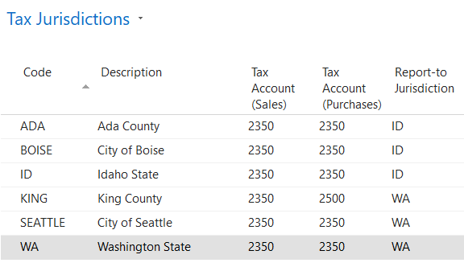
Tax Jurisdiction Setup
Set up each taxing jurisdiction which will collect sales/use tax. Tax will be calculated and reported for each jurisdiction.

Slide 16
Tax Jurisdiction Setup
Tax Account (Sales/Purchases) – Set the G/L account where the tax liability will be posted.
Report-to Jurisdiction – Specifies the reporting tax jurisdiction you want to associate with the jurisdiction you are setting up. For example, if you are setting up a jurisdiction for Seattle, WA, the report-to jurisdiction is WA because WA is the tax authority to which you report Seattle sales tax.

Slide 17
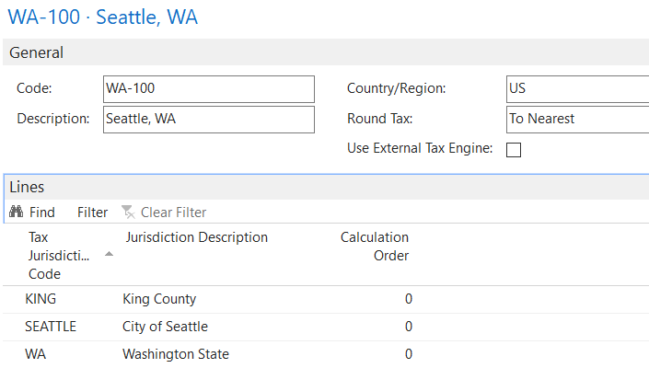
Tax Area Setup
Collection of jurisdictions to which the customer/vendor is subject. To be assigned to customers, vendors, and locations.

Slide 18
Tax Jurisdiction Setup
Tax Account (Sales/Purchases) – Set the G/L account where the tax liability will be posted.
Report-to Jurisdiction – Specifies the reporting tax jurisdiction you want to associate with the jurisdiction you are setting up. For example, if you are setting up a jurisdiction for Seattle, WA, the report-to jurisdiction is WA because WA is the tax authority to which you report Seattle sales tax.

Slide 19
Tax Area Setup
Grouping of jurisdictions assigned to customers and/or vendors.
List all jurisdictions that fall within the tax area.
Calculation Order is used to determine the sequence the program must use when tax is calculated. This setting is relevant when using the “Calculate Tax on Tax” feature.

Slide 20
Customer Card Setup
Taxable? What Jurisdictions?
Tax Liable
Tax Area Code
Tax Bus. Posting Group
Other Fields (no impact of sales tax):
Tax Identification Type
Tax Registration No.
Tax Exemption No.

Slide 21
Vendor Card Setup
Taxable? What Jurisdictions?
Tax Liable
Tax Area Code
Tax Bus. Posting Group
Other Fields (no impact of sales tax):
Tax Identification Type
Tax Registration No.

Slide 22
Location Card Setup
Setting can be used to provide tax area instead of vendor card.
Do Not Use for Tax Calculation Flag
Tax Area Code
Other Fields (no impact of sales tax):
Tax Exemption No.

Slide 23
Sales & Receivables Setup
Tax Differences

Slide 24
Purchases & Payable Setup
“Use Vendor’s Tax Area Code” Setting – Flag used to determine whether purchase transaction uses the Tax Area from the vendor card or from the location code on the purchase order/invoice.

Slide 25
Item Card Setup
What items are taxable?
Tax Group Code – Used to identify tax rates for tax jurisdiction.
Tax Prod. Posting Group – Together with Tax Bus. Posting Group can be used to determine the appropriate Tax Transaction Type on the Tax Posting Setup page.

Slide 26
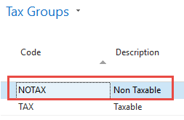
Tax Group Code Setup
Tax Group Codes are created and assigned to items to differentiate the tax rates for various groups of items.

Slide 27
Tax Detail Setup
The Tax Detail Setup is where all the previous setup steps come together to identify the actual tax rates to be used for sales and purchase transactions.
The Tax Jurisdiction Code and Tax Group Code combination is used to set rates for the transaction.

Slide 28
Tax Detail Setup
Tax Type – Used to determine whether rates apply to sales and/or use tax.
Effective Date – Start date when rates are effective.
Tax Below Maximum – Tax rate percentage.
Certain jurisdictions will adjust their tax rate based on the amount charged. For those jurisdictions, the Maximum Amount/Qty. and Tax Above Maximum fields can be used.

Slide 29
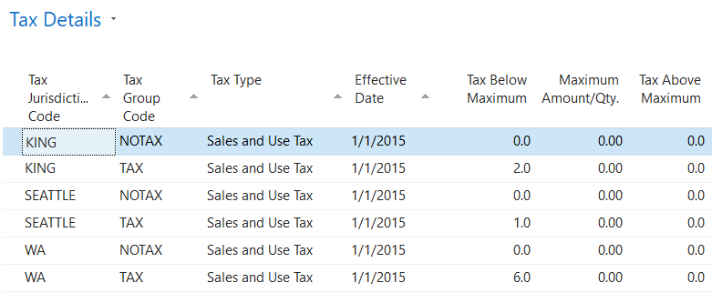
Tax Detail Setup

Slide 30
Demo

Slide 31
Sales Transaction Example
Customer 1000-Smith Retail to be used.
Tax Area for customer is WA-100 with the following jurisdictions:
WA – 6.0% tax rate
KING – 2.0% tax rate
SEATTLE – 1.0% tax rate
Total – 9.0% tax rate
Item 150 used with Tax Group Code of TAX
If using Prepayments watch for the Prepayment Includes Tax Flag

Slide 32
Sales Transaction Example

Slide 33
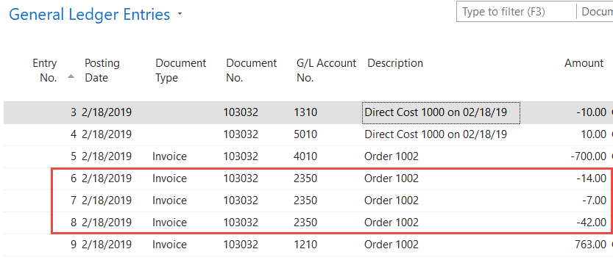
Sales Transaction Example
Posting Example – Note that a tax entry is made for each jurisdiction in the tax area code.

Slide 34
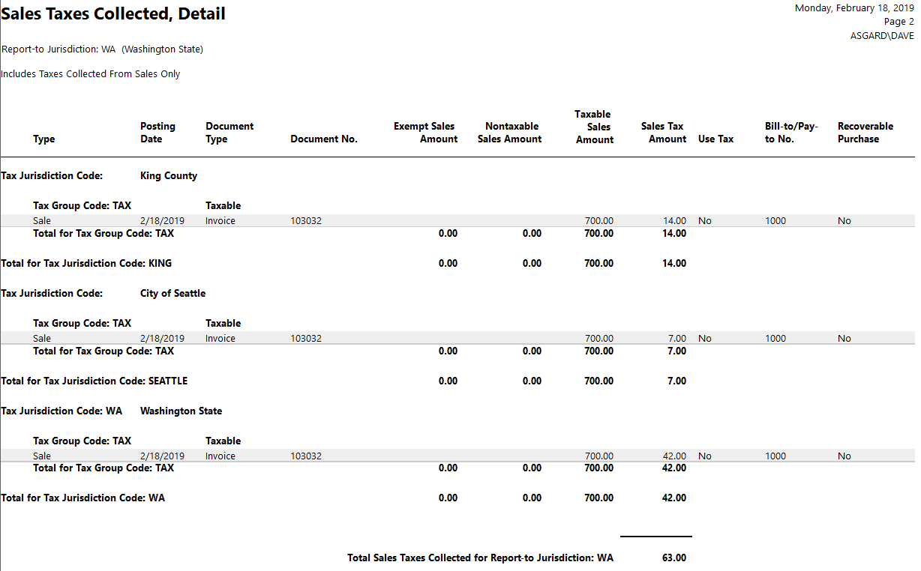
Sales Tax Collected Report
Report used to calculate the taxes posted for the desired period for the tax jurisdictions.

Slide 35
Use Tax Example
Processing Use Tax on Purchase Orders/Invoices is similar to calculating sales tax on sales documents.
The purchase document lines include a field labeled “Use Tax” which determines how the use tax is applied to the purchase line item.

Slide 36
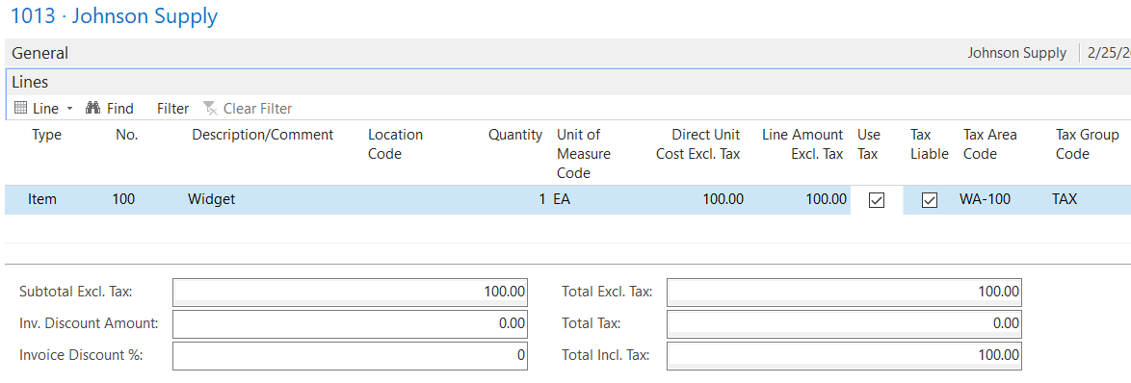
Use Tax Example
With the “Use Tax” flag checked, the vendor invoice is posted with the net amount posting to the vendor ledger entries…

Slide 37
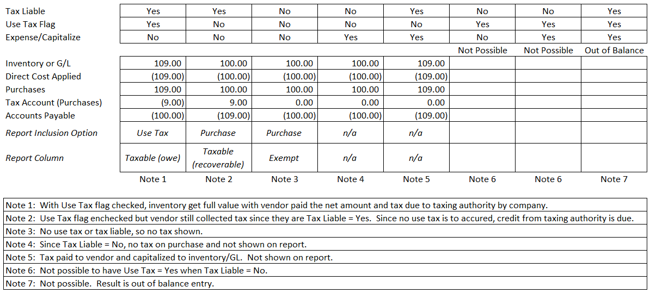
Use Tax Posting Summary

Slide 38
Use Tax
Be careful! The use tax module is more of an assumed self-assessment vs recording the amount the vendor charged. While you can, you will need 2 groups. One for self-assessed and one for vendor imposed that capitalizes the amount.

Slide 39
BC Built-In
Pro
Already there! Super easy setup and away you go
Limited to no integration time or cost
Easiest option for limited states/limited customers with tax
Con
Certificates need to be managed and ready for audit, numbers entered on ship-to level to be weary of drop-ship
Have to fill out each state filling and remit on time, can be time consuming and open to errors
Someone has to update in BC/NAV for each state, county, city, region and local

Slide 40
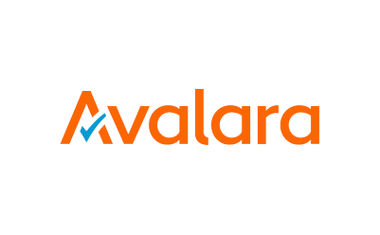
Outside System
Pro
They manage tax rates
Many have certificate management systems, that look for the cert and then apply the proper tax and alert for an expiring certificate
Many will file for you and even if you or the employee responsible is out of office there is no worries of filing late
Con
Can be expensive
Integration can be expensive and run longer than expected
What you configure is what you get
You have to learn a whole new system

Slide 41
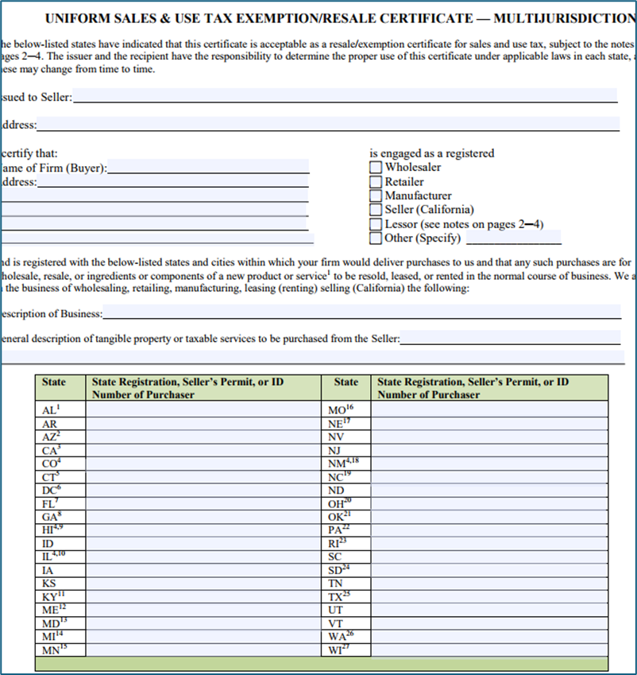
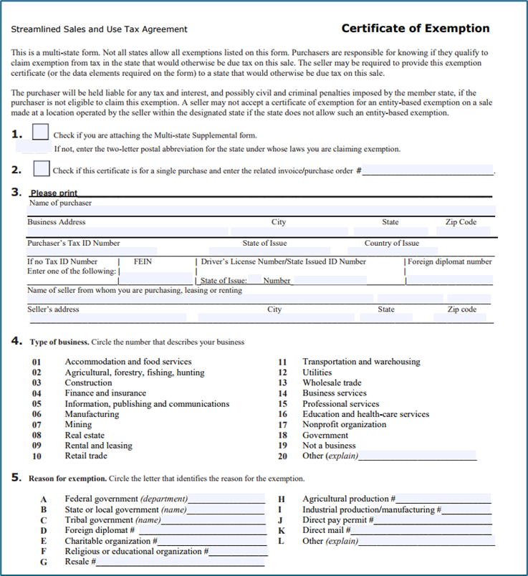
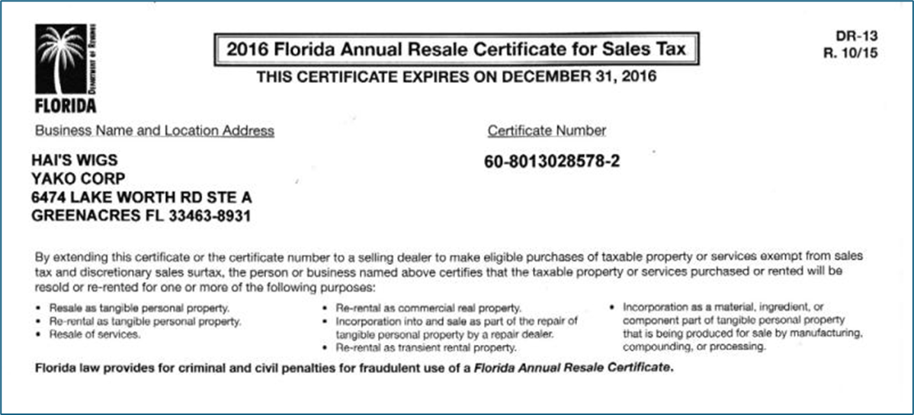
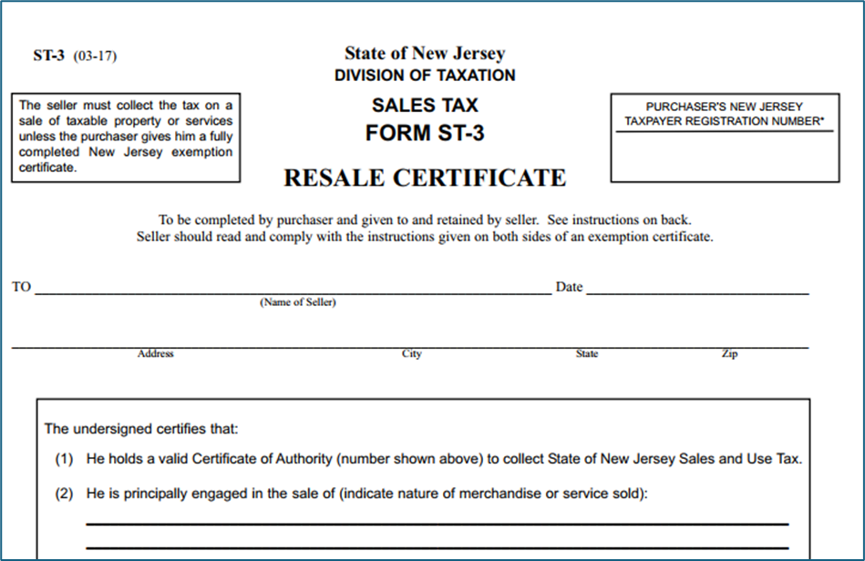
Exemptions
Generic State Issued Certificates
State Specific Forms -Required by certain states: NJ (ST-3), NY (ST-121) and VA (ST-12) are among those
MULTIJURISDICTION Form – multiple registered forms
Streamline Sales Tax Form (SSUTA, SST)
Proof goods left the state – like shipping documents

Slide 42
What to watch for?
If not generic watch for:
Your name and address are on them
Description is what they purchase from you, words like MISC or leaving blank could result in the cert being void
It is signed and dated – some forms do expire, others stay active forever (CO – 5 years, CA – never expires)
Auditors are more interested in sales you said were exempt vs sales that had tax
If you exempt a sale in error or without proper exemption the tax burden will fall on the company and any fines/interest. Audits are generally 3 years but some, like NY can legally go back 7 years.

Slide 43
Q&A

