Slide 2
Subcontracted Manufacturing in Business Central
Robin Finnell
Senior BC Consultant
Dexpro Dynamics
Notes:
Welcome to my breakout on Managing Resistance on a project or change initiative. If this is not the session name you expected to see, you are in the wrong room, but feel free to stay and learn more about resistance and how to address it.

Slide 3
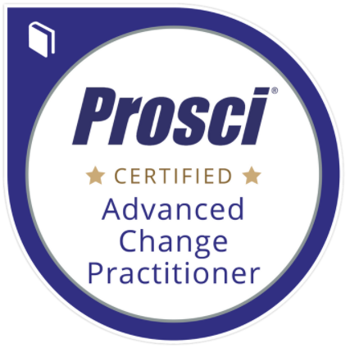
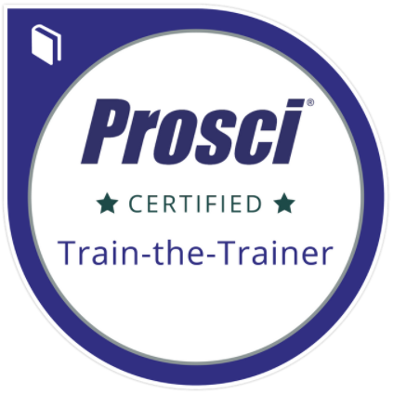
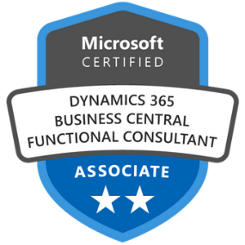
Robin Finnell
Sr. Business Central Consultant
(m) 503-801-2971
rfinnell@dexprodynamics.com
Notes:
A little bit about me… I am a MS certified functional consultant and have been in the MS space since 2008; first in NAV, then I took a short foray into F&O, then back into BC. I am certified as a trainer and advanced change management practitioner by Prosci, although I am change management agnostic. I don’t care which methodology you use; I just urge you to use it.

Slide 4
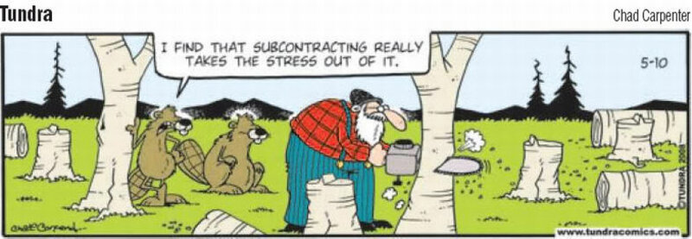
I FIND THAT SUBCONTRACTING REALLY TAKES THE STRESS OUT OF IT

Slide 5
Learning Objectives
Managing Subcontractor Consignment Inventory
Setting Up Subcontracting Work Centers
Setting Up Routings With Subcontracting Operation Steps
Live Demo -
Create Subcontracted PO
Process Subcontracted Production Order

Slide 6
Managing Subcontractor Consignment Inventory

Slide 7
Subcontractor Stockkeeping Units
Maintain Accurate Consignment Inventory
Set up reorder policies per SKU
Decrement inventory using:
Sales Invoice
Item Journal
Production Order

Slide 8
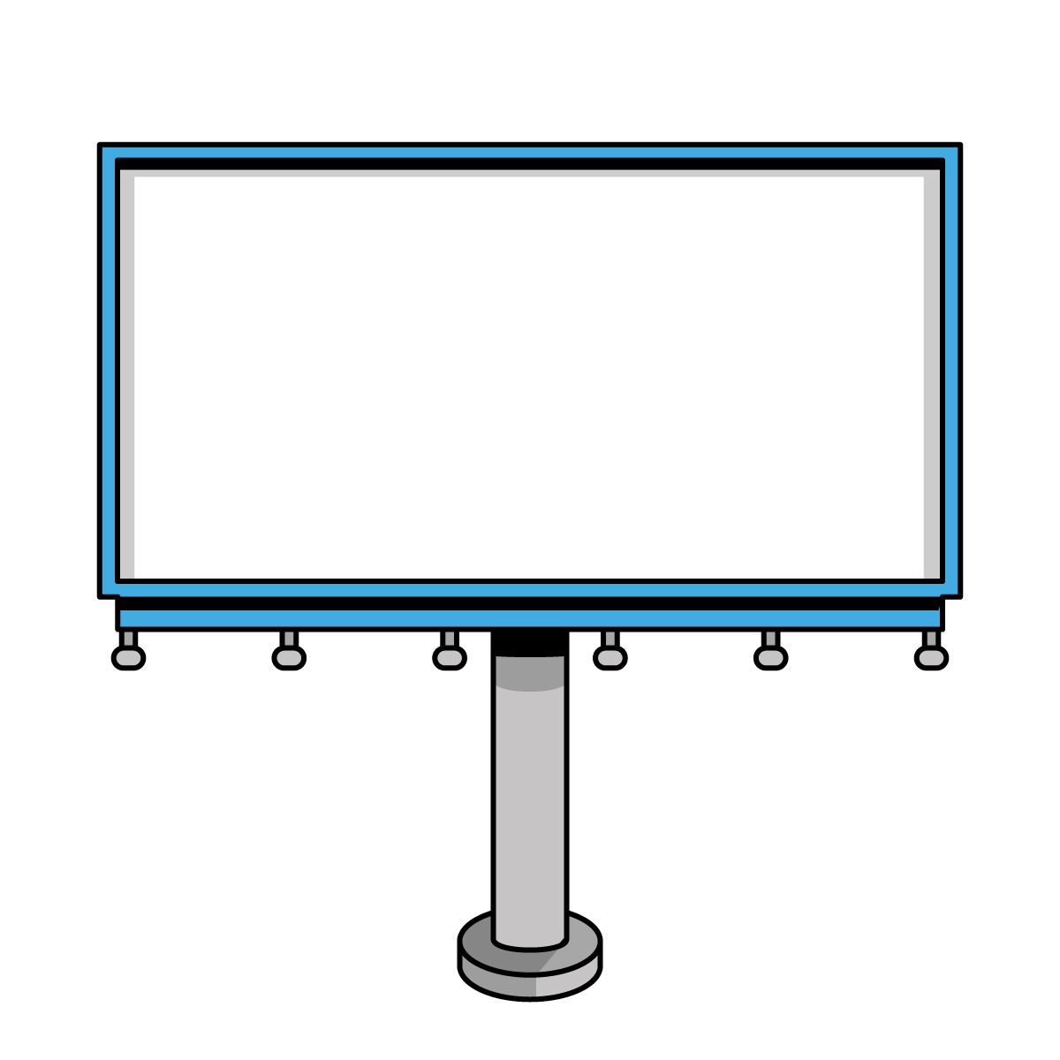
How many of you track inventory at vendor locations?

Slide 9
Setting up Subcontracting Work Centers

Slide 10
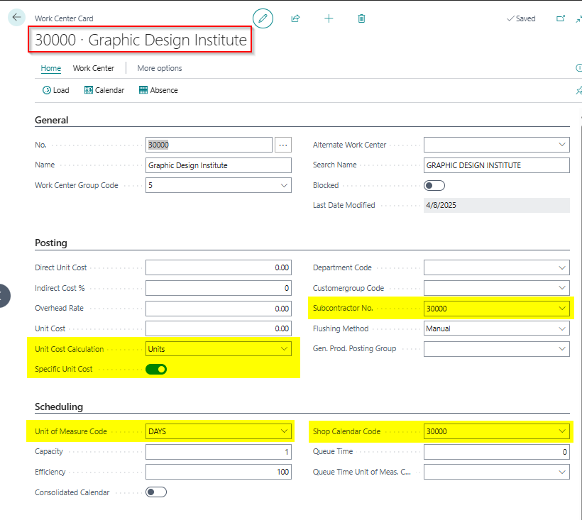
Setting up Subcontracting Work Centers
Posting Fast Tab
Unit Cost Calculation
Set up as Units – Usually
Cost generated per unit instead of a measurement of time
Specific Unit Cost
If toggled to true, the cost is item specific and set up on the routing line
Subcontractor No.
Links the work center to the vendor who does the subcontracted work - for PO creation
Scheduling Fast Tab
Unit of Measure Code
Set up as days - usually (unit of time the product will be at the subcontractor
Shop Calendar Code
This is specific to the vendor hours of operation
Notes:
If the Work Center is vendor specific, I tend to use the vendor number as the work center number

Slide 11
Setting Up Routings With Subcontracting Operation Steps

Slide 12
Setting Up Routings With Subcontracting Operation Steps
Wait Time - number of days(time) before you can expect items back from the subcontractor
Unit Cost per - this is where you enter the unit cost when it is specific to the routing and not to the work center in general
Notes:
If the subcontracted step is the last step of the routing…it will post an output entry to your production order when you receive the PO. If you want to verify your production order before posting the output entry, add a final step to the routing after the Subcontracted step.

Slide 13
Any questions about what we’ve covered so far?

Slide 14
Live Demo
Create Subcontracted PO
Process Subcontracted Production Order

Slide 15
Any questions?

Slide 16
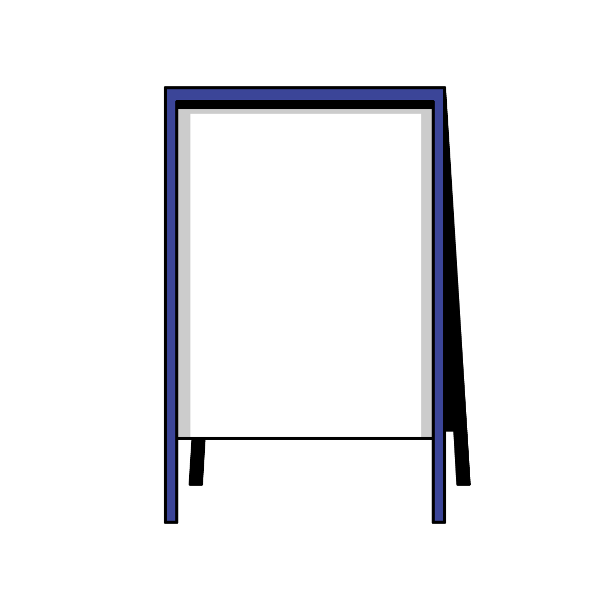
Shameless Survey Plug…
The session survey can be accessed via the session details in the mobile app

Slide 17
Want to Learn More?
Want to Learn More?
503-801-2971
rfinnell@dexprodynamics.com
LinkedIn

