Slide 2
Using AI to Improve Supply Chain Transparency

Slide 3
Speaker
30+ years in software, consulting & leadership
Deep experience in supply chain
Passionate about serving others
Hiking, fly fishing, skiing enthusiast
Jeffrey Porter
Chief Marketing Officer | StockIQ

Slide 4
Speaker
17+ years in various positions in supply chain software
Deep experience in forecasting and supply planning
Help manufacturers & distributors meet their financial / operational goals
Family activities and vacations

Slide 5
Agenda
Preface: AI, ML, data science, and math are put to good use.
How can I use AI to decide what information to gather?
Identify the decisions you want to improve with AI.
Gather sample data relating potential input variables to outcomes of interest.
Use filter models to estimate variable importance.
How can I use AI to summarize complex datasets?
Summarize the shape of the joint distribution.
Quantify degree of knowledge about the relationship between inputs and outputs.
Use unsupervised learning to discover groups and anomalies.
How can I use AI to guide attention to urgent or important data?
A known and predicted anomalies are the main source of urgency.
Important data has a disproportionate influence over decisions.
Value-of-information analysis guides attention to data you really need.

Slide 6
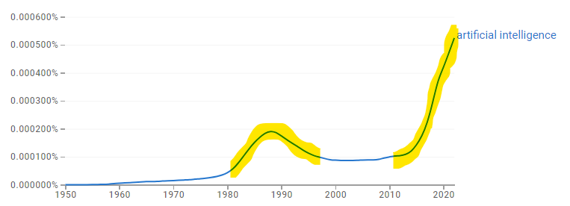
AI = ML = data science = applied math
The AI effect occurs when the definition of AI changes to exclude the capabilities of new AI.
*
*
*
*
https://books.google.com/ngrams/graph?content=artificial+intelligence&year_start=1950&year_end=2022

Slide 7
How can I use AI to decide what information to gather?

Slide 8
Identify the decisions you want to improve with AI.
AI is always about optimizing a decision.
Supplier and procurement AI optimizes how goods and services are obtained.
Inventory management and capacity planning AI optimizes how goods and services are held.
Logistics and distribution AI optimizes how goods and services are delivered.
Example: delivery risk management

Slide 9
Gather sample data relating potential input variables to outcomes of interest.
CRM and ERP systems are key data sources—better yet a data warehouse containing their data.
Alteryx, Knime, RapidMiner, and similar tools accelerate exploratory analysis.
R remains the richest exploratory-analysis toolkit.
Example: A graph database (e.g. Neo4J) facilitates network-flow analysis.

Slide 10
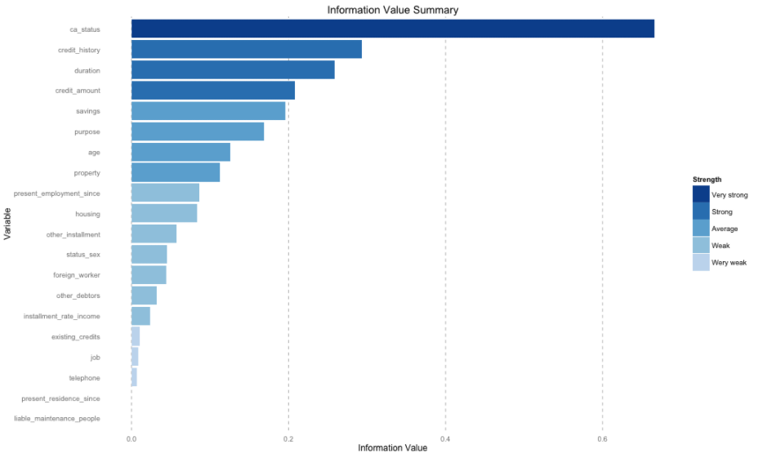
Use filter models to estimate the importance of variables.
Common models for variable filtering are random forest (R randomForest), elastic net (R glmnet), and gradient boosting (R catboost).
It’s sometimes necessary to transform variables first, e.g., standardizing (converting to Z scores) or normalizing (mapping into the unit interval).

Slide 11
How can I use AI to summarize complex datasets?

Slide 12
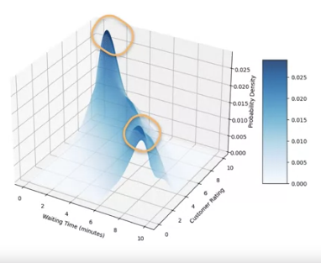
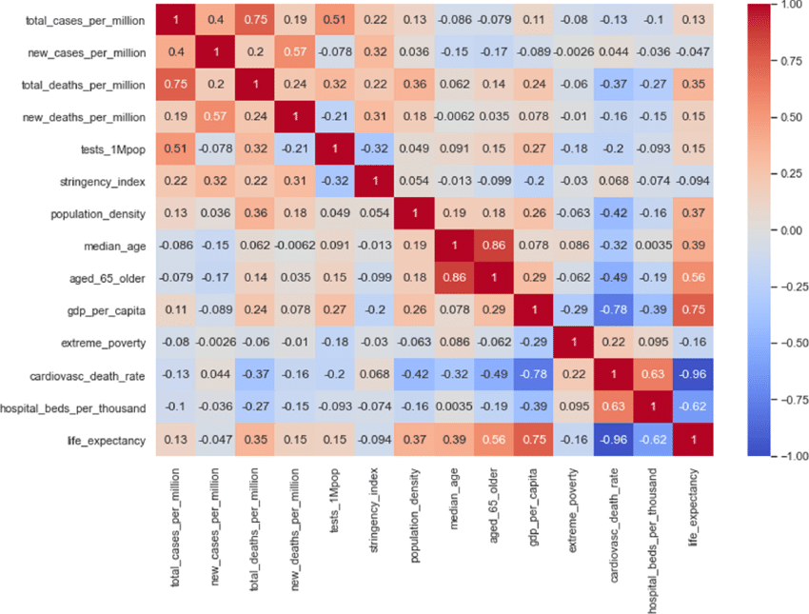
Summarize the shape of the joint distribution.
We explore relationships between predictors to develop hypotheses about appropriate model architectures.
Important issues include
summary statistics
missingness
imputation
correlations
interactions
smoothness
extreme values
(non)linearity
monotonicity
parametric fit
dimensionality

Slide 13
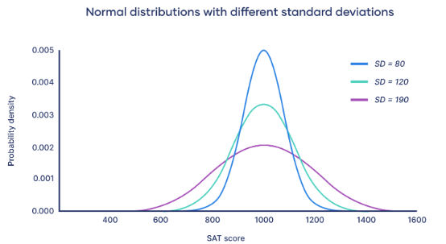
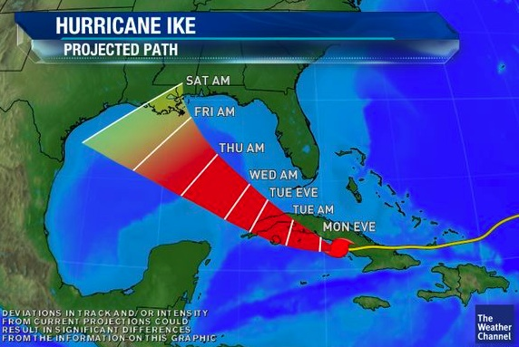
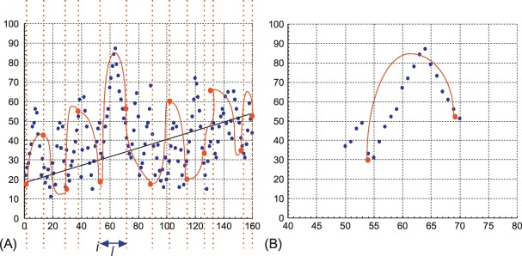
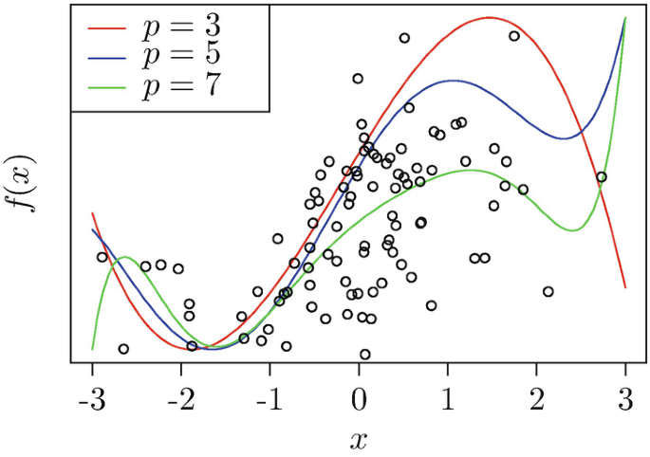
Quantify the degree of knowledge about the relationship between inputs and outputs.

Slide 14
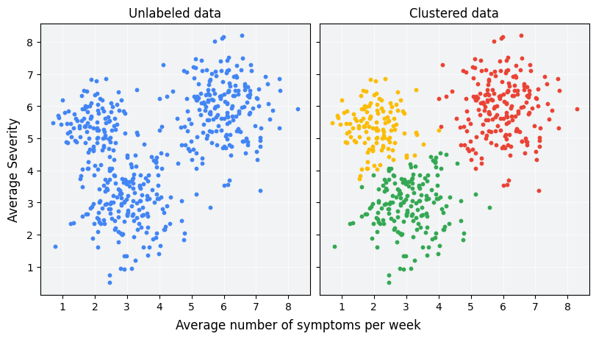
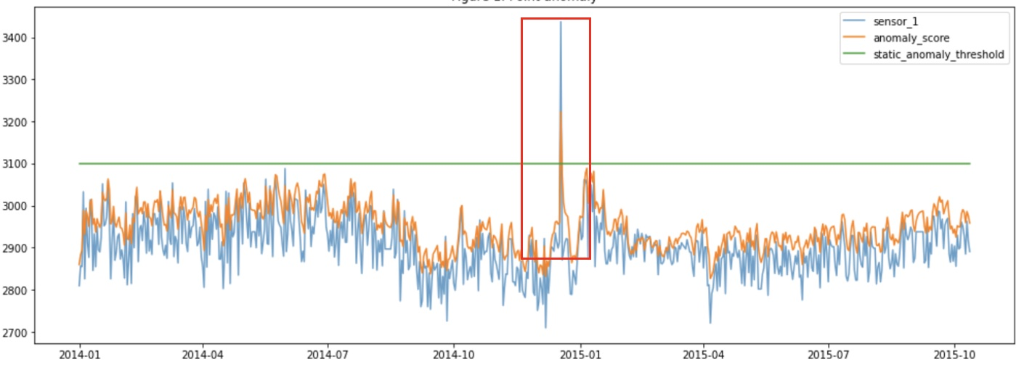
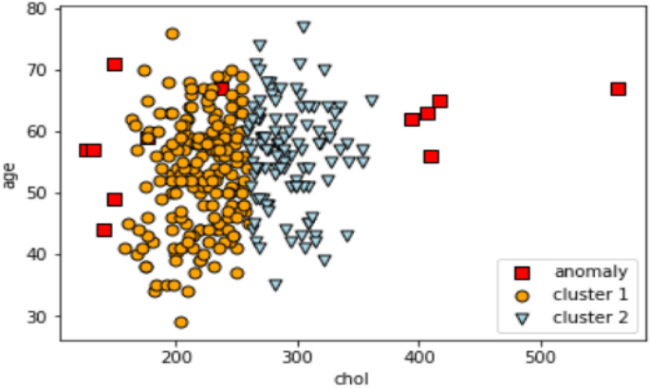
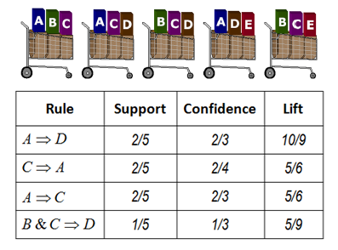
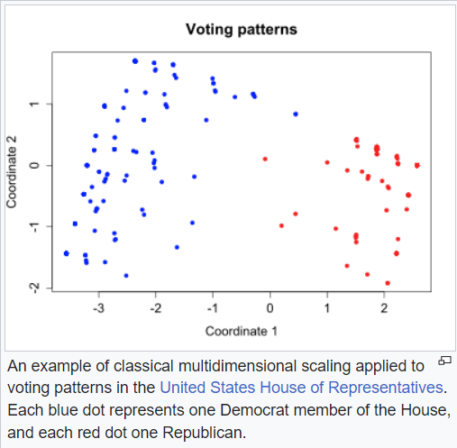
Use unsupervised learning to discover groups and anomalies.

Slide 15
How can I use AI to guide attention to urgent or important data?

Slide 16
Known and predicted anomalies are the main source of urgency.
A picture is worth a thousand words.
Quantify the risk (expected value, maximum probable gain or loss).
Executives are more sensitive to maximum probable loss than other metrics.

Slide 17
Important data has a disproportionate influence over decisions.
It can be challenging to explain AI decisions. (Different variables can matter most for different decisions made by the same model.)
Decision-explanation techniques are often model-specific and don’t combine well over ensembles.
The Shapley technique (R iml library) is model-independent, explaining decisions in terms of the inputs that drive them.

Slide 18
Value-of-information analysis guides attention to the data you need.
The value of imperfect information is the difference between the expected value of a decision made with the additional information and the expected value in the absence of the additional information.
We impose a judgmental distribution on the additional information, reflecting our beliefs about what it’s likely to tell us.
How much would you pay for a winter-weather forecast before choosing a shipping route?

Slide 19
Key takeaways
Prioritize decisions you want to model before exploring data.
Stick with exploratory analysis until you find good signal.
Make the business case for a real advanced analytics (data science and data engineering) business function to create and maintain production AI models. Data science is very hard!
Someday generative AI will be mature enough to automate these activities. It’s not nearly that mature.

Slide 20
Suggested Resources
Fangjiao Ma et/al, “Probabilistic Wildfire Risk Assessment Methodology and Evaluation of a Supply-Chain Network,” International Journal of Disaster Risk Reduction Vol. 82 (Nov. 2022), https://www.sciencedirect.com/science/article/pii/S2212420922005593
Ahmed Abideen and Fazeeda Binti Mohamad, “Improving the Performance of a Malaysian Pharmaceutical Warehouse Supply Chain by Integrating Value-Stream Mapping and Discrete-Event Simulation,” Journal of Modelling in Management (April 7, 2021), https://www.emerald.com/insight/content/doi/10.1108/JM2-07-2019-0159/full/html
Jing Wang et/al, “Data-Driven Supply-Chain Monitoring Using Canonical Variate Analysis,” Computers & Chemical Engineering Vol. 174 (June 2023), https://www.sciencedirect.com/science/article/pii/S0098135423000984

Slide 21
Thank You!
Any questions now?
If not, you can contact us later:
Jeffrey Porter jporter@stockiqtech.com M (970) 481-0040
Jeff Woodmansee jwoodmansee@stockiqtech.com M: (970) 420-1777
www.StockIQTech.com

