Slide 2
AppSource Optimization Field Guide & Success Stories

Slide 4
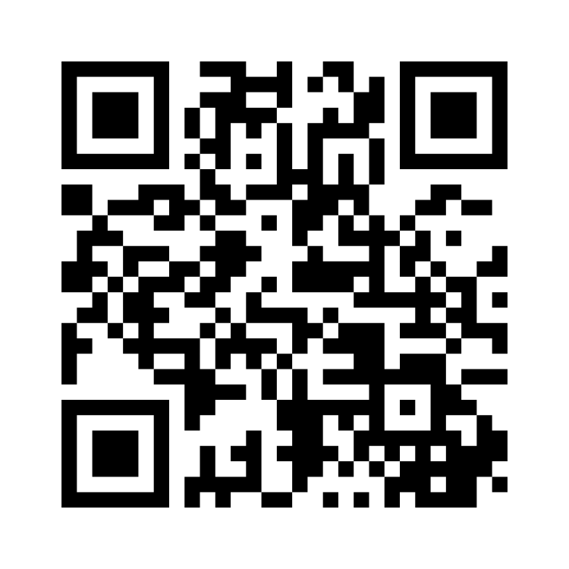

Slide 5
About me
Channel and partner development, product marketing, and strategy transformation
Founder of Enki Consulting, specializing in advising Microsoft partners on strategy, operations, and growth
Avid hiker and skier (i.e., from Vancouver), and a passionate supporter of the Toronto Raptors
Connect with me:
Linkedin.com/in/KhaledNassra
Khaled@go4enki.com
Go4enki.com

Slide 6
Does AppSource matter?

Slide 7
77%
of B2B buyers say they won’t talk to a salesperson until they’ve done their own research
Gartner, “Future of Sales” Report

Slide 8
2.2M
total mobile and desktop visitors to AppSource in February 2025
SimilarWeb, 2025; SEMrush – average nonunique visitors based on both sites

Slide 9
Really?

Slide 10
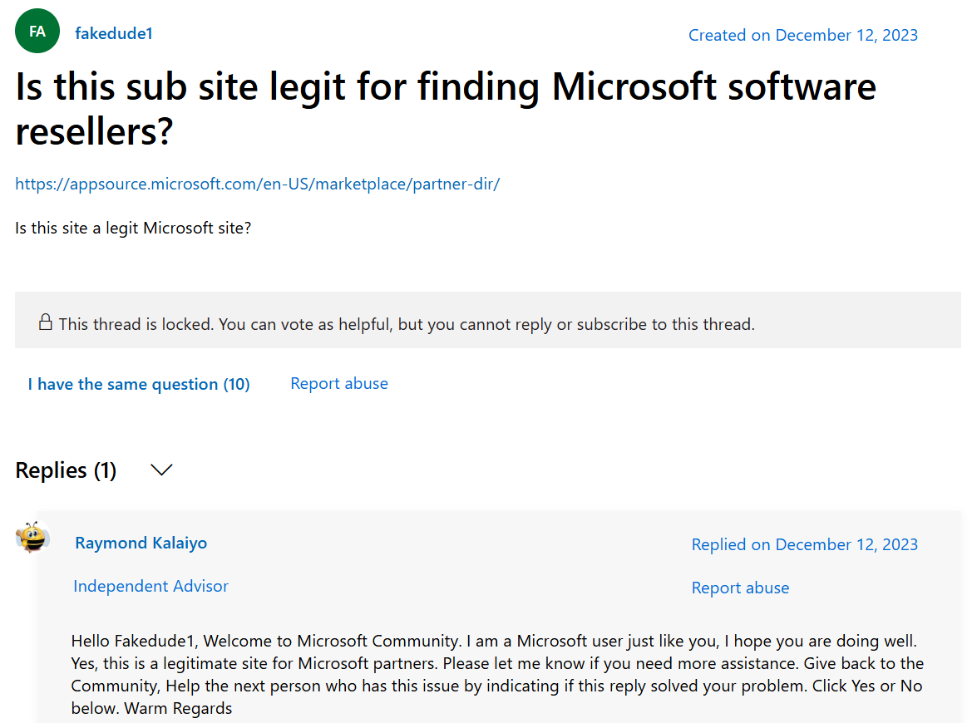
Really?

Slide 11
Really?

Slide 12
How monetizable is this?

Slide 13
It doesn’t matter how we think users and prospects should view AppSource
what matters is how they do in reality

Slide 14
Keyword intent analysis
20% of the keywords AppSource ranks for are informational, 30% are navigational, and 50% are transactional
Do we think 50% of AppSource visitors are ready to make a purchase decision?

Slide 16
Desirability (Human)
Viability (Business)
Feasibility
(Technical)
Innovation

Slide 17
The
new buyer’s journey
new

Slide 18
The traditional buyer’s journey
Awareness
Cold outreach, events / tradeshows
Consideration
Discovery, demos
Close
Interest Sales intro call, collateral
Traditional funnel

Slide 19
The new new buyer’s journey
Awareness
Cold outreach, events / tradeshows
Consideration
Discovery, demos
Close
Interest Sales intro call, collateral
Problem identification Self search, regulation
Initial validation Videos, pricing
Decision
Solution discovery Online presence, peers
Traditional funnel
New funnel

Slide 20
Case analysis

Slide 21
AppSource pages that rank #1 for a keyword*
Limited to keywords averaging more than 50 searches a day

Slide 22
AppSource pages that rank #1 for a keyword*
This does not necessarily translate 1:1, but it’s a good instrumental variable given the lack of insights into AppSource optimization
Specialization
Social proof
Listing quality
Blend of all
Limited to keywords averaging more than 50 searches a day

Slide 23
Positioning and specialization
Gain creators
You can explore how your offerings’ value can be communicated to customers more effectively through empathy and by focusing on the customer’s perspective
Products & services
Gains
Customer jobs
Pains
Pain relievers

Slide 24
Segmentation
Segment name | Characteristics | Goals | Challenges
Small and Medium Businesses (SMBs) | Growing businesses with limited budgets and resources, seeking scalable solutions | Achieve cost-effective implementations with clear ROI and minimal disruption | Limited expertise and resources, concerns over costs and timelines
Enterprise Organizations | Complex organizational structures with high demands for alignment and scalability | Streamline complex projects while aligning solutions with business goals | High risk of misalignment and resistance to change due to complexity
Public Sector and Nonprofits | Budget-conscious, compliance-driven organizations with multi-stakeholder involvement | Enhance operational efficiency, ensure compliance, and maintain accountability | Scrutiny over spending, difficulty managing diverse stakeholder needs
Industry-Specific Enterprises | Operate in niche industries with specialized workflows and regulatory needs | Adopt tailored solutions to improve competitiveness and drive innovation | Selecting interoperable solutions that meet industry-specific challenges

Slide 25
AppSource pages that rank #1 for a keyword*
This does not necessarily translate 1:1, but it’s a good instrumental variable given the lack of insights into AppSource optimization
Specialization
Social proof
Listing quality
Blend of all
Limited to keywords averaging more than 50 searches a day

Slide 26
Feedback loops and buyer/seller empowerment
Make providing feedback easy and accessible
Incentivize engagement from both sides
Create educational, exploratory content
Close the loop with clear communication

Slide 27
Feedback loops and buyer/seller empowerment
Make providing feedback easy and accessible
Incentivize engagement from both sides
Create educational, exploratory content
Close the loop with clear communication

Slide 28
Guide to AppSource success

Slide 29
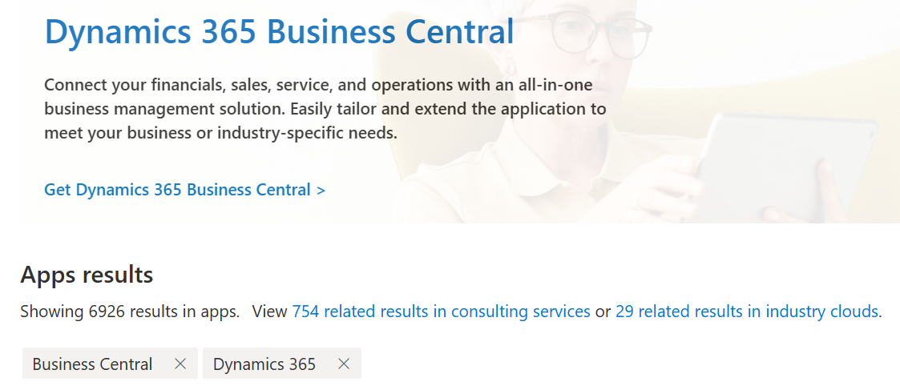

Slide 30
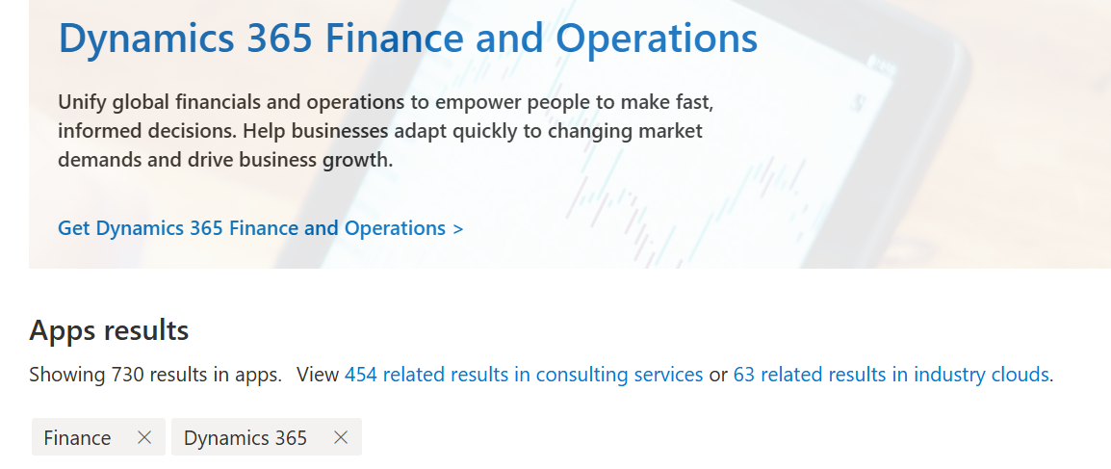

Slide 31
Choices to make

Slide 32
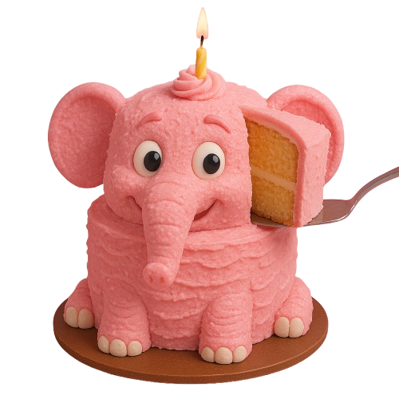
Choices to make

Slide 33
Choices to make
Problem identification Self search, regulation
Initial validation Videos, pricing
Decision
Solution discovery Online presence, peers

Slide 34
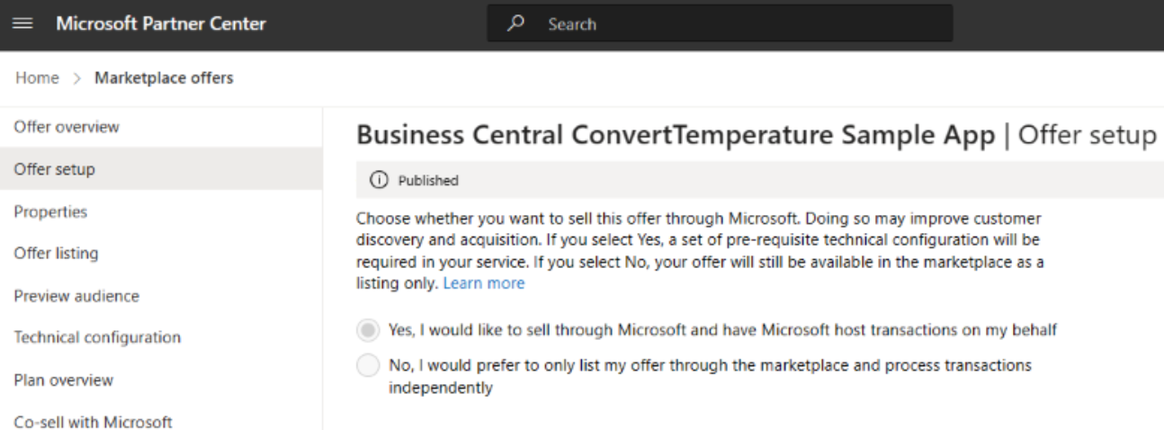
Choices to make

Slide 35
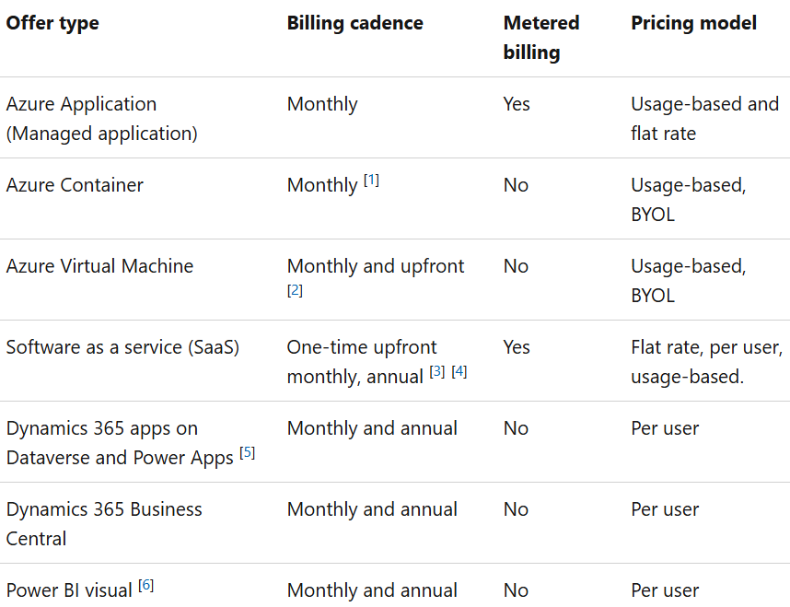
Choices to make

Slide 37
`Quick tips for a sustained success

Slide 38
Things great listings have in common
Connect your listing to real GTM efforts
Clear, customer-focused messaging and CTAs
Business outcomes over features
Use of video, and social proof
AppSource should be a part of your funnel
Know that driving traffic takes many steps
AppSource does not have to lead to a sale
Aligning with Microsoft priorities
Common pitfalls to avoid
Identify sales plays that fit your solution
Consider the direction of the channel
Focus on industry and differentiation
Listing with too much jargon
No clear CTA or weak offer
No marketing linked to the listing
Lack of sales team alignment
Quarterly internal health checks
Updating messaging to match your ICP?
Refreshing CTAs and visuals?
Mapping listing to new Microsoft priorities?
Tracking listing traffic or lead conversion?

Slide 39
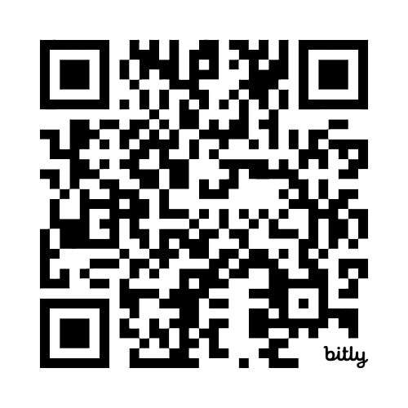
Download today’s slides

Slide 40
Thank you for joining this session
Please rate it in the app
Connect with me:
Linkedin.com/in/KhaledNassra
Khaled@go4enki.com

