Slide 2
Managing Resistance on a Project or Change Initiative
Robin Finnell
Senior Consultant
Dexpro Dynamics
Notes:
Welcome to my breakout on Managing Resistance on a project or change initiative. If this is not the session name you expected to see, you are in the wrong room, but feel free to stay and learn more about resistance and how to address it.

Slide 3
Robin Finnell
Business Central Consultant
(m) 503-801-2971
rfinnell@dexprodynamics.com
Notes:
A little bit about me… I am a MS certified functional consultant and have been in the MS space since 2008; first in NAV, then I took a short foray into F&O, then back into BC. I am certified as a trainer and advanced change management practitioner by Prosci, although I am change management agnostic. I don’t care which methodology you use, I just urge you to use it.

Slide 4
Notes:
This is what we tend to run into a lot. Project managers who initiate a project and tell everyone how great the new solution is going to be. But they fail to anticipate the resistance that is a natural reaction to change.

Slide 5
Learning Objectives
Define Resistance and determine common causes
Learn what
10 aspects of change impact a person the most
Discover the top 10 tactics for managing resistance
Understand how to integrate resistance management throughout the project lifecycle

Slide 6
Define Resistance
and determine common causes

Slide 7
re·sist·ance
/rəˈzist(ə)ns/
noun
the refusal to accept or comply with something; the attempt to prevent something by action or argument.
Notes:
The Oxford Dictionary defines resistance as:

Slide 8
What does resistance look like?
Emotion – Fear, loss, sadness, anger, anxiety, frustration, depression, focus on self
Disengagement – Silence, ignoring communications, indifference, apathy, low morale
Work impact – Reduced productivity/efficiency, non-compliance, absenteeism, mistakes
Acting out – Conflict, arguments, sabotage; overbearing, aggressive or passive-aggressive behavior
Notes:
Change is an individual phenomenon and so is resistance. The root cause for one person’s resistance may not be the same as another person’s because it depends on factors such as personal history, current events in their life, and other current changes at work.

Slide 9
What does resistance look like?
Negativity – Rumors/gossip, miscommunication, complaining, focus on problems, celebrating failure
Avoidance – Ignoring the change, reverting to old behaviors, workarounds, abdicating responsibilities
Building barriers – Excuses, counterapproaches, recruiting dissenters, secrecy, breakdown in trust
Controlling – Asking lots of questions, influencing outcomes, defending current state, using status
Notes:
Regardless of the source or what it looks like, resistance to change can have negative impacts on initiatives and the organization.

Slide 10
Why does resistance occur?
Drivers that influence an employee’s resistance to change:
The impact on their work
The credibility of people communicating the change
Personal factors, including finances, age, health, mobility, and family
The change’s alignment with their value system
The organization’s history of handling change
Notes:
Resistance to change often occurs due to a combination of factors including fear of the unknown, lack of understanding about the change, poor communication, mistrust in leadership, concerns about personal impact, fear of failure, and a desire to maintain the status quo, essentially stemming from a natural human tendency to feel uncomfortable with uncertainty and disruption to routine.

Slide 11
Why does resistance occur?
Sources of resistance can include:
Employees who are highly invested in the current way of doing work
People who created the current way of doing work that will be changed
Employees who expect more work as a result of the change
People who have been very successful and rewarded in the current way of doing work
Those who advocated a particular alternative, (e.g., they wanted Option B, but Option A was selected)
Notes:
Research on human brain function shows that resistance is not only a psychological reaction to change but also physiological. To act in a new way requires more power from the brain. When presented with a new way of doing something, the physiological reaction is to revert back to what the brain already knows.
Do not be surprised by resistance! Even if the project solution is a wonderful improvement to a problem that plagues employees, there will be resistance to change. Comfort with the status quo is very powerful. Moving into an unknown future state creates anxiety, fear and stress, even if the current state is painful. Project teams and change management teams should always expect resistance and then actively work to address and mitigate it.

Slide 12
Have you ever encountered resistance on a project or change?
Notes:
What do you think resistance looks like? Can you give some examples of how resistance might show itself? Does anyone want to share their personal experience with resistance on a project?
Now that we know what resistance looks like and how it might present itself, let’s look at some areas that may drive resistance.

Slide 13
10 Aspects of Change Impact
and how they drive resistance
Notes:
There are 10 aspects of change impact and each of them alone are enough to drive resistance. When a person is affected by a combination of these, the resistance is compounded. By incorporating these aspects into your change impact assessment, you can gain a more comprehensive understanding of how the change affects individuals within your organization.
Your initiative may or may not impact these 10 aspects of how somebody shows up each day in their job. But you won't know until you start to ask, think about, and define change impact at that individual level.
This also helps us understand that change impacts different groups differently. A change that impacts one group only marginally might completely disrupt another group within the organization. These 10 aspects and the framework of focusing on change impact at the individual level help us start to make sense of how change comes to life across our organization.

Slide 14
What are the 10 Aspects?
Aspect | Definition
Processes | The actions or steps taken to achieve a defined end or outcome
Systems | A combination of people and automated applications organized to meet a set of objectives
Tools | An item or implement used for a specific purpose; can be a physical object such as mechanical tools or a technical object such as a web authoring tool or software program
Job Roles | A description of what a person does including competencies essential to performing well in that job capacity
Critical Behaviors | Vital or essential response of an individual or group to an action, environment, person or stimulus
Mindsets/Attitudes/Beliefs | Mental inclination, disposition or frame of mind reflected in behaviors
Reporting Structure | The authority relationships in a company or organization; who reports to whom
Performance Reviews | The process and indicators of how performance is measured and assessed relative to objectives
Compensation | Amount of the monetary and non-monetary pay provided in return for work performed
Location | A physical geographical place that provides facilities for a stated purpose
Notes:
We tend to live at 30,000 feet, but change happens at 300 feet. Our job as change agents is to close that gap, taking what might be an enterprise-level transformation and boiling it down into the individual change impacts. If we want to demonstrate empathy for our stakeholders, build adoption metrics, or help our colleagues manage change, we need a model to empower us so that we have this mindset from the start.
You can leverage this list in a variety of ways. The most basic is to list the “10 Aspects” down the left column of a two-column worksheet. You could ask your stakeholder participants to “name it to tame it” by listing the current and/or future states of the project at hand for each aspect and use the information to determine the amount of impact to the stakeholder/group.
Sometimes, facilitating this activity with the project team using a design-thinking, interactive approach with a ton of sticky notes and a conference room wall can be super effective.

Slide 15
Benefits of defining Change Aspects
Build Empathy
Define Ability
Create Adoption Metrics
Engage Employees
Identify Blind Spots
Personalize Engagement
Notes:
While there are many benefits to defining change aspects, to me, these are the top six.

Slide 16
Build Empathy
Build Empathy
By defining how stakeholders are impacted by a change, you’re able to put yourself into the shoes of the impacted employees.
Notes:
Getting sponsors and project team members to explore how their initiative impacts their employees is a huge benefit to the project’s success.
Empathy matters.

Slide 17
Define Ability
Define Ability
Ability is defined as the demonstrated capability to implement “the change” and the achievement of “the desired change” in performance or behavior.
Notes:
By defining the Aspects of Change Impact, you provide a framework to define “the change” and what constitutes Ability so that employees can be prepared, equipped and supported to make those specific changes.

Slide 18
Create Adoption Metrics
Create Adoption Metrics
To know what you would measure to determine adoption and usage, you need to know and define what “to sufficiently adopt and proficiently use” means for impacted employees.
Notes:
Answering the question, “What will we measure to determine if the change is occurring?” depends on how you define adoption and usage.

Slide 19
Engage Employees
Engage Employees
Defining the Aspects of Change Impact is an effective way to directly engage employees in co-creating a shared definition and understanding of the upcoming change and its impact.
Notes:
You might see change impact you had not previously identified, and impacted employees feel empowered and engaged while increasing their understanding of the change.

Slide 20
Identify Blind Spots
Identify Blind Spots
It can be difficult to filter down to the impacts a project will have on individuals and groups within the organization.
Often, a project team or sponsor misses a particular area of impact - and sometimes it’s an area of special concern for impacted employees.
Notes:
Utilizing the 10 Aspects of Change Impact provides a perspective that enables you to catch the areas of impact that are often overlooked.

Slide 21
Personalize Engagement
Personalize Engagement
You can more effectively personalize your support and interventions when armed with detailed descriptions of how the change is impacting each individual.
Notes:
By defining the impact to each individual in each of the 10 Aspects, the answers to “How big of a change?” and, thus, “How much change management?” can be answered relative to the material impact the initiative will have on that individual and how they do their job.

Slide 22
Any questions about what we’ve covered so far?

Slide 23
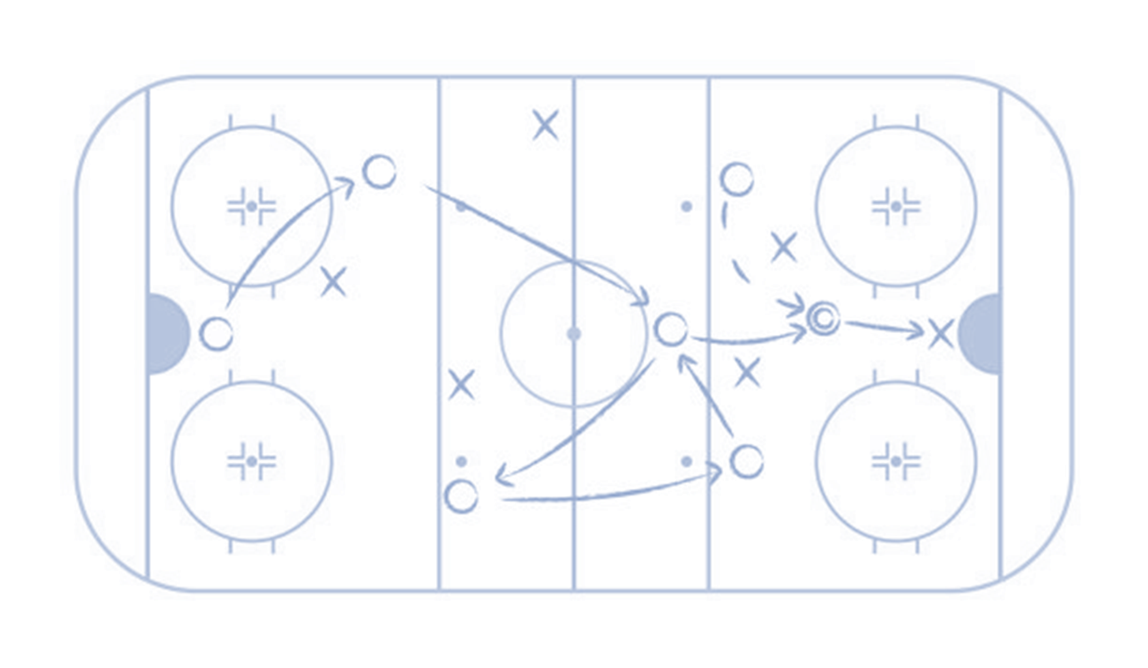
Top 10 Tactics
for managing resistance
Notes:
When you can't prevent resistance or when resistant behaviors persist despite proactive measures, the following 10 Tactics for Managing Resistance can be effective.

Slide 24
Top 10 Tactics for Managing Resistance
Focus on the "what" and let go of the "how”"
Remove barriers
Provide simple, clear choices and consequences
Create hope
Show the benefits in a real and tangible way
Make a personal appeal
Convert the strongest dissenters
Demonstrate consequences
Provide incentives
Listen and understand objections
Which of these tactics do you think are the most effective?

Slide 25
Top 10 Tactics for Managing Resistance
Focus on the "what" and let go of the "how”"
Remove barriers
Provide simple, clear choices and consequences
Create hope
Show the benefits in a real and tangible way
Make a personal appeal
Convert the strongest dissenters
Demonstrate consequences
Provide incentives
Listen and understand objections
Do these first four in order every time
These can be done in any combination after the first four

Slide 26
Listen and Understand Objections
When experiencing resistant behaviors, the first and most important thing to do is to listen to understand the reasons for the objections.
Notes:
When you think you understand, ask them to elaborate.

Slide 27
Focus on the "what" and let go of the "how"
Focus on what needs to be accomplished and offer the team the opportunity to provide input on how to accomplish the change.
Notes:
When you know the end goal, the approach for getting there can be shared by those proceeding through the change.

Slide 28
Remove Barriers
You understand where your team members’ resistance points reside. Perhaps they are related to job motivation, job security, career progression, or personal commitments.
Notes:
Probe to understand and help employees address what's holding them back from adopting the change.

Slide 29
Provide simple, clear choices and consequences
In some cases, you must be direct:
“I understand that you may not be interested in participating in this change, but the team will follow this new process as explained. If you don't choose to adopt the new changes, X will be the result."
Notes:
The key is to provide choices in a clear and straightforward manner and include any consequences of their decisions.

Slide 30
Create Hope
Creating hope focuses on the future state.
What's on the other side of adopting and using the change?
What is the opportunity associated with it?
Notes:
Having a well-constructed "why" helps with creating hope. Why are we making the change? Why right now? What’s the risk if we don’t change?

Slide 31
Show the benefits in a real and tangible way
People can have a hard time envisioning the future state of a change.
We like to say that the current state is rooted in emotion, but the future state is rooted in analytics.
Notes:
In other words, when a person has never done something before, you can show them through data and evidence that they're going to get there.

Slide 32
Make a personal appeal
Try making a personal appeal to your teams with whom you hold a high degree of trust and an open relationship.
Notes:
Ask for their support and restate why you believe the change will benefit the team.

Slide 33
Convert the strongest dissenters
The most vigorous dissenters can become your strongest advocates.
Notes:
Sometimes the natural tendency is to avoid the strongest dissenters. However, if the manager can invest in interventions or tactics to convert dissenters, they might find a strong advocate.

Slide 34
Demonstrate consequences
Demonstrating consequences is a viable form of resistance management.
Notes:
However, use this tactic with caution. Once employed, the results will become part of the organizational history that may have cascading impacts on employee engagement.

Slide 35
Provide Incentives
In this tactic, people managers can offer bonuses, extra time off, or the ability to work from home in exchange for adopting the change—a little quid pro quo.
Notes:
Sometimes it's effective and sometimes it's not.

Slide 36
Integrating Resistance Management
throughout the project lifecycle

Slide 37
How will resistance be identified throughout the project lifecycle?
By implementing specific mechanisms (measurement tools and soft measurements) you can identify resistance.
Examples include:
Employee feedback – Include employee feedback loops as a component of the Communications Plan and People Manager Plan
People manager input – Give people managers the opportunity to provide direct feedback to the project team during coaching activities
Project team issues – Issues that are identified by the project team should be logged directly to the project issues log or risk log to be monitored closely
Compliance audits – Compliance audits conducted as part of the post-implementation support activities and focused on proficiency metrics will identify additional areas of resistance where support is needed
Notes:
Resistance Management is an active process that lasts the length of your project and beyond. By implementing certain mechanisms, you can identify resistance in a timely manner throughout the lifecycle of the project.
Even before the project kicks off, you can establish some of these mechanisms, such as an employee feedback loop. As you communicate about the change, offer affected employees a way to ask questions and provide insight. Allow people leaders the opportunity to bring direct feedback to the project team. Utilize a project issues log or risk log and monitor it daily. Post go-live, ensure there are methods in place to measure usage and proficiency.

Slide 38
Activate roles that manage resistance
As a Project Manager or Change Manager, you can’t do it alone!
Activate key roles to work with you:
Senior Leaders – Help manage resistance by communicating the business reasons for the change directly to impacted people and groups
People managers – Help manage resistance by working with the people and teams who report directly to them
Identify Resistance
Address Root Causes (personal & organizational)
Notes:
Why Are People Managers So Important During Change?
Because they are preferred senders of information
Employees trust them
And they are close to where the change happens

Slide 39
Any questions?

Slide 40
Shameless Survey Plug…
The session survey can be accessed via the session details in the mobile app

Slide 41
Want to Learn More?
Want to Learn More?
503-801-2971
rfinnell@dexprodynamics.com
LinkedIn

