Slide 1
BC Manufacturing Duel:
Assembly vs. Manufacturing

Slide 2
Session Agenda
Review Assembly Mgmt.
Demo Assembly Mgmt.
Review Manufacturing
Demo Manufacturing
Closing Thoughts
Q&A Time
Ben Baxter
President of Accent Software, Inc.
20-Years implementing Business Central
Specialize in Manufacturing and Projects

Slide 3
Assembly Mgmt.

Slide 4
Capabilities
Bill of Material
Labor Allocation
Assemble-to-Stock
Automation – Assemble-to-Order
Single Entry (Qty)

Slide 5
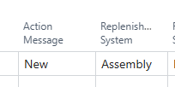
Where?
Assembly Order List (Manual ATS)
Planning Worksheet (ATS)
Sales Order Line (ATO)
Project Planning Lines (ATO)

Slide 6
Demo

Slide 7
Manufacturing

Slide 8
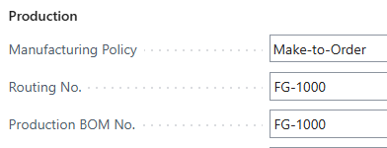
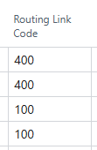
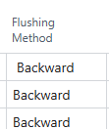
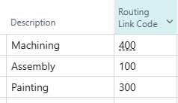
Capabilities
Bill of Material
w/ Versions
Routing
w/ Versions
Subcontracting
MTS and MTO
Integration
Automation

Slide 9
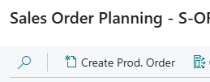
Where?
Planning Worksheet
Sales Order Planning
Role Center / Prod. Order List
Order Planning (Do Not Use)

Slide 10
Demo

Slide 11
Which is right for you?
Assembly Management
Short Duration Builds
One Step Process
Kitting
No version history required
Manufacturing
Operation based Costing
Version History
Subcontracting
Actual Time Tracking
Do you have to choose only one?
No! You can use both if it makes sense for your business (different Locations, different business units, etc.)!

Slide 12
Q&A
Ben Baxter
Accent Software, Inc.
ben@accenterp.com
https://www.AccentERP.com/

Slide 13
Thank You

