Slide 2
Mastering Credit Card Payments in Dynamics 365 F&O: The Definitive Guide

Slide 3


Peter Ramer
Contact Info:
Email: alex.itguy@outlook.com
Blog: http://d365foblog.com
Security Course: http://d365fosecurity.com
Book: Security and Audit Field Manual: Dynamic 365 for Finance & Operations
LinkedIn
Microsoft MVP Profile
Background:
Awarded Microsoft MVP in Business Applications in November 2019
Have worked with AX since 2013
Have worked with D365FO since 2016
Have spoken at Summit (US & Europe), Focus, and local chapters around AX/D365FO security and have done webinars around native controls in both versions
Director of Managed Application Services, Consumer Products Senior Analyst
Contact Info:
Email: peter.ramer@rsmus.com
Blog: https://dynamics365musings.com
LinkedIn
Microsoft MVP Profile
Background:
Awarded Microsoft MVP in Business Applications in November 2022
Have worked with AX since 2006
Have worked with D365FO since 2016

Slide 4

Alessio Mazzanti
Contact Info:
Email: alex.itguy@outlook.com
Blog: http://d365foblog.com
Security Course: http://d365fosecurity.com
Book: Security and Audit Field Manual: Dynamic 365 for Finance & Operations
LinkedIn
Microsoft MVP Profile
Background:
Awarded Microsoft MVP in Business Applications in November 2019
Have worked with AX since 2013
Have worked with D365FO since 2016
Have spoken at Summit (US & Europe), Focus, and local chapters around AX/D365FO security and have done webinars around native controls in both versions
Senior Partnerships Manager at Adyen
Contact Info:
LinkedIn
Alessio.Mazzanti@adyen.com
+1 415-818-6521

Slide 5
Agenda
Terminology
The Process
How F&SC works
Common Issues
D365 Payment Connectors
Token Migration
Payment Processor Spotlight
Digital Wallets

Slide 6
Terminology
Cardholder – receives a credit card from an issuing bank. Buys Stuff
Merchant – Accepts credit cards as payment for stuff
Merchant Bank – Maintains merchant account. Allows merchants to accept credit payments

Slide 7
Terminology
Payment processor – process credit and debit card transactions. They connect merchants, merchant banks, and card networks
Issuing banks – Issue credit cards to card holders. (Ex. CHASE, Wells Fargo, Citi)
Card associates (Visa, Mastercard, Discover, American Express) – sets interchange rates and controller between issuing banks and acquiring banks

Slide 8
Terminology
Gateway – Offer flexibility to connect to the payment processor of your choice. Or sometimes multiple payment processors.
Advantages – Greater flexibility to change payment processors without coding a new integration. Another layer of security.
Disadvantages – Another point of contact, sometimes increased transaction cost over a direct connection.

Slide 9
The Process
Authorization
Capture
Settlement
Funding

Slide 10
Authorization
Cardholder uses their credit card to see if they are approved to receive the goods or services.
Merchant sends to payment processor.
Payment processor sends to card association, which gets to the issuing bank.
Issuing bank approves or declines based on available credit, account status, fraud, and other factors
Notes:
The cardholder presents their card (swipe, tap, insert or other secure method i.e. contactless or by entering number for online credit card payment) to a merchant in exchange for goods or services. The request might originate from a credit card terminal or point of sale system in a brick-and-mortar store, an eCommerce website gateway, through mobile or in-app payment acceptance.
The merchant sends a request for payment authorization to their payment processor.
The payment processor submits transactions to the appropriate card association, eventually reaching the issuing bank.
Authorization requests are made to the issuing bank , including parameters like CVV, AVS validation and expiration date.
The issuing bank approves or declines the transaction. Transactions can be declined for insufficient funds or available credit, if the cardholder’s account has been closed or expired, if a payment is past due or other factors.
The issuing bank then sends the approval (or denial) status back along the line to the card association, merchant bank and finally to the merchant.

Slide 11
Capture
Occurs when the cardholder receives the good or service
  Immediate at a brick and mortar store
  Otherwise, when the product is shipped
  Services are typically captured up front.
Notes:
At a brick and mortal store, the cardholder leaves with the goods, so capture is immediate.
Otherwise capture happens when the products are shipped.
It is against best practices to capture before shipping goods.

Slide 12
Settlement
Merchants send batches of authorized transactions to their payment processor
Payment processor communicates with the card associations, then the issuing banks.
The issuing bank charges the cardholder’s account for the amount.
Older versions of AX used to manage the settlement batch software, but this now happens on the payment processor side.
Notes:
Payment processor communicates with the card associations, then the issuing banks.
The issuing bank charges the cardholder’s account for the amount.

Slide 13
Funding
The issuing bank transfers funds for the transactions to the merchant bank, minus the transaction fees
The merchant bank deposits funds into the merchant account.
The settlement and funding occurs overnight.
Notes:
The issuing bank transfers funds for the transactions to the merchant bank, minus the transaction fees
The merchant bank deposits funds into the merchant account.

Slide 14
How F&SC Works
Payment Services, accounts receivable parameters, and terms of payment Setup
Add a new credit card
Add credit card to sales order
Authorize Card
Ship/Capture

Slide 15
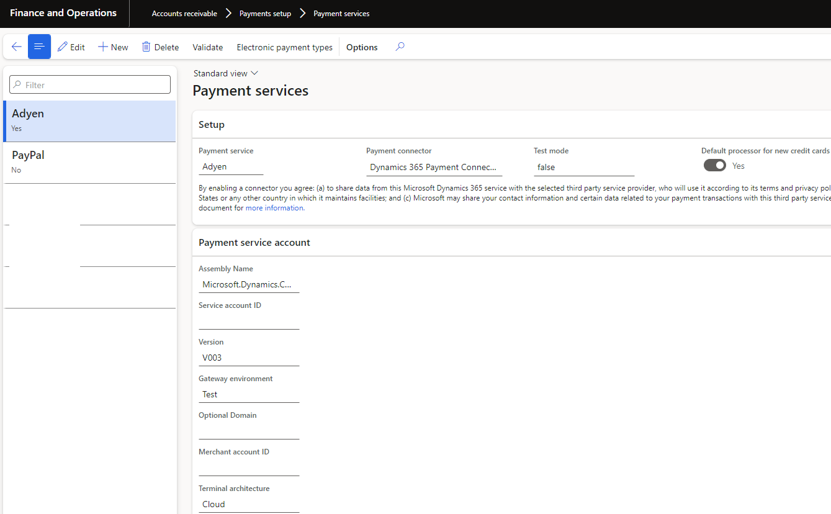
D365 Payment Services
Accounts receivable>Payments setup>Payment services

Slide 16
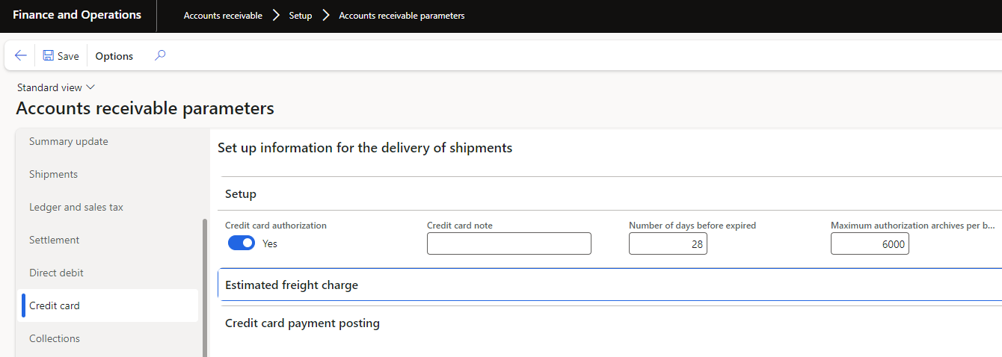
Accounts Receivable Parameters

Slide 17
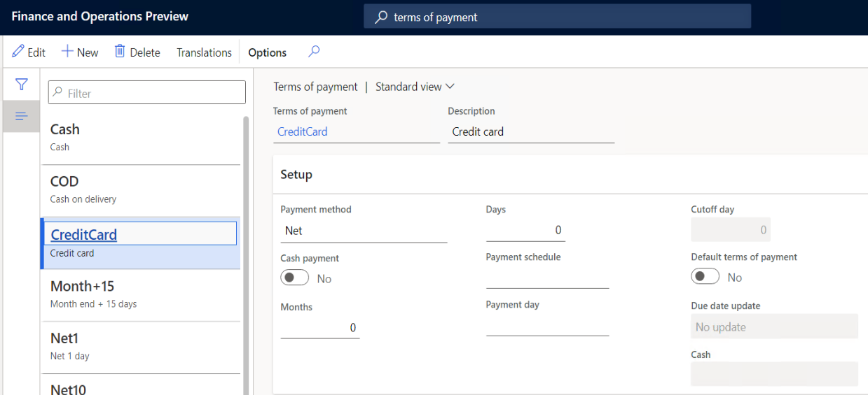
Set Up Terms of Payment

Slide 18
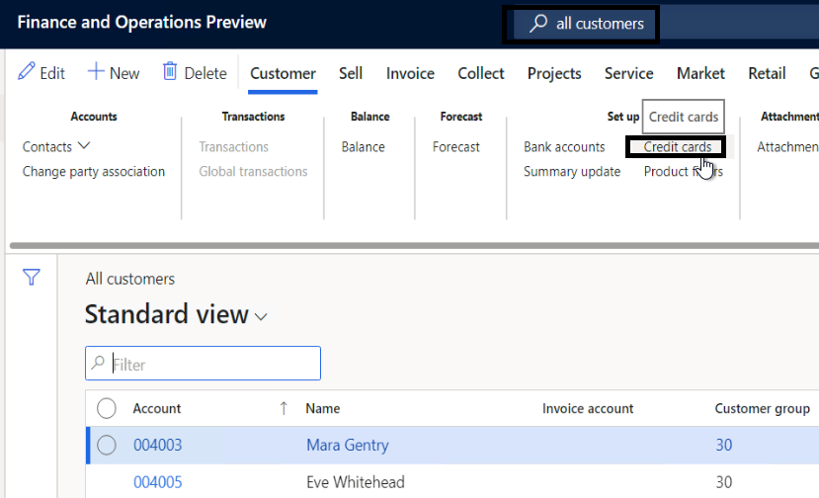
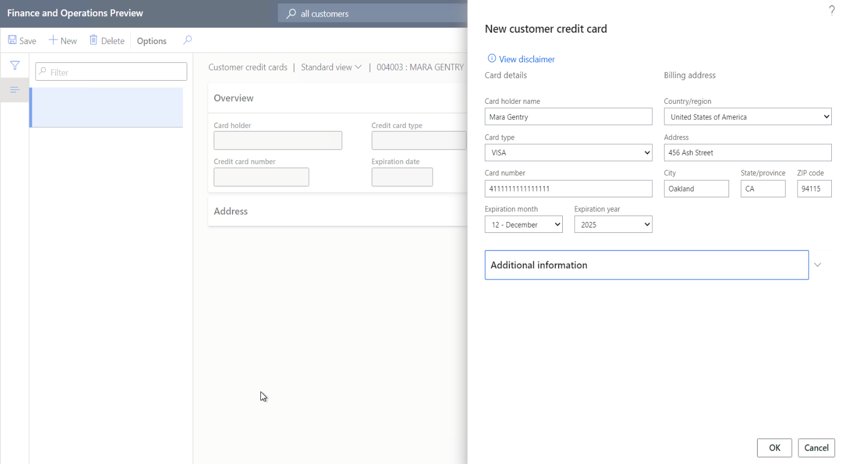
Add A New Credit Card

Slide 19
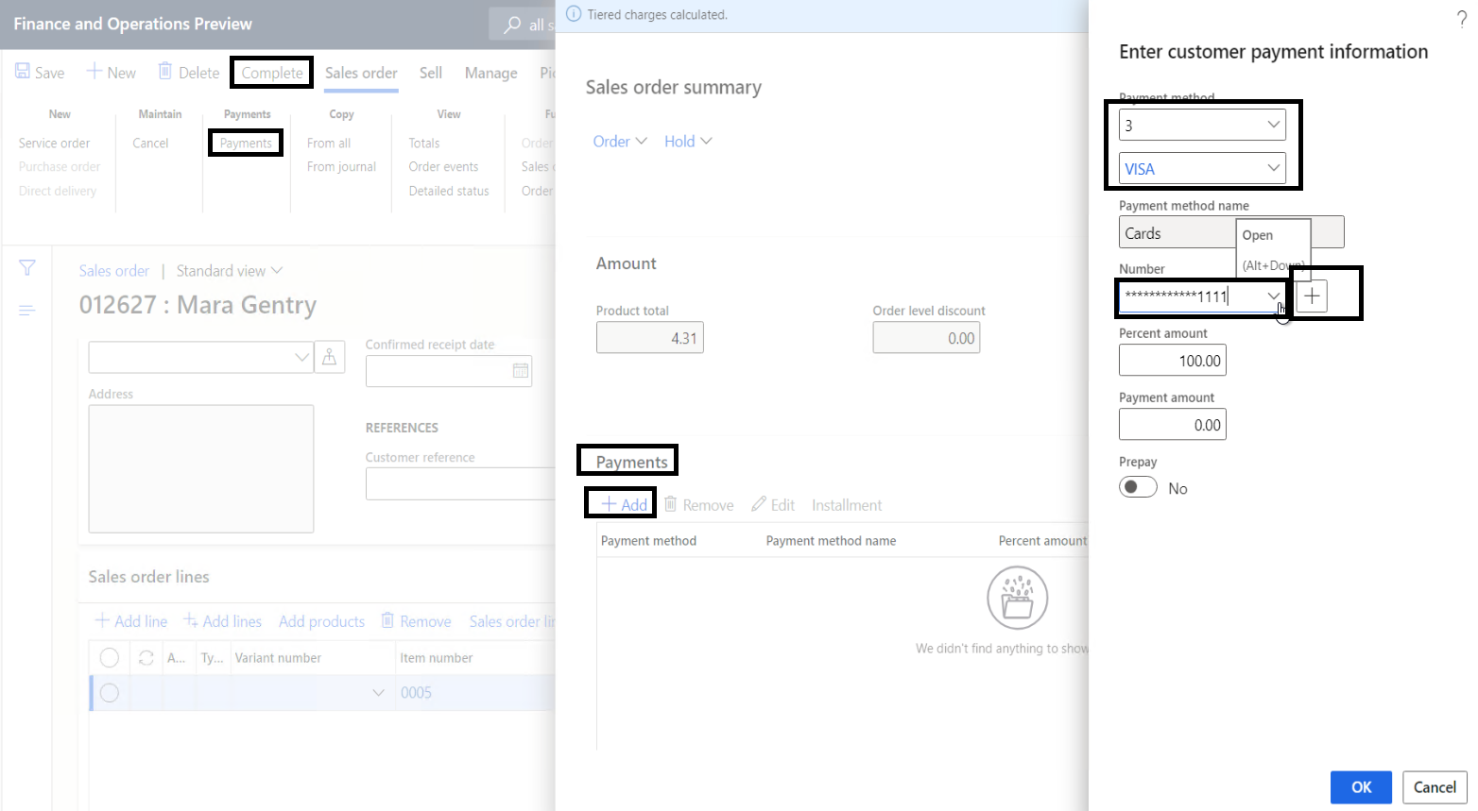
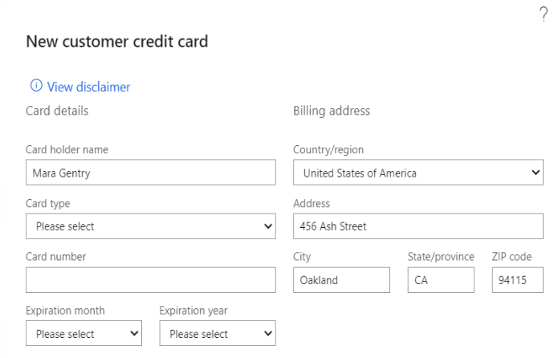
Add Credit Card To A Sales Order

Slide 20
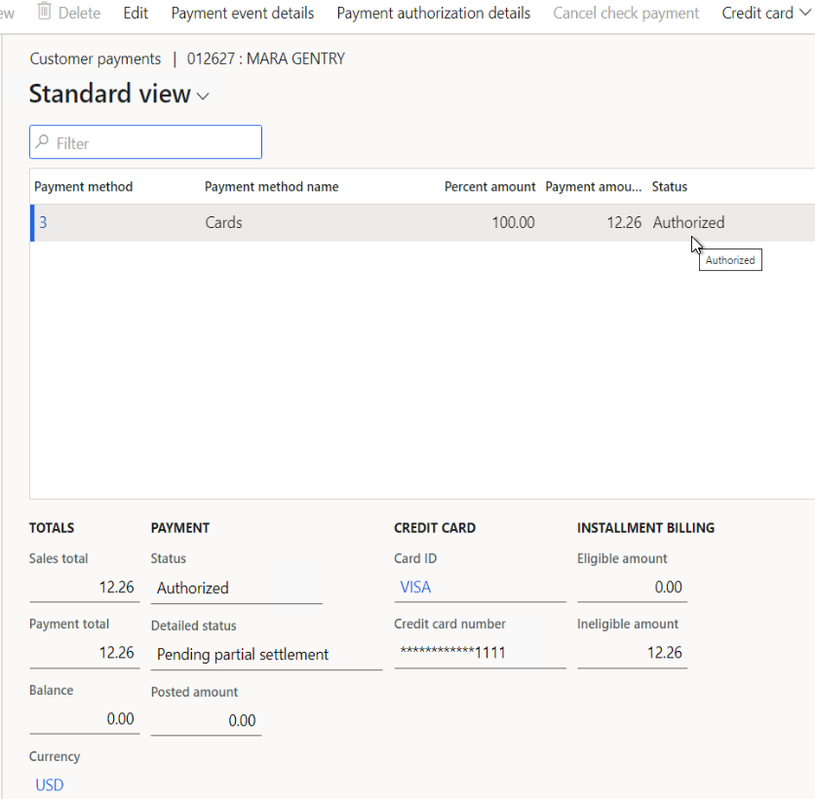
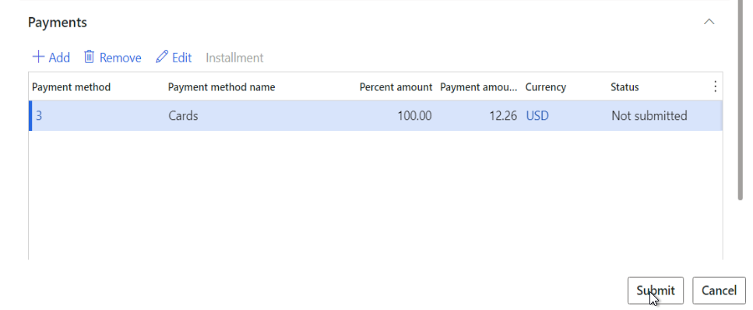
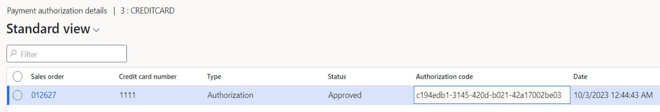
Authorize A Credit Card
Authorization occurs when the order is submitted.

Slide 21
Card Verification Value (CVV)
This is a 3 or 4 digit security code that is provided when the credit card information is initially provided.
It should never be ‘stored’ by the system.

Slide 22
Address Verification
Always accept transaction – Accept the transaction, regardless of address verification results.
Account holder – Compare the cardholder's name from the transaction with the credit card company’s information.
Billing address – Compare the cardholder's name and billing address from the transaction with the credit card company’s information.
Billing postal code – Compare the cardholder's name, billing address, and postal code from the transaction with the credit card company’s information.

Slide 23
Data Support Levels
Level 1 – Transfer the transaction date, transaction amount, and description.
Level 2 – Transfer all Level 1 information, plus the shipping and merchant addresses, and tax information.
Level 3 – Transfer all Level 2 information, plus order line information.

Slide 24

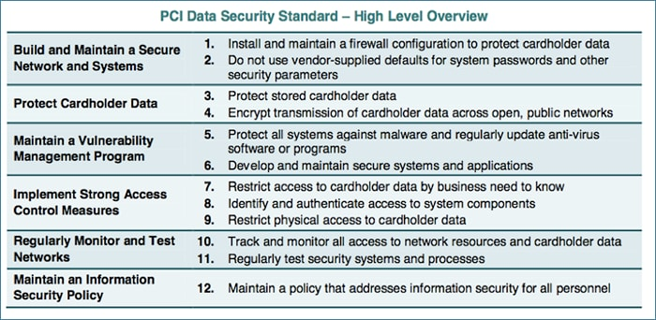
PCI Compliance
Payment Card Industry (PCI) Data Security Standard (DSS) was developed to protect cardholder information and prevent fraud.

Slide 25
Card Tokens
Instead of storing encrypted cardholder data in a merchant’s system, replace it with a ‘token’ that represents this data.
Tokens are stored in the payment processor database, with the cardholder information.
This way, if a merchant’s DB is stolen, no cardholder data is actually stolen.
Communication to payment processors is often IP whitelisted to prevent token’s being used from other systems.

Slide 26
Website Integrations and Auth Codes
When an order is placed on a web, payment is added to the order. A token is retrieved and an authorization code.
The authorization code (and often the token) is sent to the ERP.
Once the order is shipped, the ERP system uses the authorization code to ‘capture’ the payment.
It is a best practice to NOT capture the payment until the order ships.
Services are typically captured up front.

Slide 27
Stale Authorizations
If items on the order are backorder (i.e. out of stock), and the order cannot be shipped for more than 7 days (this time varies from 7-31 days), the authorization could become ‘stale’.
Remember, an authorization represents a ‘hold’ for that amount on the customer’s credit limit. It wouldn’t make sense to keep an indefinite ‘hold’ on the customer’s ability to buy, and never ship.
Therefore, after the authorization is stale, merchants need to use a credit card ‘token’ to get a NEW authorization code. If the website integration did not provide the ‘token’, merchants will need to call up the customer. (This is time consuming and not guaranteed to reach the customer)

Slide 28
Stale Authorizations - Continued
The Authorization resubmit batch job in D365 can re-authorize payments to maintain an active authorization
This is helpful for merchants with longer ship times.
The alternative option is to void the authorization (or let it go stale). Then, when the order ships, the system will re-authorize and capture the payment.
The risk is that at the time of reauthorization, you receive a decline; because the customer’s credit limit is maxed out. (i.e. they bought something else while waiting for the product to ship)

Slide 29
Incremental/Partial Captures
Scenario: Order placed for 3 items, each $33.33, totaling $100.
Initial Authorization occurs for $100.
Question: What happens if you ship 1 item at a time, each a week a part.
Does the system capture, then create a new authorization each time?
Or can the system capture against the original authorization?

Slide 30
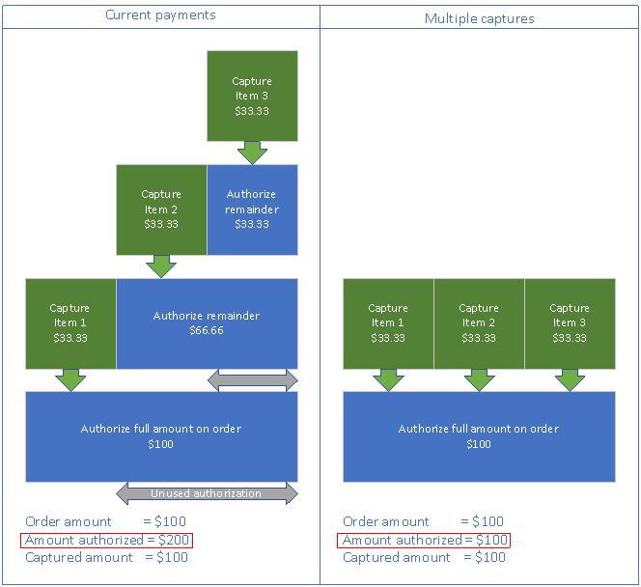
By default a new auth is created each shipment.
This increases transaction cost and has risks over overlapping auths that reach the credit limit.
See this link to Enable Incremental Capture
This is supported by Adyen. Other 3rd party payment processors may or may not support this.

Slide 31
Voiding an Authorization
In certain situations, the D365 system will make a call to ‘void’ a credit card authorization. Such as when the credit card payment is removed or changed to a different card.
This removes the ‘hold’ on the customer’s credit limit.
Otherwise, the authorization will automatically be removed when it becomes ‘stale’.
It is ‘kind’ to void authorizations that are known to no longer be needed.

Slide 32
Returns
When a return order references an original order that was paid using a credit card, call center functionality refunds back to the original credit card.

Slide 33
Approve Credit Card Returns
In D365, in the call center parameters form, you can set the thresholds above which must be manually approved.
Call center > Journals > Payment management > Credit cards > Refund approval

Slide 34
Customer Payment Journals
Credit Card payments can be used to pay for customer payment journals.

Slide 35
Common Issues
Stale Authorizations
Declines
Batch Jobs that continually try to authorize, and receive a decline

Slide 36
D365 Payment Connectors – Payment Properties
In order to generically support payment processor’s inputs, the x++ code does not send in a defined list of parameters.
Instead, it sends in a list of Payment Properties, as a single XML string.

Slide 37
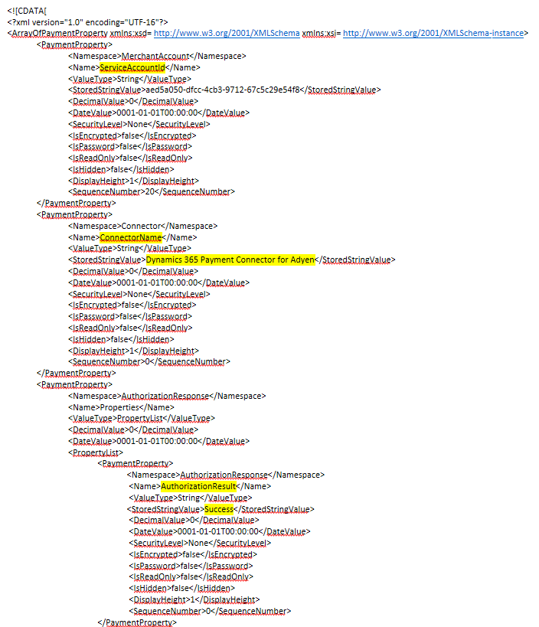
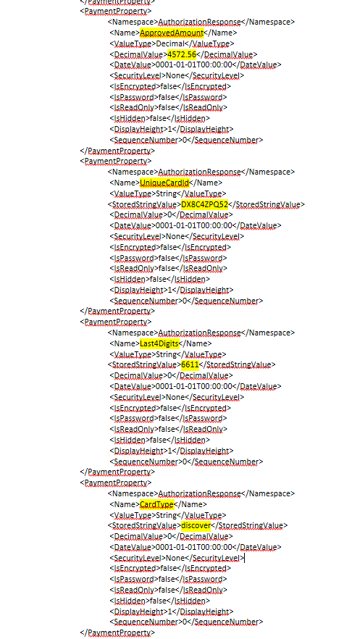
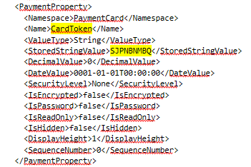

Slide 38
D365 Payment Connectors
The Payment Connector dll is deployed inside a model named RetailPaymentConnectors*. See here.
The connector is responsible for reading the payment property data, then make an API call to the payment process, and returning a response.

Slide 39
D365 Payment Connectors - Integration
Any outside system that creates a token or authorization code, such as an ecommerce website, will need to ‘store’ the credit card information in the correct records, CreditCardAuthTrans, CreditCardCust, MCRCustPaymTable, and in correct Payment Properties Format.

Slide 40
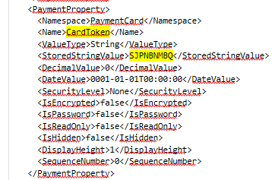
D365 Payment Properties - Integration
CreditCardPaymentProperties creditCardProperties = CreditCardPaymentProperties::fromProperties(this.processorProperties);
creditCardProperties.add(CreditCardPaymentProperty::newValue(
RetailConst.GenericNamespace::get_PaymentCard()
, RetailConst.PaymentCardProperties::get_CardToken()
,_creditCardContract.parmVaultToken()));

Slide 41
D365 Payment Connectors – Multi-Channel Support
You will want use a payment processor that supports all of your channels: Ecommerce, Call Center, and Point of Sale.
If you do not, then you will not be able to perform common functionality in each channel.

Slide 42
Changing Payment Processors - Token Migration
If you change which payment processor you use, you will need to work with the payment processor to migrate tokens.
Remember, a token is just a reference to the cardholders information in the payment processor’s database.
Unless the NEW payment processor database gets this data, you won’t be able to process any open transaction, or use that existing token.

Slide 43
Payment Processor Spotlight - Adyen
“Adyen is the only unified commerce payment adapter that is natively available within the Microsoft Dynamics platform”

Slide 44
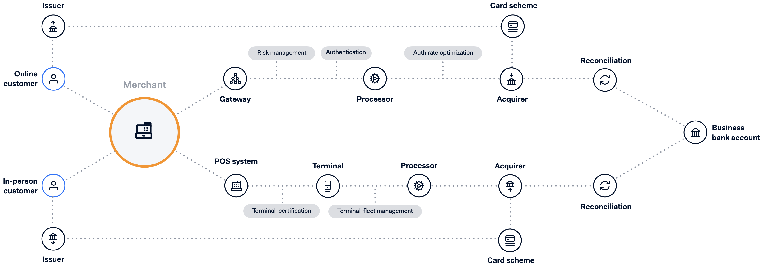
Omnichannel traditional

Slide 45
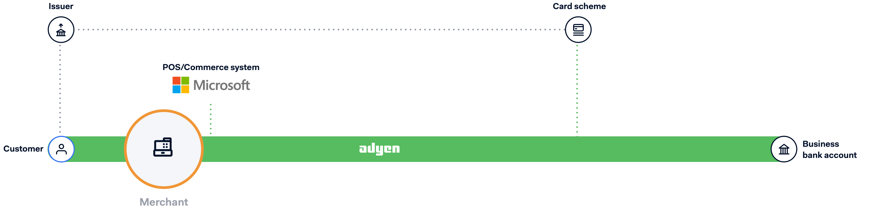









Unified Commerce Adyen
Gateway
Risk management
Authentication
Processor
Auth rate
optimization
Terminal certification
Terminal fleet
management
Reconciliation
In-person payments
hardware and software
Acquirer

Slide 46
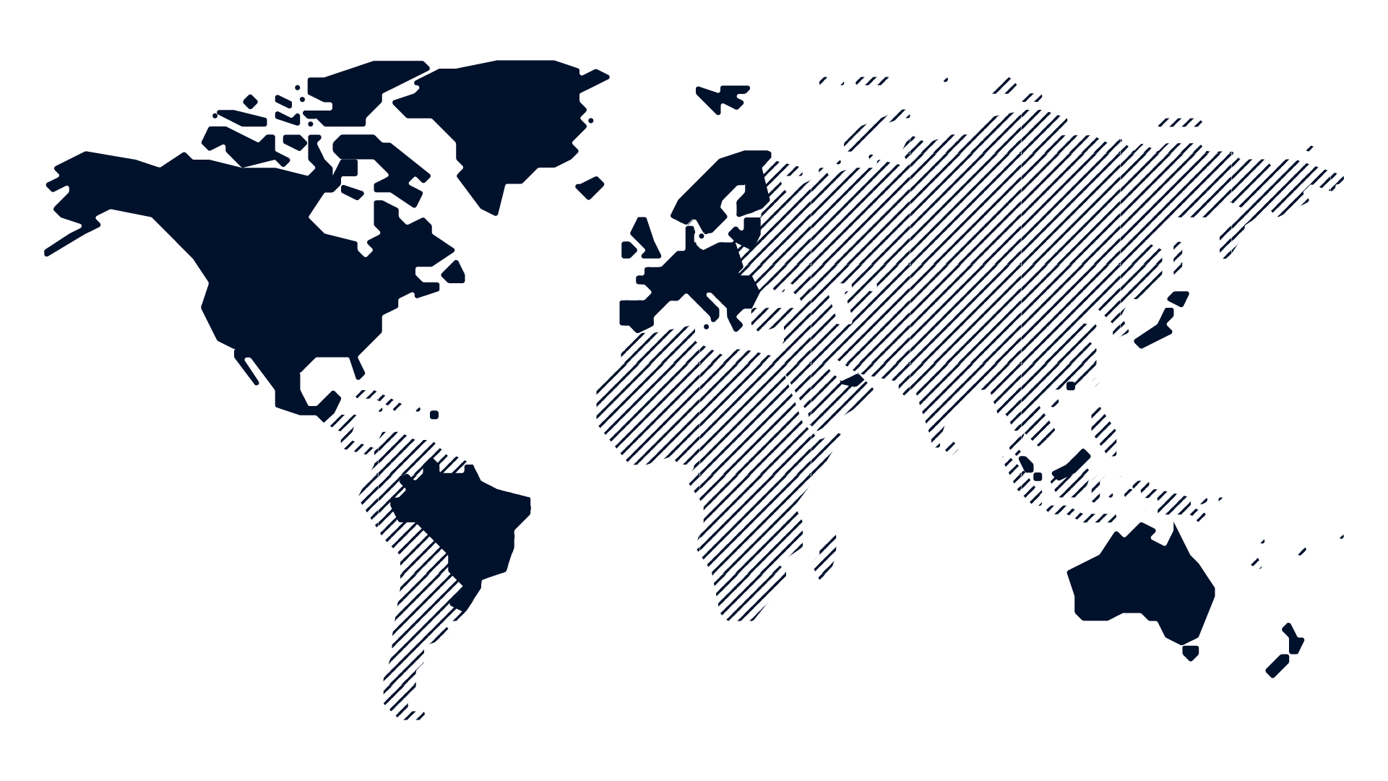

Wherever you're doing business
we’re there too
Adyen Acquiring
Australia
Brazil
Canada
Europe
Hong Kong
Japan
Malaysia
Mexico
New Zealand
Puerto Rico
Singapore
United Arab Emirates
United States
Other countries
We also offer e-commerce payment processing solutions in countries where full stack Adyen Acquiring is not available (yet).
Notes:
The technology businesses are using is dominated by legacy systems with fragmented platforms that just don’t work together. Resulting in huge inefficiencies, geographical isolation & channel isolation that lead to a poor user experience. Our platform consolidates payment processes in multiple regions. No other party in the world is able to do this on one single platform.
Important: We have the ability to process payments all over the world, but it works differently for each region. For Partner Acquiring the offer may differ for only processing (gateway) or cross-border possibilities
Notes:
Iceland: Can’t settle in Icelandic krona.
Greenland: Acquiring, no POS.
Australia: We are not able to process Diners in Australia over our global AdyenDiners rails.
[HUB] https://hub.is.adyen.com/our-solution/products-and-features/acquiring/

Slide 47


Slide 48



Dynamics 365 Commerce
Adyen <> Payment Connector
Full 2023
Active Merchants
150
Number of Transactions
155 Mln
Volume (USD) Authorized
$11 Bln

Slide 49

Contacts

Slide 50






Payment Processor Spotlight – New West
Innovative Global Dynamics 365 Payment Solution and Worldwide Service Provider
Omnipresent Support for All Major Card Brands,
Pay-by-QR, Pay-by-Link, Quasi-cash, e-Wallets,
Buy Now/Pay Later, Foreign Wallets, and Crypto
Easy-to-Deploy Solutions for Dynamics 365 Finance and Operations, Store Commerce, and Point of Sale
24/7/365 Happiest, Most Responsive Real US-Based Employees Support Team

Slide 51
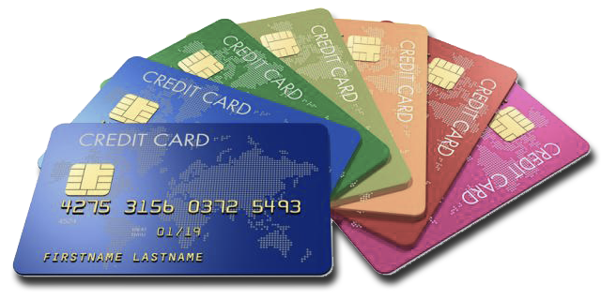
Payment Processor Spotlight – New West
Investing in Research and Development for a Bright Future
Rocking the Forefront of the Industry
Comprehensive B2B and B2C Support
Fully Secure Expanded Features
Experts in Streamlined Operations and
Improved Bottom Line
Most Responsive, Effective Customer Support Team
in Payments in the World
Contact sales@newestech.com to connect

Slide 52
Digital Wallets
Check whether your payment processor supports Digital wallets such as Paypal, Apple Pay, Google pay, Amazon Pay.
D365 allows multiple payment connectors to be enabled at once. Each mapped to a different method of payment. (i.e. Credit Card, Paypal, ect)
Again, work with your payment process to ensure the payments you wish to accept work across all of your channels.

Slide 53
Key take-aways
Payments are complicated!
There are costly pitfalls if you do not plan ahead across channels
Payments are an area where good ongoing support is vital.
Payments are how many people make their money so it is not something you want to get wrong.

Slide 54
Suggested Resources
https://www.fisglobal.com/en/insights/merchant-solutions-worldpay/article/how-credit-card-processing-works
https://learn.microsoft.com/en-us/dynamics365/commerce/tasks/configure-credit-card-processing
https://www.paloaltonetworks.com/cyberpedia/what-is-a-pci-dss
https://learn.microsoft.com/en-us/dynamics365/commerce/dev-itpro/manage-payment-authorizations
https://learn.microsoft.com/en-us/dynamics365/commerce/dev-itpro/incremental-capture
https://learn.microsoft.com/en-us/dynamics365/commerce/dev-itpro/incremental-capture#enable-incremental-capture
https://learn.microsoft.com/en-us/dynamics365/commerce/call-center-refund-payments

Slide 55
Suggested Resources
https://learn.microsoft.com/en-us/dynamics365/commerce/dev-itpro/deploy-payment-connector
https://learn.microsoft.com/en-us/dynamics365/commerce/dev-itpro/end-to-end-payment-extension
https://download.microsoft.com/download/e/2/7/e2735c65-1e66-4b8d-8a3c-e6ef3a319137/The%20Guide%20to%20Implementing%20Payment%20Connector%20and%20Payment%20Device_update.pdf
https://learn.microsoft.com/en-us/dynamics365/commerce/dev-itpro/payment-connector-package
https://learn.microsoft.com/en-us/dynamics365/commerce/dev-itpro/wallets

Slide 59


THE ELEMENTS AND BACKGROUNDS ON THE FOLLOWING PAGES CAN BE COPIED AND PASTED INTO YOUR SLIDES.​ VISIT DYNAMICSCON.COM TO DOWNLOAD MORE.

Slide 60











Slide 61







Slide 62



Slide 63








Slide 64


