Slide 2
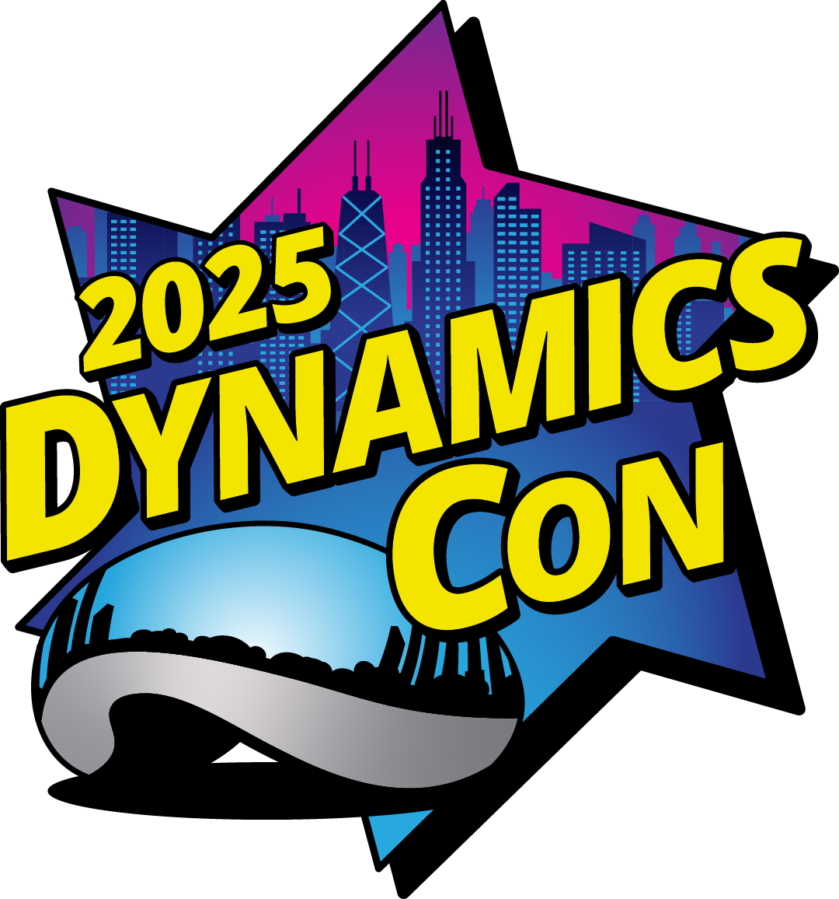
Mastering Engineering Change Management in Dynamics 365

Slide 3
Eric van Hofwegen
Jon Phipps
Senior Solution Architect at STAEDEAN
North America Channel Director at STAEDEAN
eric.vanhofwegen@staedean.com
jonathan.phipps@staedean.com
Eric van Hofwegen | LinkedIn
Jon Phipps | LinkedIn

Slide 4
Engineering Change Management
Slide Updated
Improve and Better Use Product Data
Reduce Data Risks
Manage Changes
Manage global IP in a dedicated engineering entity
Manage product properties and attributes
Strong searching capabilities
Release product data (push or push/pull)
Release product data using product readiness control
Manage product status
Product ownership controls who can make changes
Migrate standard D365 F&SCM items to engineering controlled items
Improved version management
Robust engineering change management solution
Local change orders in operational companies
Transactional insight

Slide 5
Scale From Single Company…
Engineering Manufacturing Plant & Service Center

Slide 6
…to Multi-company
Engineering Product Group X
Manufacturing Plant 1
Engineering
Service Center
Engineering Product Group Y
Manufacturing Plant 2

Slide 7
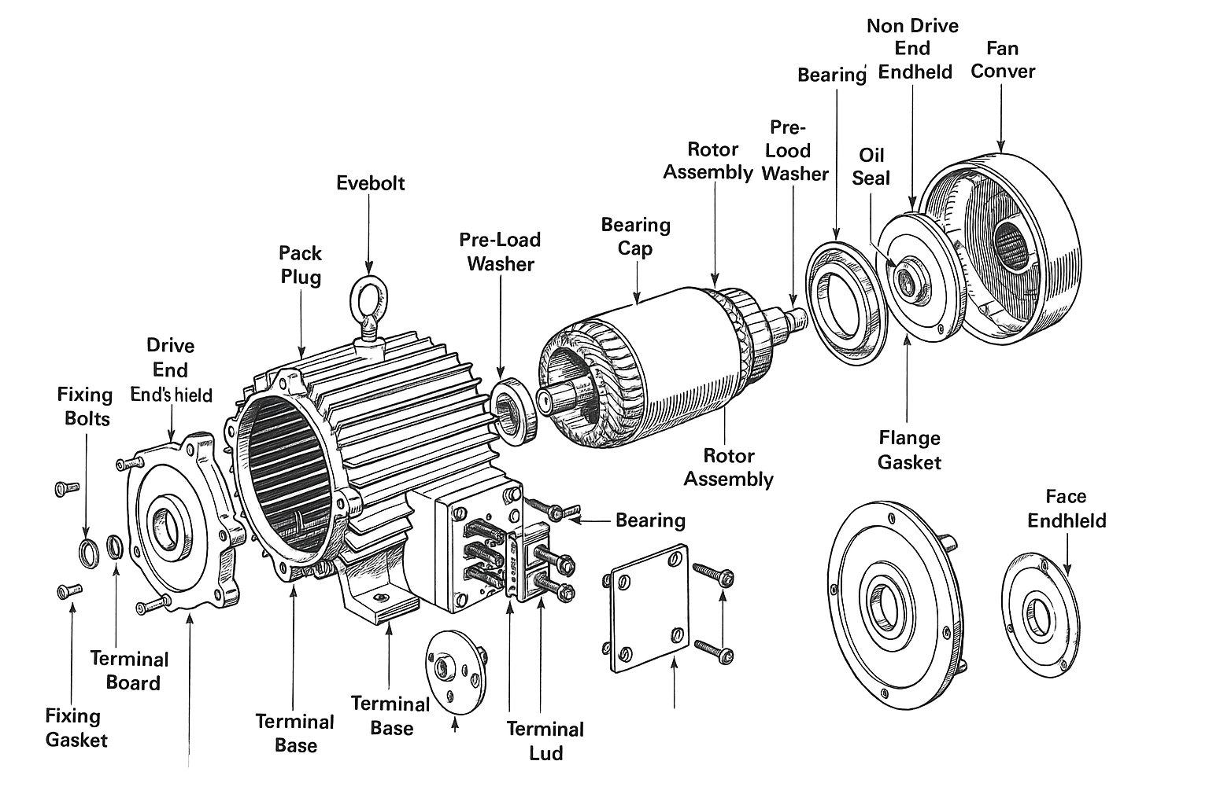
Attribute Search
Attributes

Slide 8
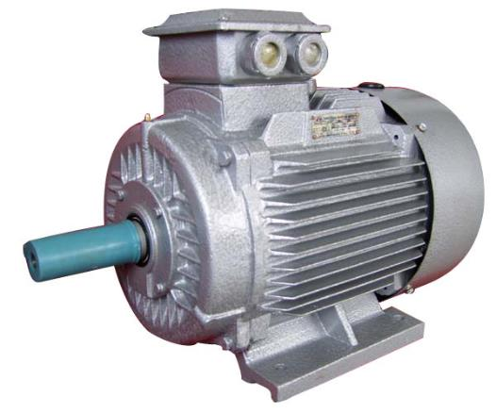
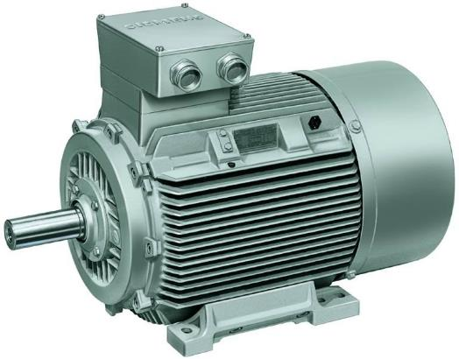
Product Versions
Changes
El. Motor – V001
El. Motor – V002

Slide 9
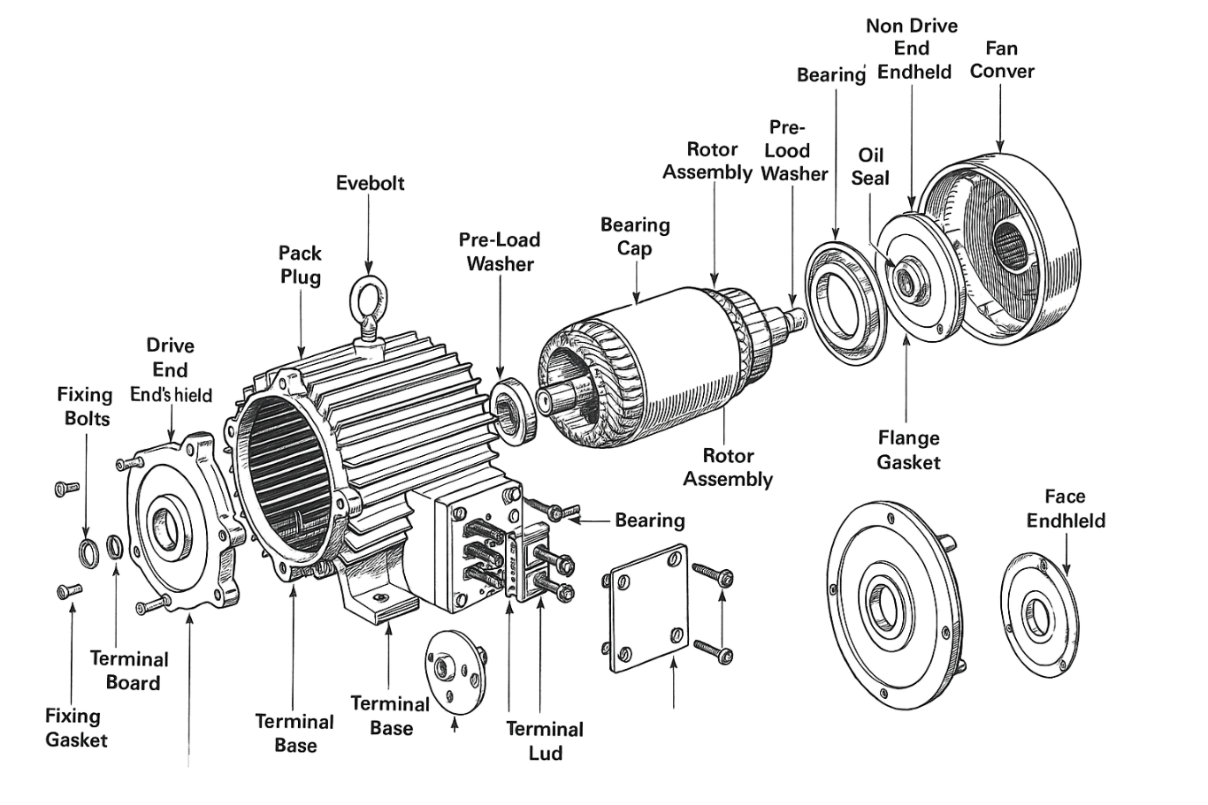
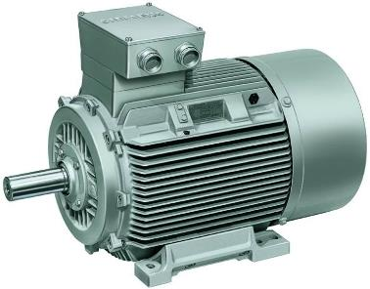
Product Readiness Control
Pricing
Marketing
Warehouse location
Financial

Slide 10
Changes: Central vs. Local
Engineering
Manufacturing Plant 1
Central engineered product structure.
With option to manage changes at local level:
Add/edit BOM lines
Add/edit Route operations
Product attributes and collateral
Manufacturing Plant 2

Slide 11
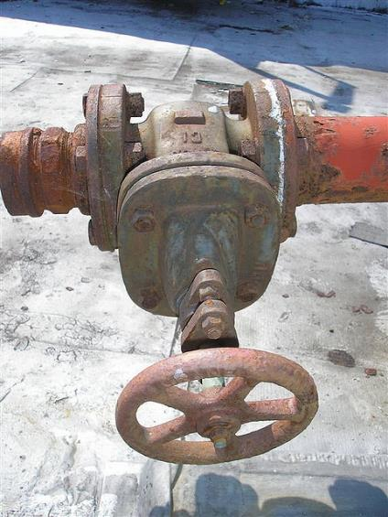
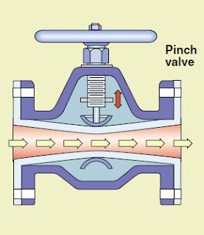
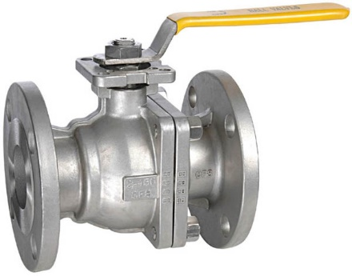
Requests (ECR)

Slide 12
Managing Engineering Changes
Service requests
External requests
Mfg. requests
Change Orders

Slide 13
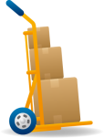
Impact of Change

Slide 14
What is Changed?
El. Motor – V001
El. Motor – V002

Slide 15
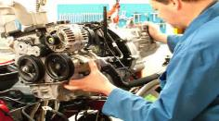
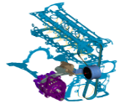
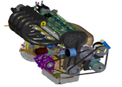
Changes During Product Lifecycle
Time
$
Market Share
Time
$
Time
Concept
Development
Detailed
Design
Prototype
Design
Manufacturing Planning
Production
Ramp Up
Production
Maintenance
Requirements
Baseline
Design Release
Baseline
Product Configuration
Baseline
Mission
Baseline
Design
Baseline
Manufacturing
Baseline
Level of
Change
Design
Change
Prototype
Production
Change
Customer
Change
Release
Cost of Change

Slide 16
Push/Pull Release and Data Ownership
Engineering
Manufacturing Plant 1
A 1.0
Push
Pull
B 1.0
C 1.0
Warehouse = W1
Vendor = XYZ
Local ECO
(optional)
A 1.0
B 1.0
C 1.0
11
21
Manufacturing Plant 2
10
A 1.0
20
Push
Pull
30
B 1.0
C 1.0
D 1.0
Local ECO
(optional)
Dynamics 365
10
20
30

Slide 17
Push/Pull Release and Data Ownership
Engineering
Manufacturing Plant 1
A 2.0
A 1.0
Push
Pull
B 1.0
C 2.0
Warehouse = W1
Vendor = XYZ
A 2.0
C 1.0
A 1.0
Qty = 3
B 1.0
C 2.0
11
C 1.0
21
Qty = 3
Manufacturing Plant 2
A 1.0
10
A 2.0
20
Push
Pull
30
B 1.0
C 2.0
C 1.0
D 1.0
Qty = 3
Dynamics 365
10
20
30

Slide 18
Lifecycle Management: Central vs. Local
Engineering company
Manufacturing Plant 1
A 3.0
Phase-out
Operational
A 3.0
Push
Pull
Local ECO
(optional)
B 1.0
C 1.0
Phase-out
B 1.0
C 1.0
Dynamics 365
Operational
Operational
Manufacturing Plant 2
Product owner
Push
Pull
A 3.0
Phase-out
Product Satus
Pre-release
Active
Phase-out
Obsolete
…
Sales yes, Pur no, …
All allowed
Sales no, Pur yes, …
None allowed
…
B 1.0
C 1.0
Operational
Operational

Slide 19
Notes:
This is just a joke, telling I got this from DynamicsCon and used AI for the following Slide. To do some AI!

Slide 21
Demonstration Process
Dynamics 365
Engineering company
(DEMF)
Manufacturing Plant
(USMF)
A 1.0
Push
Pull
A 1.0
Local ECO
(optional)
B 1.0
C 1.0
D 1.0
B 1.0
C 1.0
Change Request

Slide 22
Process with a PLM System
Engineering
Dynamics 365
Engineering company
(DEMF)
Manufacturing Plant
(USMF)
A 1.0
Push
Pull
A 1.0
Local ECO
(optional)
B 1.0
C 1.0
D 1.0
B 1.0
C 1.0
Change Request
CAD / PLM

Slide 23
Engineering and Manufacturing Summary
Release Management
Push to operational companies at once
Operational companies pull when needed
Engineering Method
Precise
Imprecise
BOM
Centrally managed
Locally managed
Route
Centrally managed
Locally managed
Local Changes
Formalized and structured
Non-formalized
Data Ownership*
Central
Local
Scalable
Flexible

Slide 24
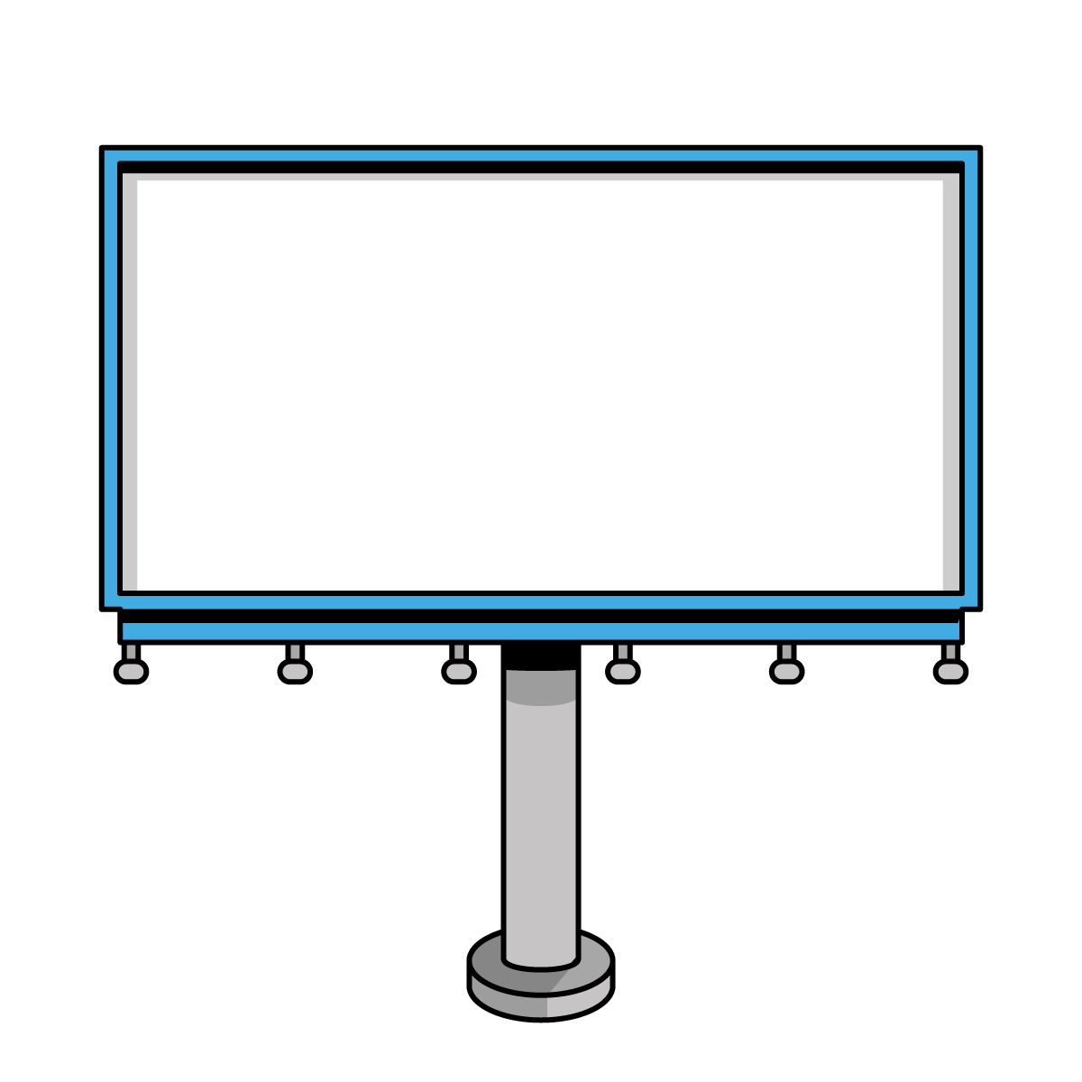
Eric van Hofwegen
Jon Phipps

