Slide 1
BC Mastering Inventory:
Deep Dive into Reordering Policies

Slide 2
Session Agenda
Demo of Planning in Action
PowerPoint Review of Settings
Demo of Settings
Closing Thoughts
Q&A Time
Ben Baxter
President of Accent Software, Inc.
20-Years implementing Business Central
Specialize in Manufacturing and Projects

Slide 3
Demo - Planning

Slide 4
Item/SKU Card: Planning Tab

Slide 5
Fixed Reorder Qty.
Stock Policy
Simplest
Only Two Fields
Tip: Don’t use Safety Stock Quantity

Slide 6
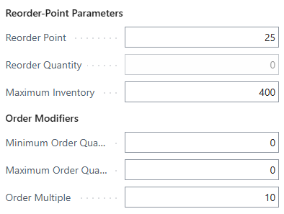
Maximum Qty.
Stock Policy
Space Constraint
Variable Suggestion
Modifiers to Control
Tip: Don’t use Safety Stock Quantity

Slide 7
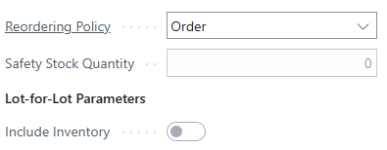
Order
Leanest Policy
Ignores Inventory
No Controls
1:1 Ratio
Auto-Reserves
Can’t use Safety Stock Quantity

Slide 8
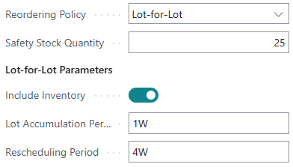
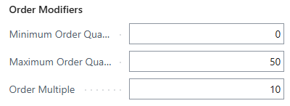
Lot-for-Lot
Lean Policy?
Groups Demand by Time Buckets
Most Flexible
Full Control
Okay to use Safety Stock Quantity
Doesn’t work with “Make-to-Order”

Slide 9
Manufacturing Setup Not just for Manufacturing!

Slide 10
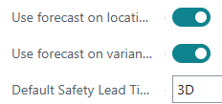
Manufacturing Setup
Non-Manufacturing:
Use forecast on Location
Use forecast on Variants
Default Safety Lead Time
Default Dampener Period
Manufacturing Specific:
Dynamic Low-Level Code
Combined MPS/MRP
Components at Location
Only use w/ single Location

Slide 11
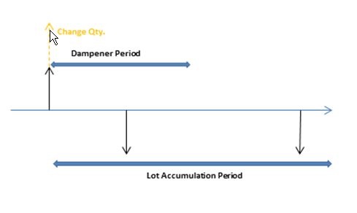
Quiet Down Planning
Dampener Period
If the Demand Date changes into the FUTURE, within the time value, the system can ignore the change.
Dampener Quantity
If the Demand Quantity DECREASES, within the value, the system can ignore the change.

Slide 12
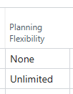
Block Planning Changes
Planning Flexibility
When set to “None” the Planning engine will not suggest making changes to that line.
This used to cause duplicate supplies, but through minimal testing has been improved to see the supply.
Where is it available?
Purchase Order Lines
Transfer Order Lines
Planning Worksheet Lines
Production Order Lines
Assembly Order Header

Slide 13
Red Herring
Replenishment System
Assembly Policy
Open vs. Released
Costing Method
BOM
Route
Item Category

Slide 14
Demo - Settings

Slide 15
Which is right for you?
You don’t have to pick just one!
Items have different values, re-stock times, demand, etc. Pick what makes sense for each Item at each Location!
It can change over time!
Maybe you started with Lean and need to move to Stock, or vice versa. That’s okay!
Talk to your planners!
They have a hard job, and their input to get the system making the right suggestions is important.

Slide 16
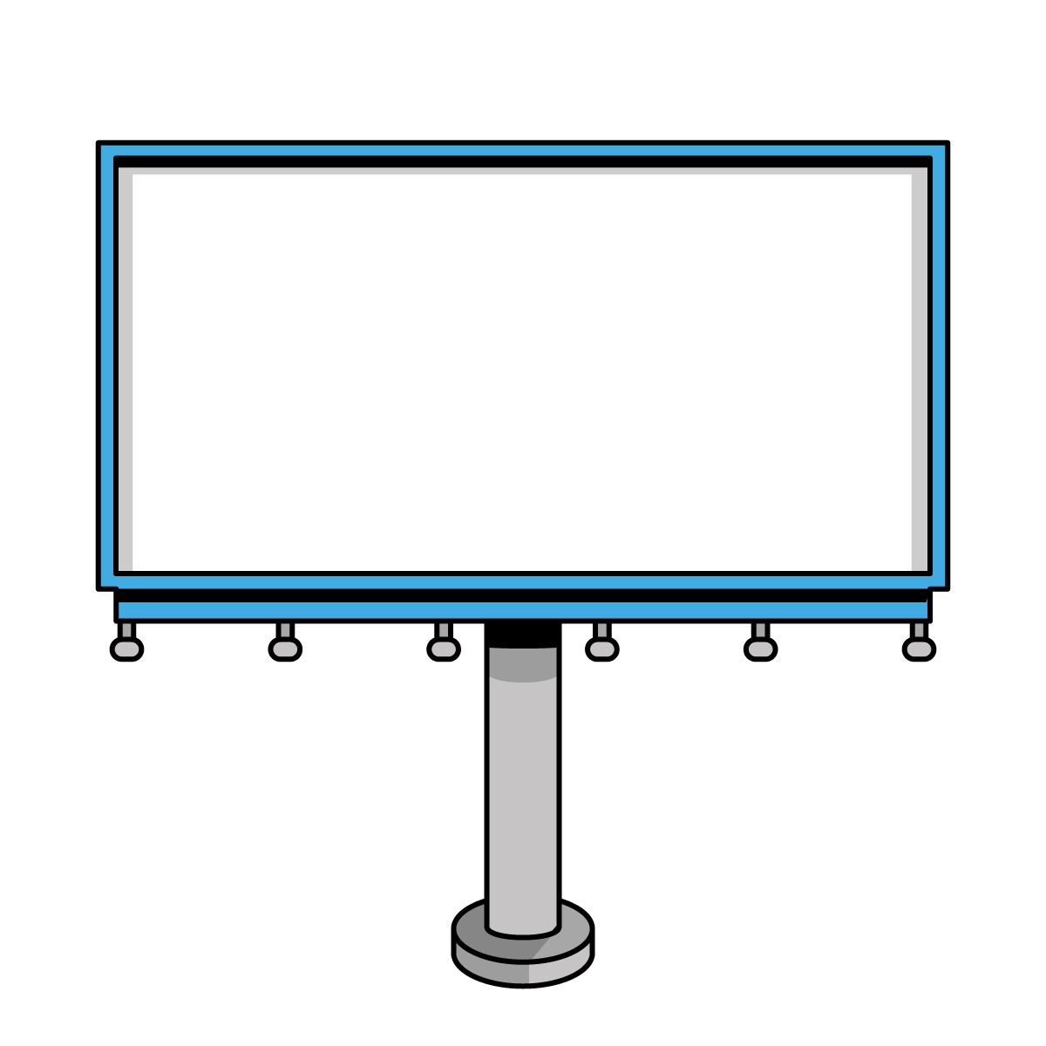
Q&A
Ben Baxter
Accent Software, Inc.
ben@accenterp.com
https://www.AccentERP.com/

Slide 17
Thank You!

