Slide 2
Mastering Production Plans with Routes and Resources

Slide 3
Jonathan Anderson
Principle Solution Architect at Argano
12 years Dynamics experience
Dynamics AX 2009 & 2012
Dynamics 365 Finance and Supply Chain
Background in Chemical Engineering
4-time Fast Track Recognized Solution Architect
Experience in variety of industries
Chemical
Service
Medical
Aerospace
Assemble to Order
Colorado Native
Wholesale Distribution

Slide 4
Course Objectives
Describe the use of resources and resource groups within Dynamics
Review time and capacity based resource setup
Review assignment of resources to routes
Including review of Primary and Secondary Operations
Setup a route for a released product utilizing
Properties
Capacities
Primary and Secondary Operations
Review MRP output and scheduling tools available
Gannt Chart
Capacity graphs

Slide 5
Course Agenda
Presentation Review
Review of Resource and Resource Groups
Review of routings
Review of tools in Dynamics for scheduling
Demonstration
Questions

Slide 6
Resources Overview

Slide 7
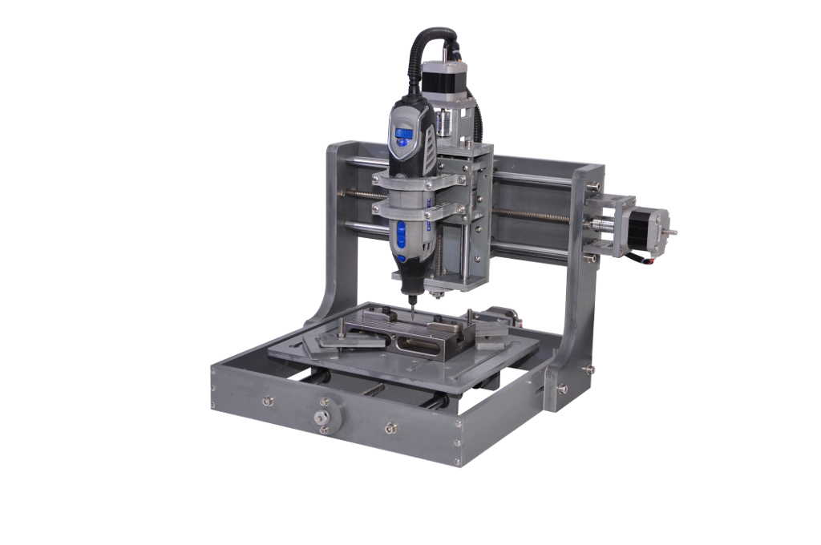
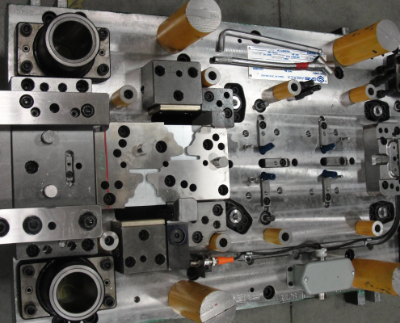
What is a resource?
A function that needs to be scheduled for production:
Machine
Human Labor
Vendor (Subcontracting)
Locations
Tool
Facility
Notes:
A resource can be any unique function that needs to be scheduled for production. This can include:
Machines
Human Labor
Vendors
Locations
Tools
Facilities

Slide 8
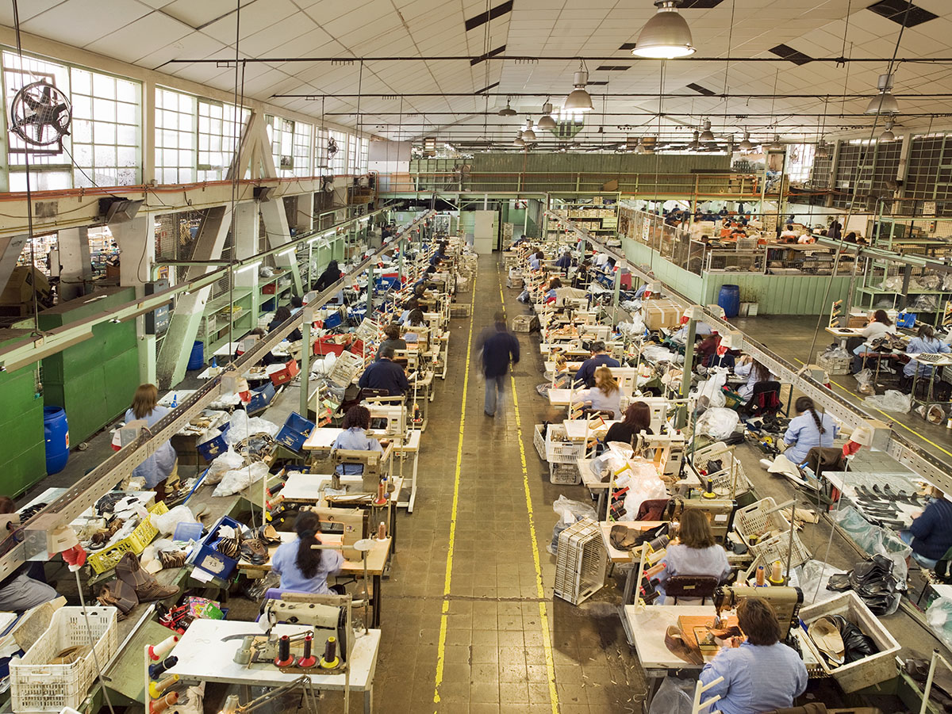
What is a resource group?
A grouping of similar and interchangeable resources
A way to see consolidated capacity for a set of resources
A resource group can only have one type of resource
Every resource must be associated to a resource group

Slide 9
What attributes are available on a resource to aid in scheduling?
Capabilities
Capacity
Properties
Finite Capacity/Property
Exclusive
Bottleneck resource

Slide 10
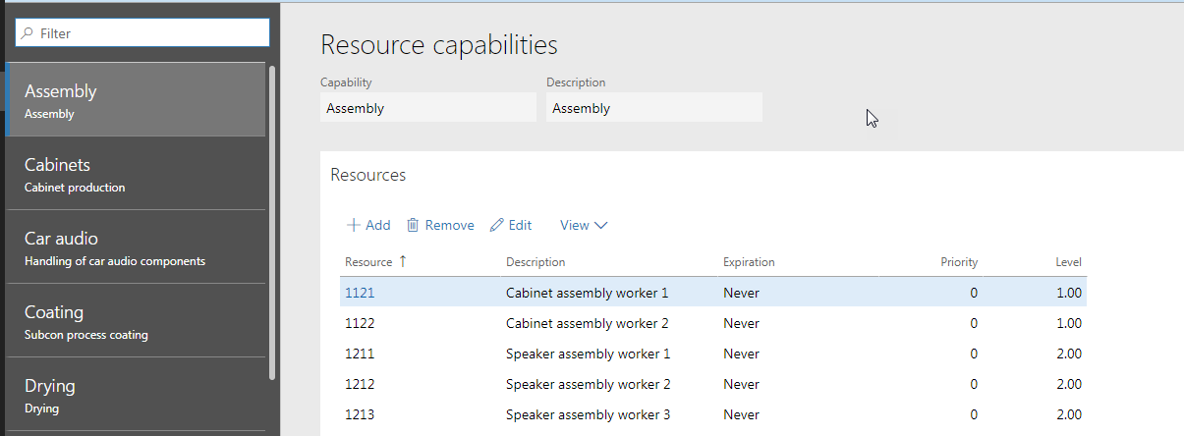
Resource Capabilities
Associate resource to capabilities and a skill level for scheduling
Resource capability and a minimum skill level can be a requirement when scheduling production by setting in the route

Slide 11
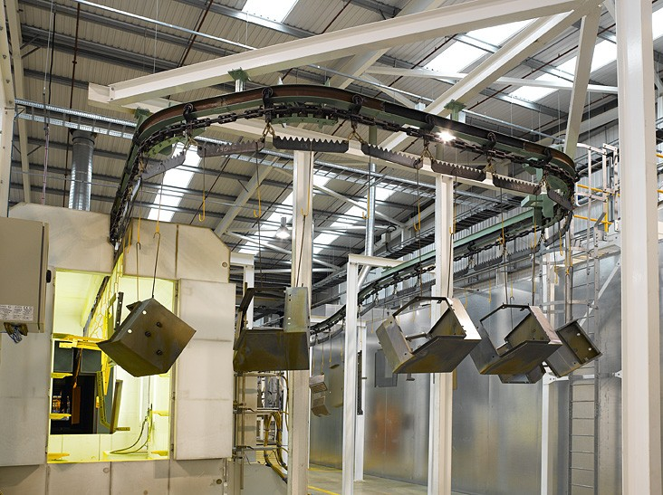
Resource Capacity
Allows for scheduling production resource based upon a throughput/hour
Strokes/hr
Meters/hr
Data/hr
Can be useful when scheduling resources with variable qty/hr but static throughput
Paint line (hooks/hour)

Slide 12
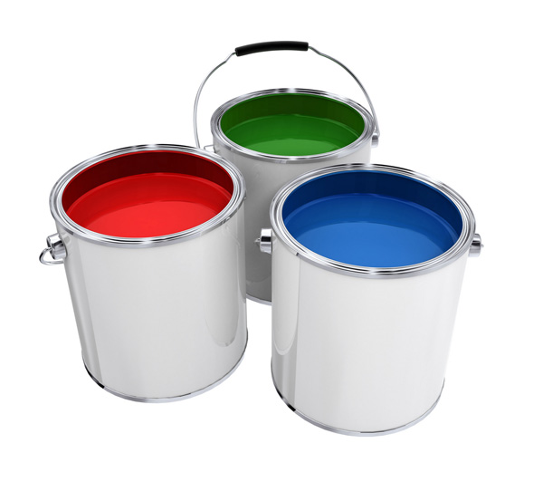
Properties
Allows for scheduling of specific product properties on specific days
Property setup on Engineer tab of released product
Specify in the calendar properties allowed for specific days/times
Useful when trying to schedule like-products together

Slide 13
Finite Capacity/Property
Finite Capacity
Limited amount of capacity on the resource/resource group
Job and Operation scheduling is based on actual available capacity in resource/resource group
Finite Property
In order for Dynamics to utilize Property scheduling for the resource, this must be set to yes.
If set to no, properties are not utilized

Slide 14
Exclusive
Used only with primary and secondary operations
Specifies the resource is booked exclusively to an operation
For example, if listed as a secondary resource at 50% utilization, the resource will be reserved at 100% of the primary time
If not selected, the resource can be scheduled for multiple jobs when there is a gap between reservations

Slide 15
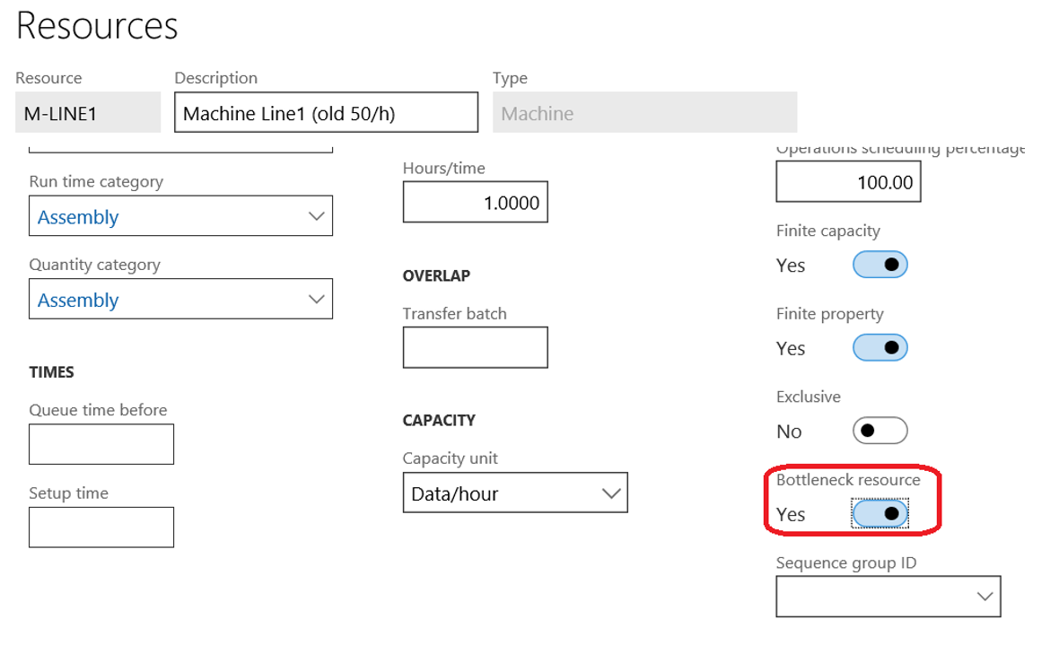
Bottleneck resource
Bottleneck resources are scheduled first during MRP
The capacity of a bottleneck is maximized and subsequent production is then scheduled based upon the bottleneck schedule

Slide 16
Resources and Routes

Slide 17
How are resources tied to routes?
Resource direct assignment
Resource Group assignment
Capability based
With or without resource type
Skill, Course, Certificate, Title
Human Labor Resources but only if resource is tied to worker

Slide 18
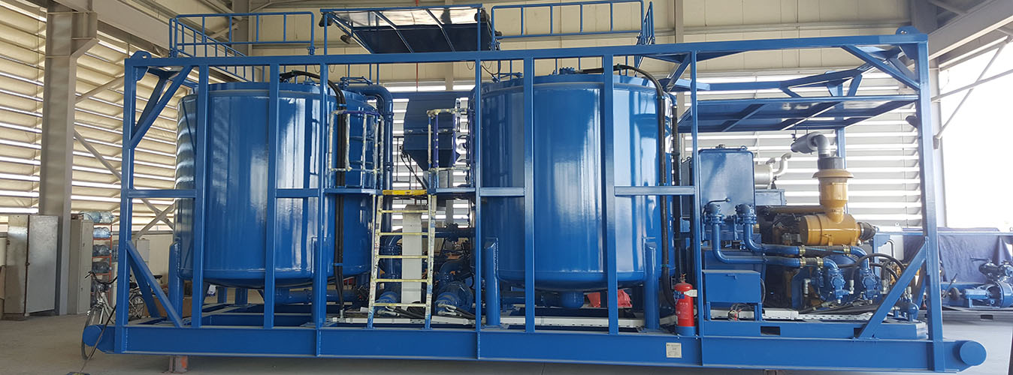
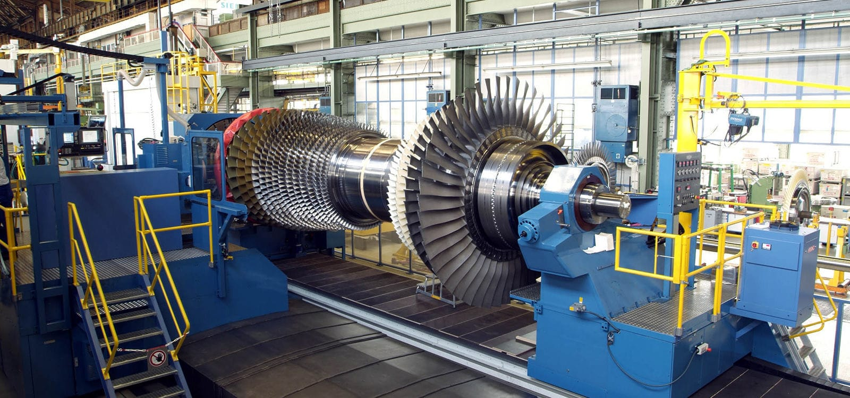
Resource Direct Assignment
Used when a specific resource must be utilized for the production of a part
Unique machine requirements/sizing
Qualification-based environments
Aerospace, pharma, etc.
Only the assigned resource can be used for production

Slide 19
Resource Group assignment
Used when any resource within a group can be used for production
Operations scheduling will schedule the group
Job scheduling will use a specific resource with capacity in the group (finite capacity on)
If finite capacity off – will always use first resource in group
Multiple machines or operators accomplishing same functions

Slide 20
Capability based assignment
Any resource with a specific capability and level can perform operation.
Can limit to resource type (Human, Machine, etc).
Used when multiple resource groups can perform work, and Dynamics should pick an available resource.

Slide 21
Worker Record based assignment
Specify one or more of the following worker based attributes for an operation
Skill
Course
Certificate
Title
Only used when resources are tied to worker records
Heavy maintenance to keep up with resources, resource groups and worker attributes

Slide 22
Primary and Secondary Operations
Primary Operation
Main resource to be scheduled for an operations
Constraining resource when planning for the work
Job start/end times based off primary resource
Entry of operation times allowed on primary
Secondary Operation
Support resource(s) for an operation
Time scheduled is based off primary operation, resource quantities and load
Cannot enter run time on secondary

Slide 23
Capacity Analysis Tools

Slide 24
What analysis tools are available?
Gannt chart
Resource capacity load
Resource capacity load, graphically
Capacity reservations

Slide 25
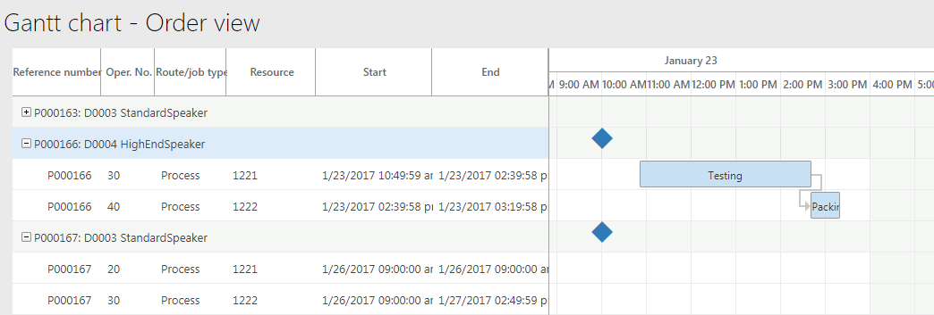
Gannt Chart
Only available when job scheduling is utilized
Show production order jobs scheduled against a resource
Allows for drag and drop of jobs between days and resources

Slide 26
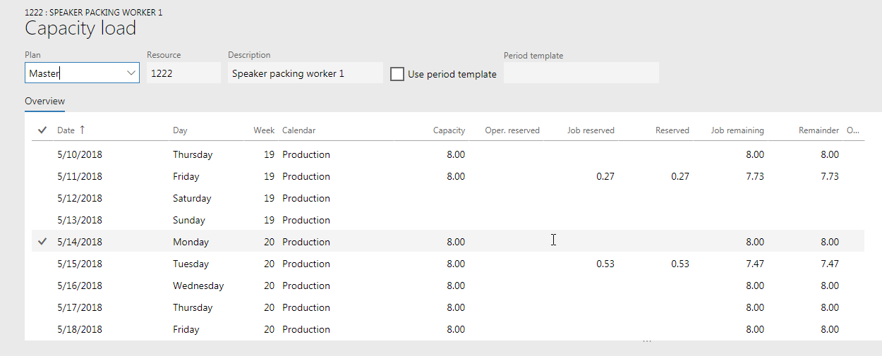
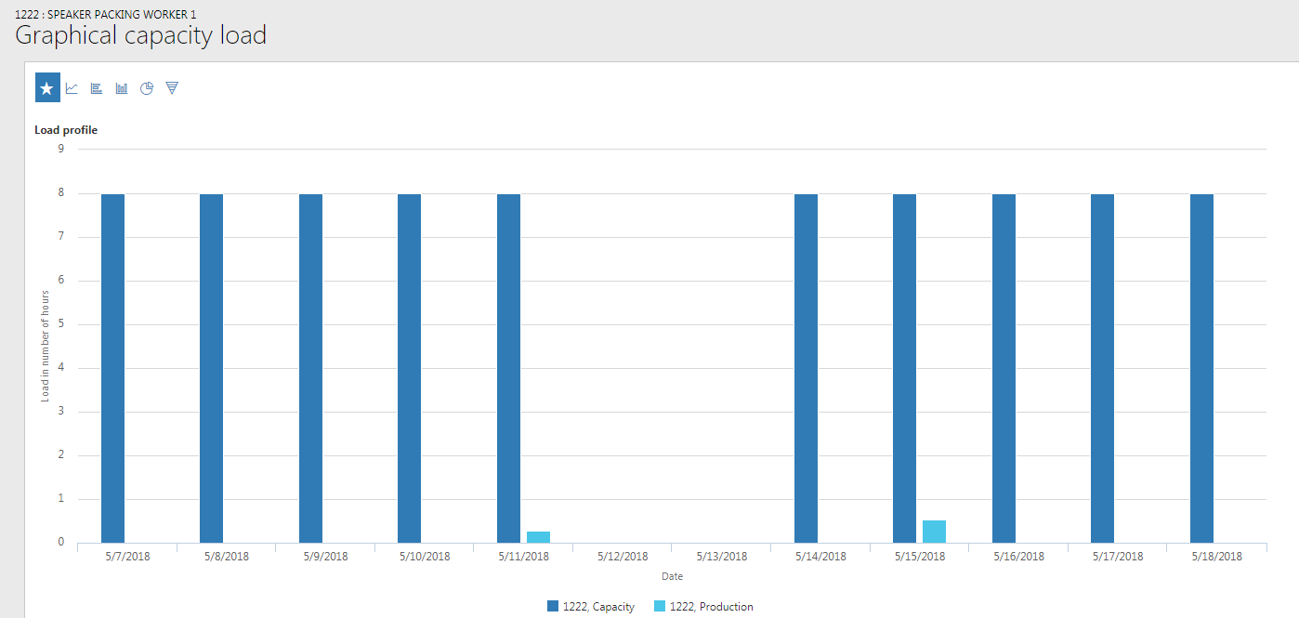
Capacity Load
Viewed graphically or table
Shows reserved capacity vs available capacity
Highlights overbooked days for a resource/group
Useful to balance scheduled when not using finite capacity

Slide 27
Capacity reservations
Displays specific jobs and production orders reservations are committed to for a resource
Allows for a table view of the data shown in the Gannt chart and detail for capacity load forms

Slide 28
Demonstration

Slide 29
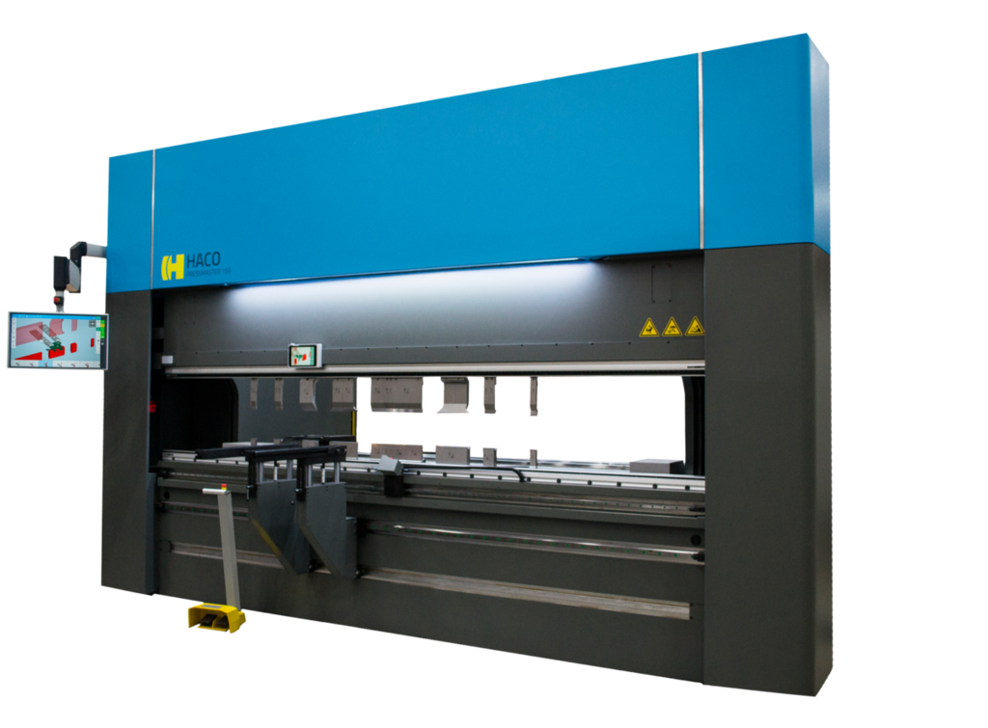
Demonstration
A metal shop produces cut, bent and painted parts from metal sheets
Single BOM level with multiple route operations
Brake Press – Finite Capacity
Paint – Throughput based
Cut & Bend – Primary and Secondary Operations
Run master planning and analyze output
Notes:
A metal shop produces products that are cut, bent and painted parts from metal sheet stock. Instead of having multiple BOM levels for production of this item with a part number at each step of the process, the company is utilizing a method of one BOM level with multiple route steps. For this demonstration we will be building a route with the multiple steps, including Bending being flagged as finite capacity, painting being a throughput based step, and cut and bend steps using primary and secondary operations. We will then run master planning and analyze the output.

